Slide 1

New Build
vs
Refurbishment
20241004
Simon Sturgis - TargetingZero
TargetingZero

Slide 2
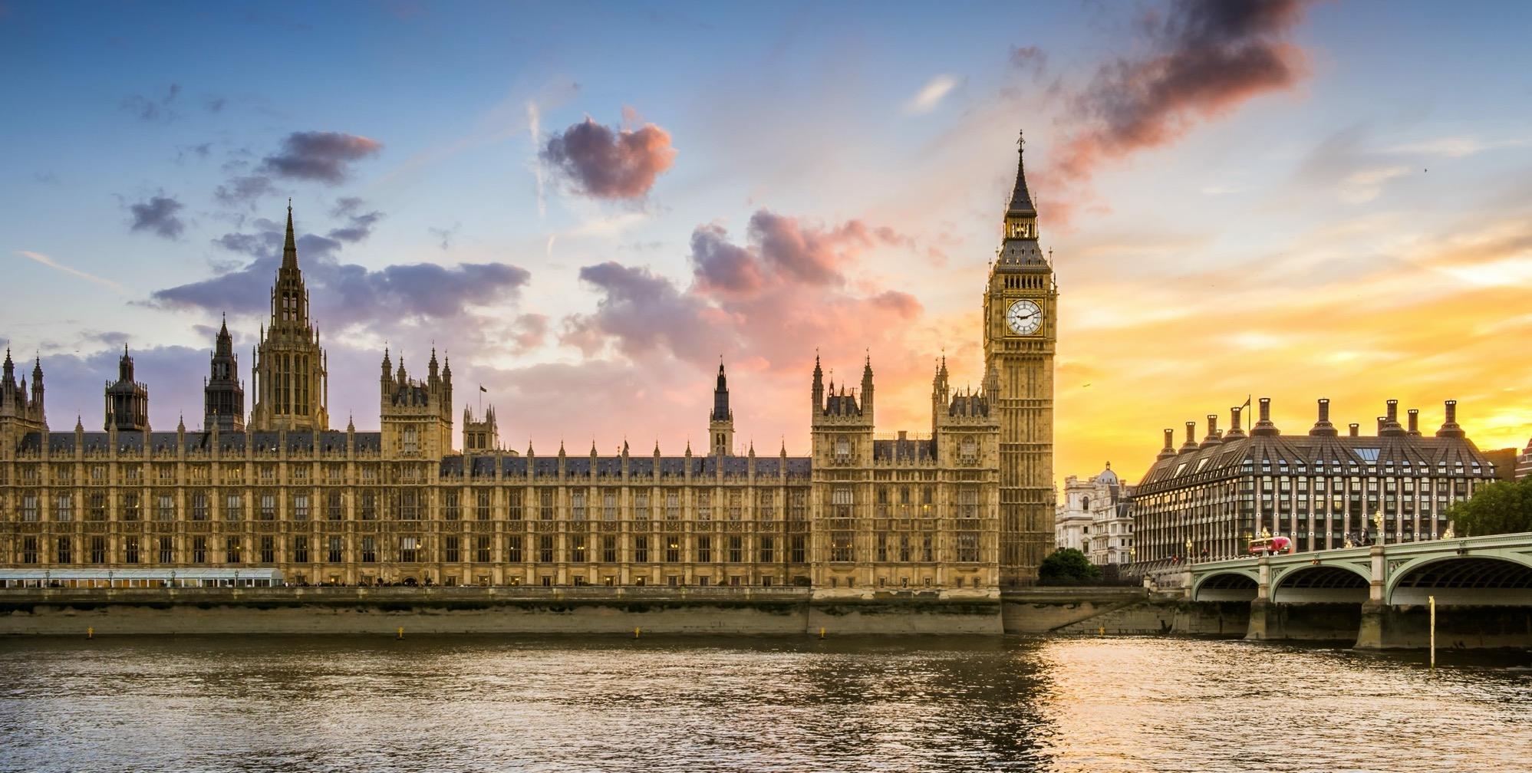

UK Net Zero Legislation
Climate Change Act 2008
Net Zero by 2050 2019
78% reductions by 2035 2021
68% reductions by 2030 2021 NDC
Simon Sturgis - TargetingZero

Slide 3
UK Trajectory to Net Zero
0
BAD
10
20
30
%
Reductions
40
50
COP26 2021
60
78% reduction
70
Act of Parliament 2021
78% reduction
80
90
GOOD
Act of Parliament 2019
Net Zero
100
1990
2000
2010
2020
2030
2040
2050
2060
Simon Sturgis - TargetingZero
Notes:
Not only buildings, but also places, people, etc.

Slide 4
UK Trajectory to Net Zero
Offices
0
BAD
10
20
Most New Build
Extensive Refurbishment
30
%
Reductions
40
50
60
Most Refurbishment +
Low Carbon New Build
70
80
90
GOOD
100
2025
1990
2000
2010
2020
2030
2040
2050
2060
Simon Sturgis - TargetingZero
Notes:
Not only buildings, but also places, people, etc.

Slide 5
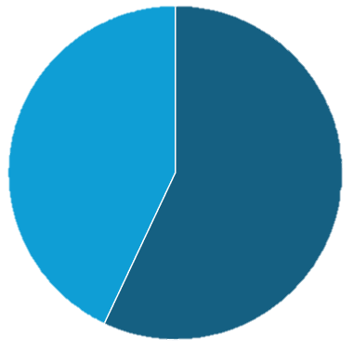
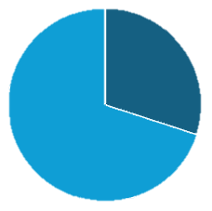
Operational vs Embodied Emissions - Offices
New Build
Refurbishment
Materials
Energy
Materials
Energy
Simon Sturgis - TargetingZero

Slide 6
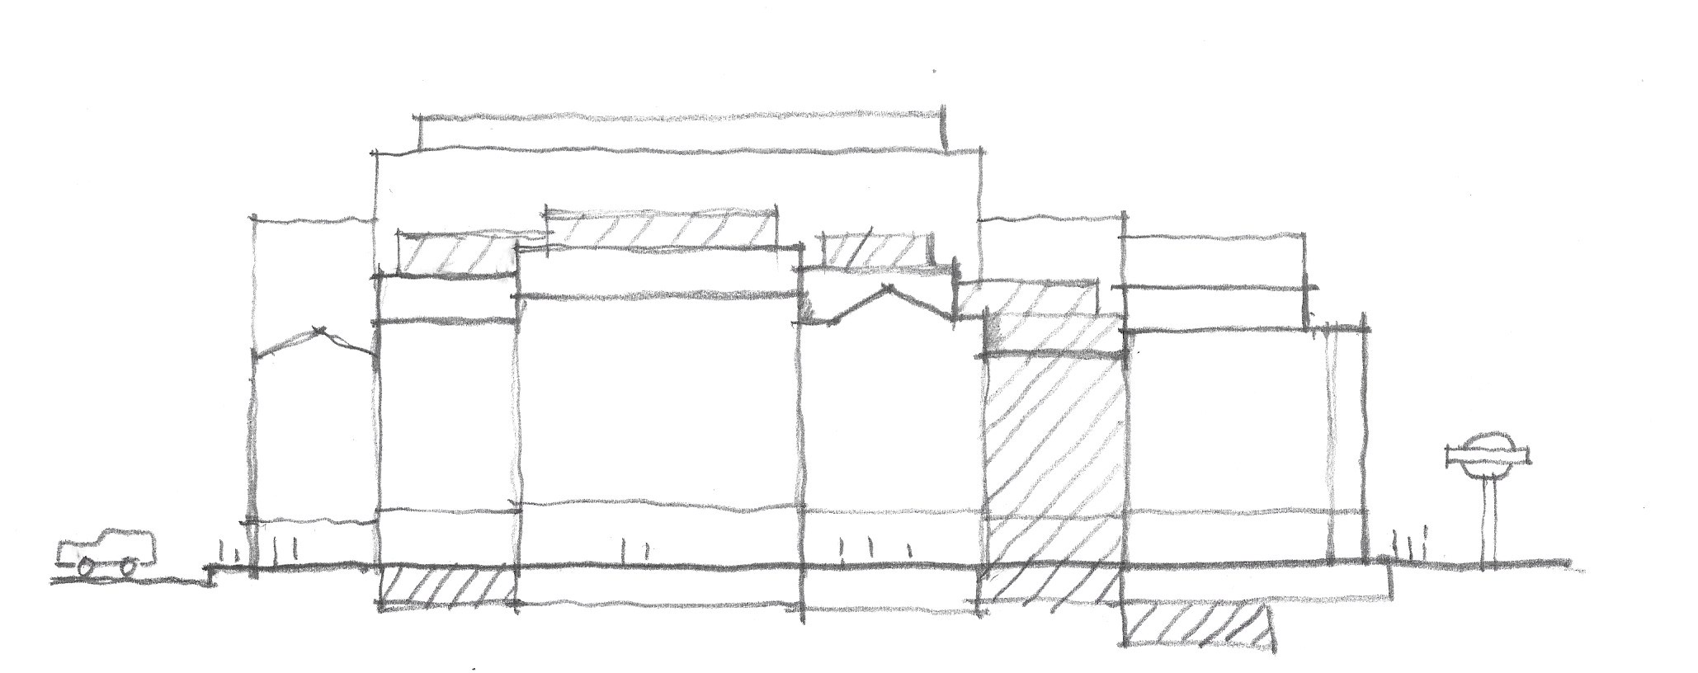
Increasing Urban Density in Heritage Areas
Site 1
Site 2
Site 3
Site 4
Existing Streetscape and Basements
Simon Sturgis - TargetingZero

Slide 7
Increasing Urban Density in Heritage Areas
Site 1
Site 2
Site 3
Site 4
CARBON VALUE
INFRASTRUCTURE
INFRASTRUCTURE
Existing Streetscape and Basements
Simon Sturgis - TargetingZero

Slide 8
Increasing Urban Density in Heritage Areas
Site 1
Site 2
Site 3
Site 4
Building beyond carbon efficient retention
Areas for selective demolition, to facilitate new construction on a
carbon cost/benefit basis.
Simon Sturgis - TargetingZero

Slide 9


Increasing Urban Density in Heritage Areas
Site 1
Site 2
Site 3
Site 4
?
?
?
?
Existing basements refurbished
Existing buildings retained, repaired and retrofitted to meet current environmental standards.
Final Scheme – Part Retrofit, Part New Build infill.
Carbon cost/benefit optimized.
Simon Sturgis - TargetingZero

Slide 10


Increasing Urban Density – Within Building’s capacity
Margaretenstrasse 9 - Vienna
Boston Seaport – Mass Timber extension
Simon Sturgis - TargetingZero

Slide 11


Examples
The Warehouse - Morris Adjmi Architects – New York
Fahle House KoK Architects - Estonia
Simon Sturgis - TargetingZero

Slide 12
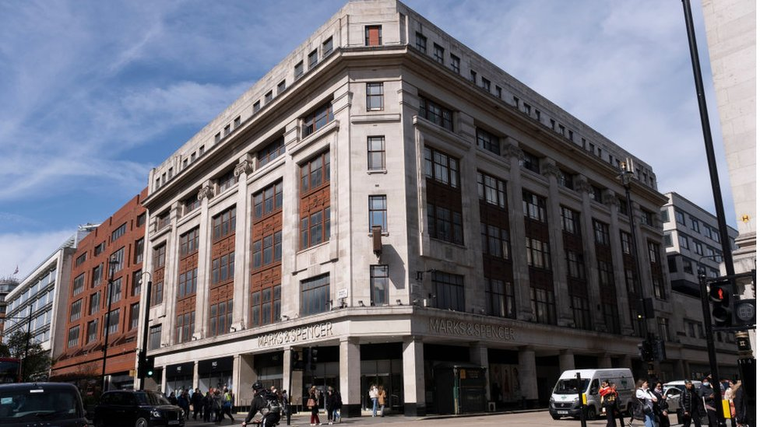
Case Study - M&S Oxford Street - London
Marks & Spencer - Oxford Street - Existing
Simon Sturgis - TargetingZero

Slide 13
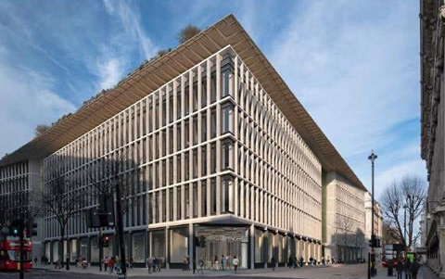
Case Study - M&S Oxford Street - London
Simon Sturgis - TargetingZero
Marks & Spencer - Oxford Street - Proposed
Simon Sturgis - TargetingZero

Slide 14

M&S Oxford Street
49 Years old
92 Years old
42 Years old
Simon Sturgis - TargetingZero

Slide 15
M&S Oxford Street
0
BAD
10
20
30
%
Reductions
40
M&S New Build
50
60
70
M&S Refurbishment
80
90
GOOD
100
1990
2000
2010
2020
2030
2040
2050
2060
Simon Sturgis - TargetingZero
Notes:
Not only buildings, but also places, people, etc.

Slide 16

M&S - How it Works – Planning Approval
National Legislation
MHCLG
Greater London Authority
Westminster City Council
Heritage and Climate
Simon Sturgis - TargetingZero

Slide 17
M&S Oxford Street
Refurbishment
is
Lower carbon
vs
New Build
Carbon Review
of Proposals
Simon Sturgis - TargetingZero

Slide 18
M&S - How it Works
National Legislation
MHCLG
Greater London Authority
Westminster City Council
Simon Sturgis - TargetingZero

Slide 19

M&S Oxford Street, London
Financial Times
Simon Sturgis - TargetingZero

Slide 20

M&S - How it Works
National Legislation
MHCLG
Greater London Authority
Westminster City Council
Simon Sturgis - TargetingZero

Slide 21
M&S - How it Works
National Legislation High Court
MHCLG
Greater London Authority
Westminster City Council
Simon Sturgis - TargetingZero

Slide 22
M&S - How it Works
National Legislation High Court
MHCLG
Greater London Authority
Westminster City Council
Simon Sturgis - TargetingZero

Slide 23
M&S Oxford Street
0
BAD
10
20
30
%
Reductions
40
M&S New Build
50
60
70
Trajectory to Net Zero
M&S Refurbishment
80
90
GOOD
100
2025
1990
2000
2010
2020
2030
2040
2050
2060
Simon Sturgis - TargetingZero
Notes:
Not only buildings, but also places, people, etc.

Slide 24
Thank You!
Simon Sturgis - TargetingZero

