Slide 1
Māori Engagement in the Climate Space – Aotearoa New Zealand
Dr Sarah Forgesson (Ngāti Whakaue, Ngāti Raukawa)
Preserving Legacies – Education and Knowledge Director
Queen’s University Belfast

Slide 2
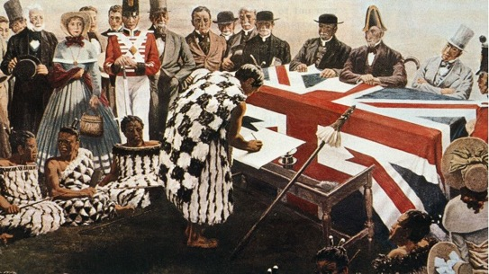
Te Tiriti o Waitangi
This bilingual treaty document was signed in 1840 between the British Crown and representatives of over 500 Māori tribes.
It is the major foundational documents which has since dictated the type of governance and policy development and is subsequently ingrained in the social, political and economic makeup of A/NZ.

Slide 3

Waitangi Tribunal
The Waitangi Tribunal was created as a permanent commission of inquiry to consider claims by Māori that Crown actions had breached the principles of te tiriti.

Slide 4
Māori Involvement

Slide 5

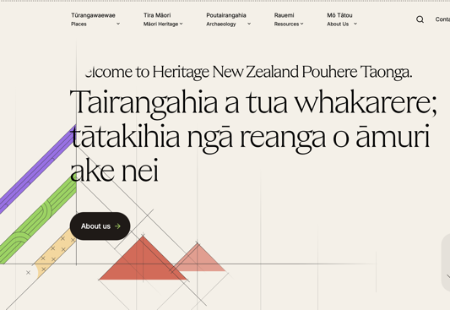
Heritage New Zealand Pouhere Taonga Act 2014
Heritage New Zealand Pouhere Taonga (Heritage New Zealand, HNPT) is an autonomous Crown entity formed under the Crown entities Act 2004. Its main act to date is the Heritage New Zealand Pouhere Taonga Act (NZPTA), which was introduced in 2014 to replace the New Zealand Historic Places Trust Pouhere Taonga Act (NZHPT Act) 1993 and has statutory functions and powers in relation to the ‘identification, preservation and conservation’ of historic and cultural heritage in A/NZ.
The Māori Heritage Council acts as an overseeing body that advocates for Māori interests and is well positioned to advocate on behalf of said interests.

Slide 6
Key Climate Policy
© Sarah Forgesson

Slide 7
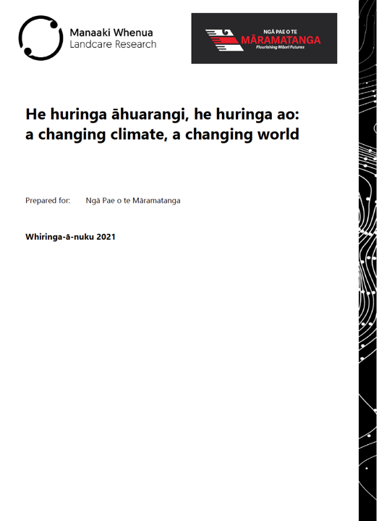

Vulnerabilities in Māori
Government funded reports published in 2017 (Ministry of the Environment 2017), identify and highlight how Māori are amongst the most vulnerable groups to the impact of the climate crisis in New Zealand, followed by a strewn of more recent publications, including the major report by Ngā Pae o te Māramatanga (NPM) and Manaaki Whenua – Landcare Research
He huringa āhuarangi, he huringa ao: a changing climate, a changing world

Slide 8
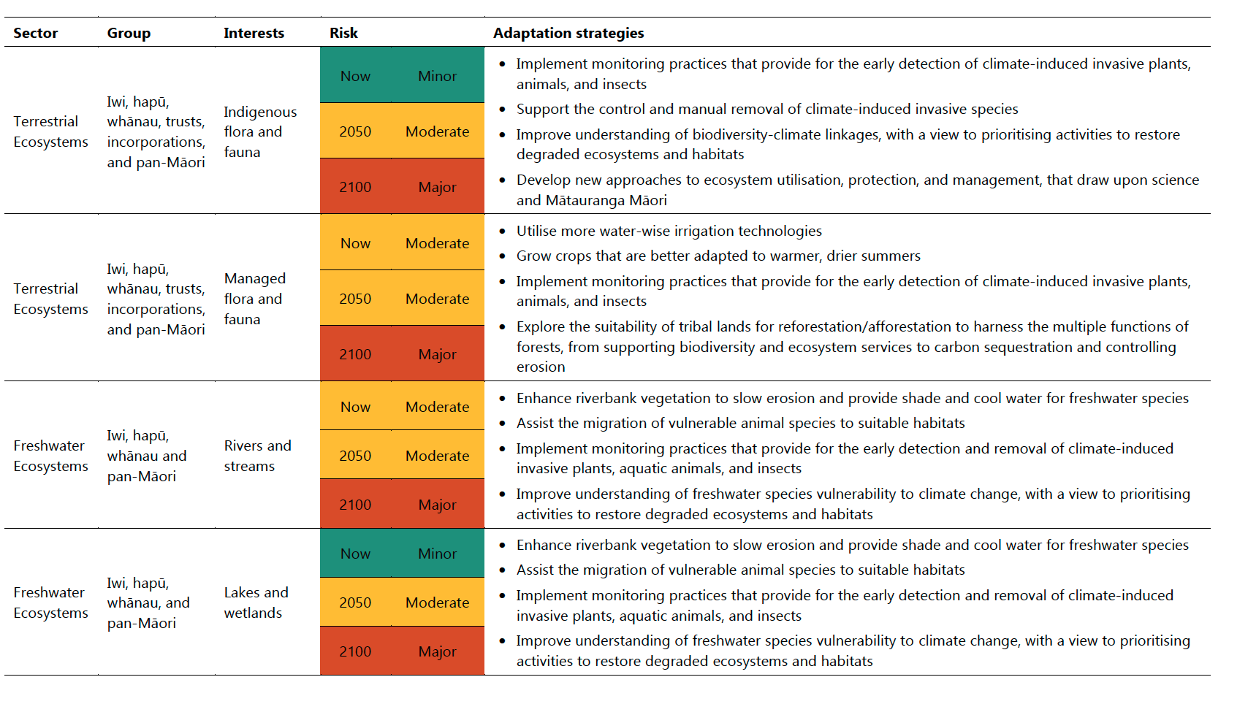

Slide 9
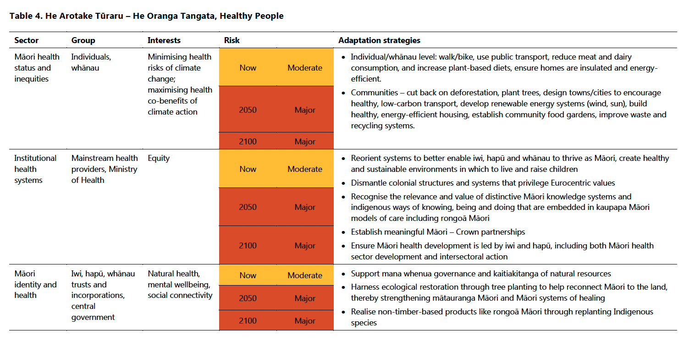

Slide 10
Impact on Māori Cultural Heritage
For Māori these impacts include loss of:
culturally significant structures and places.
access to equitable resources (forestry, primary sectors, seafood).
cultural practises.
native taonga species.
Climate change also impacts the ability to pass down Mātauranga Māori to future generations and enact cultural processes such as manaakitanga, whanaungatanga, and kaitiakitanga.

Slide 11
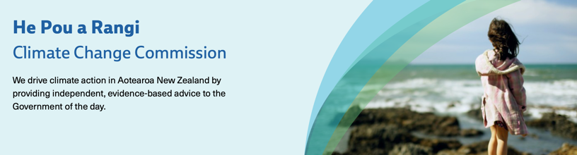
He Pou a Rangi – Climate Change Commission
Crown-Māori engagements on the climate crisis have proceeded primarily on the basis of direct dialogue prompted by the Climate Change Commission's recommendations
Produce independent advice to the Government on the direction of policy that will enable Aotearoa New Zealand to respond and achieve a low-emissions, climate-resilient future.
This is mainly done through public consultation – often targeted

Slide 12
Māori and Climate Vulnerability
Various provisions were brought about by the Climate Change Commission sought to ensure the effective participation of Māori in decision-making - specifically requiring the Minister to ensure consultation with iwi and Māori has been adequate including emission reduction plans which conceivably would include any mitigation policies which might affect the relationship of Māori with their traditional lands.
Consultation with Māori needs to fulfil Crown’s obligation to give effect to the principles of the Treaty of Waitangi – namely that of partnership.
Climate Change Commission’s addition of a Chapter addressing the “the key concerns raised by Iwi/Māori submissions” in direct response to consultation with Māori where they expressed disappointment in the Commission’s lack of attention to Māori-specific issues

Slide 13
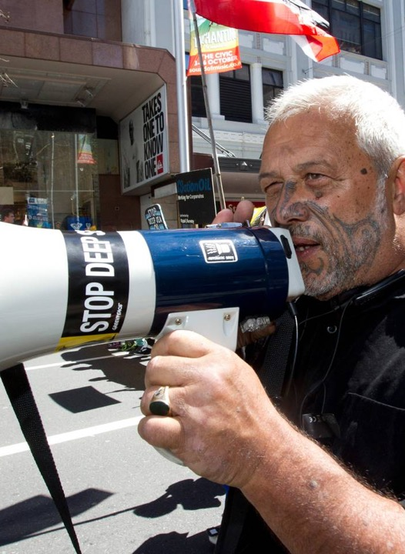
Climate Change Iwi Leaders Group
"The climate change challenge for Māori society is about sustainable living arrangements and development, as much as it is about natural hazards management such as risks associated with flooding, storms and coastal erosion," says Mike. “Our mission is to bring together engagement, understanding, empowerment and implementation to drive Māori-led climate resilience strategies.”
Climate Change Iwi Leaders Group chair Mike Smith is seeking a declaration in the High Court the Government is "failing" Māori through inaction over climate change. Photo / File

Slide 14
Presence in Reporting
Two major national level reports around climate change:
National climate change risk assessment for New Zealand
National adaptation plan

Slide 15
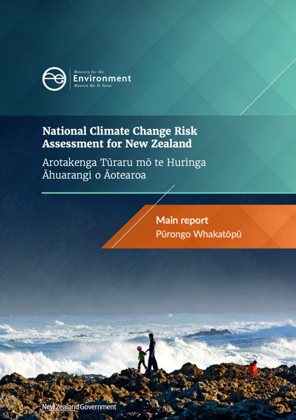
National Climate Change Risk Assessment for New Zealand
Arotakenga Tūraru mō te Huringa Āhuarangi o Āotearoa
Identifies 43 priority risks across five value domains (natural environment, human, economy, built environment and governance)
The risk assessment was meant to feed to Government information to prioritise action, including through the national adaptation plan.

Slide 16
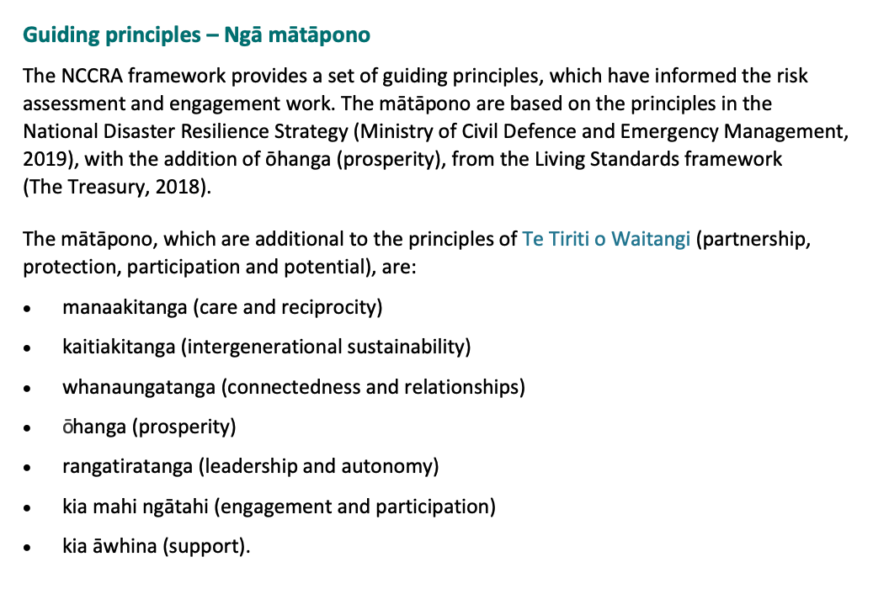

Slide 17
Risks for Māori
Risks to Māori social, cultural, spiritual and economic wellbeing from loss and degradation of lands and waters, as well as cultural assets such as marae, due to ongoing sea-level rise, changes in rainfall and drought.
Risks to Māori social, cultural, spiritual and economic wellbeing from loss of species and biodiversity due to greater climate variability and ongoing sea-level rise.
Risks to Māori and European cultural heritage sites due to ongoing sea-level rise, extreme weather events and increasing fire weather.
Risk of a breach of Treaty obligations from a failure to engage adequately with and protect current and future generations of Māori from the impacts of climate change.
Some risks will have a disproportionate impact on Māori or certain Māori groups

Slide 18
Risks for Māori
  Enhanced risks include:
  Risks to social cohesion and community wellbeing from displacement of individuals, families, and communities due to climate change impacts.
  Risks of exacerbating existing inequities and creating new and additional inequities due to differential distribution of climate change impacts.
  Risks of conflict, disruption, and loss of trust in government from changing patterns in the value of assets and competition for access to scarce resources primarily due to extreme weather events and ongoing sea-level rise.

Slide 19
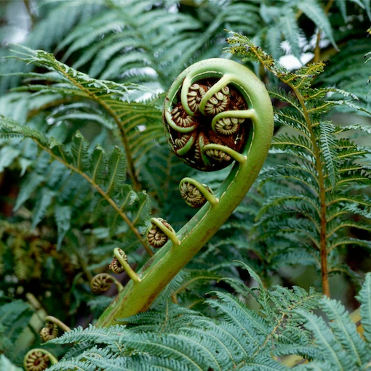
Mātauranga Māori-based gaps
Mātauranga Māori is about a Māori way of being and engaging in the world – in its simplest form, it uses kawa (cultural practices) and tikanga (cultural principles) to critique, examine, analyse and understand the world.
It is based on ancient values of the spiritual realm of Te Ao Mārama (the cosmic family of the natural world) and it is constantly evolving as Māori continue to make sense of their human existence within the world.

Slide 20
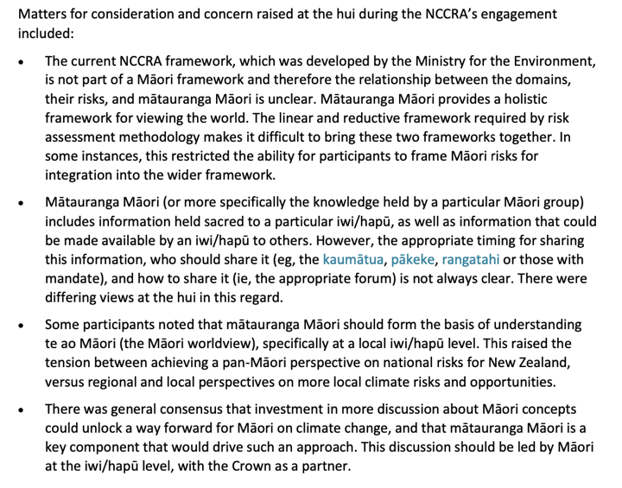

Slide 21
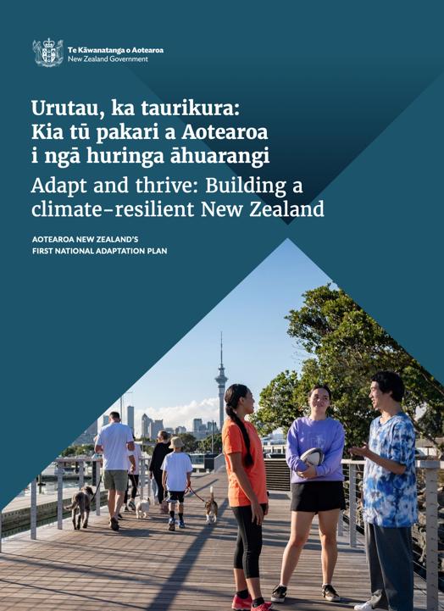
Adapt and thrive: Building a climate-resilient New Zealand – New Zealand's first national adaptation plan
Urutau, ka taurikura: Kia tū pakari a Aotearoa i ngā huringa āhuarang
Contains strategies, policies and actions that will help New Zealanders adapt to the changing climate and its effects – so we can reduce the potential harm of climate change, as well as seize the opportunities that arise.

Slide 22
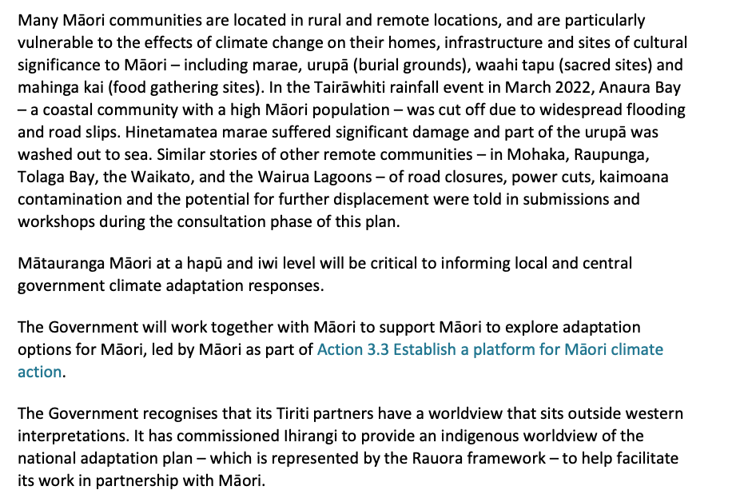

Slide 23
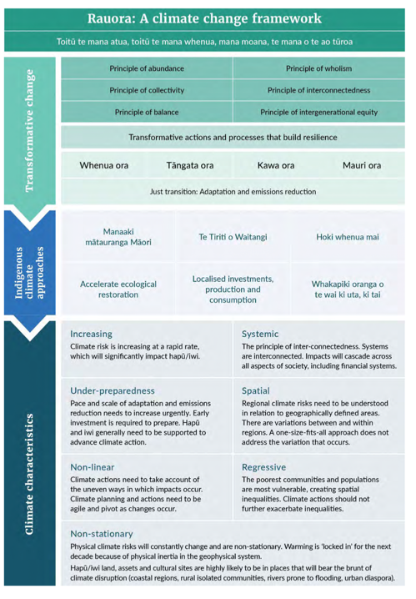
Rauora: A Climate Framework
The Rauora framework is also a foundation from which iwi, hapū and whānau can apply their own mātauranga-a-iwi (knowledge with an iwi-specific base).
The notion of whenua ora, tangata ora, mauri ora recognises that the land, people and associated life forces are interconnected. In this way, a well land is a well people, and so too are the life forces of these components of the world healthy. The notion of kaitiakitanga is implicit in this approach, where Māori continue to strengthen their stewardship of the environment.
The Rauora framework supports and promotes transformative approaches, resilience building and supporting measures. It elevates and celebrates the contributions indigenous values and mātauranga Māori can bring to climate action.

Slide 24
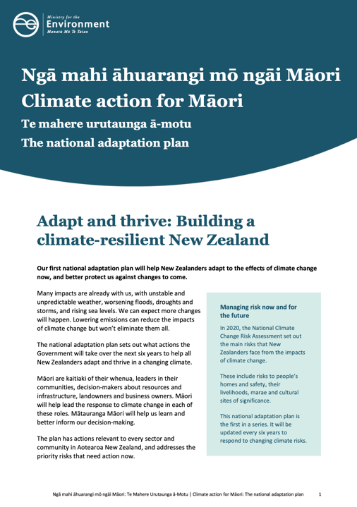
Action 3.10 Assess socio-economic and climate vulnerability for Māori:
Action 3.27 Develop a framework for assessing exposure and vulnerability of taonga/cultural assets to climate change.
The plan supports the development and use of mātauranga Māori in our adaptation journey, including through the following actions:
Action 3.7.6 Produce guidance on integrating mātauranga Māori into adaptive planning and working with mana whenua.
Action 3.21 Develop mātauranga Māori indicators of climate impacts on the natural environment.
Action 3.24 Produce new tools and guidance specific to mātauranga Māori and mātauranga indicators.
Action 5.8 Support kaitiaki communities to adapt and conserve taonga/cultural assets.
Action 6.3 Implement Te Mana o te Taiao – Aotearoa New Zealand Biodiversity Strategy 2020.
Action 6.4 Implement the proposed National Policy Statement on Indigenous Biodiversity.

Slide 25
Action 6.7 Implement the National Policy Statement for Freshwater Management 2020.
Action 7.2 Partner with Māori landowners to increase the resilience of Māori-owned land, homes and cultural sites.
Action 7.3 Partner with Māori to support Māori-led approaches to adaptation planning.
Action 9.3 Develop the emergency management workforce.
Action: 9.6 Building community resilience through social cohesion.
Action 9.9 Expand current funding for proactive community resilience.
Action 10.5 Deliver the Māori agribusiness extension programme.
Action 10.17 Support Māori small business resilience and transitions.

Slide 26
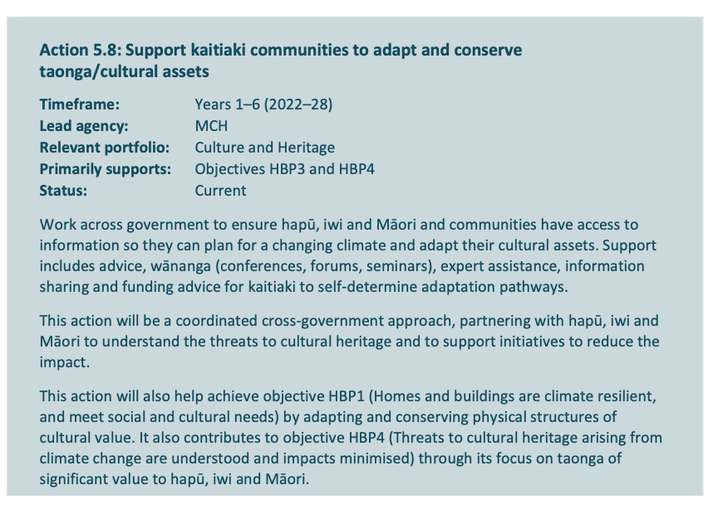

Slide 27
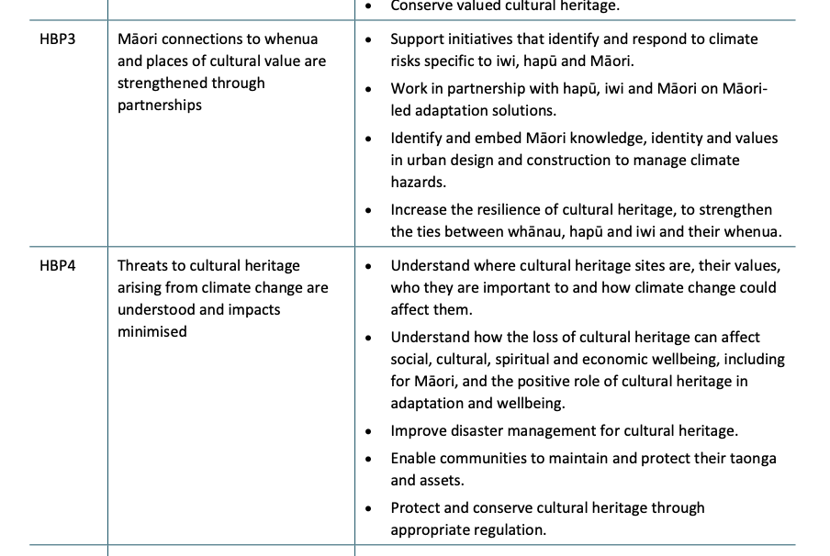

Slide 28
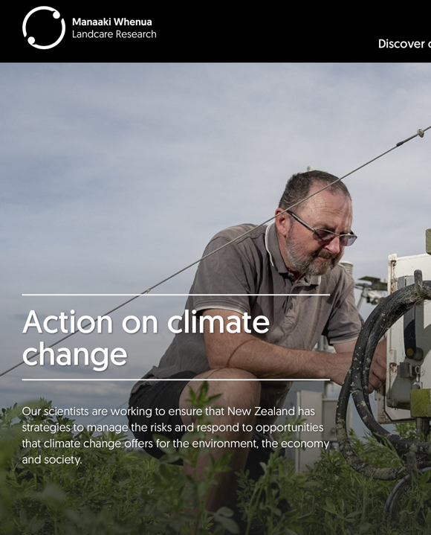
Manaaki Whenua –
Landcare Research
Dedicated stream to climate change research – namely focused on adaptation and mitigation
More land use and management focused, but there is an increasing acknowledgment of Mātauranga and tikanga in there research with Manaaki Taiao.
Is a rōpū (group) made up of Manaaki Whenua – Landcare Research Kairangahau Māori (Māori researchers) working on Māori-led research projects within a range of science portfolios

Slide 29
Manaaki Whenua – Landcare Research
For around 1000 years in Aotearoa, traditional knowledge (mātauranga Māori) has been handed down from ancestors (tupuna, tipuna), rangatira, kaumātua, kuia, tohunga, and knowledgeable people. Mātauranga Māori, as with other indigenous peoples’ knowledge systems, has an important role in contemporary resource management. Manaaki Whenua – Landcare Research is a key partner in working alongside Māori to help achieve kaitiakitanga goals and aspirations.

Slide 30
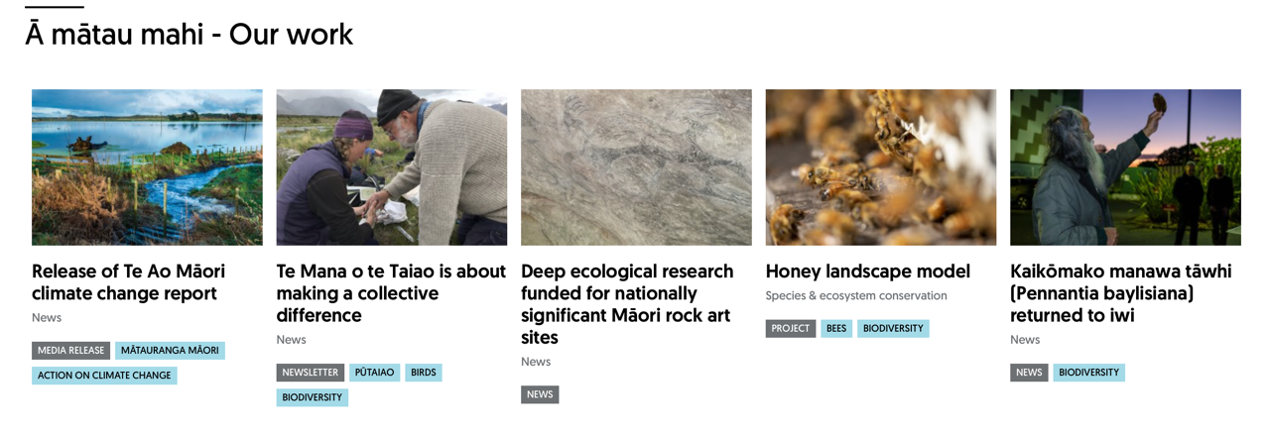
Manaaki Whenua – Landcare Research

Slide 31
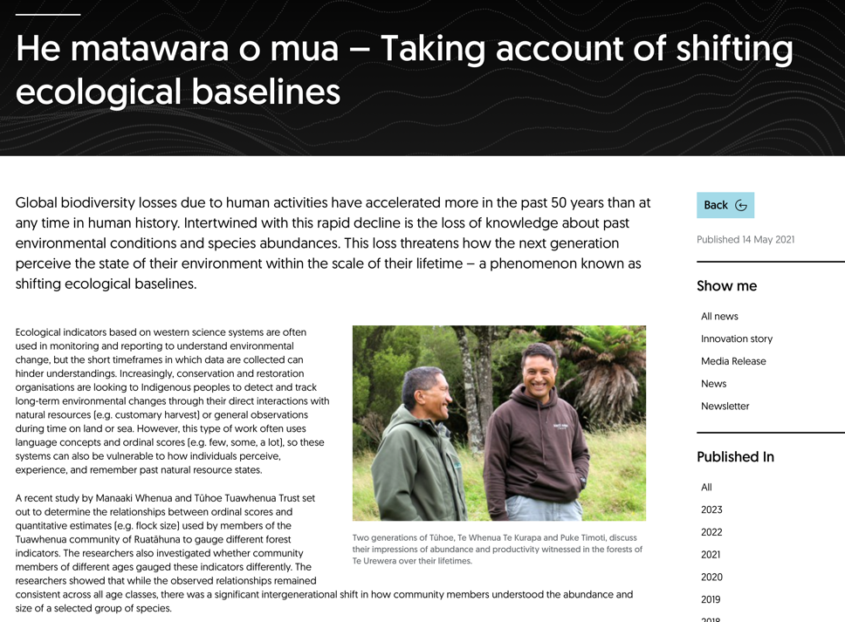

Slide 32
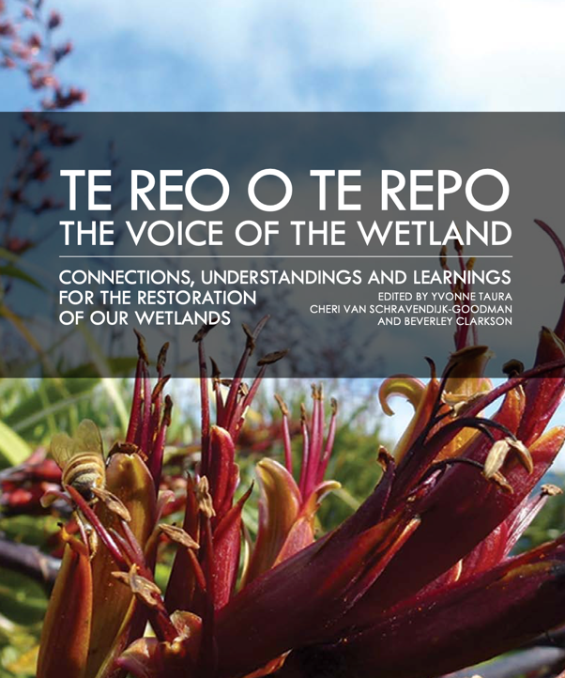
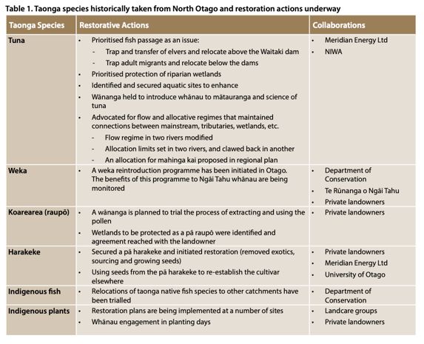
Te Reo o Te Repo – the Voice of the Wetland

Slide 33
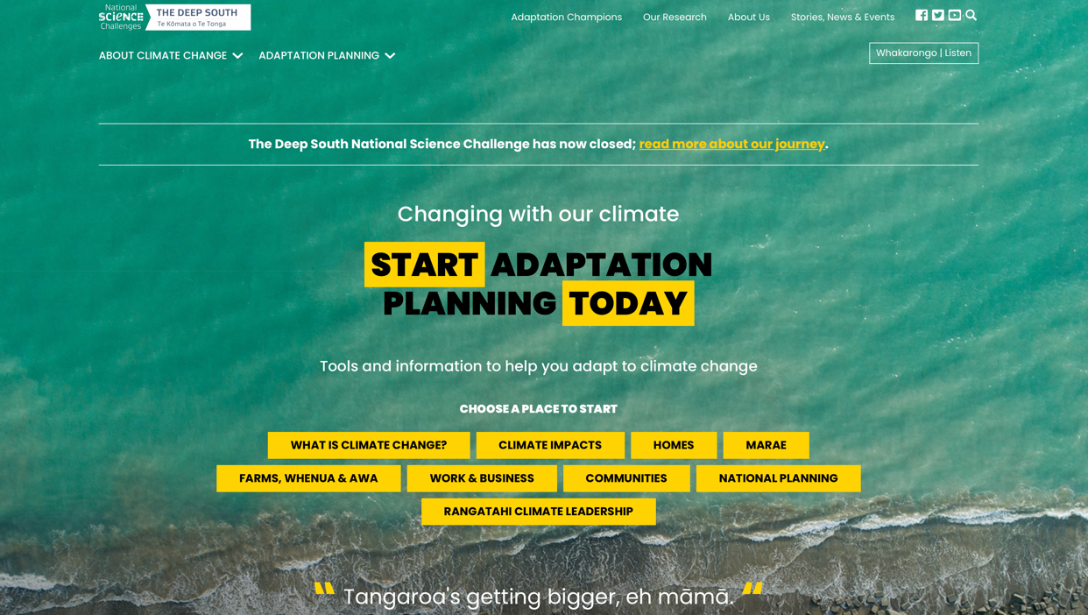

Slide 34
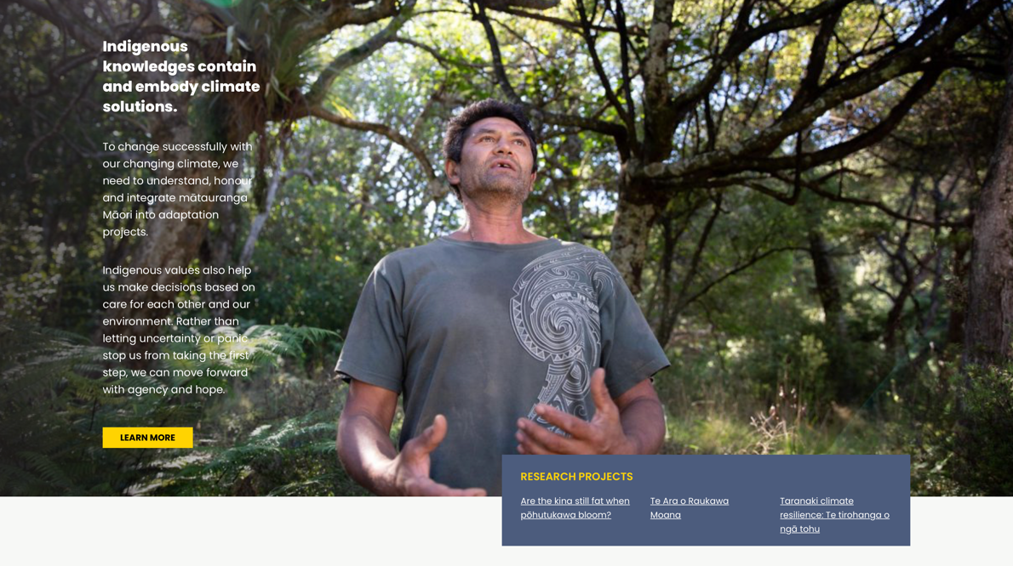

Slide 35
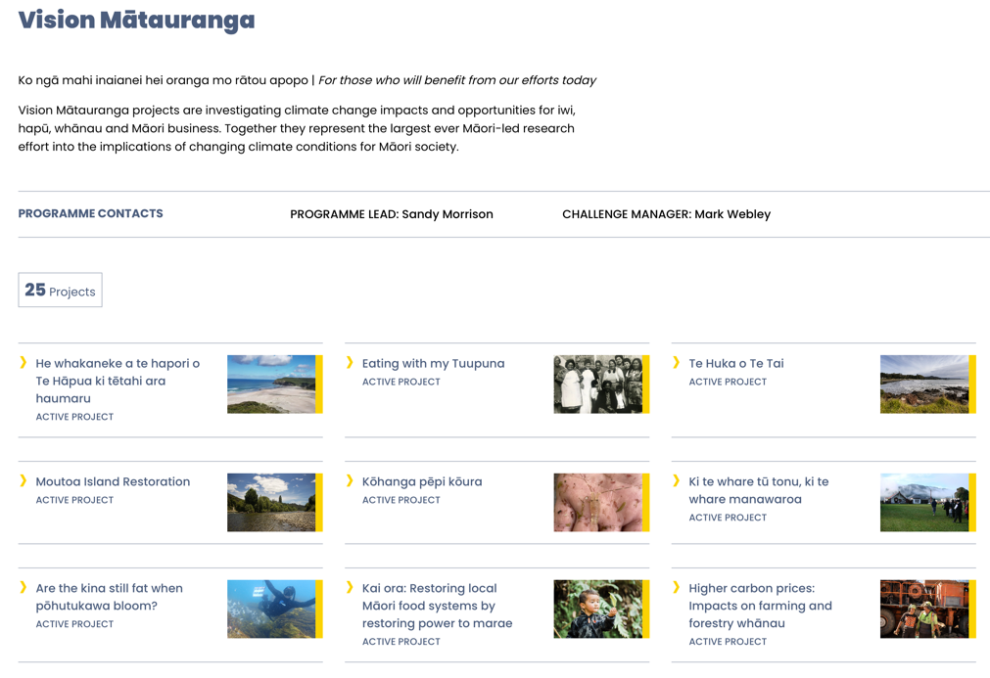

Slide 36
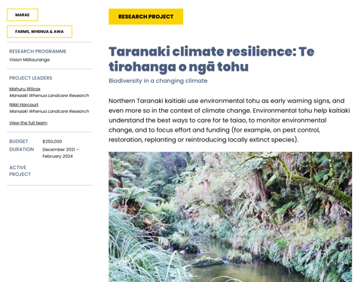
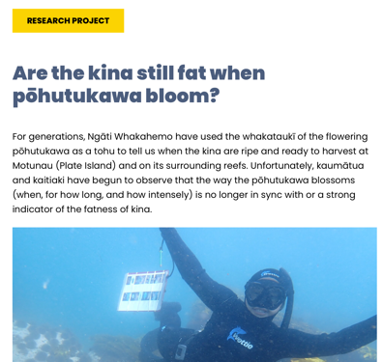
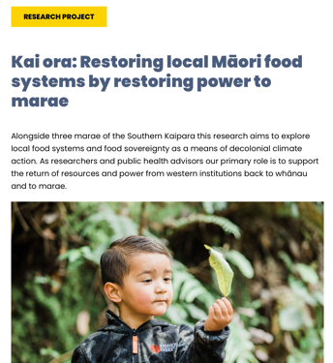

Slide 37
Climate Planning and Encoded Knowledge
After their arrival in Aotearoa. Māori developed various forms of codifying knowledge—many based upon oral delivery.
Some narrative forms include moteatea (chants, poems), whaikorero (oratory, speechmaking), maramataka (calendar), waiata (songs), pepeha (quotations), whakataukī/whakatauāki (proverbs), whakapapa (genealogies) and pūrākau (stories)—each with its own categories, style, complex patterns and characteristics

Slide 38
Whakataukī/Whakatauākī
Koia tēnei: ko te toroa noho au, e tangi ana ki tōna kāinga; e mihi ana
“This is a fact: I live like an albatross, crying out to its nesting place and greeting (you in sorrow).”
(A saying used to refer to the confiscation of lands and the displacement of Māori from their homes)
He ua kowhai
“A kōwhai shower”
(A saying that describes a spring shower, at the time of the kōwhai blooms, and signals the appearance of the tūī as well as the availability of some food sources)
Ki te kore te tangata e manaaki i tōna taiao, ka kore te tangata e whai orange
“If people do not take care of the environment, we are not taking care of our own health and wellbeing.”

Slide 39

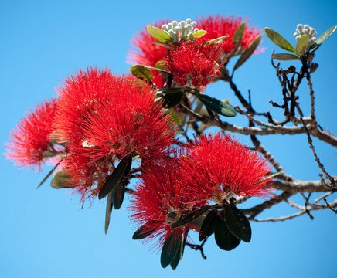

Slide 40
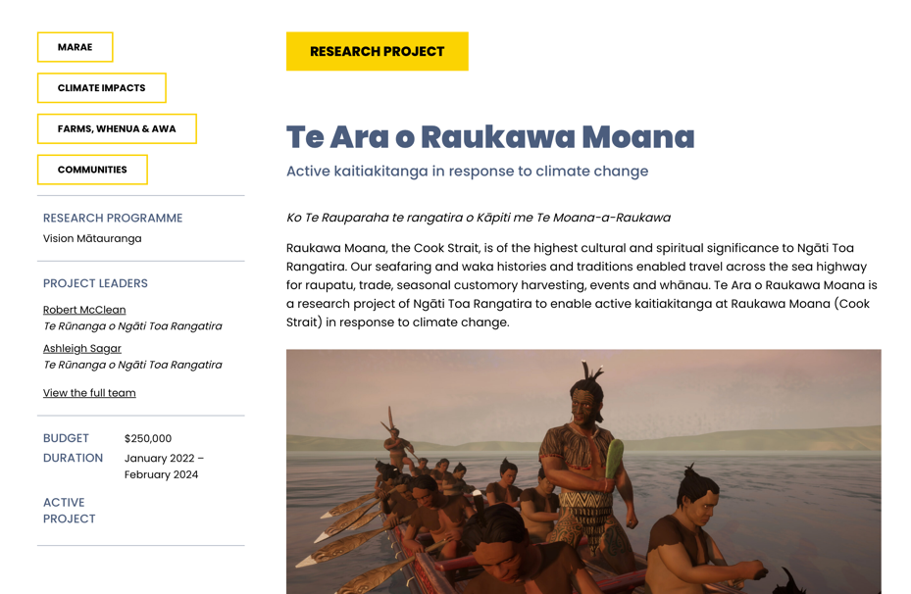
Revitalisation of Knowledge

Slide 41
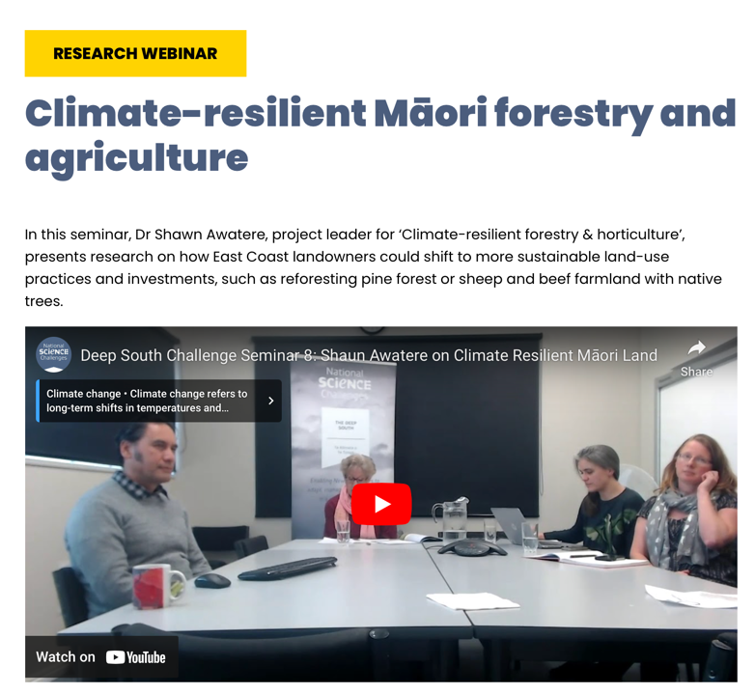

Slide 42
Environmental Tohu
Environmental indicators or tohu, are also abundant in regards to knowing the weather and climate.
These indicators help us make judgements about the health of wildlife, the time for planting and harvesting, and the management of risks such as crossing seas and local rivers. Many of the tohu used by Māori are closely aligned with changes in local weather and climate conditions.
The use of tohu comes from Te Ao Māori principles that all things are connected through whakapapa (genealogy). These whakapapa connections in the environment reveal much about what’s happening in our skies.

Slide 43
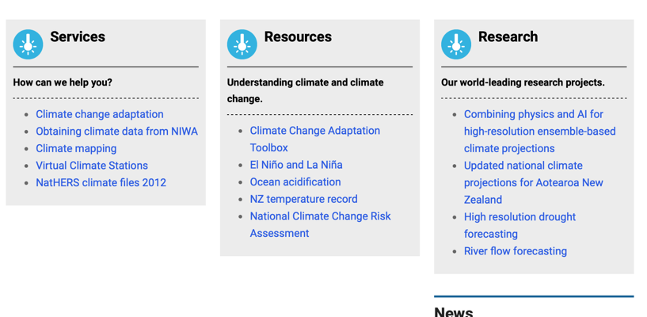
NIWA – Taihoro Nukurangi
Provide the main national climate data and modelling for Aotearoa
Most data is relegated to the national scale, with coarse data available on a regional scale

Slide 44
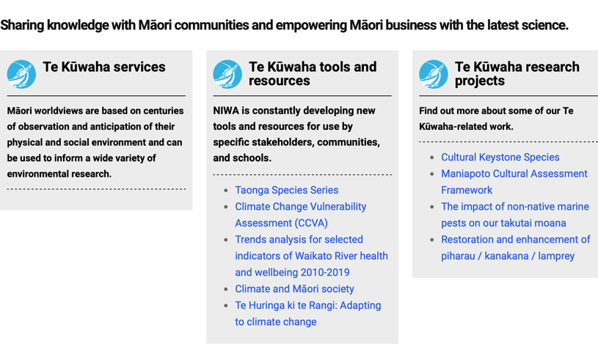
Te Kūwaha - Māori Environmental Research

Slide 45
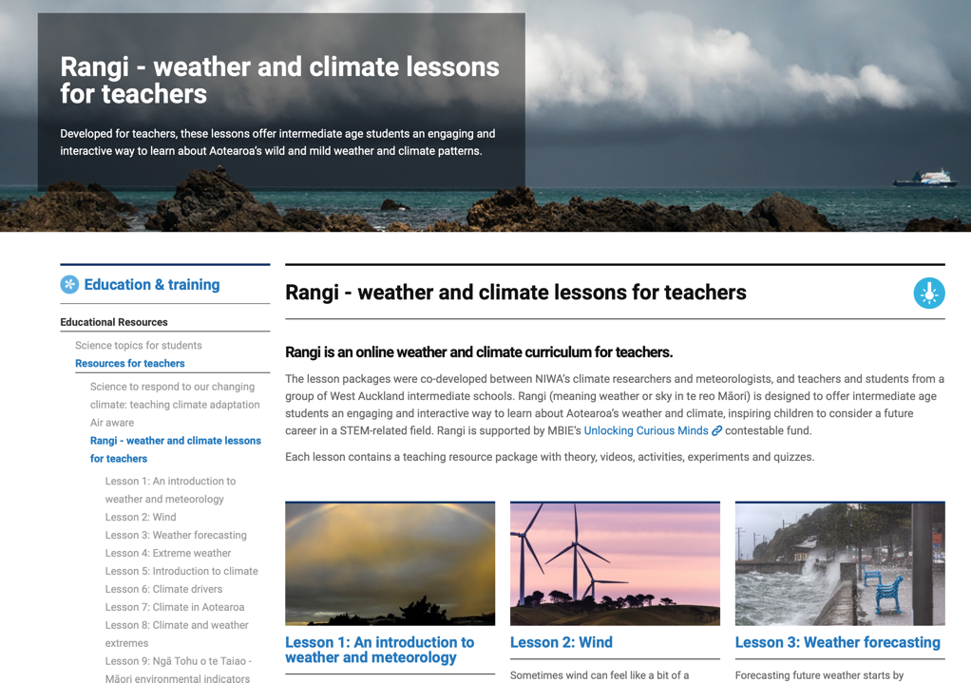

Slide 46
Tohu were developed through close interactions with local environments and processes over time. Māori learned and developed a detailed knowledge of the links between the natural environment and changing weather conditions based on careful observations of daily, monthly and seasonal conditions.
These observations included the behaviour of certain birds, the blooming of certain trees and flowers, and the movement of certain stars.
Different across iwi and hapū, as part of separate Mātauranga-a-iwi, Mātauranga-a-hapū
NIWA has done extensive research on tohu across the country

Slide 47
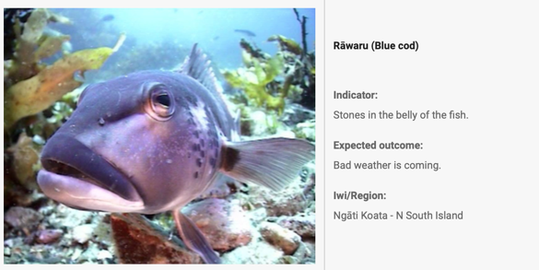
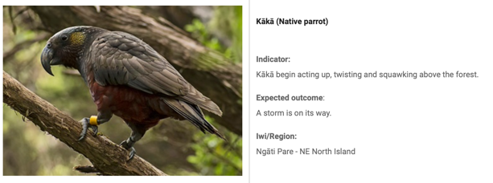
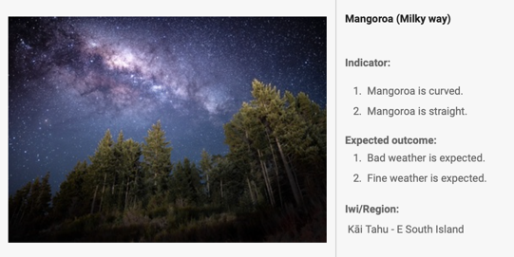
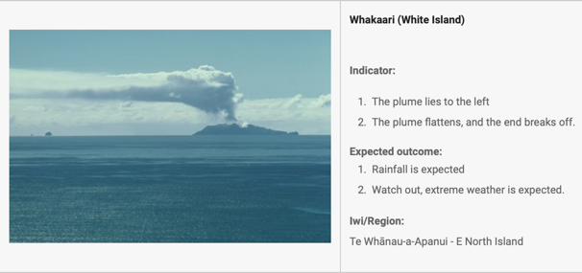

Slide 48
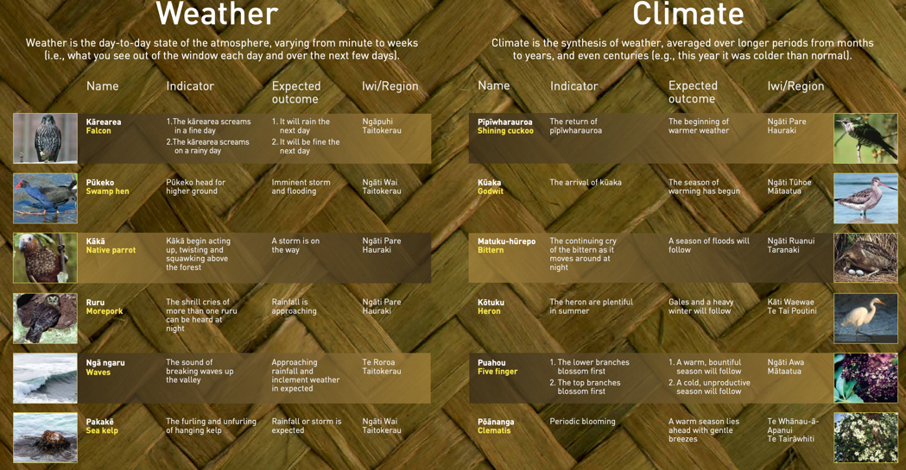
Traditional Māori Weather and Climate Forecasting

Slide 49
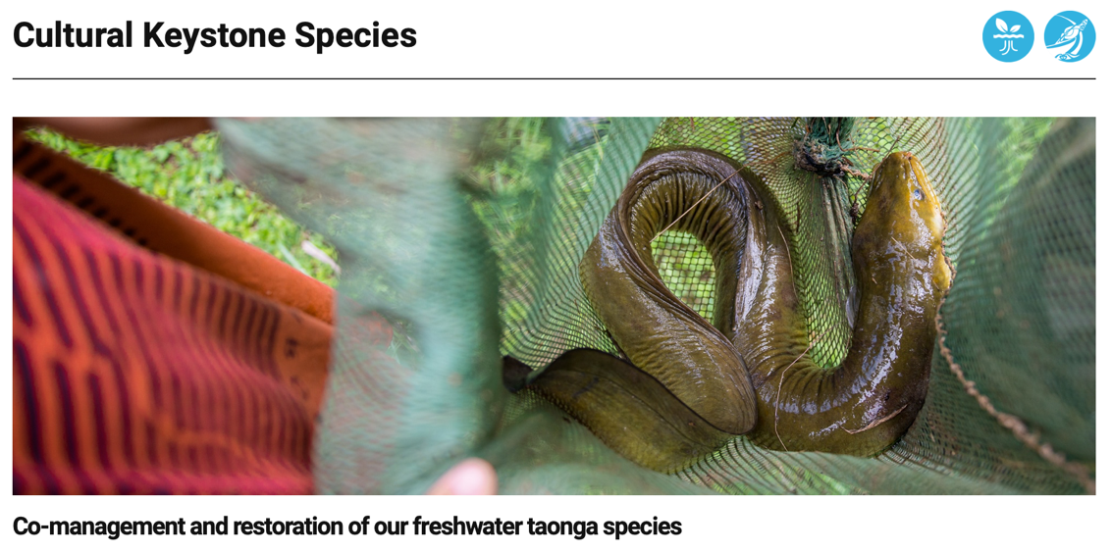
Cultural Keystone Species

Slide 50
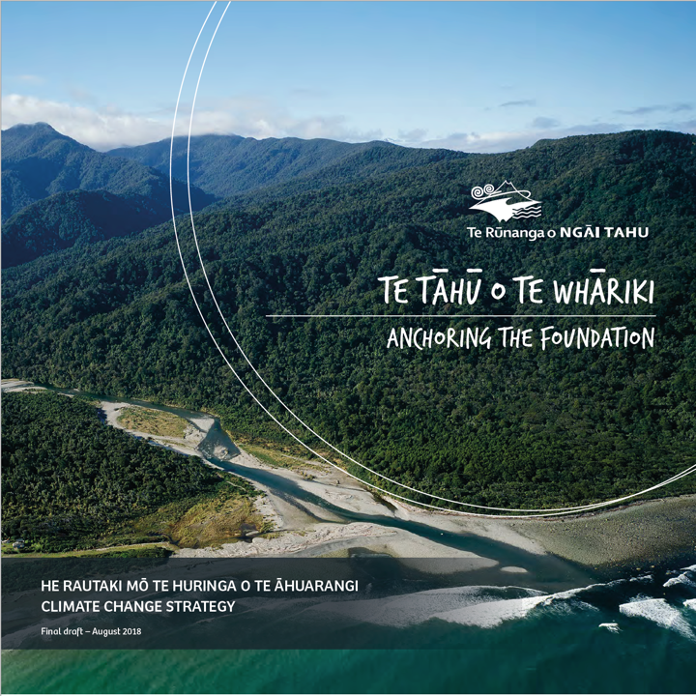
Ngāi Tahu
In 2016 Ngāi Tahu tribal governance identified the need to develop a strategy to give Ngāi Tahu direction in ensuring resilience in the face of the impacts of climate change.

Slide 51
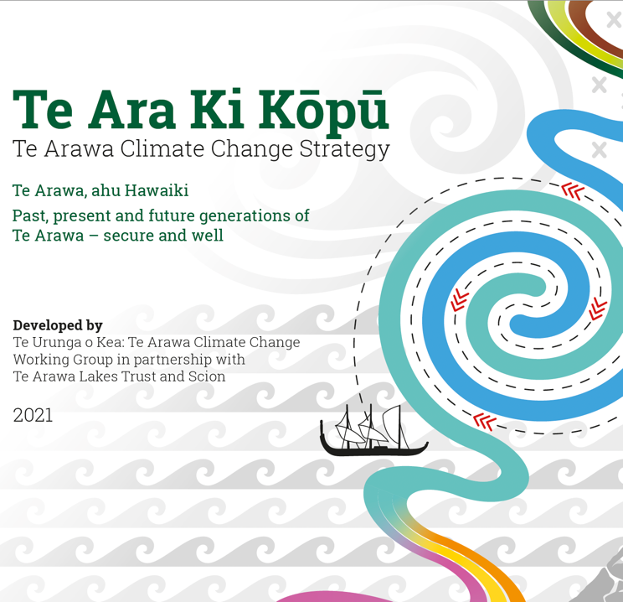
Te Arawa
Completed by Te Urunga o Kea: Te Arawa Climate Change Working Group which is part of the wider Te Arawa Lakes Trust, and done in collaboration with Scion.
Launched on 1 October 2021 with comprehensive series of videos and wananga highlighting the goals and aspirations of Te Arawa.
Another widely active iwi in the climate space

Slide 52
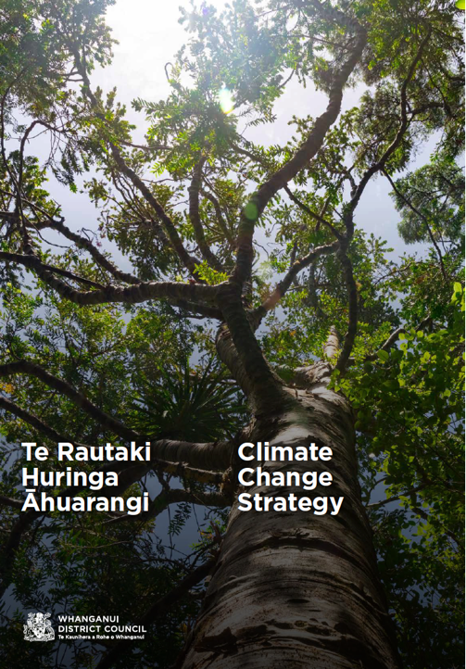
Whanganui District
Council
Not iwi based but founded in core Māori values
Completed in 2021
‘This strategy tells a story of the New Zealand European and Māori
(te ao Māori) world views coming together to address climate change in
a uniquely Whanganui way.’

Slide 53
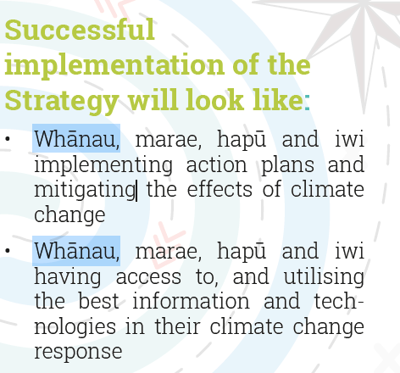
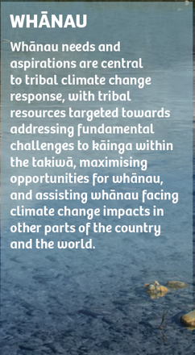
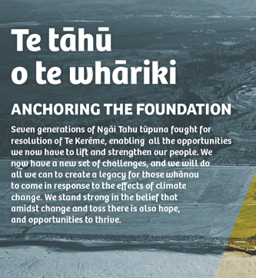
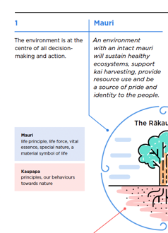
Core Values and Considerations
Focus on Whānau
Focus on Whakapapa
Focus on Rangatiratanga
Focus on Kaitiakitanga
Focus on Capacity Building
Focus on Tikanga
Focus on Mātauranga

Slide 54
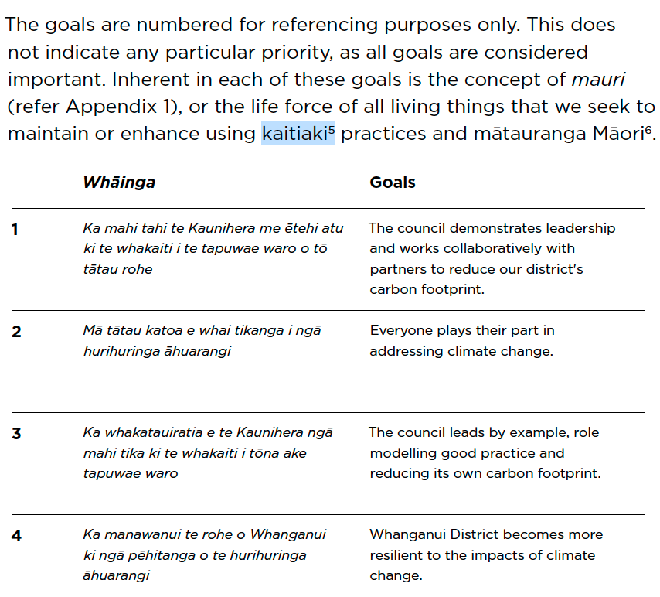
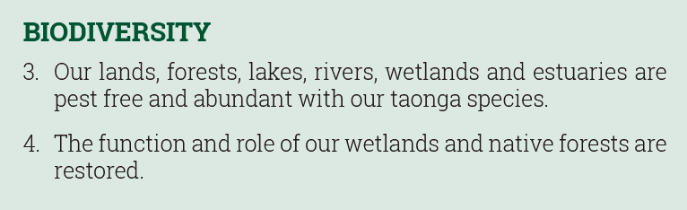
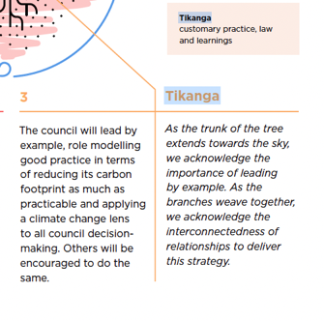





Slide 55

Heritage Sector
Action 5.8: Support kaitiaki communities to adapt and conserve taonga/cultural assets
Action 3.26: produce guidance for disaster risk management for cultural heritage
Action 3.27: develop a framework for assessing exposure and vulnerability of cultural assets/taonga to climate change
Action 7.1: research how cultural heritage contributes to community wellbeing and climate change adaptation

