Slide 1
Brazil-based historian who works with Quilombolos on heritage and climate change matters
PhD Luana Campos – CPAN/UFMS – CCMCPC/Icomos - Brazil

Slide 2
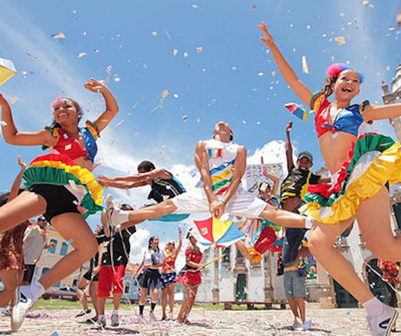
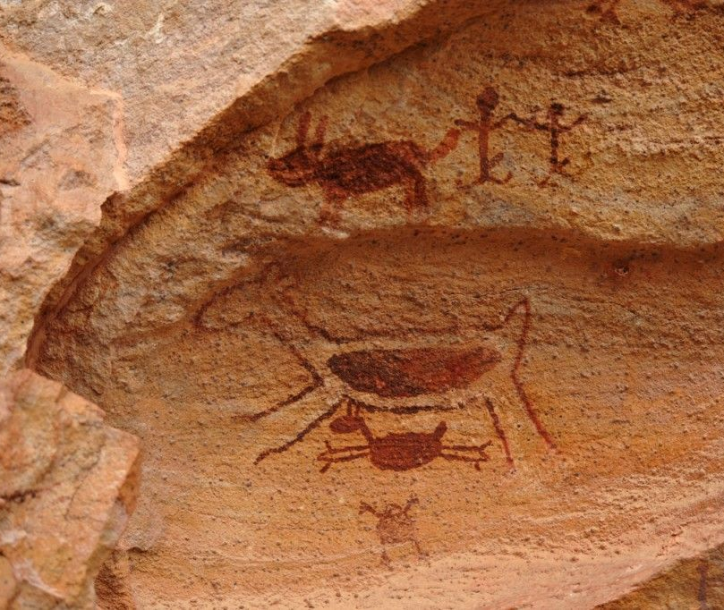
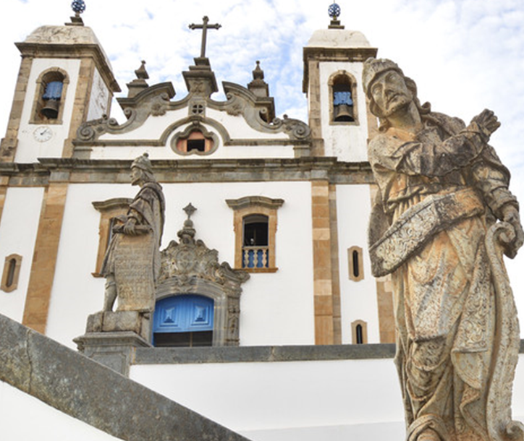
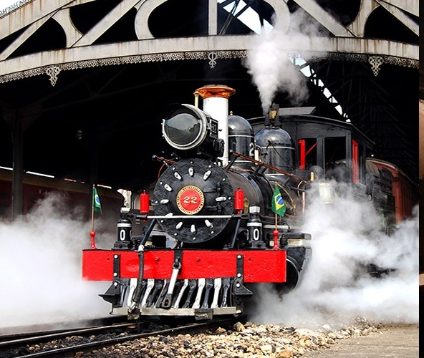
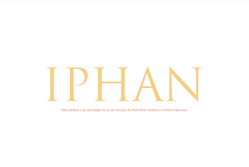
Brazilian heritage, legally protected since 1937, is as diverse as its territory.
Intangible heritage
Archaeological sites
Valued heritage
National Institute of
Historical and Artistic Heritage
tangible heritage

Slide 3
In 2013, climate change in Brazil was predicted until 2100 and scientists estimated an increase of up to 6ºC in temperature if gas emissions remain high.

Slide 4
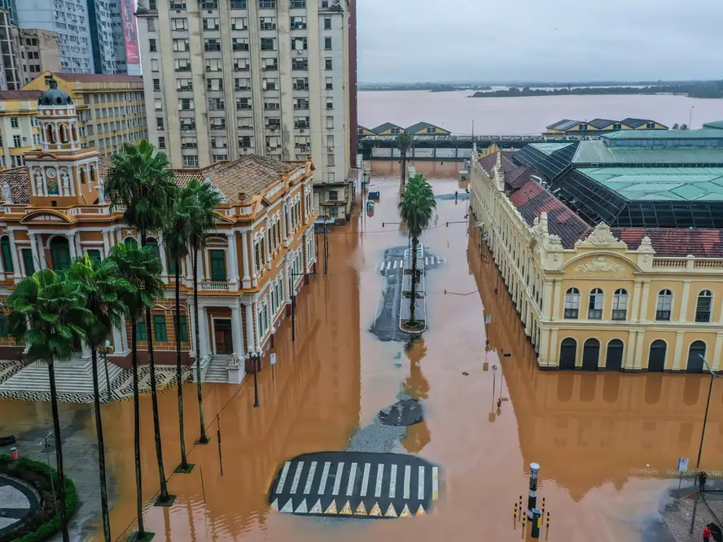
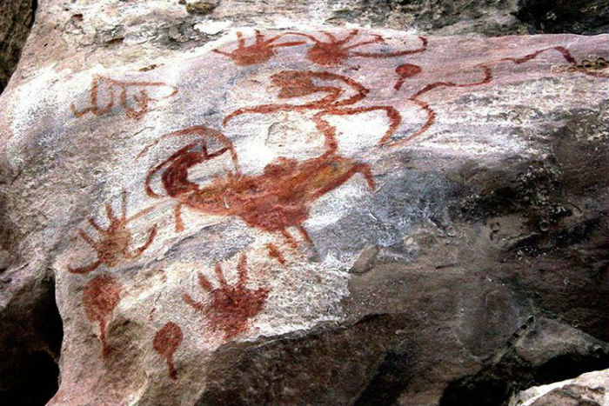
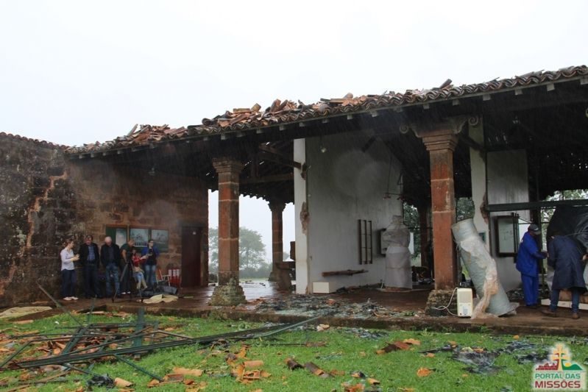
Cultural heritage and climate change
Historic center of Porto Alegre flooded
Rock art burned by fire
How Brazilian cultural heritage is being impacted by the effects of climate change?
Museum of São Miguel das Missões destroyed by hurricane

Slide 5
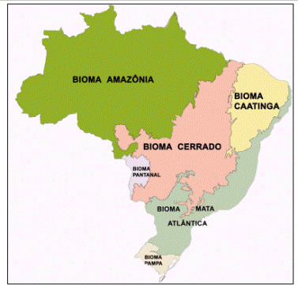
Dialogues on Cultural Heritage and Climate Change
climate actions
for more information:
https://www.gov.br/iphan/pt-br/acesso-a-informacao/acoes-e-programas/programas/ciclo-de-dialogos-patrimonio-cultural-e-acoes-climaticas

Slide 6
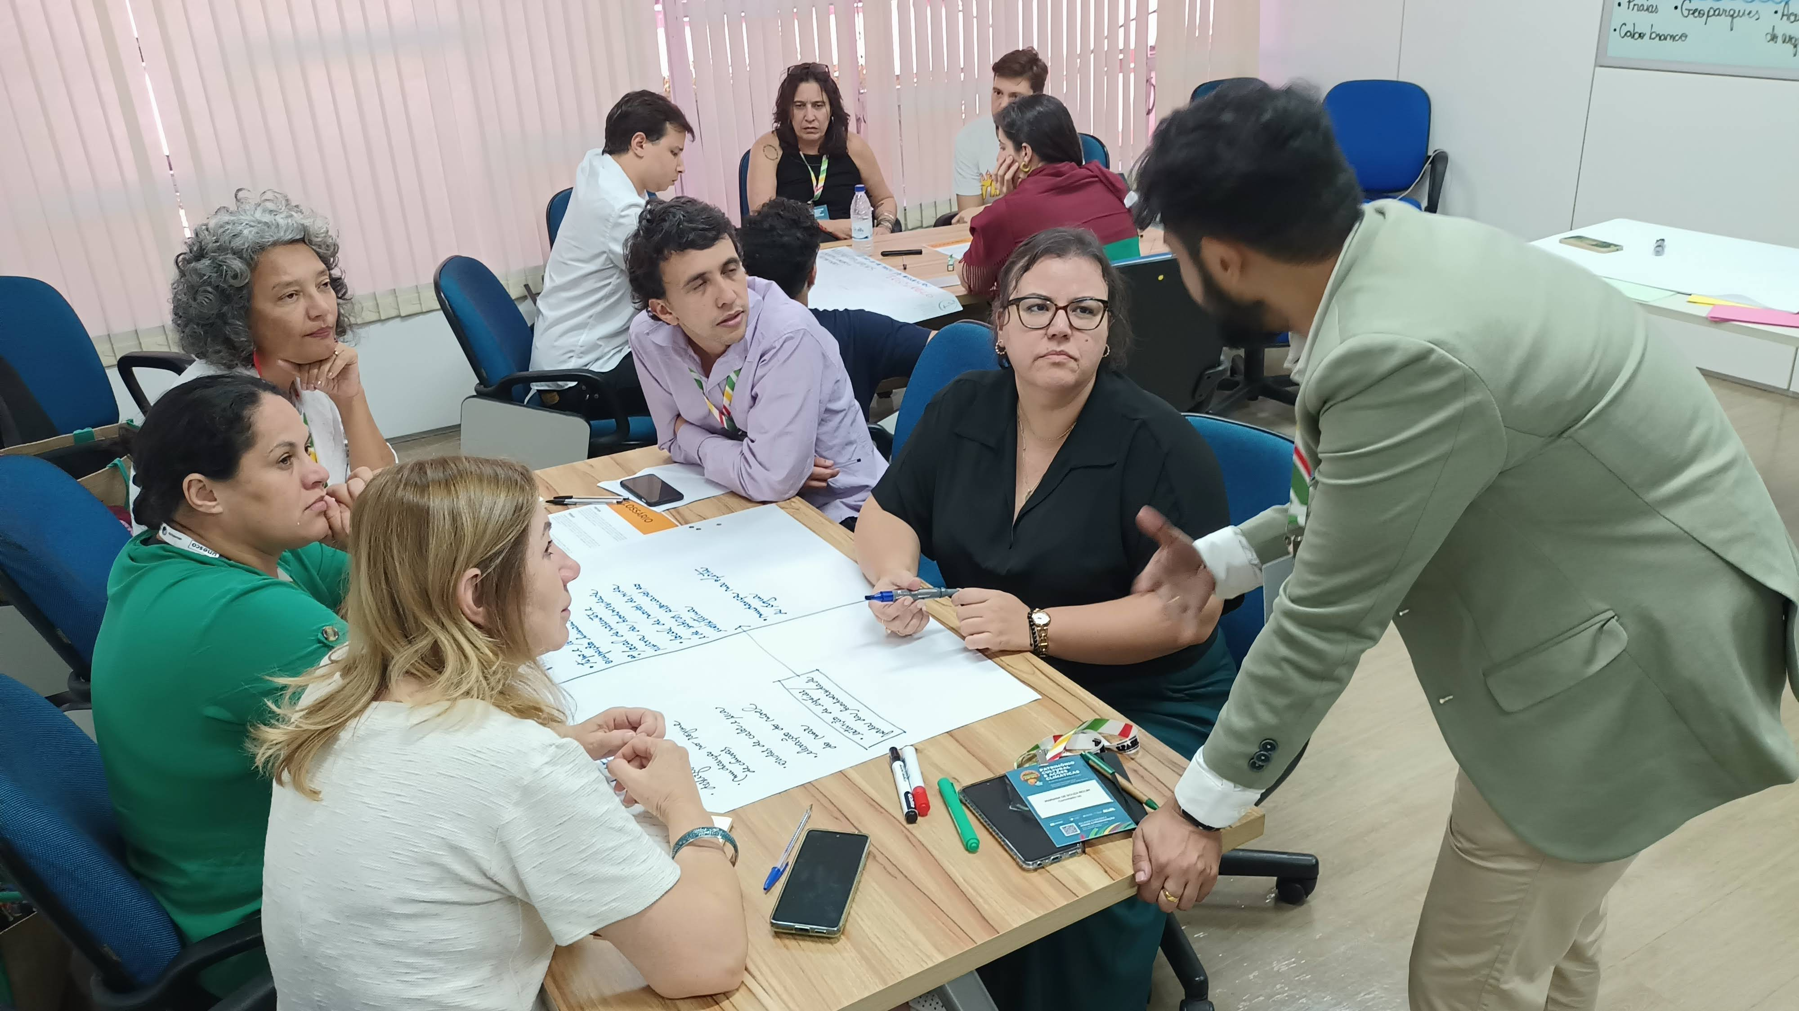
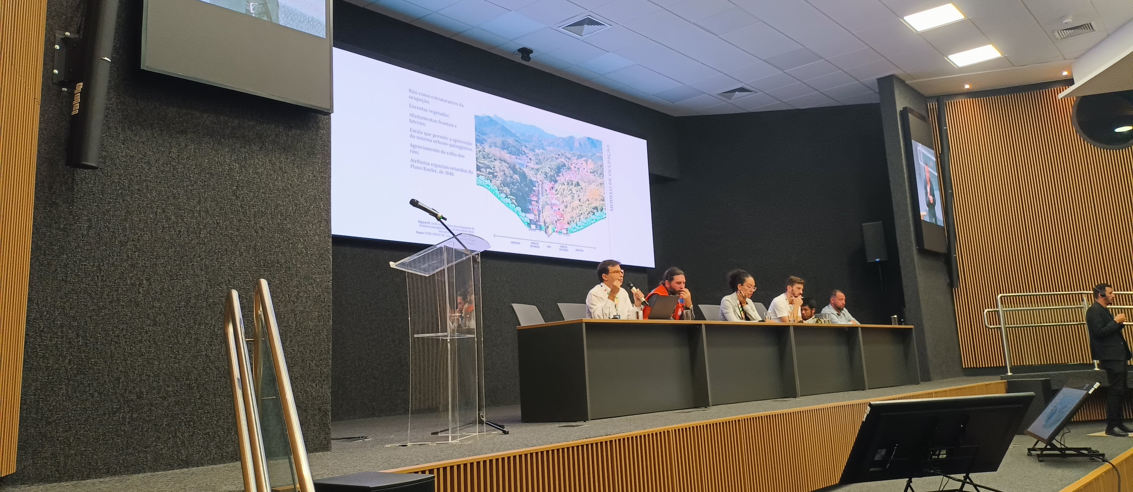
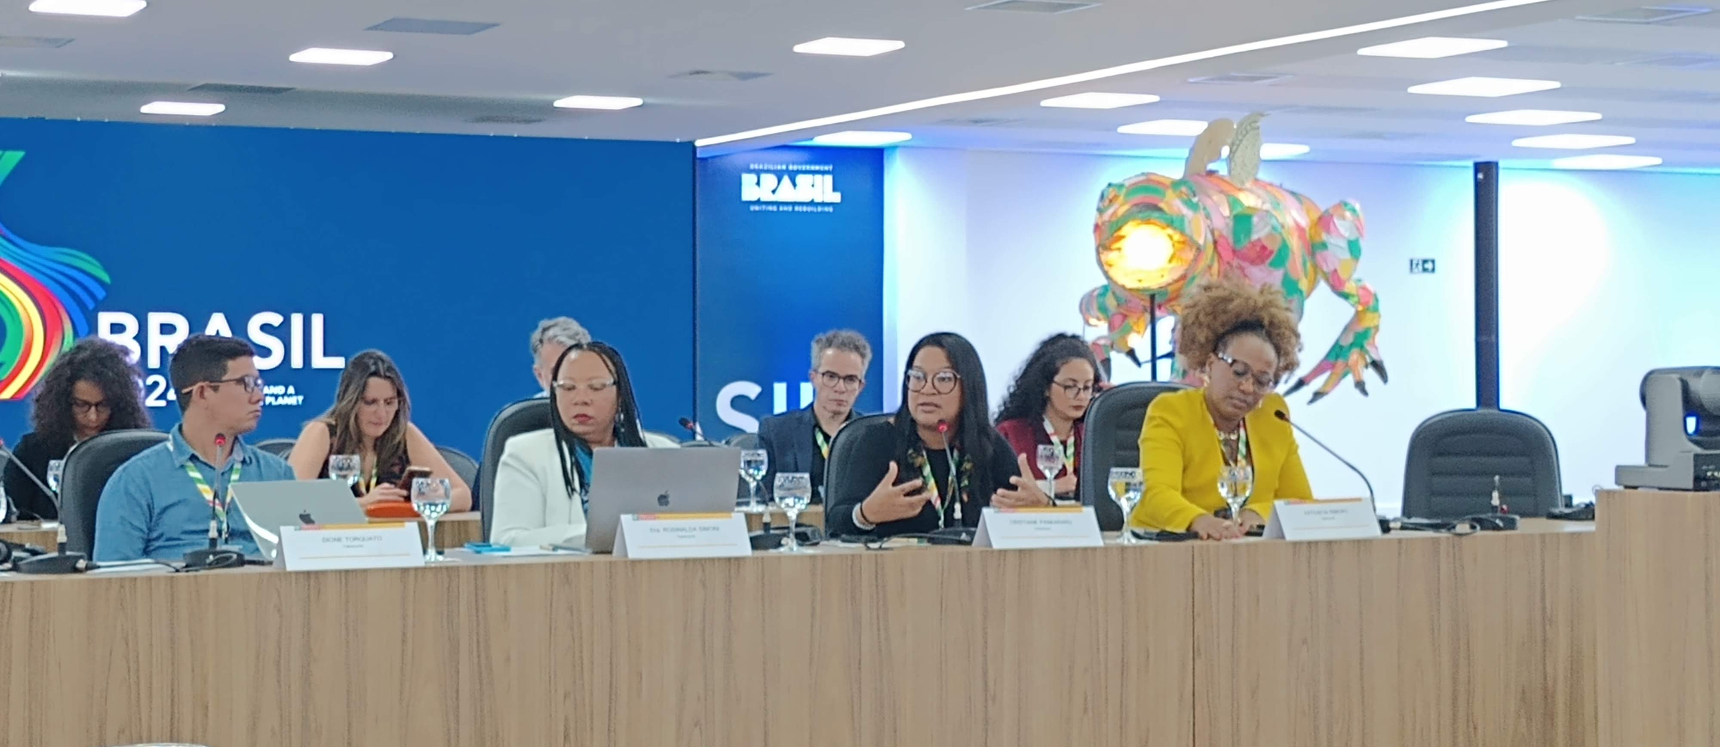
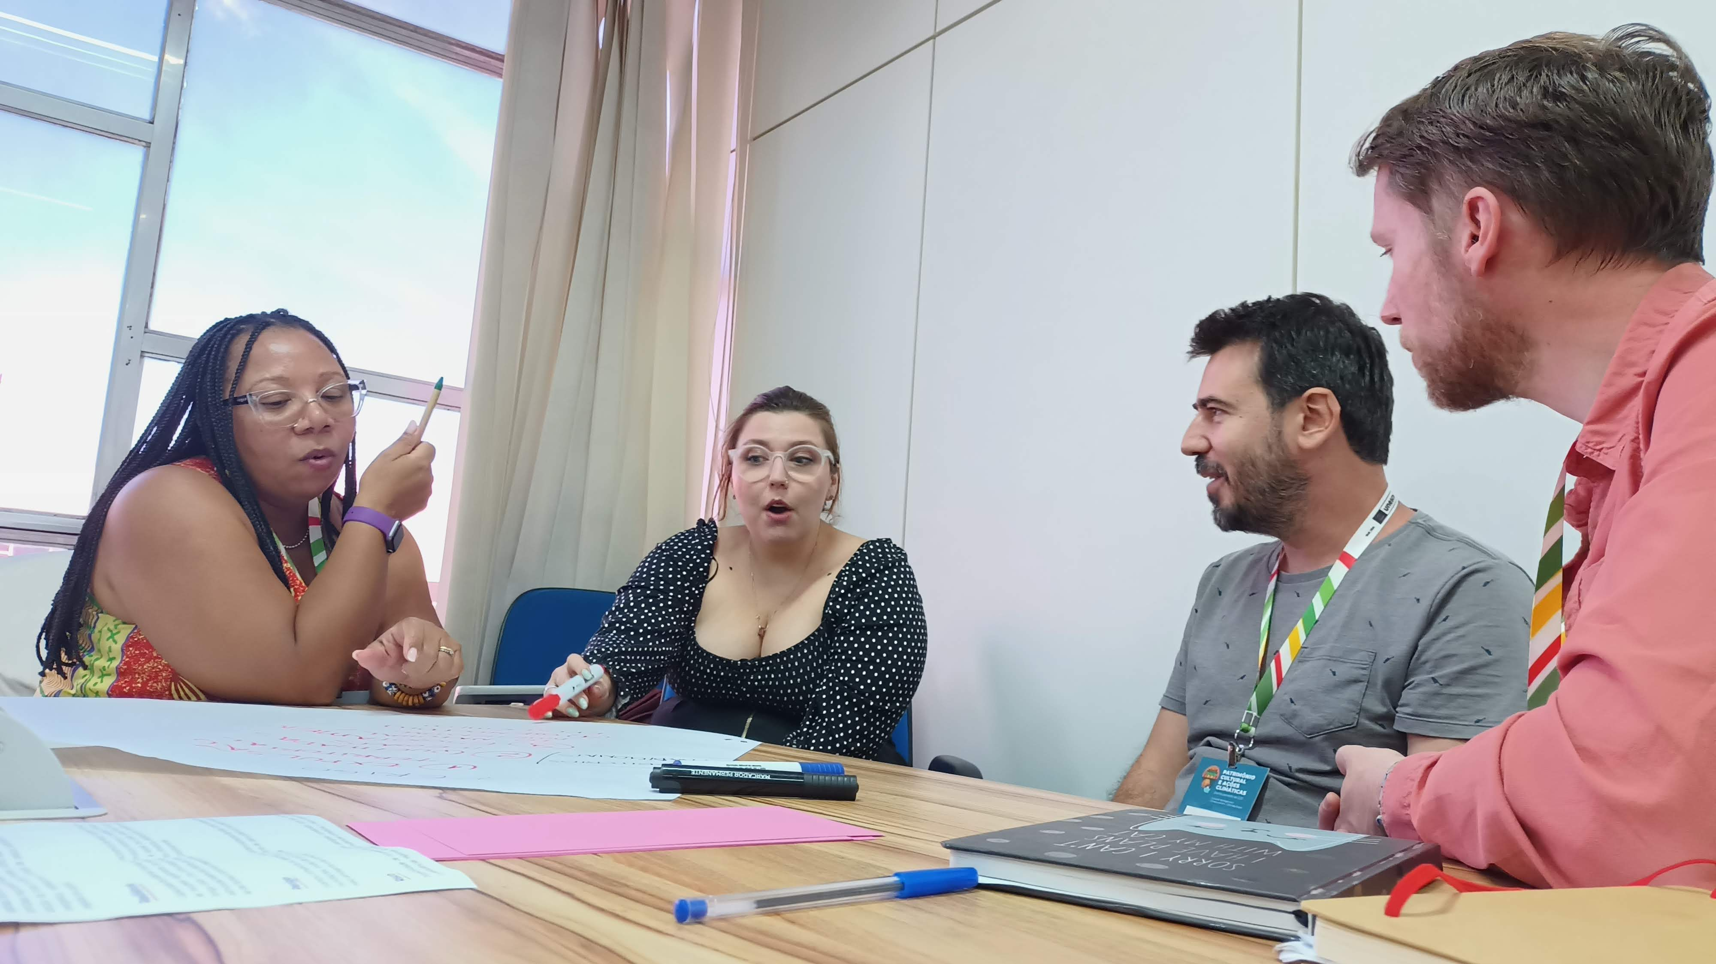
Launch of the action in Brasilia – May/2024

Slide 7
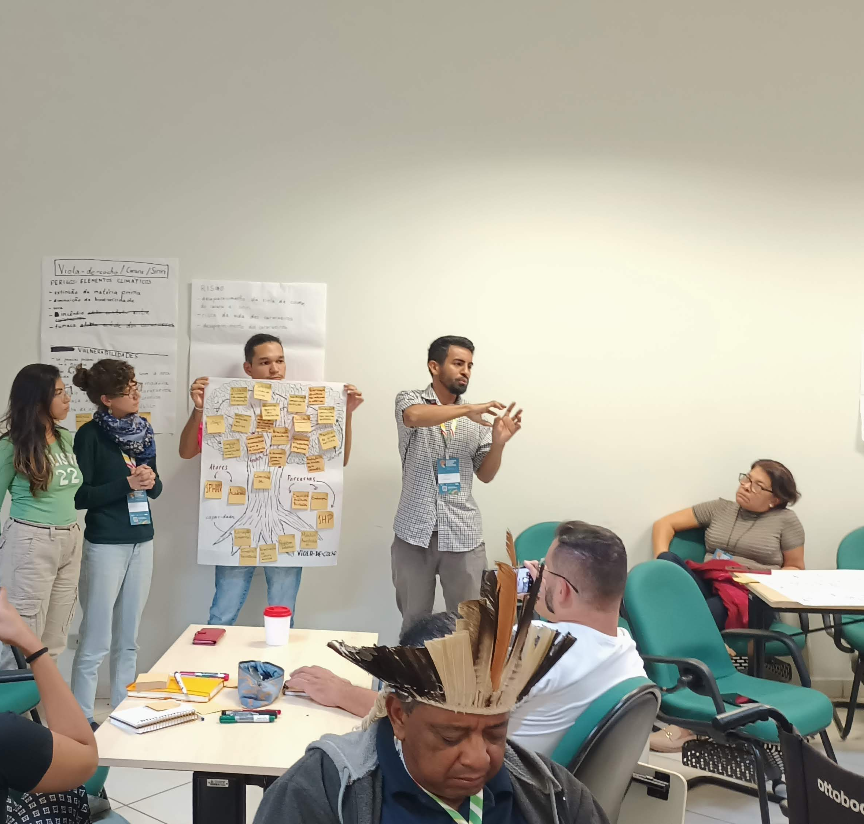
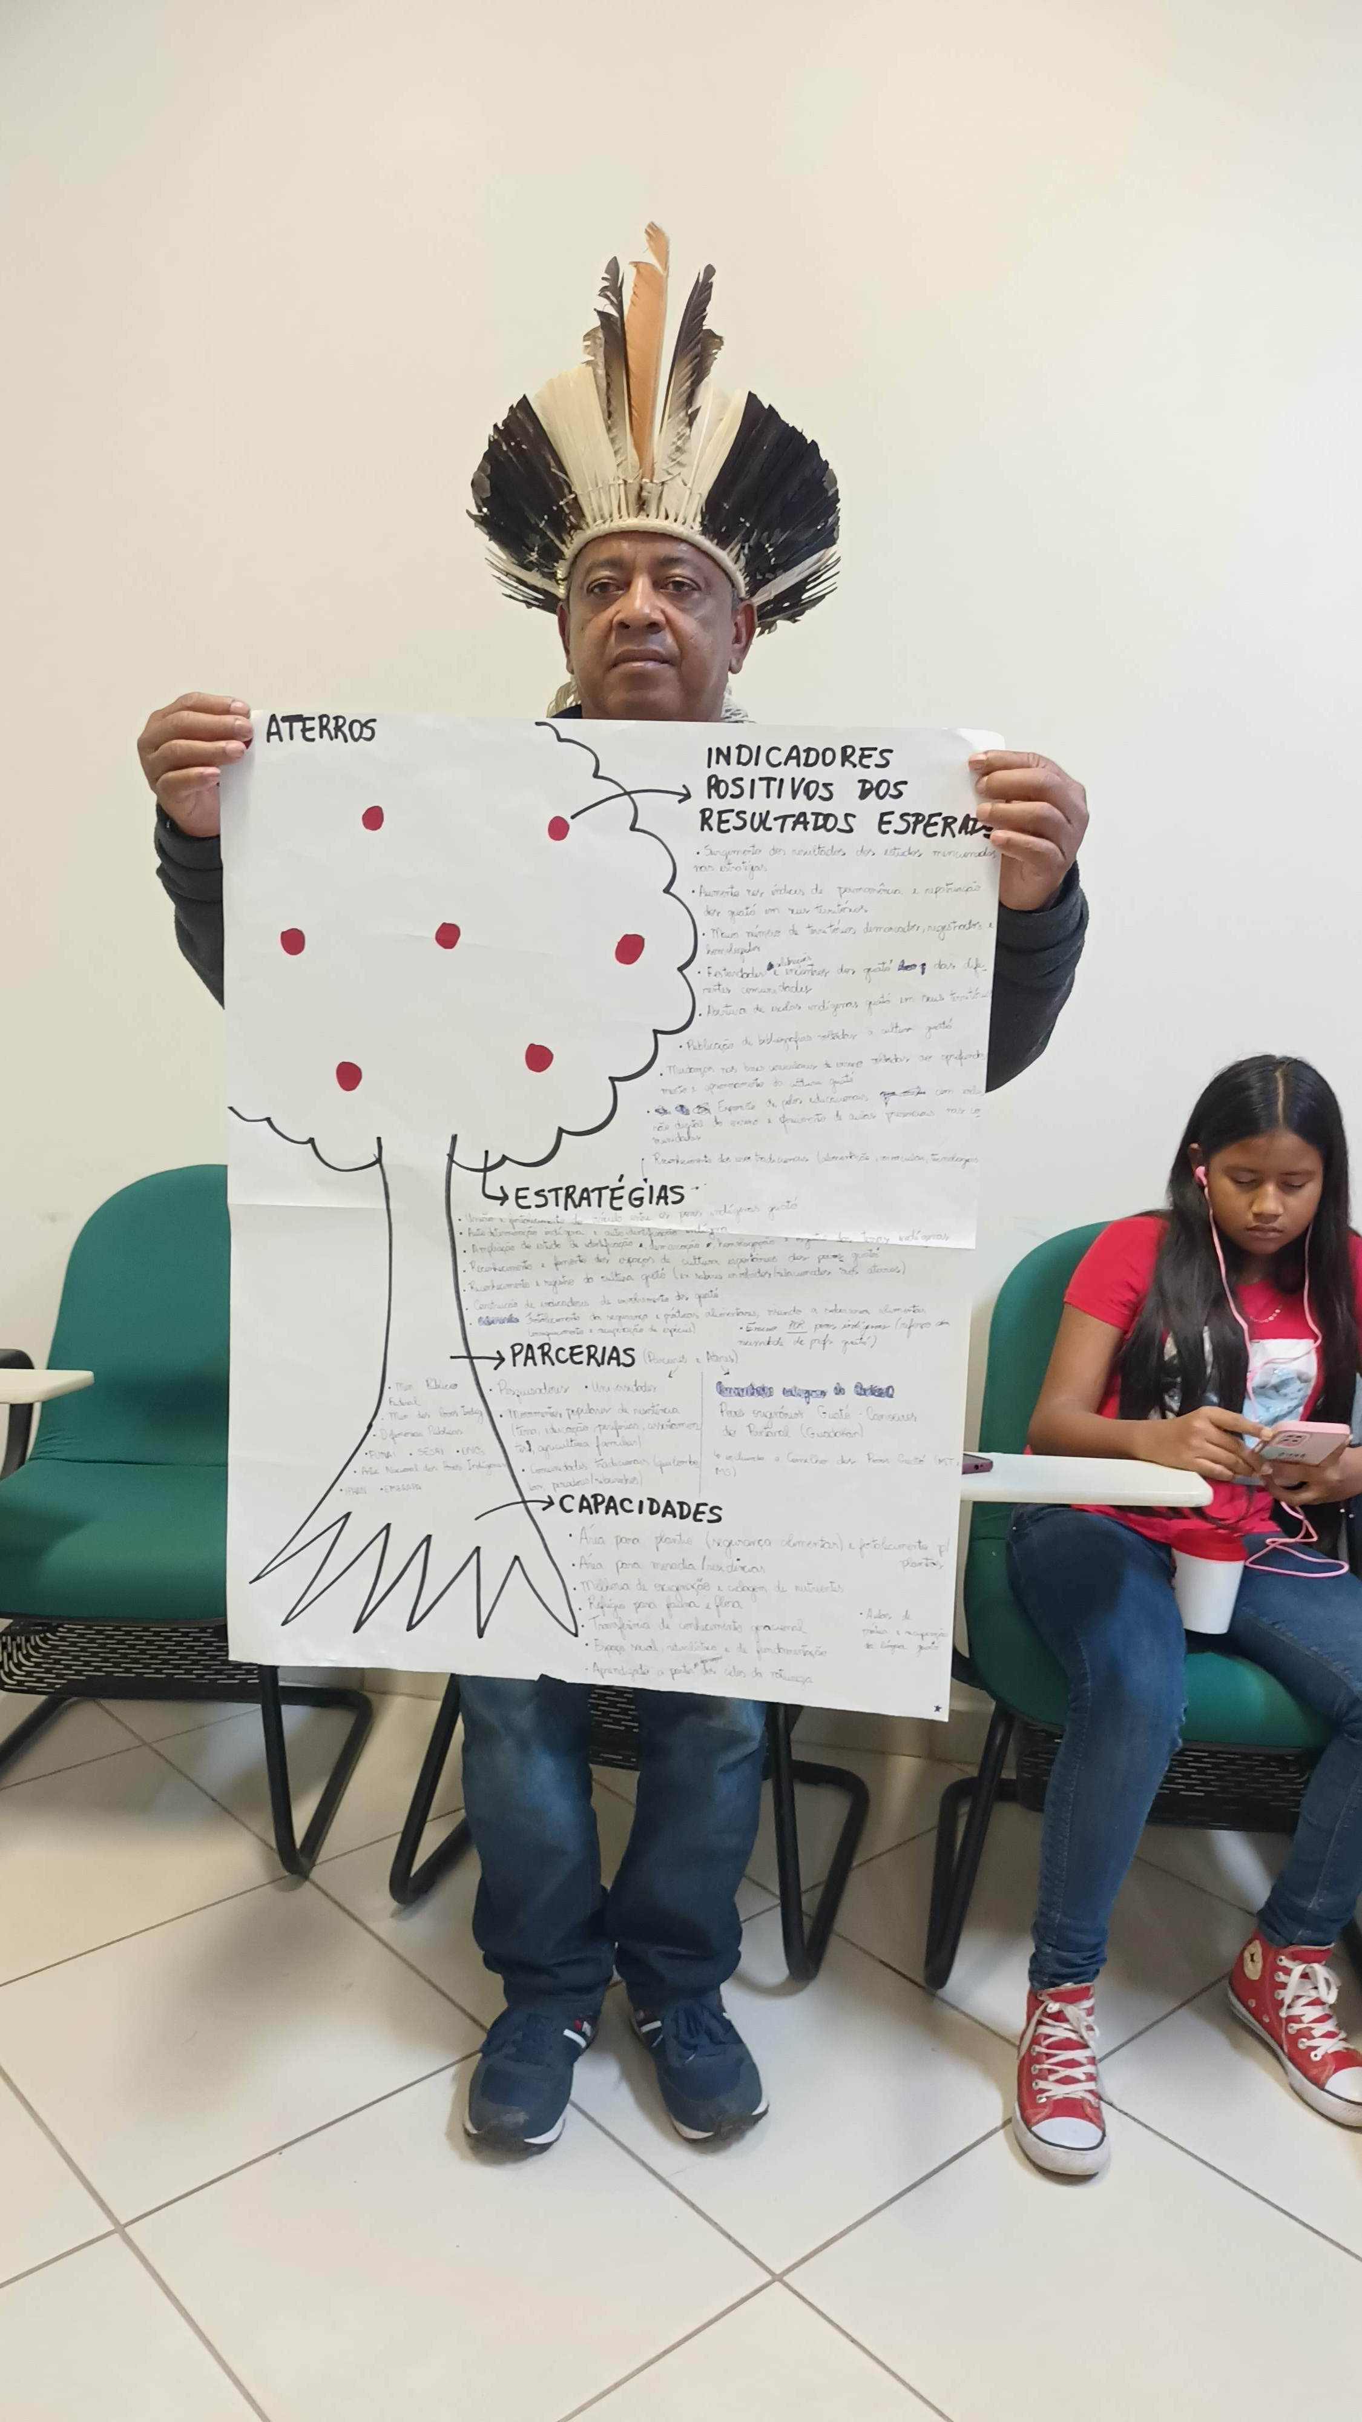
Workshop in the Pantanal – june. 2024

Slide 8
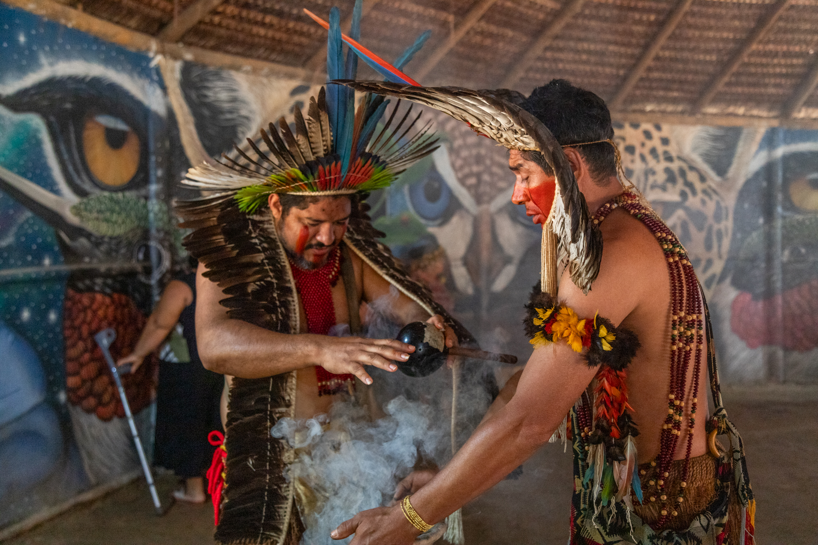
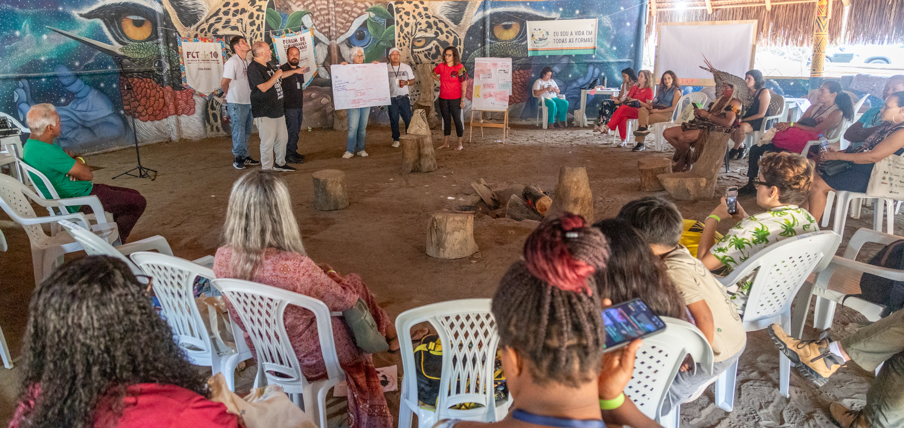
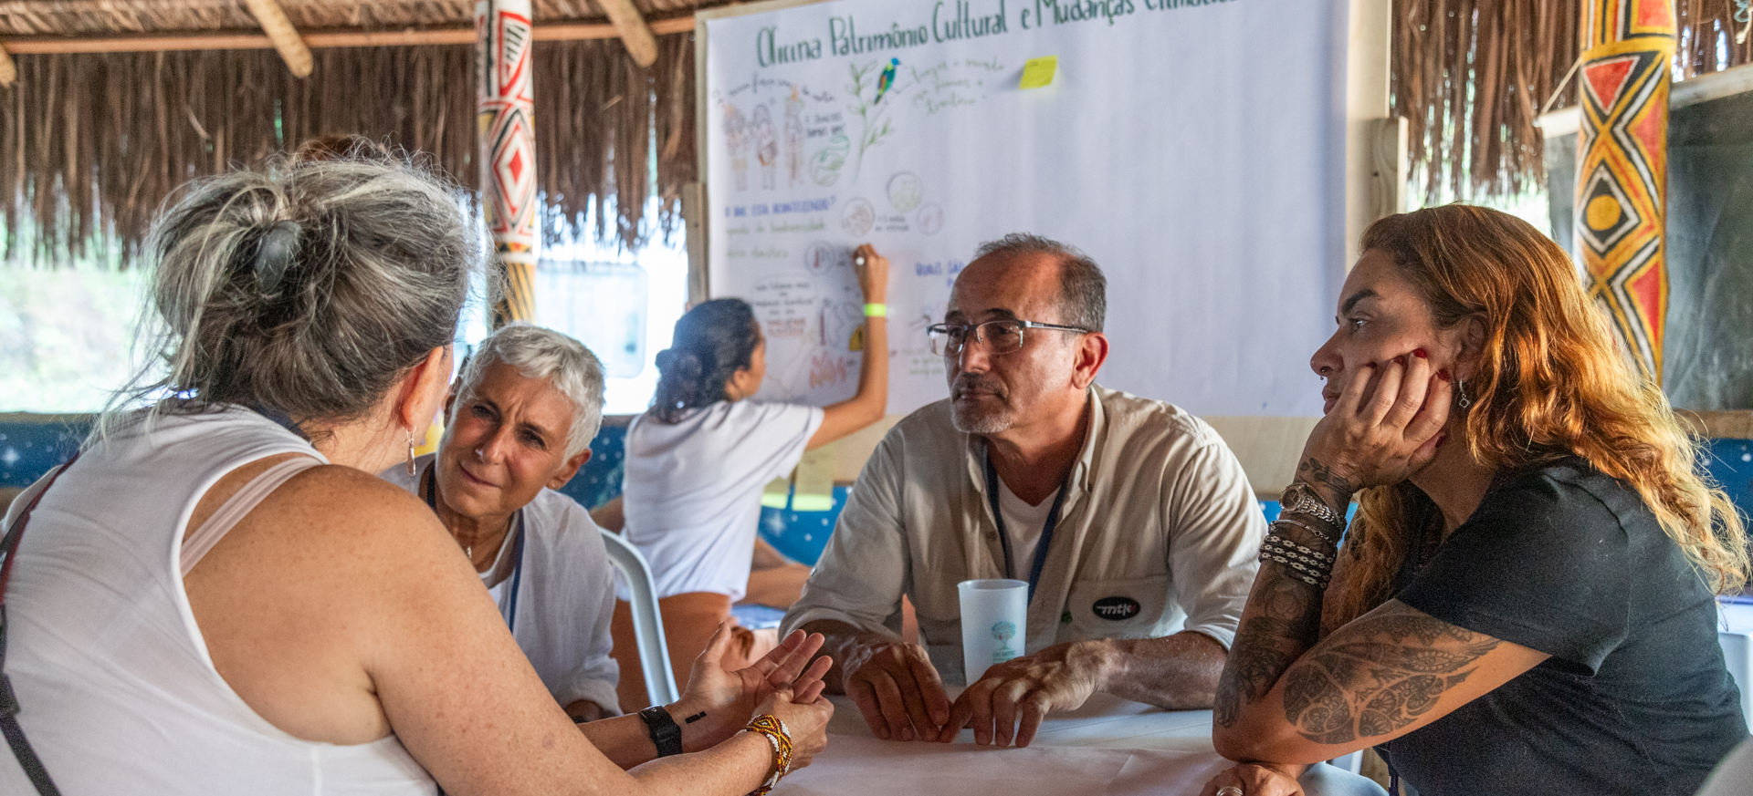
Workshop in
the Atlantic Forest
Sep. 2024

Slide 9
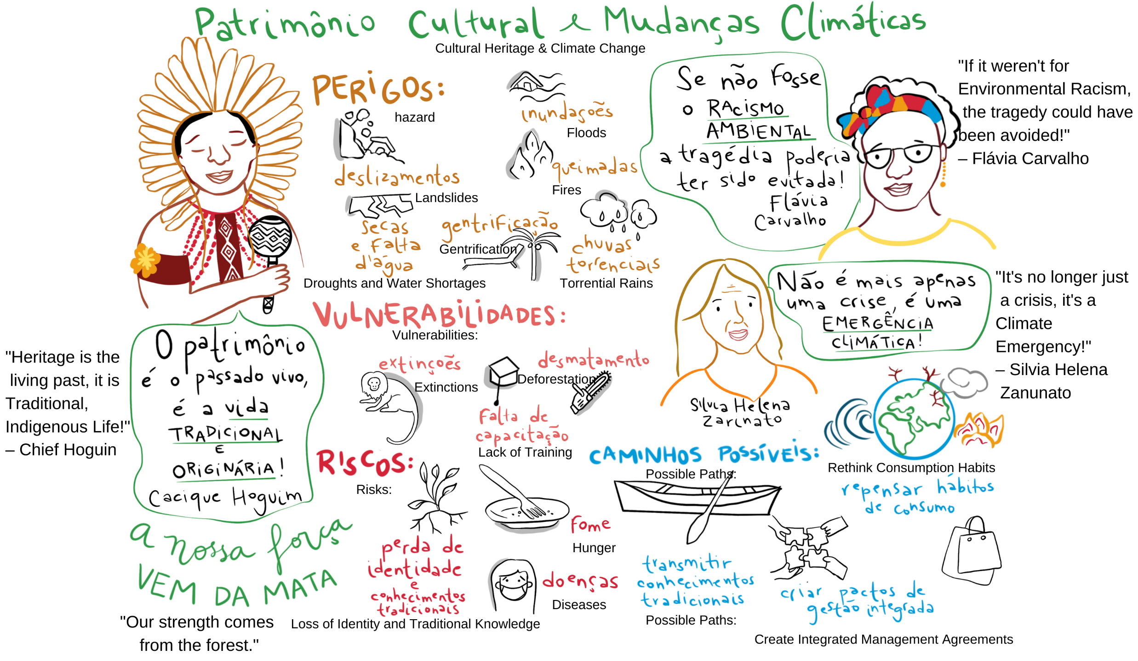
Example result:
key hazards,
vulnerabilities,
exposures
and risks

Slide 10
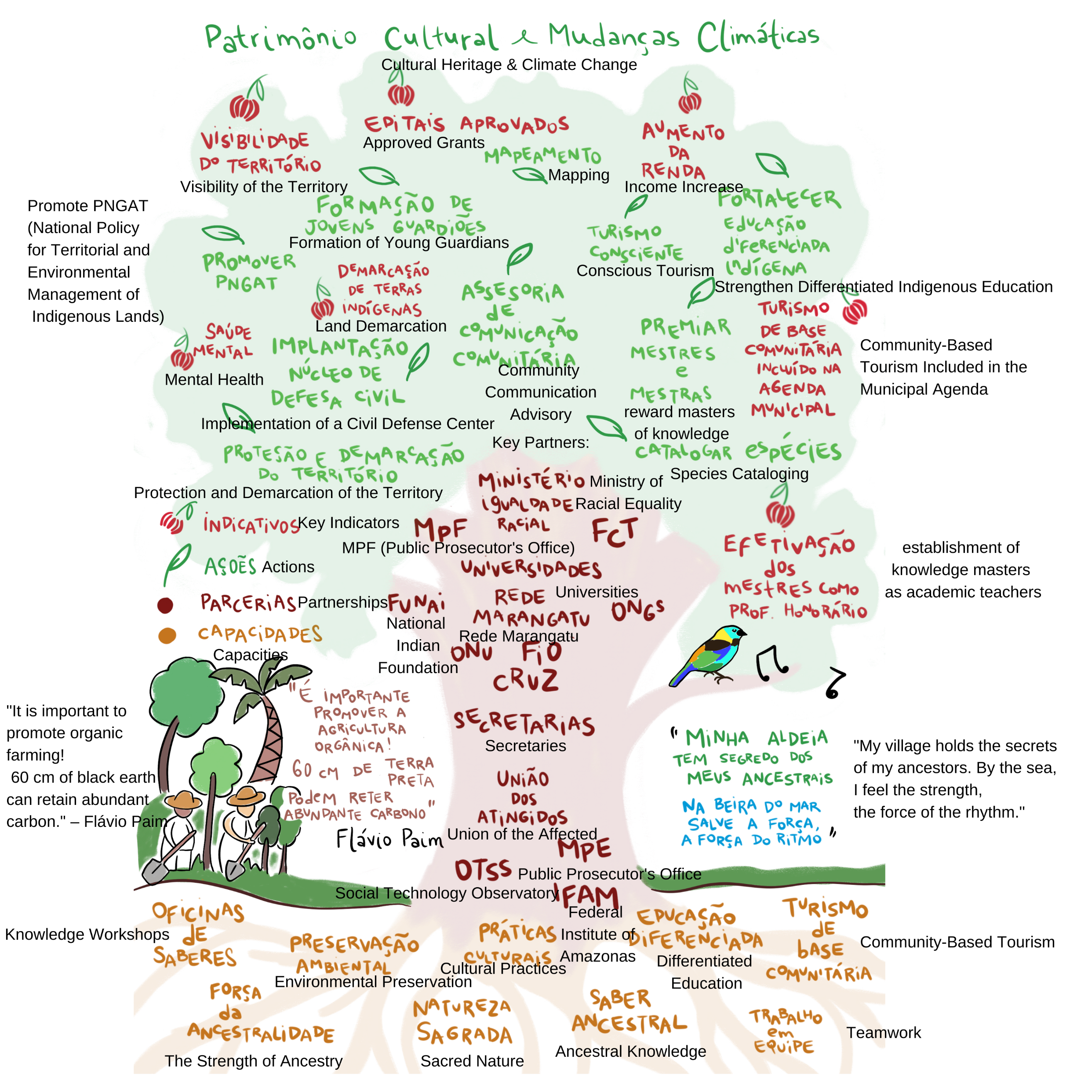
Example result:
main capabilities,
partnerships,
actions and
outcome

Slide 11
The idea is to identify the impacts of climate change on cultural heritage from the perspective of the people directly involved and to seek solutions in traditional practices themselves, optimized by new technologies.

Slide 12
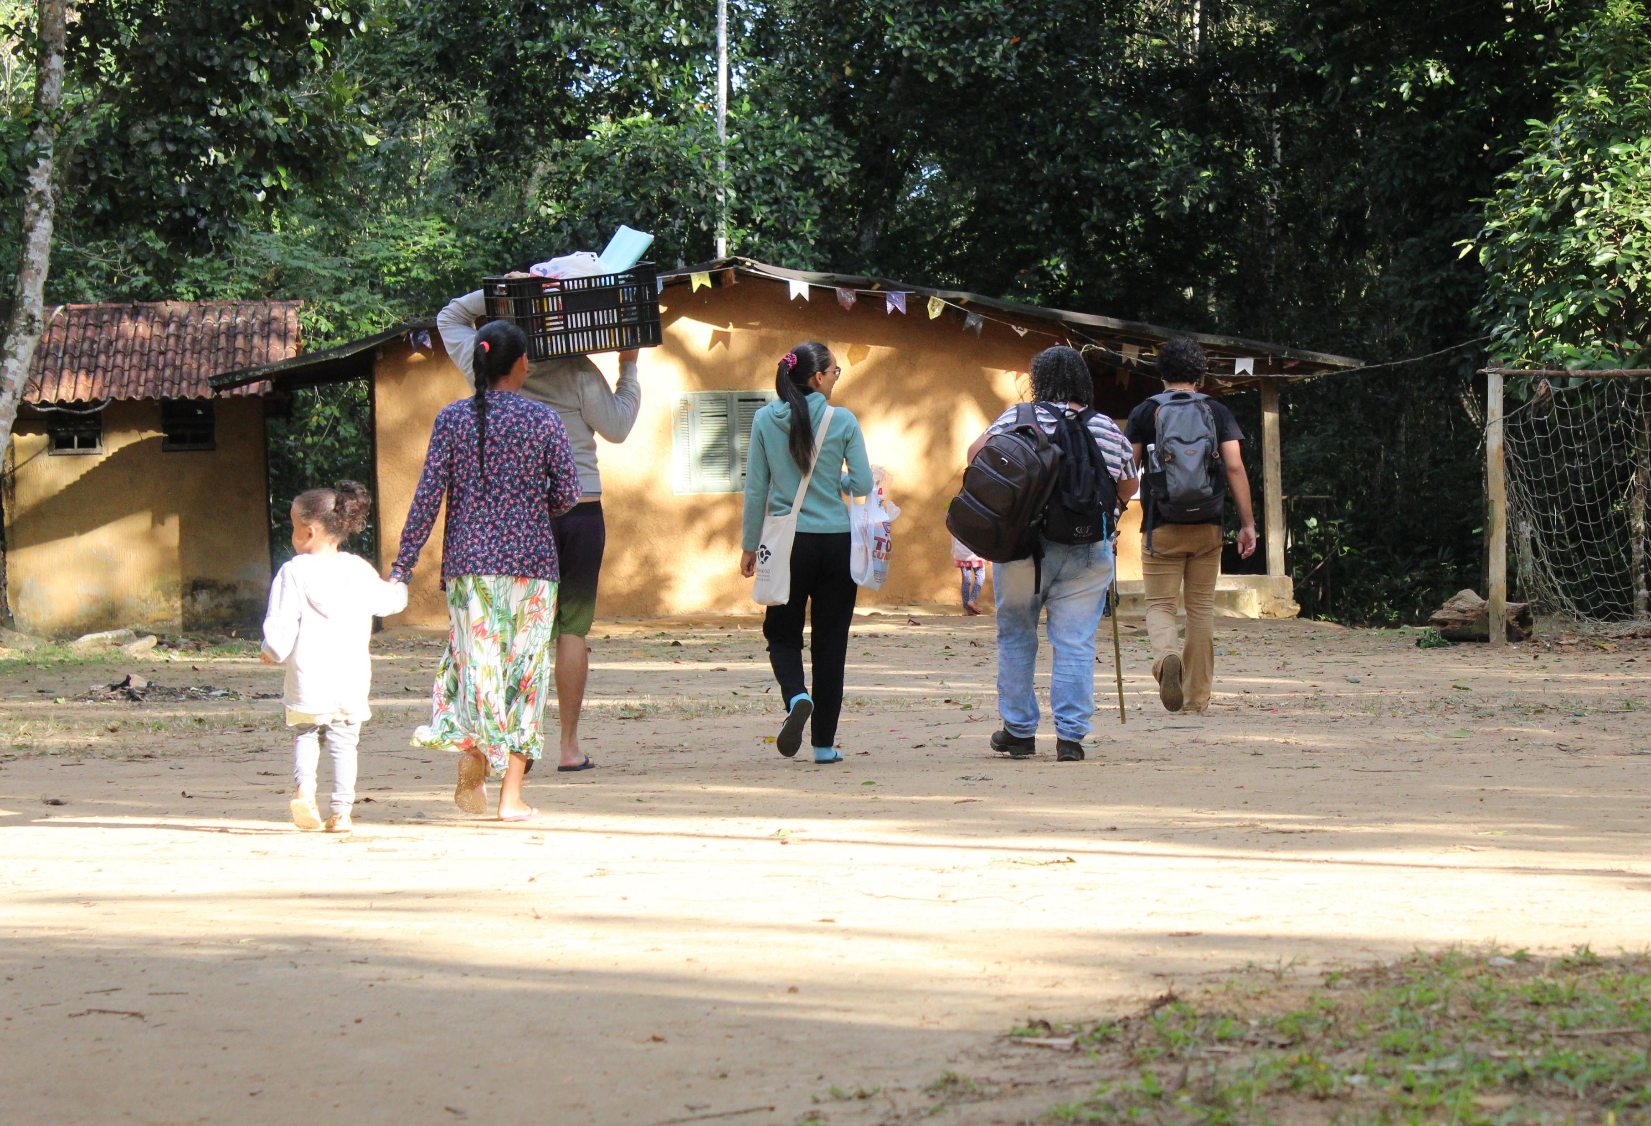
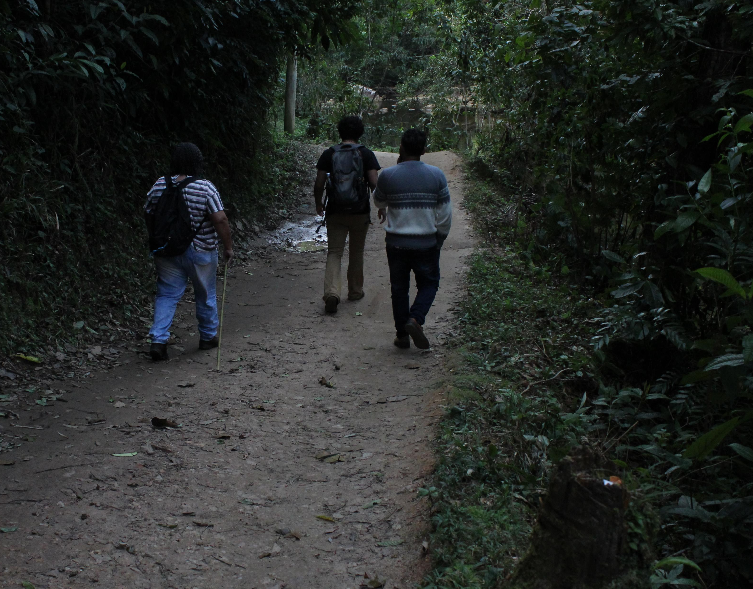
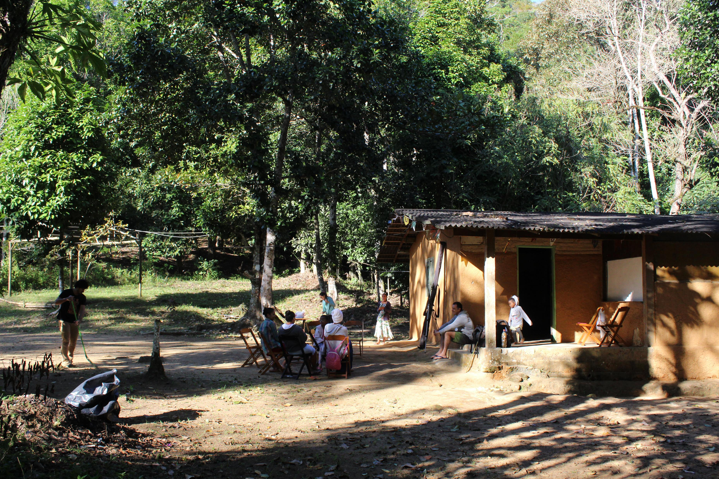
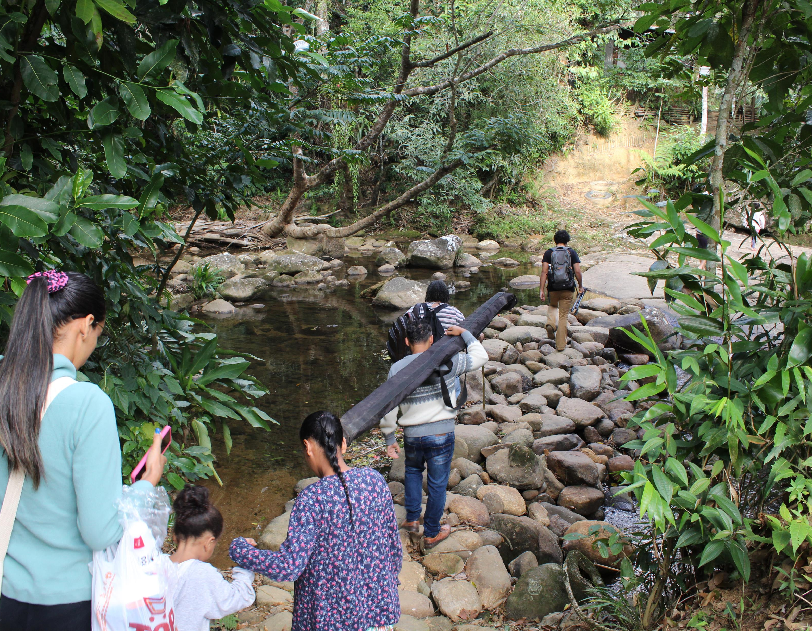
Quilombola community of Camburi in Ubatuba

Slide 13
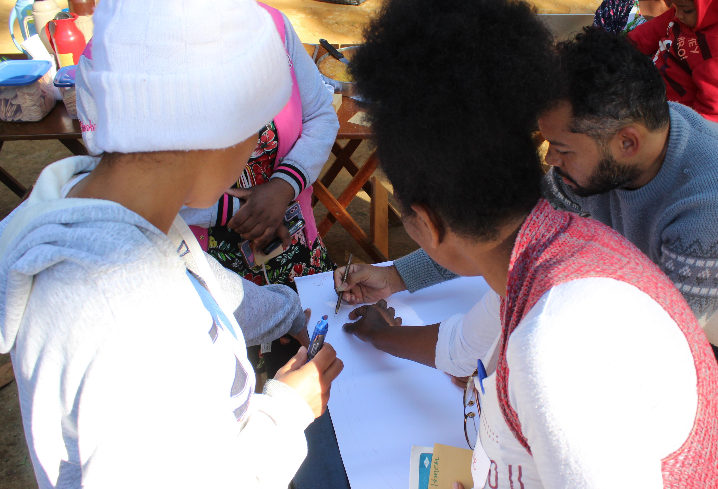
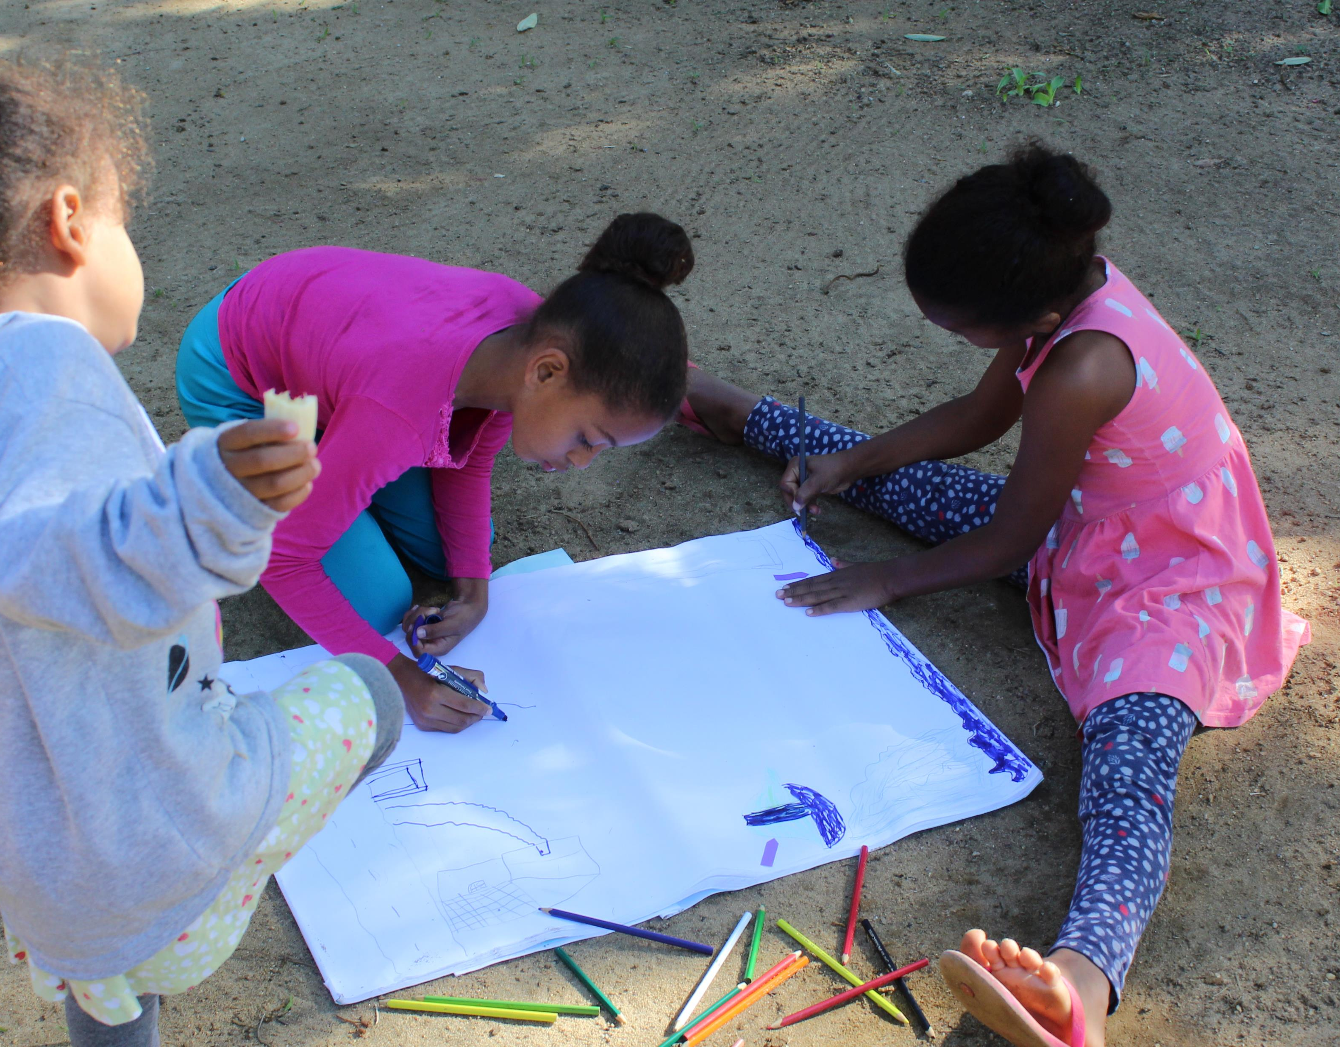
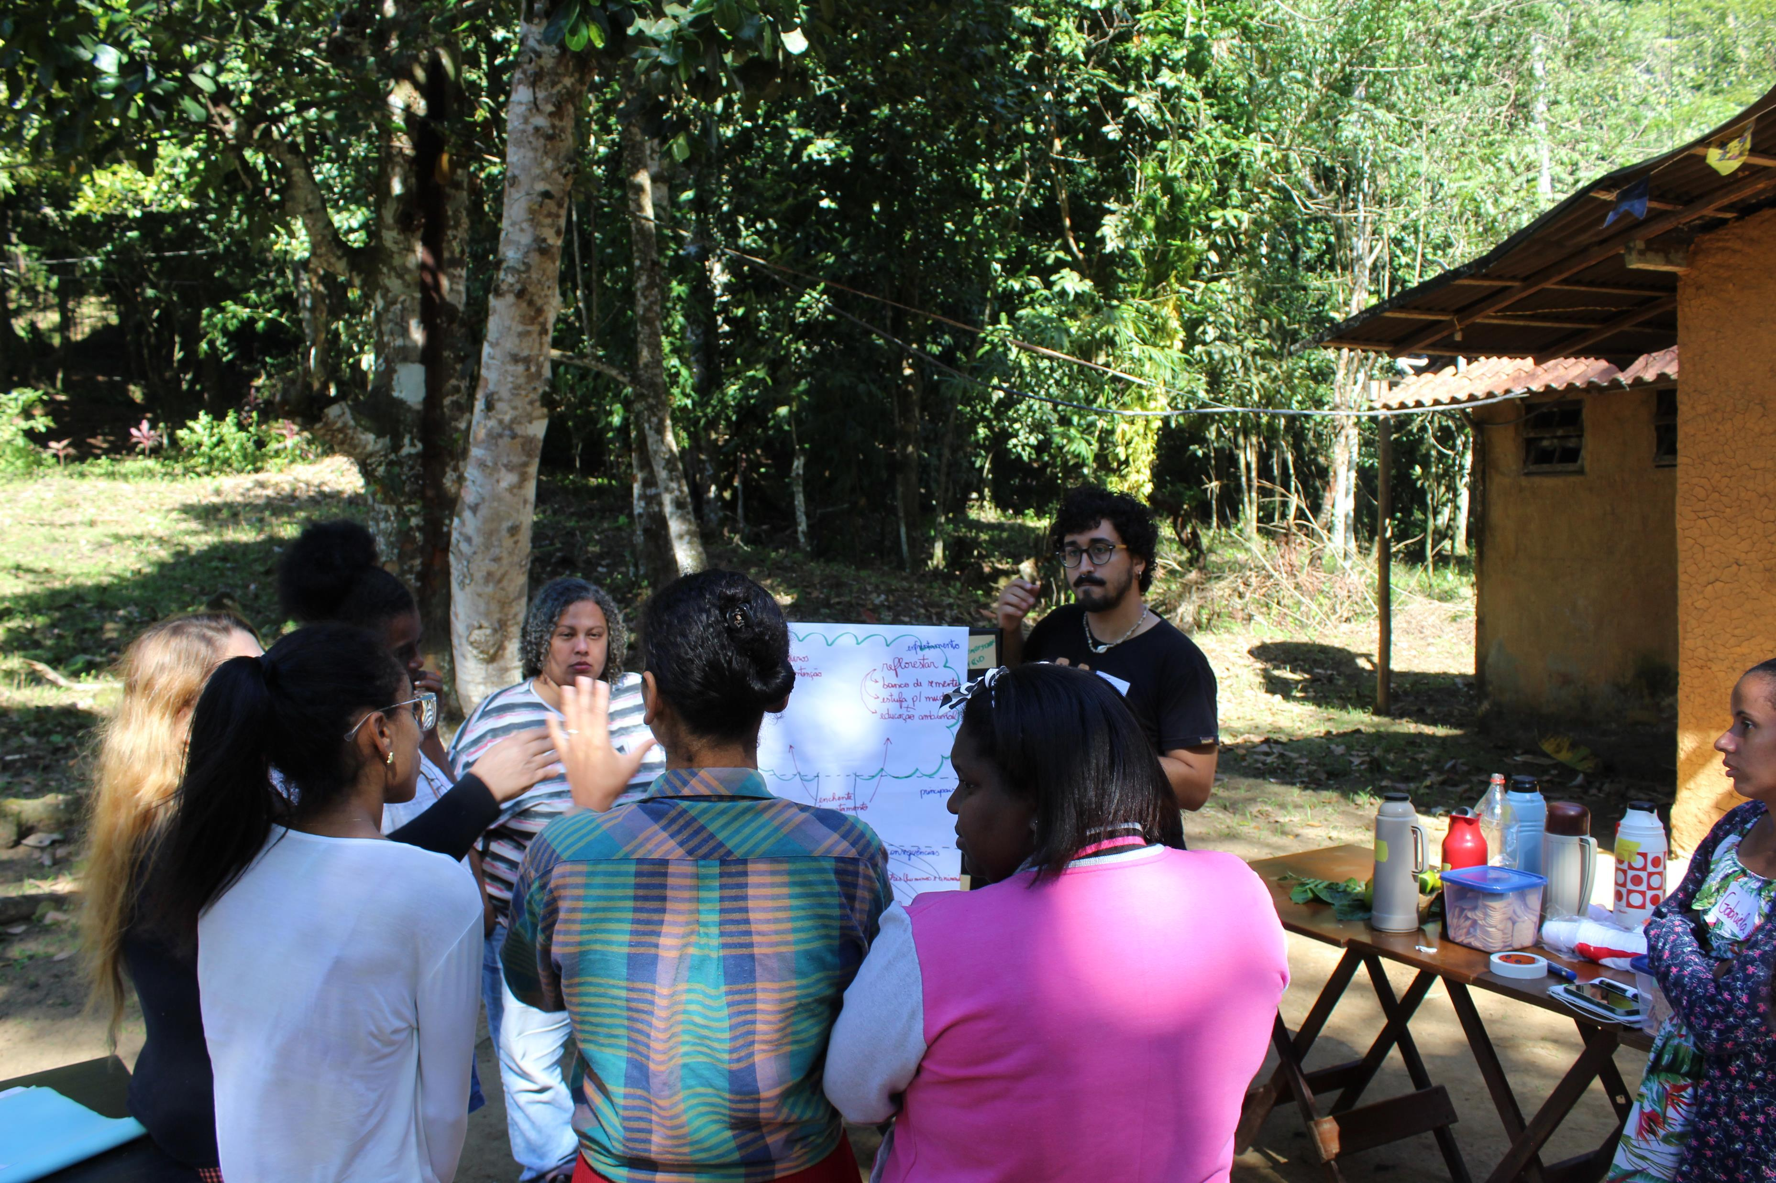
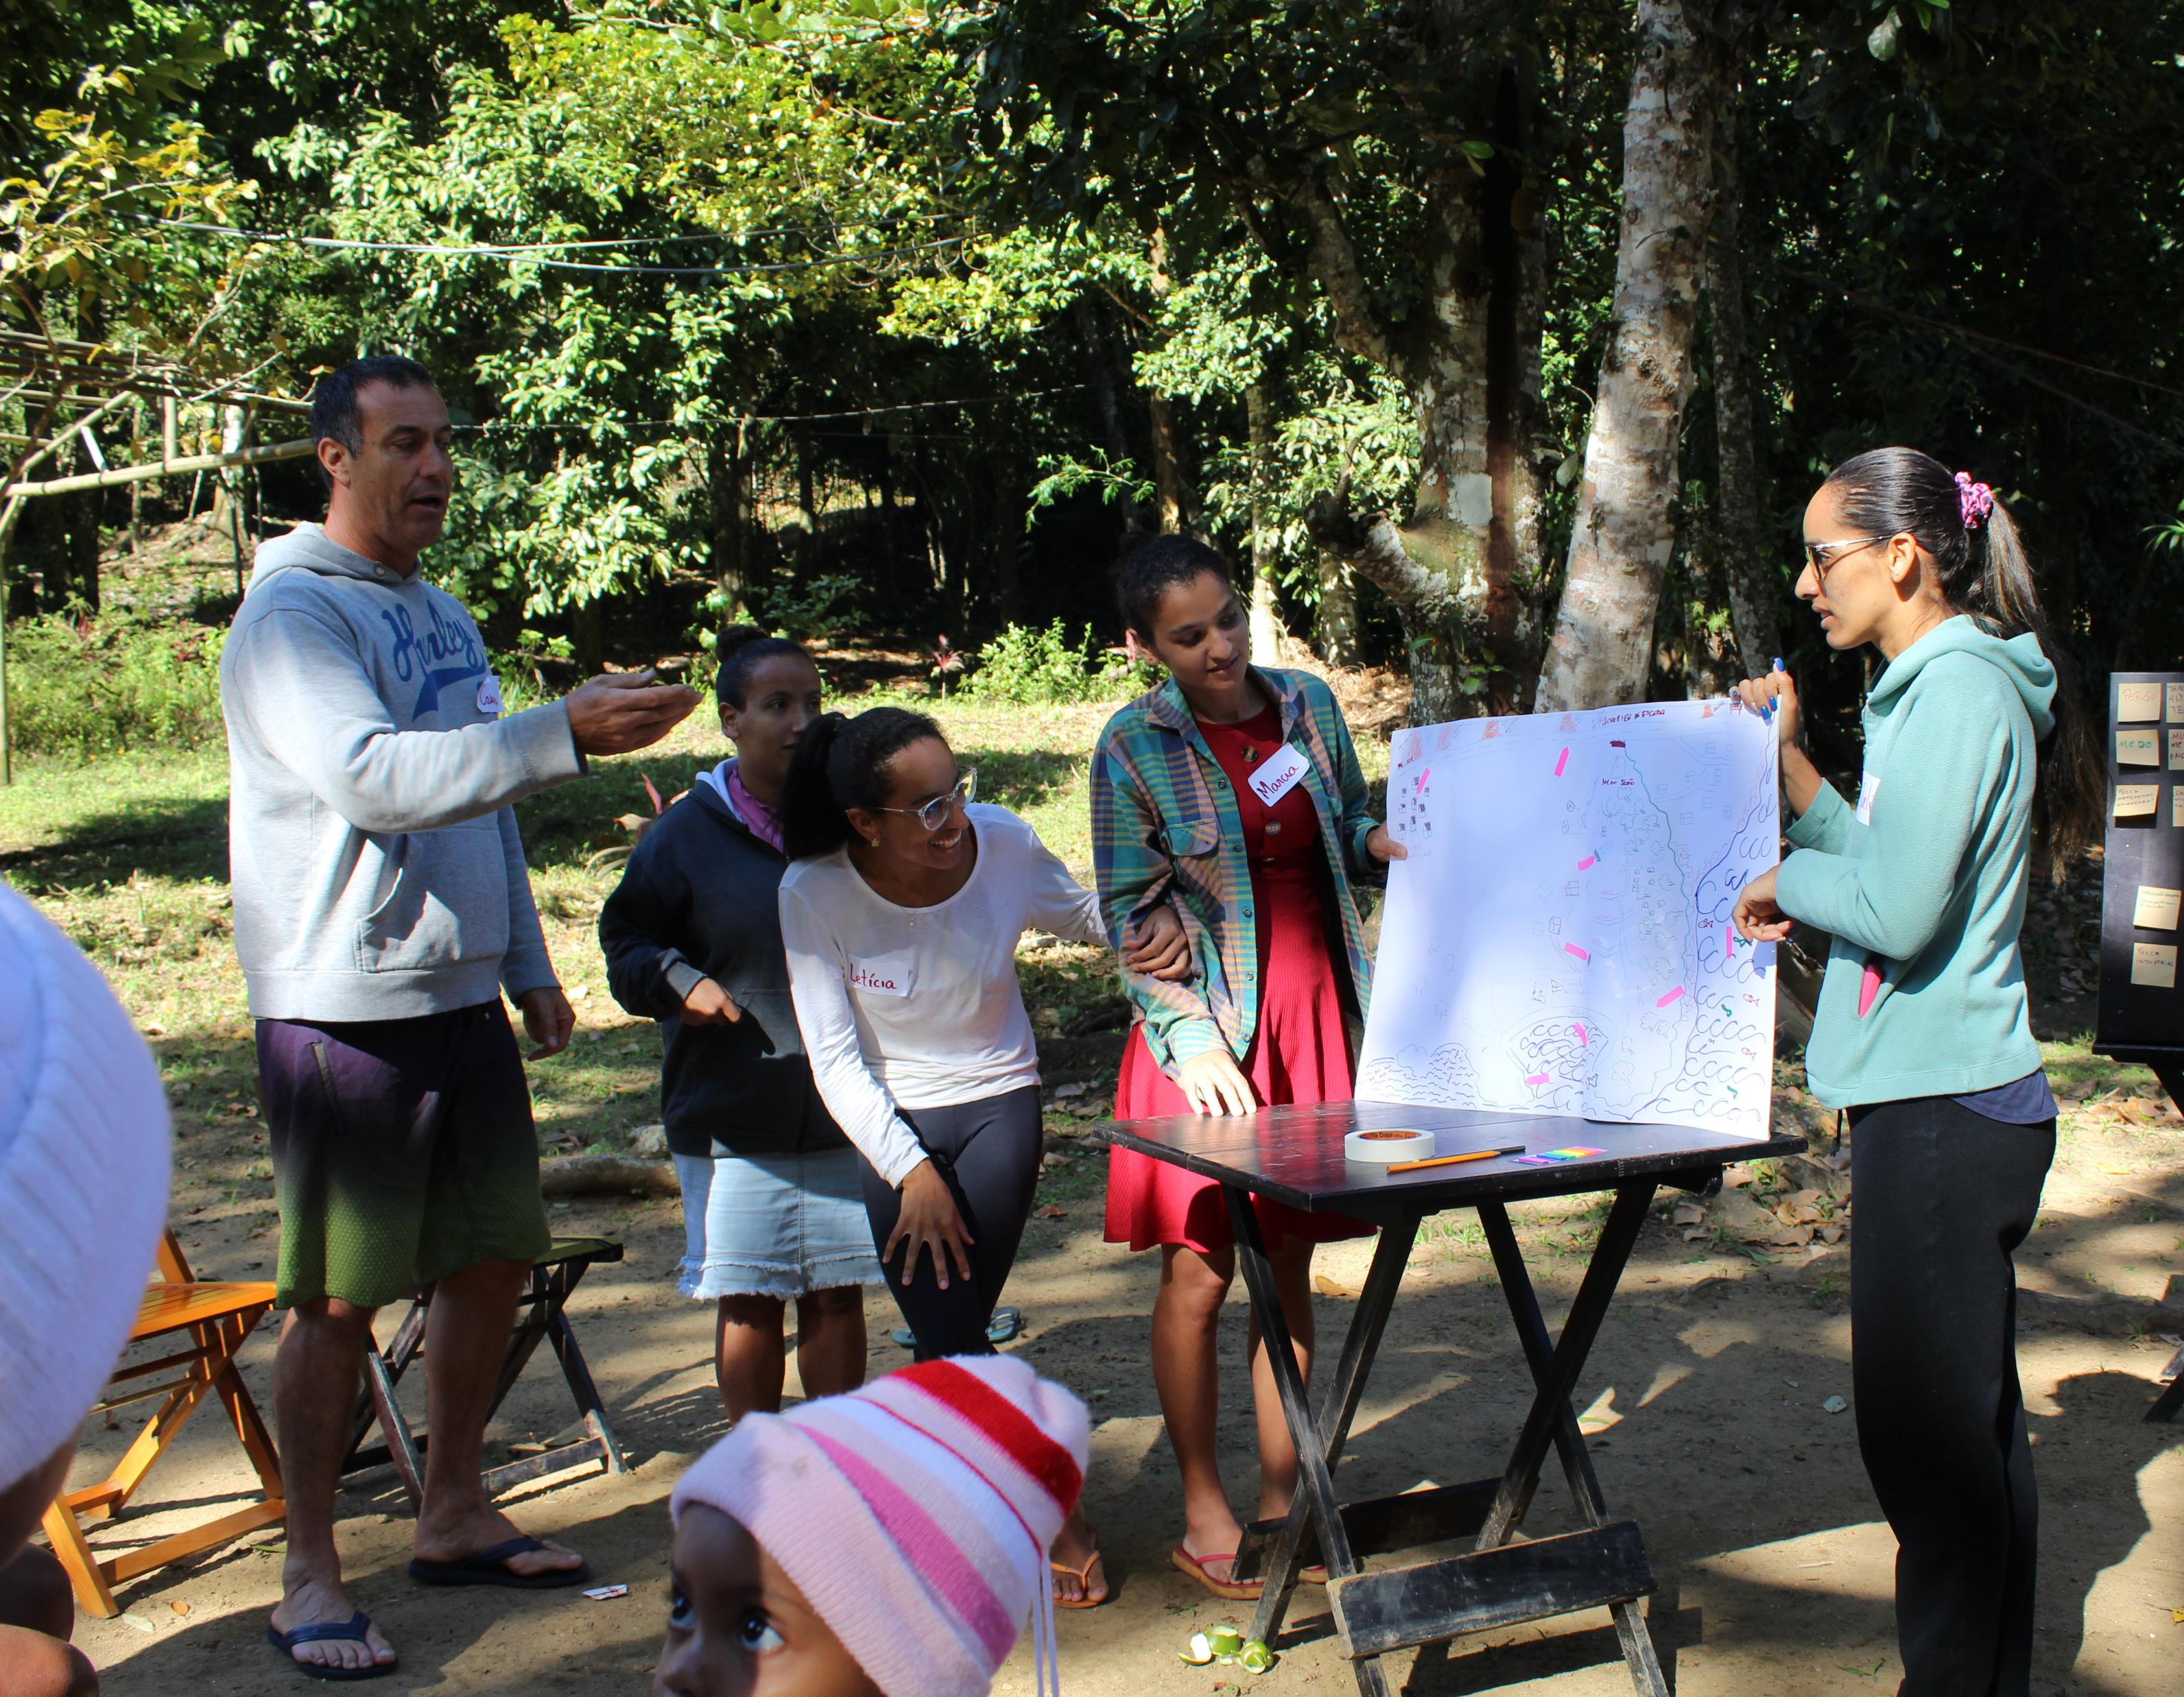
Quilombola community of Camburi in Ubatuba

Slide 14
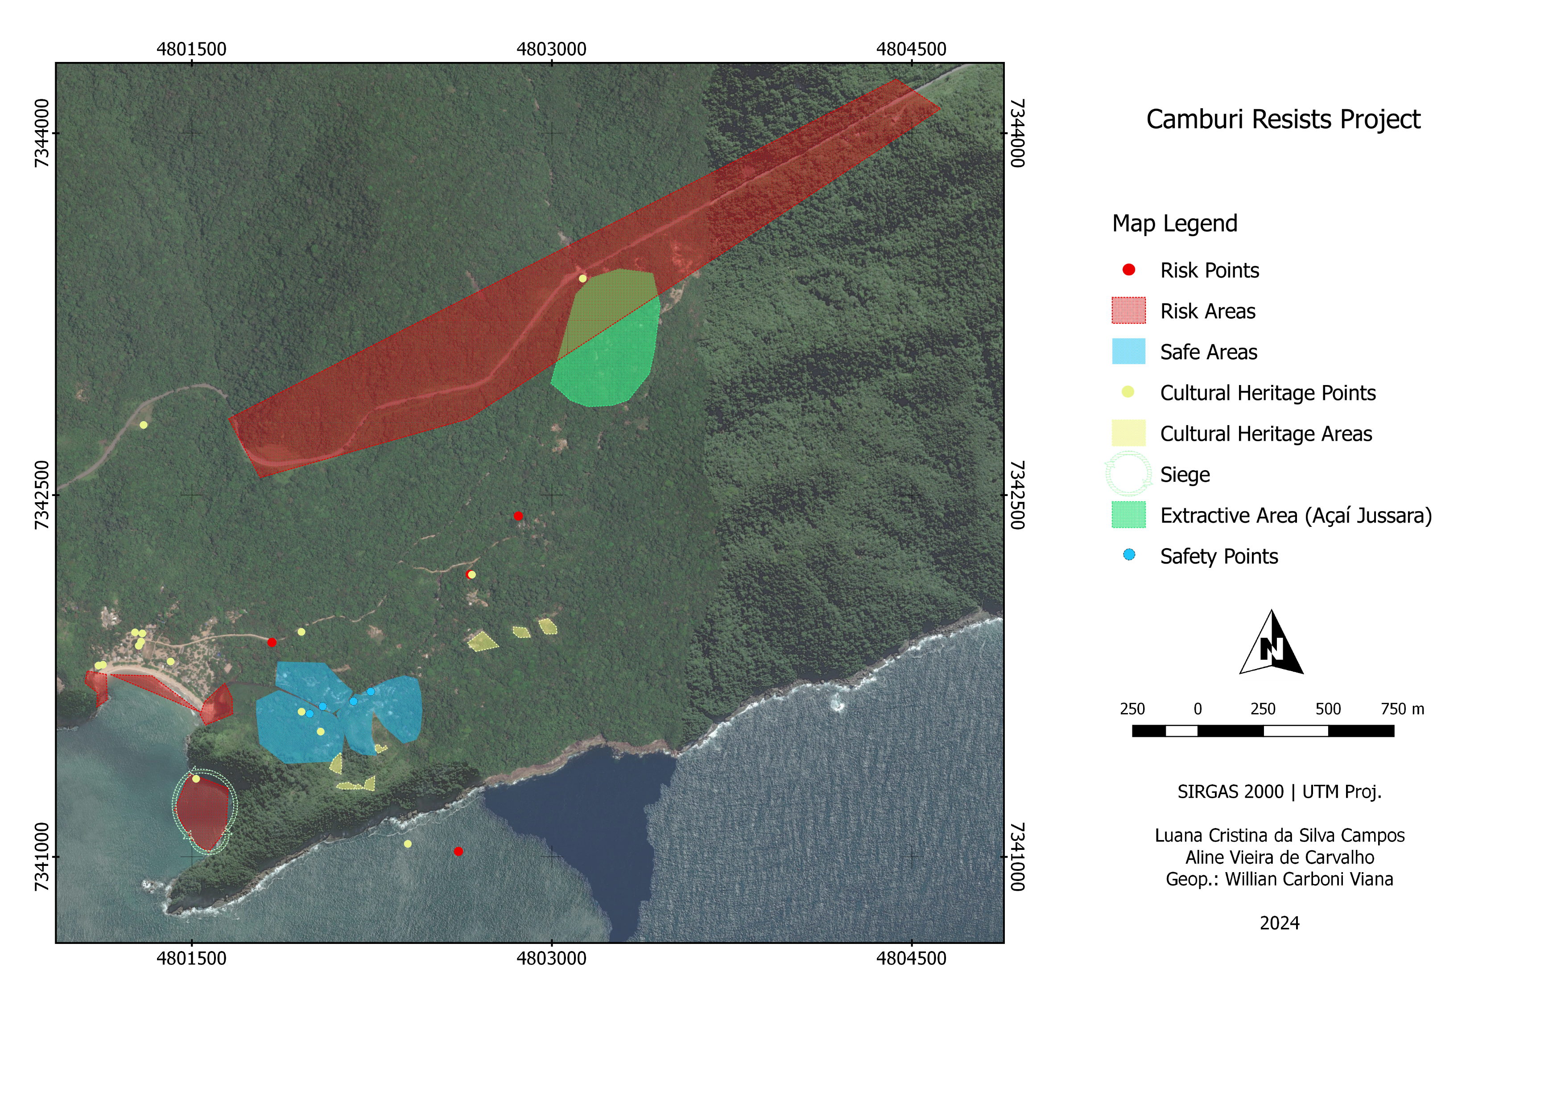

Slide 15
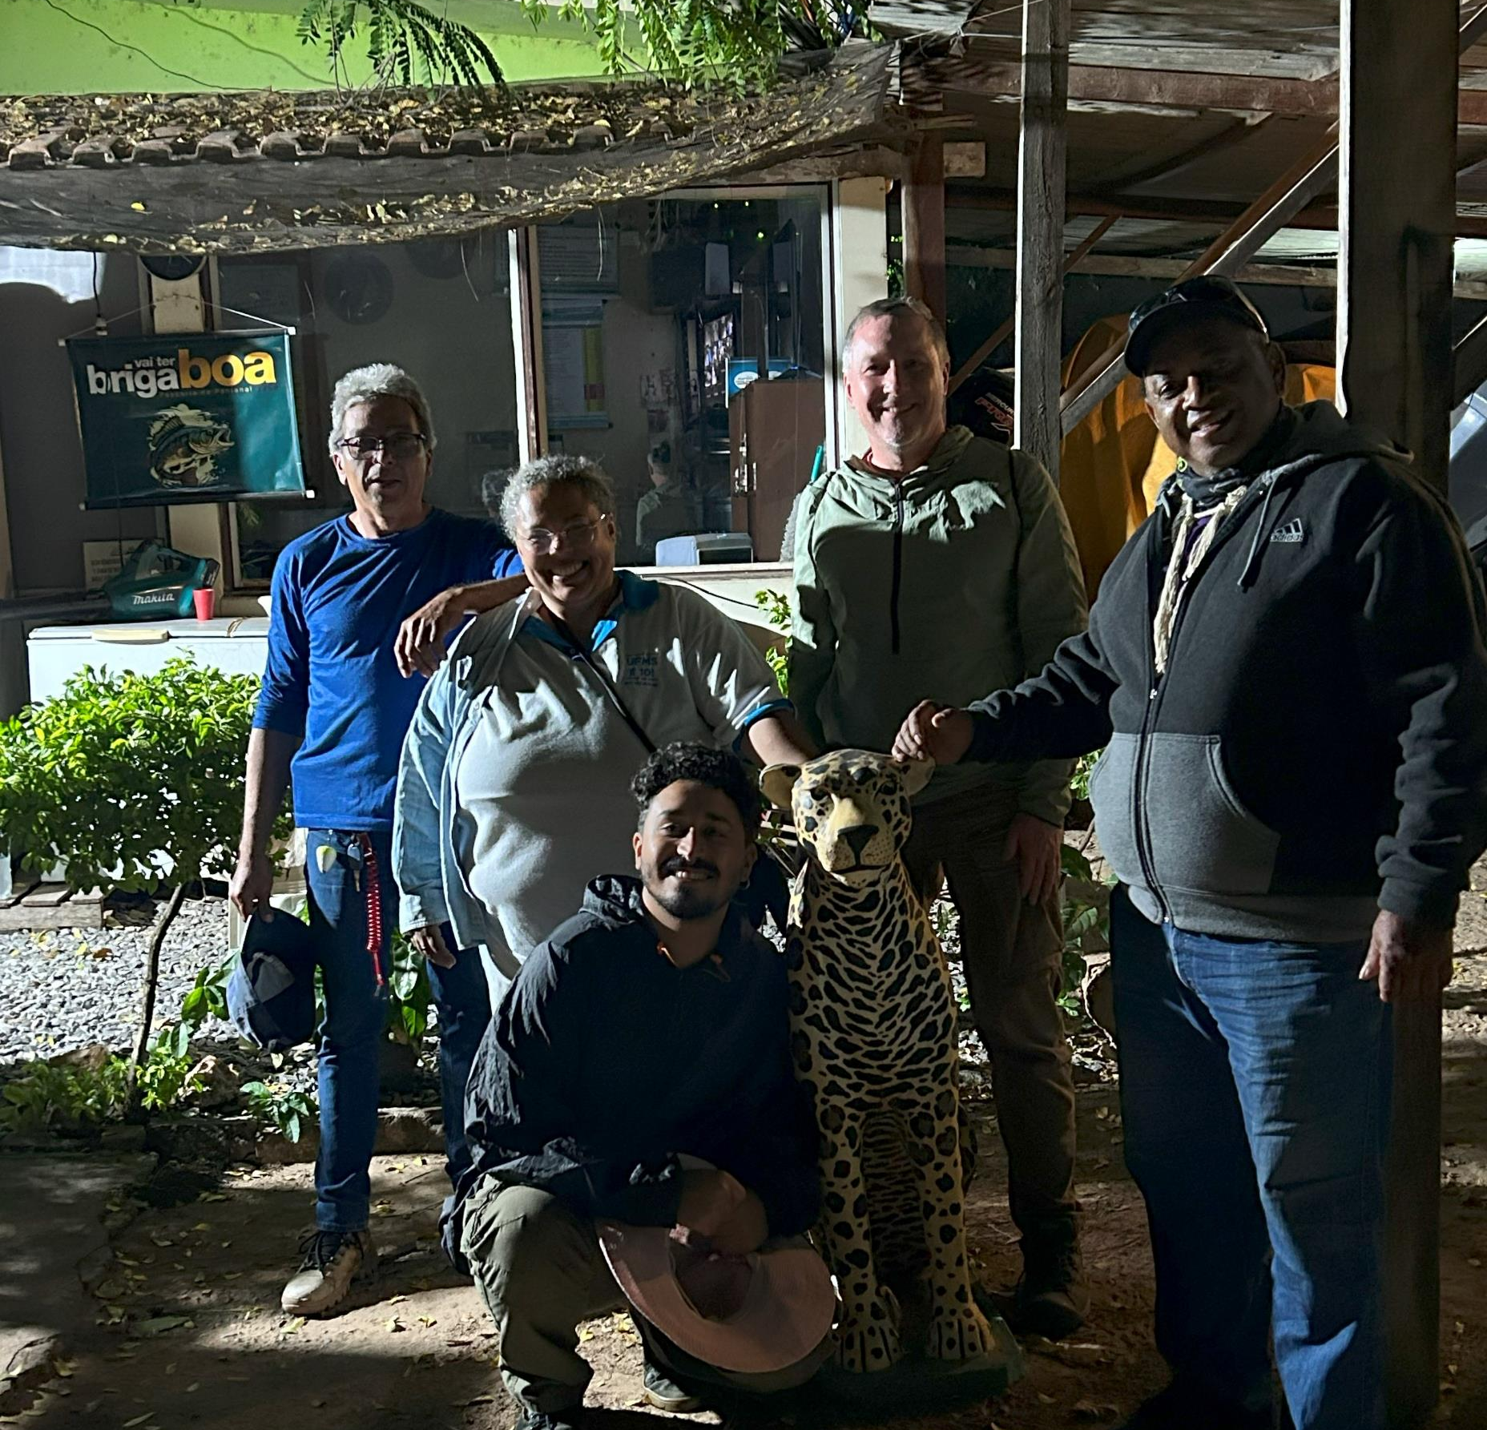
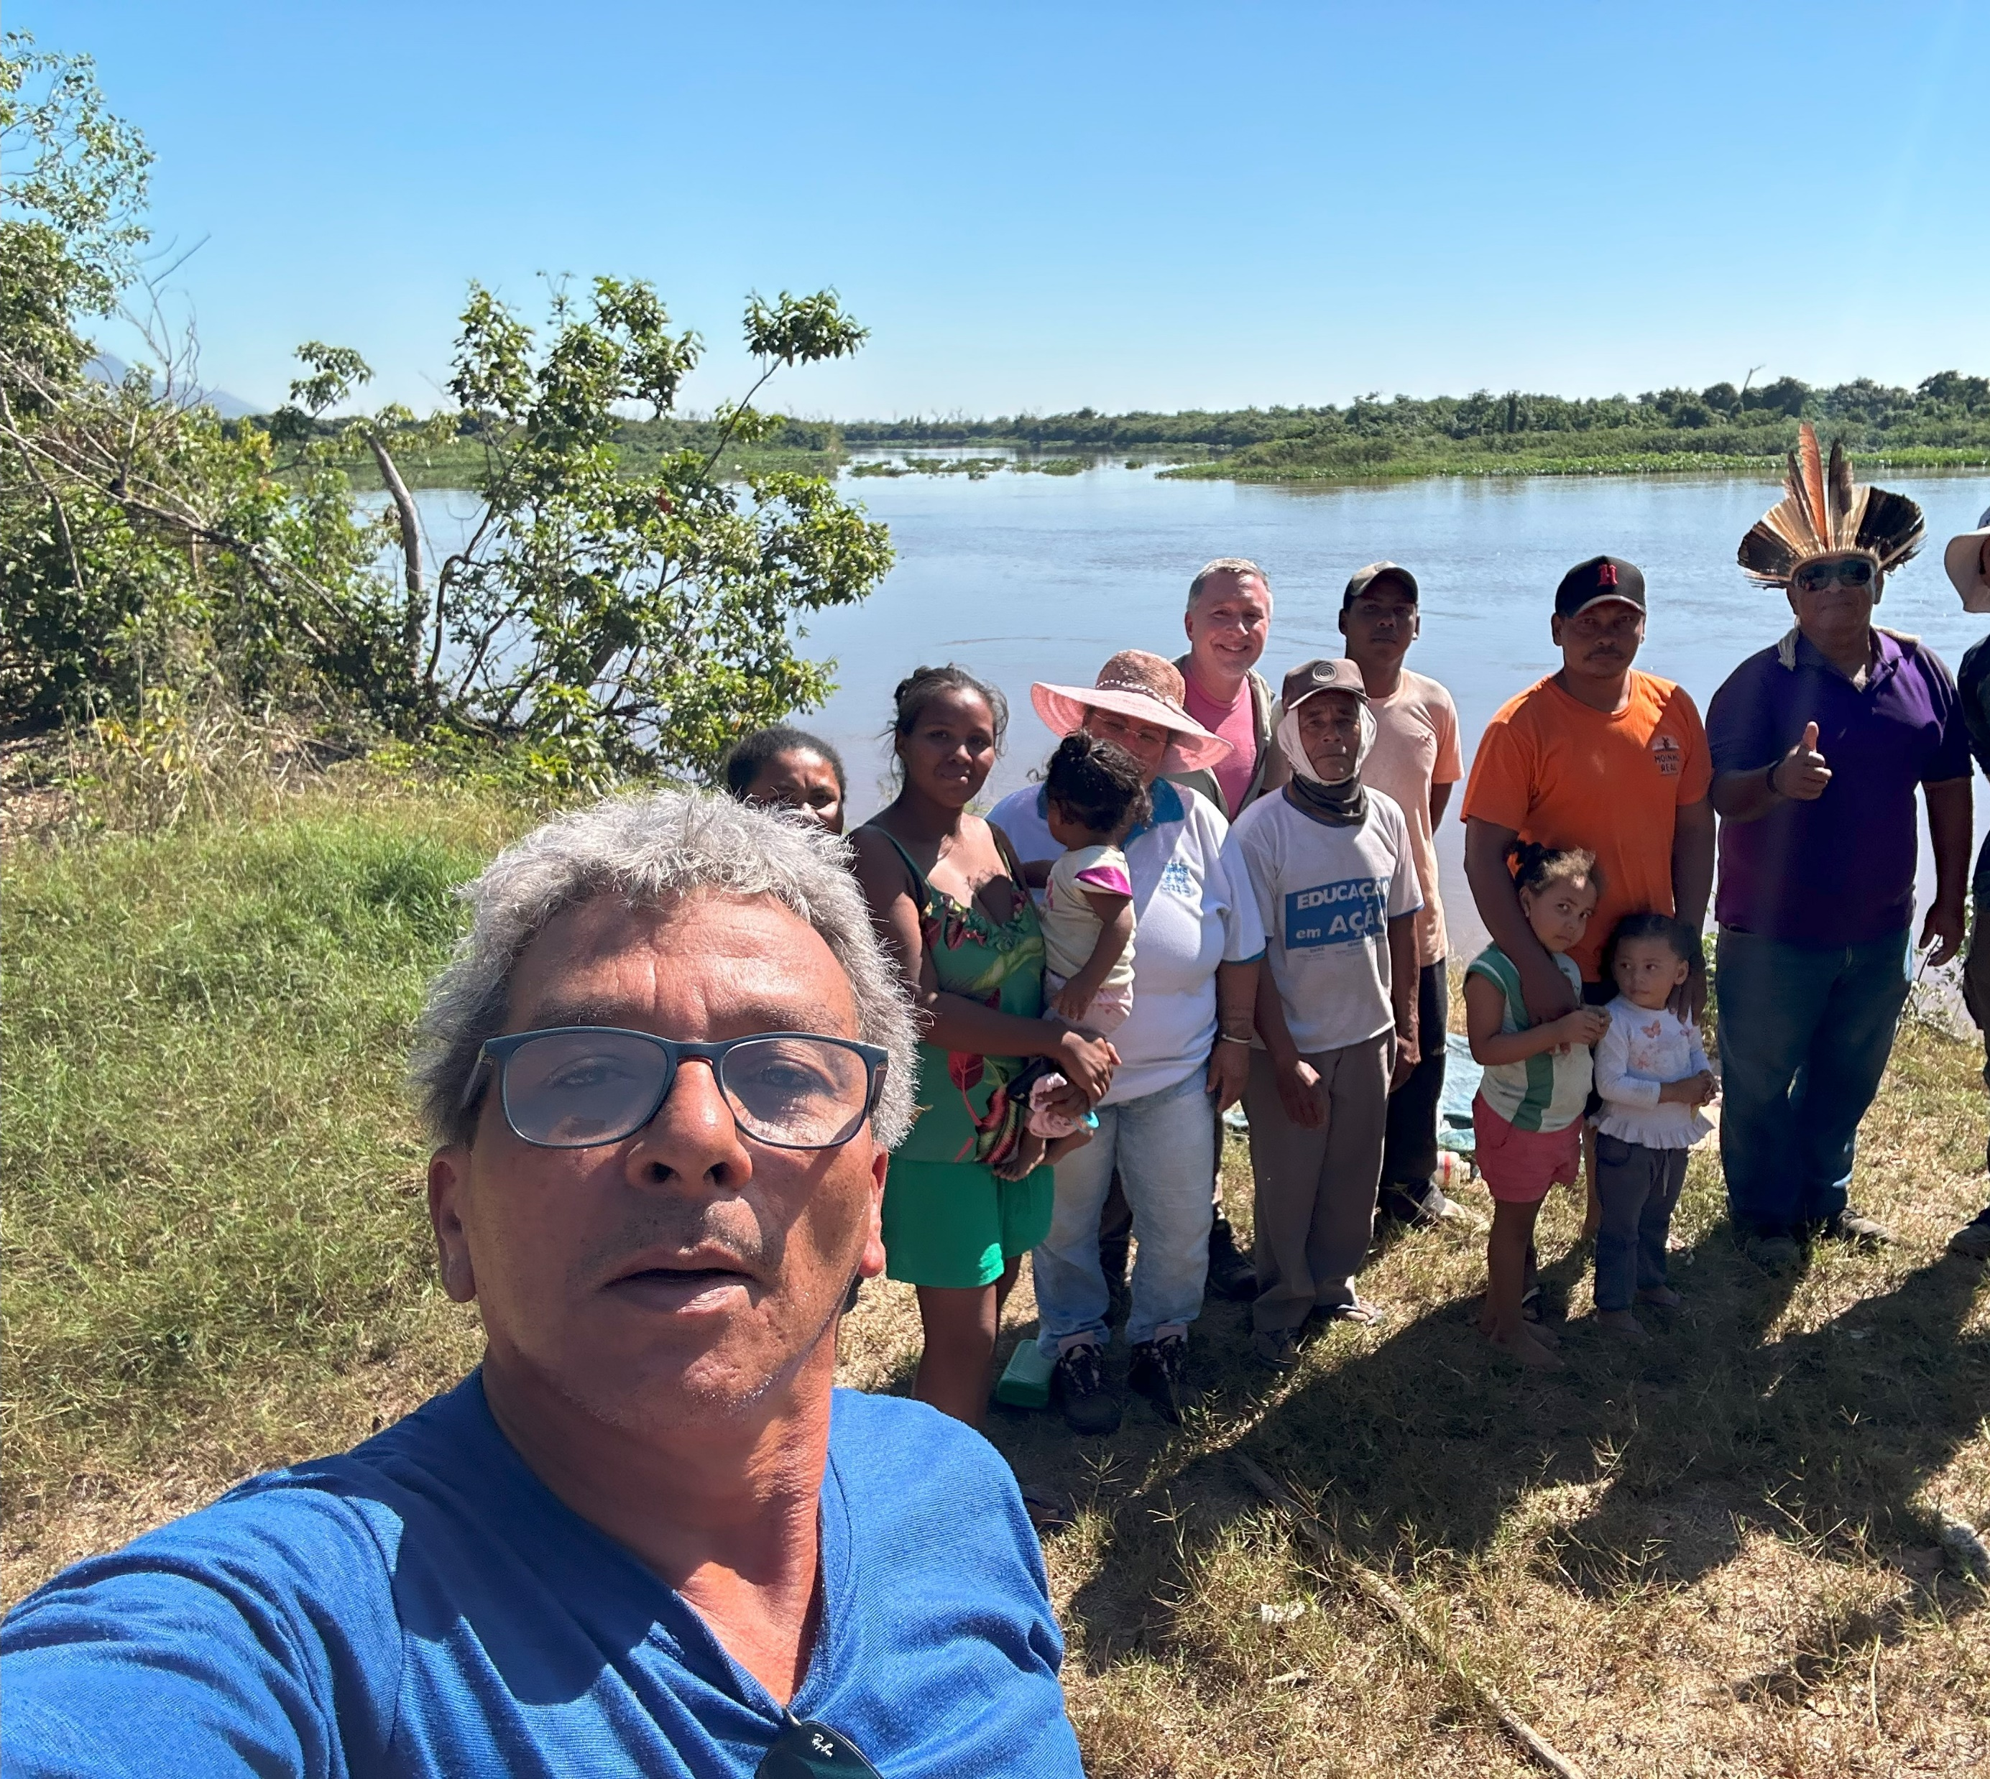
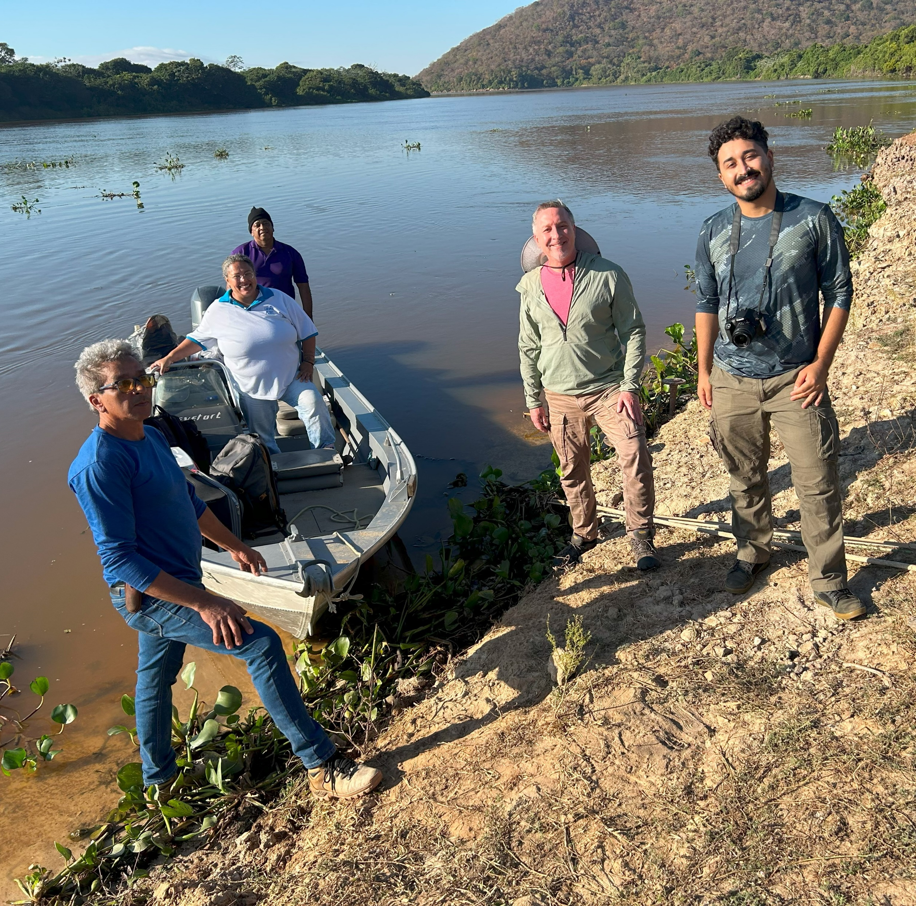
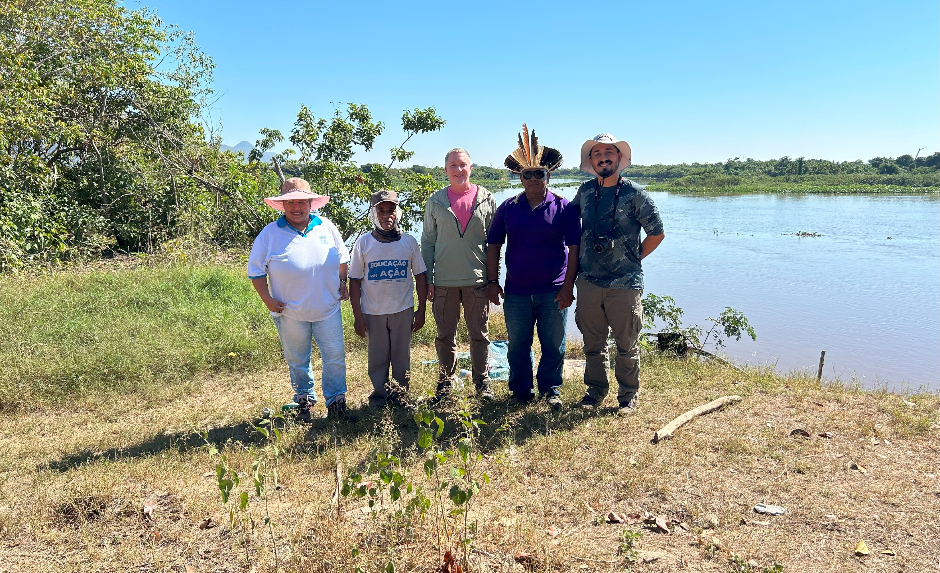
Guatós Indigenous community in the Pantanal of Mato Grosso do Sul

Slide 16
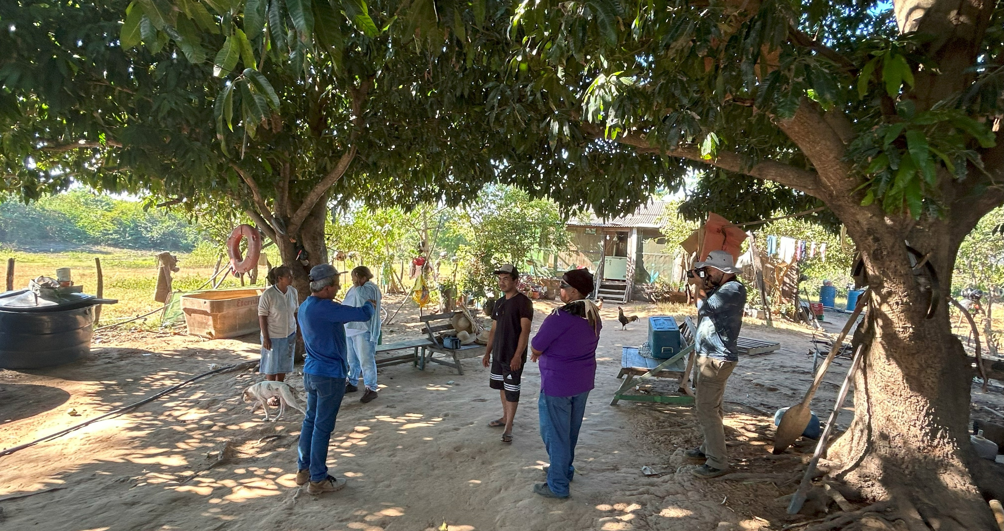
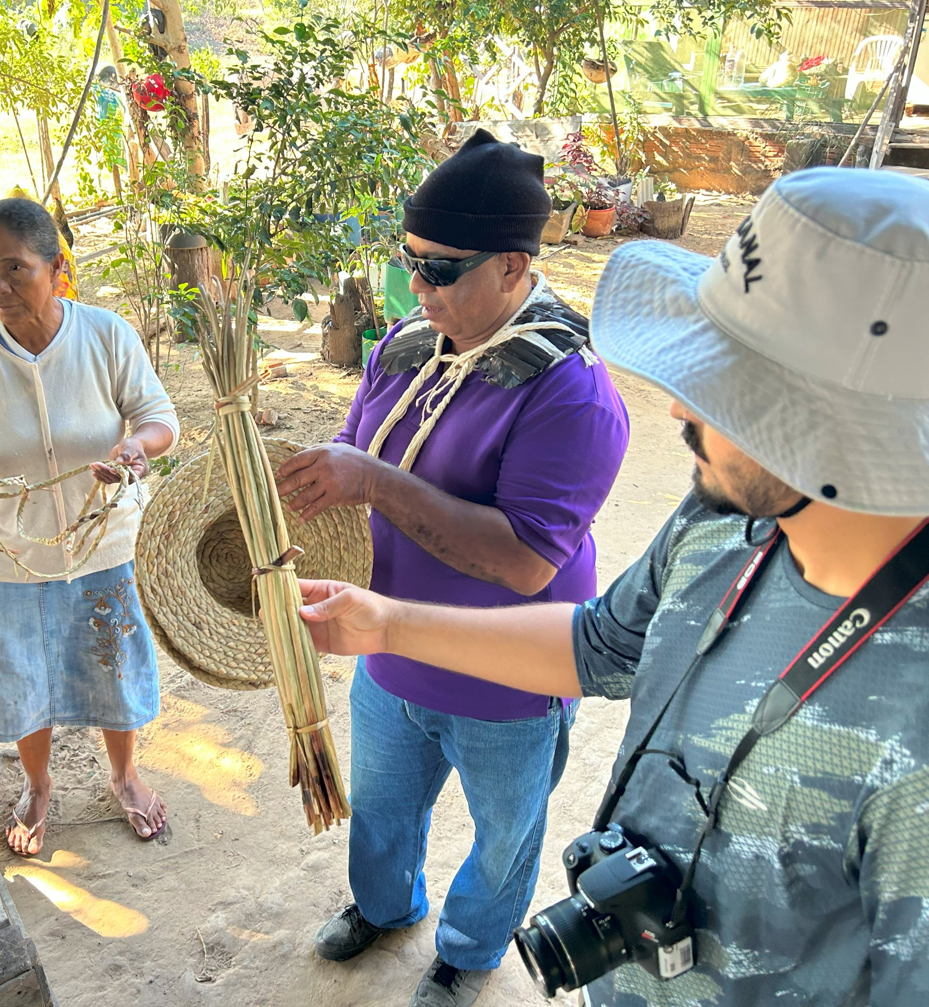
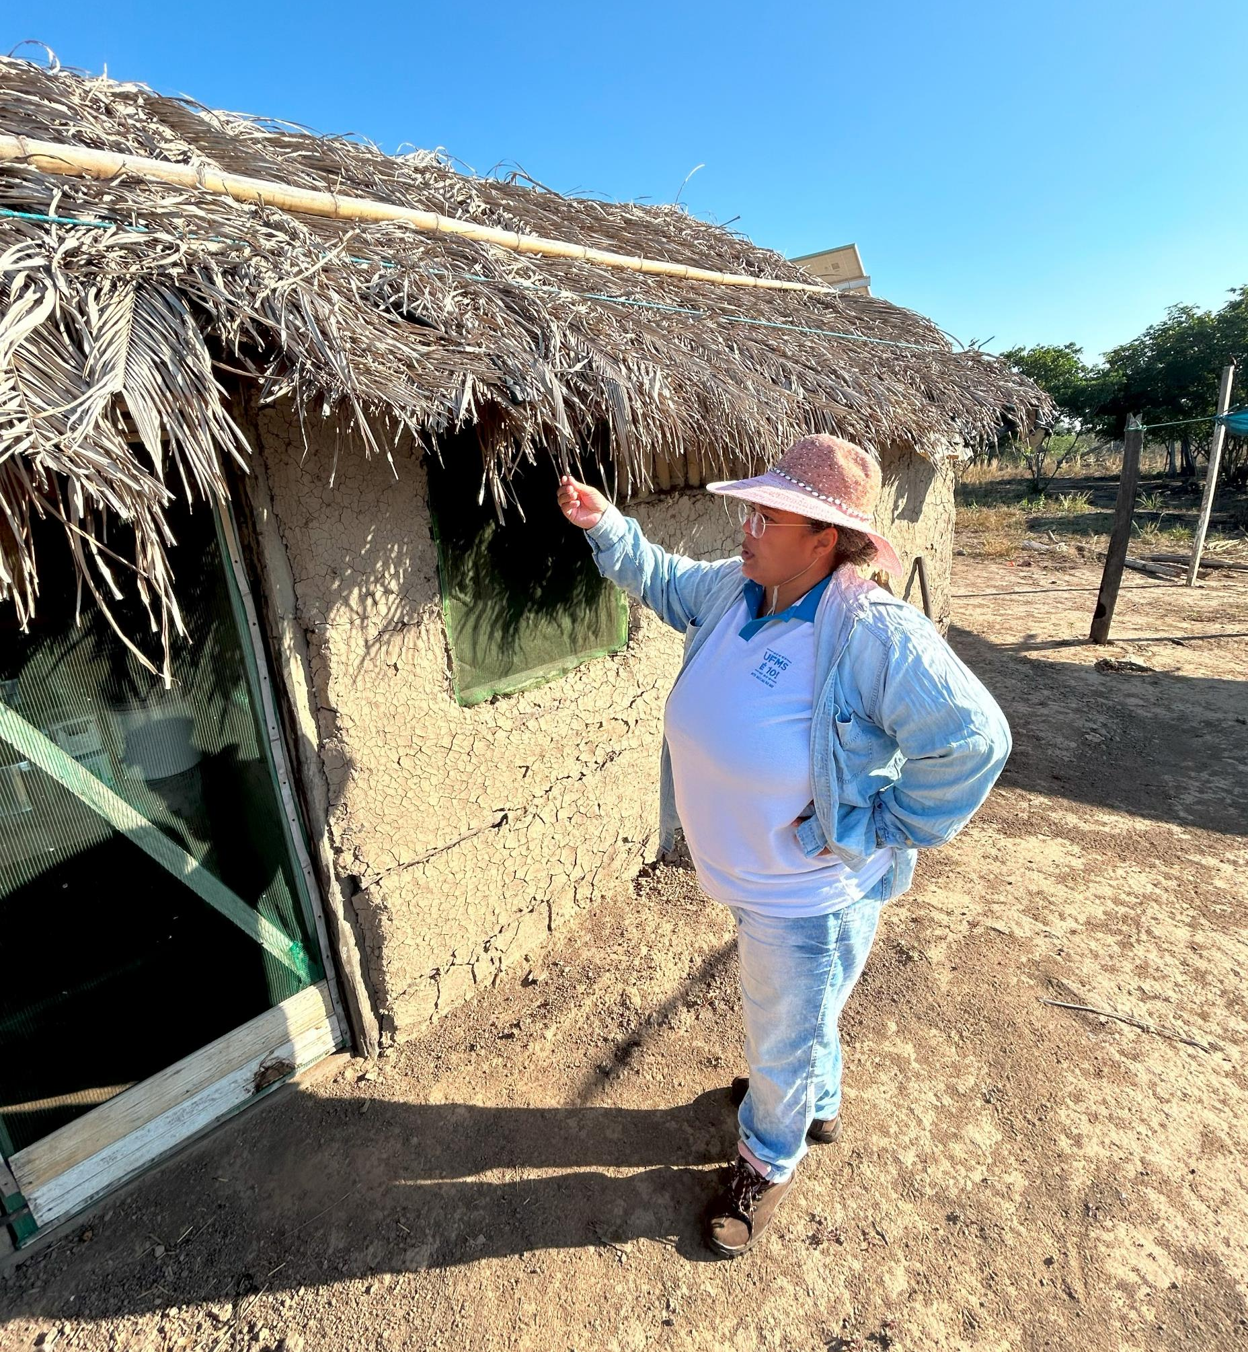
Guatós Indigenous community in the Pantanal of Mato Grosso do Sul

Slide 17
Thank you very much to everyone.
E-mail: lcampos.ms@gmail.com ou luana_campos@ufms.br

