Slide 1
Enhancing resilience of cultural heritage sites: lessons learnt from initiatives undertaken by Greece
George Kremlis
Member of the Board of the EPLO and Director of its Circular Economy & Climate Institute
Chairman of the Greek Initiative at UN level: Addressing climate change impacts on cultural and natural heritage
U.S. Climate Heritage in the International Context
ACHP, October 4, 2024

Slide 2
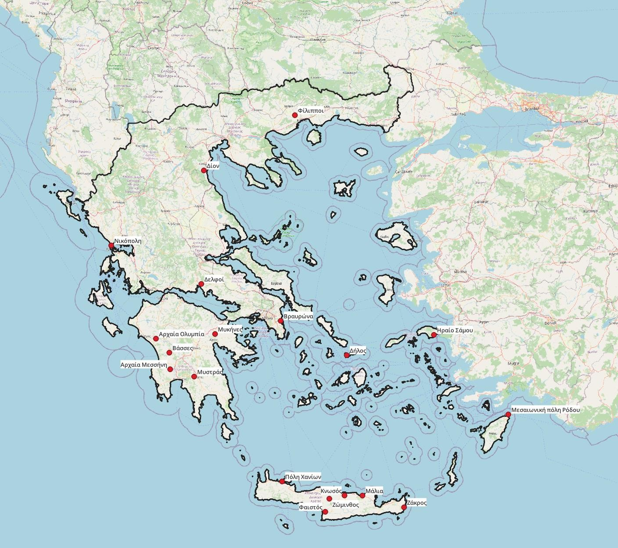
Initiative #1. Define vulnerability for archaeological sites and monuments from climate change impacts– Develop 19 adaptation plans by the end of 2025

Slide 3
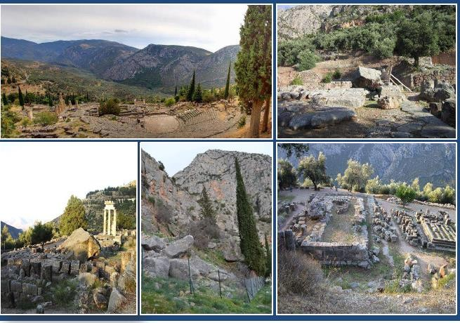
Ιnitiative #2. Promote proactive technical works for 5 archaeological sites
Countermeasures against rock falls in Delphi

Slide 4
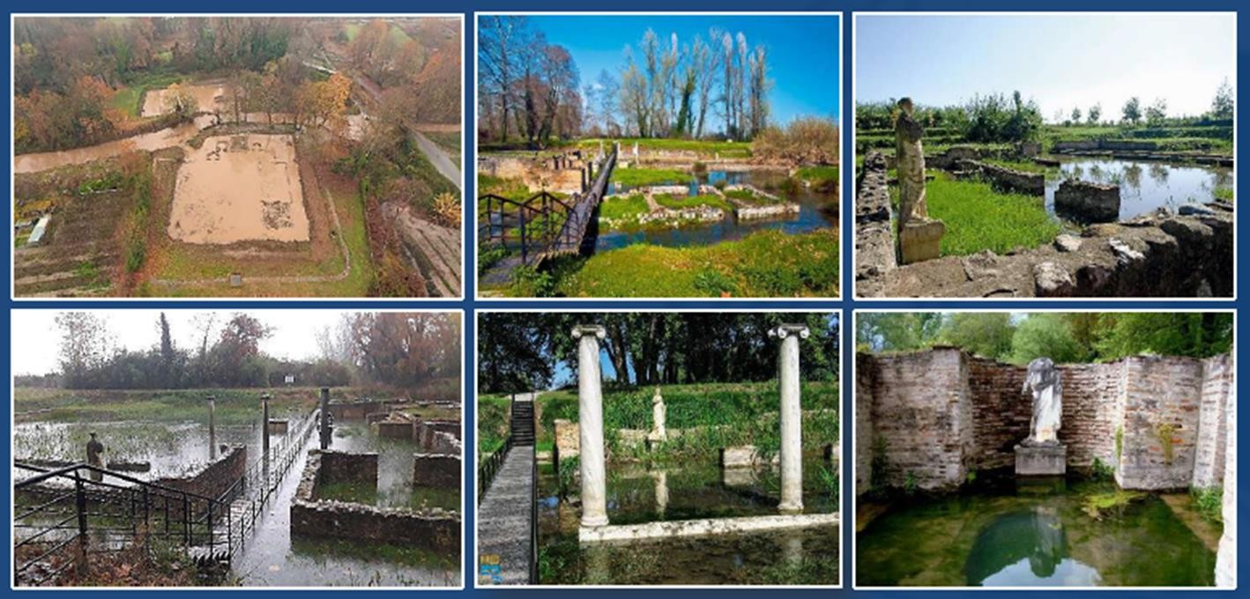
Flood protection works at Dion

Slide 5
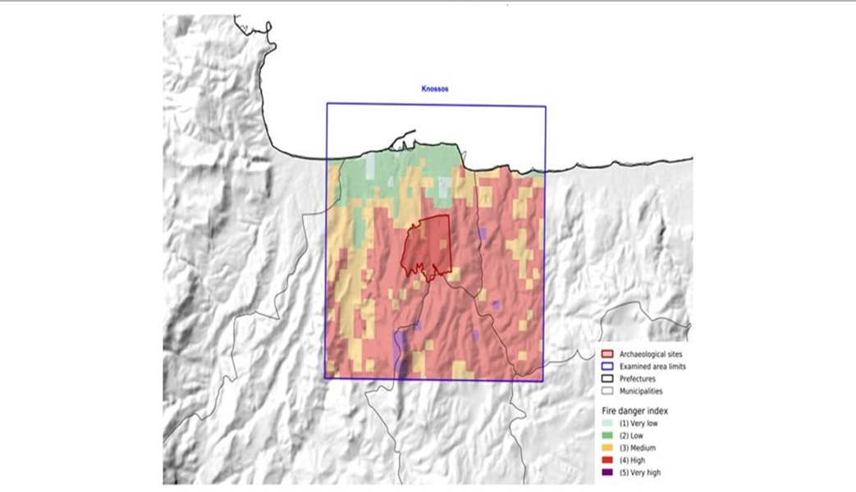
Initiative #3: Enhance the resilience dimension for the management plans of UNESCO sites for present and future climate risks (forest fires and floods)
Knossos
Maps like this have been produced for all the 19 UNESCO archaeological sites.

Slide 6
INITIATIVE #4: COOPERATION WITH THE MINISTRY OF CLIMATE CRISIS AND CIVIL PROTECTION FOR THE IMPLEMENTATION OF PROACTIVE MEASURES FOR OVER 30 ARCHAEOLOGICAL SITES THAT DEMONSTRATE HIGH CLIMATE RISK FOR FOREST FIRES
Improvement of the passive and active fire prevention systems within the archaeological area.
Back-up systems for power supply.
Instalment of watering systems in the vicinity of the archaeological sites.
Fire propagation modelling/sensors in the visible and thermal infrared
Fire drills
Evacuation plans for visitors and workers.

Slide 7
INITIATIVES DEVELOPED IN RELATION TO ADAPTATION/RESILIENCE OF CULTURAL AND NATURAL HERITAGE BY THE GREEK MINISTRY OF CULTURE & SPORTS
Mapping, at the national level, of the vulnerability of cultural sites and monuments from the impacts of climate change.
Development of adaptation/resilience plans for cultural/archaeological sites and monuments of nature.
3.Energy retrofitting of selected Museums to cope with the impacts of climate change – circular museums.
Drafting, in cooperation with the Ministries of Civil Protection, of civil protection plans for areas where cultural/archaeological sites and monuments of nature are located.

Slide 8
INITIATIVES DEVELOPED IN RELATION TO ADAPTATION/RESILIENCE OF CULTURAL AND NATURAL HERITAGE BY THE GREEK MINISTRY OF CULTURE & SPORTS
5. Special protection plans for selected cultural/archaeological sites and monuments of nature to cope with climate risks.
→World Heritage Properties in Greece - two current initiatives:
Compilation of management plans for 15 World Heritage Sites (14 cultural, 1 mixed)
Pilot Disaster Risk Management Plans for World Heritage Sites in Greece (Tiryns and Mycenae, Acropolis of Athens, Daphne Monastery)
Dedicated program for the preventive protection and conservation of monuments.
Project funded by European Recovery Fund titled “Tackling the threats of climate change to the long-term viability of cultural sites of tourist and economic significance”
(Recording and monitoring systems of the effect of climate change on micro-environment & identification and documentation of the climate change impacts on cultural heritage).

Slide 9
INITIATIVES UNDERTAKEN BY THE MINISTRY OF ENVIRONMENT AND ENERGY OF GREECE
National Plan for Adaptation to Climate Change (NAS)
13 Regional Adaptation Action Plans (RAAPs)

Slide 10
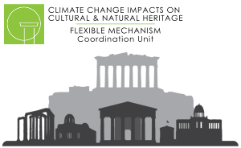
Greek Initiative at UN level: “Addressing climate change impacts on cultural and natural heritage”
FLEXIBLE MECHANISM
steering committee
(Greece, UNESCO, WMO, UNFCCC)
Experts, Scientists
identify and digitalize the threatened sites/monuments upon proposals of the countries concerned
(Questionnaire - 31 replies until Sept. 2024)
create a database with best practices in the field of climate change impacts on cultural and natural heritage
record and develop know-how and data related to the threats faced by international cultural heritage and monuments of nature, because of the climate crisis
Focal Points
create an international network with the view to establishing synergies in the fields of protection of the cultural and natural heritage from climate change impacts
EU MED 9 Pilot Project : Α “Climate identity” for each selected monument
Greece: island of Delos
Cyprus: Archaeological site of Nea Paphos
Spain: Alhambra and Generalife
https://ccich.gr/

Slide 11
HORIZON EUROPE “TRIQUETRA PROJECT”
It aims at creating an evidence-based assessment platform that allows precise risk stratification, and also creates a database of available mitigation measures and strategies, acting as a Decision Support Tool towards efficient risk mitigation and site remediation. The overall approach of Triquetra is based on three distinct steps: 1. Risk Identification 2. Risk Quantification 3. Risk Mitigation
Addressed Cultural Heritage Typologies (mainland – rural areas, underwater sites and coastal areas)
Innovative Tools for In-situ Sensing & Monitoring
Decision Support Platform (8 different pilot sites across Europe)
21 organizations from 7 countries, 3 year-duration: started on 01/01/2023
Lead Partner: National Technical University of Athens
https://triquetra-project.eu/

Slide 12
2nd NEW ELEUSIS SYMPOSION
“Mysteries of Flourishing – Ancient Roots, Modern Blossoms”
In the framework of 2023 Eleusis European Capital of Culture
25, 26 & 27 September 2024
https://eleusis.worldhumanforum.earth/

Slide 13
2nd NEW ELEUSIS SYMPOSION
“Mysteries of Flourishing – Ancient Roots, Modern Blossoms”
In the framework of 2023 Eleusis European Capital of Culture
25, 26 & 27 September 2024
Ancestral Intelligence
Artificial Intelligence
Emotional Intelligence
https://eleusis.worldhumanforum.earth/

Slide 14
LESSONS LEARNT
There is a need to refine the criteria for ecosystems in order to also refer to the concentration, continuity and integrity of the cultural heritage.
The strong variation in climate vulnerability by location requires a site-based analysis.
An adaptation plan cannot be applied indiscreetly to all sites
Monitor how climate change and the socio-economic changes may impact the communities which support the conservation of cultural heritage.
Exhaust all efforts to promote adaptation on site to respect the immoveable concept and avoid the loss of cultural memory and intangible heritage.
Communicate local knowledge in adaptation.
Take note that adaptation is not limitless.

Slide 15
THANK YOU!
gkremlis@eplo.int

