Slide 1
Climate Mitigation Strategies
Incorporating Heritage
Moderator:
Speakers:
Erica Avrami
Simon Sturgis
Antonio Jesús Antequera Delgado

Slide 2
CO2
EMBODIED CARBON
EMBODIED
CO2
OPERATIONAL CARBON
OPERATING
LAND USE
LAND USE

Slide 3
37%

Slide 4
CO2
EMBODIED CARBON
EMBODIED
Building Reuse
Material Reuse
Life Cycle Analysis
Deconstruction

Slide 5
MINIMIZE
EMBODIED CARBON EMISSIONS
through the reuse of buildings, and the deconstruction and reuse of building materials, and the recycling of construction & demolition waste
10%

Slide 6
Federal tax incentives
Rehabilitation Historic
Building Reuse
1976
Amortization and accelerated depreciation to incentivize building rehabilitation.
5 year amortization for property on the National Register
1979
10% credit based
on qualified expenditures for rehabilitation of a building 20 years or older.
1981
Three-tiered tax credit system:
15% for buildings 30-39 years old,
20% for buildings 40 or older, and
25% for historic buildings.
1986
Two-tiered tax credit system:
10% for buildings built before 1936,
20% for historic buildings.
2017
Two-tiered tax credit system:
10% for buildings built before 1936,
20% for historic buildings.

Slide 7
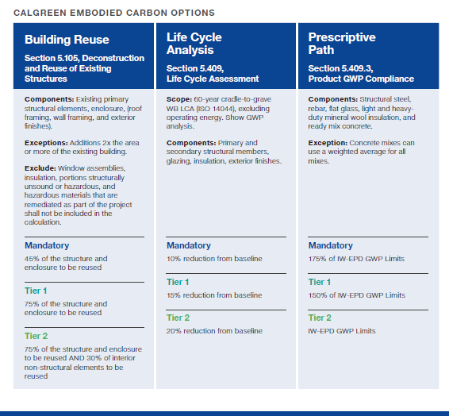
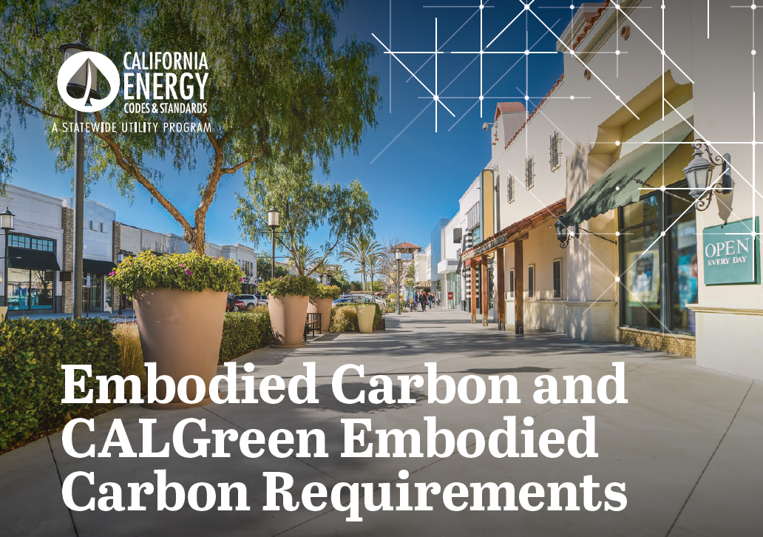
Building and Material Reuse
Life Cycle Analysis

Slide 8
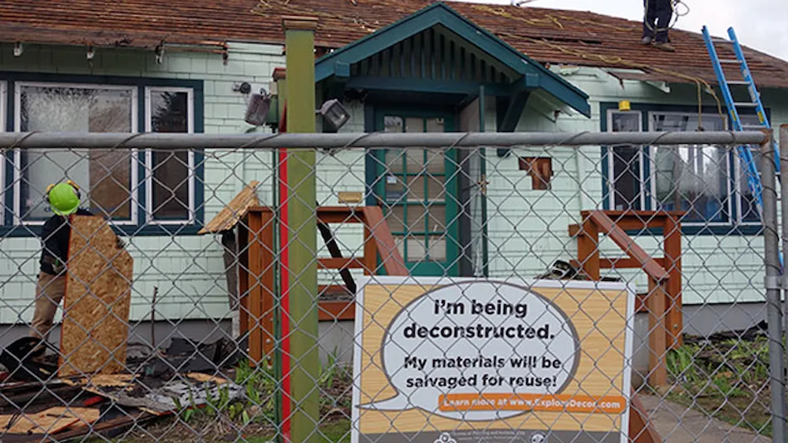
Deconstruction
https://www.cdrecycler.com/news/portland-oregon-deconstruction-ordinance/

Slide 9
CO2
OPERATIONAL CARBON
OPERATING
Energy Codes
Building Performance Standards
Sustainable Roofs

Slide 10
MINIMIZE
OPERATIONAL CARBON EMISSIONS
by improving energy efficiency, and decreasing or eliminating the use of fossil fuels
on site (direct) and at
energy sources (indirect)
27%

Slide 11
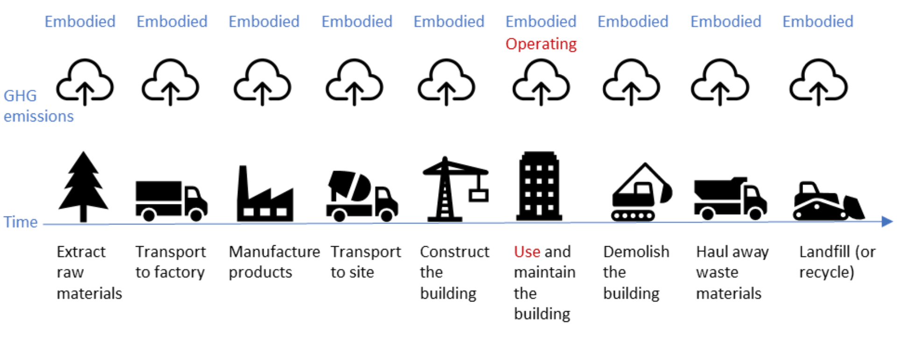
Significance of Operational Carbon
This operating carbon accounts for
Approx. 70% of total emissions over the typical lifecycle of a building, on average, though studies vary
Adapted from C40knowledgehub.org

Slide 12
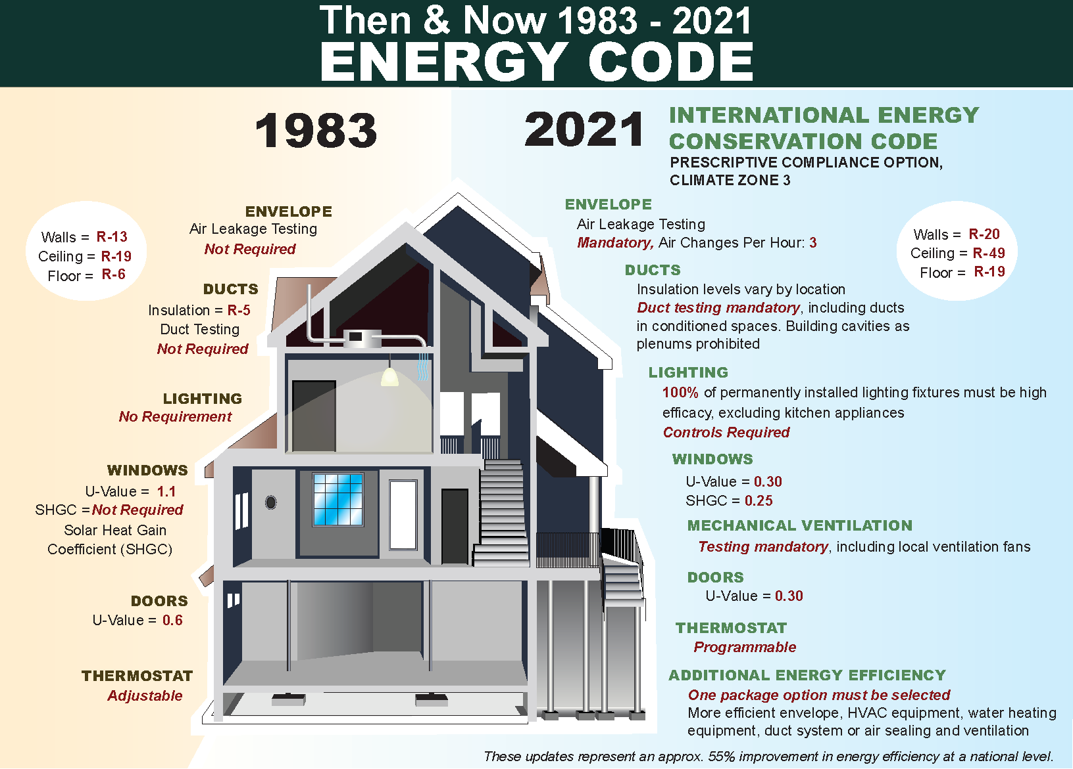
Energy Codes
Energy codes seek to reduce energy consumption and improve efficiency at the time a new building or renovation to an existing building is designed.
https://sustainableenergyaction.org/

Slide 13
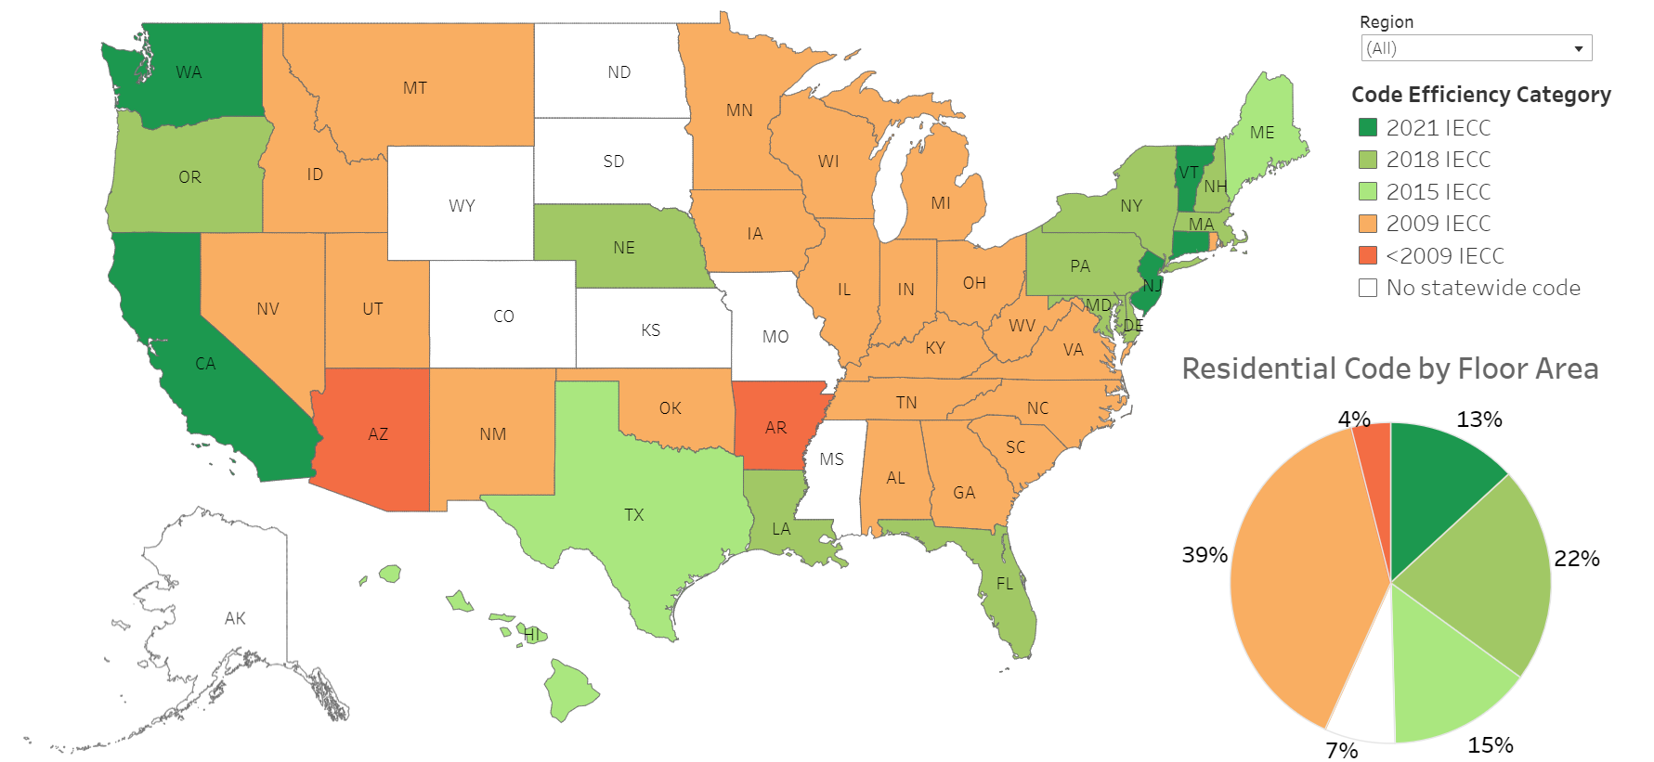
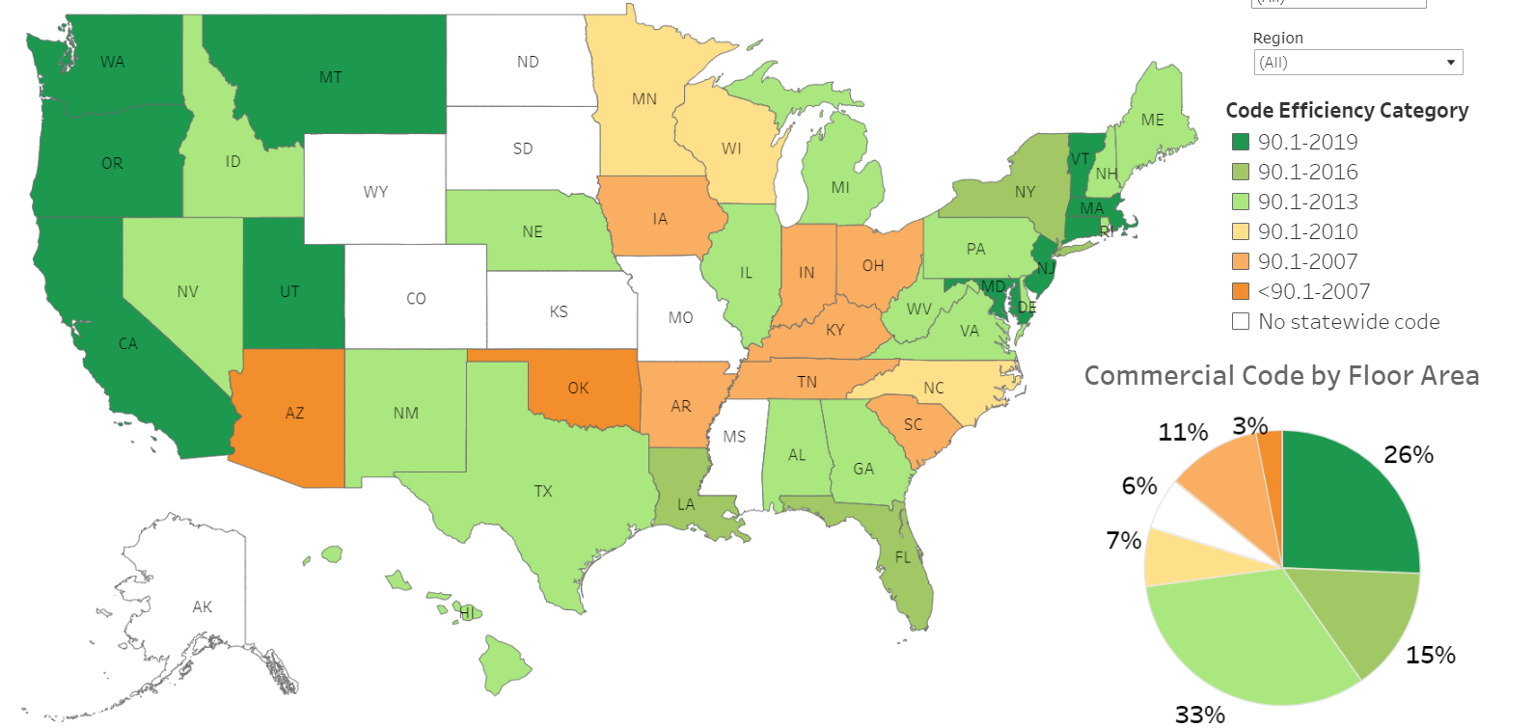
Status of Energy Code Adoption by State (as of Dec 2023)
Residential
Commercial
https://www.energycodes.gov/infographics

Slide 14
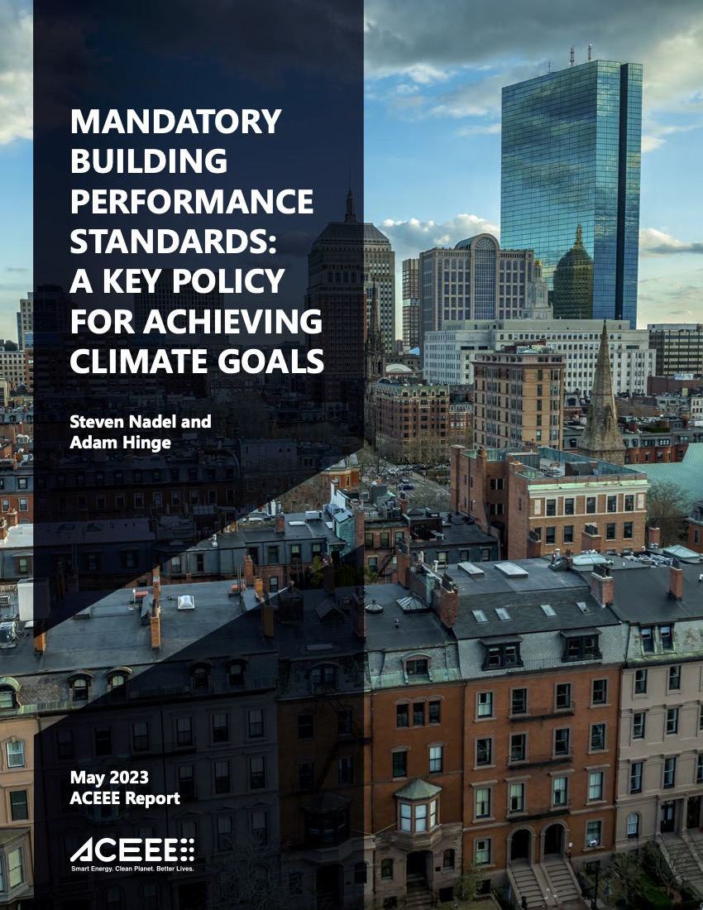
Building Performance Standards
Building performance standards seek to reduce actual operating emissions and/or energy use of existing buildings over time.

Slide 15
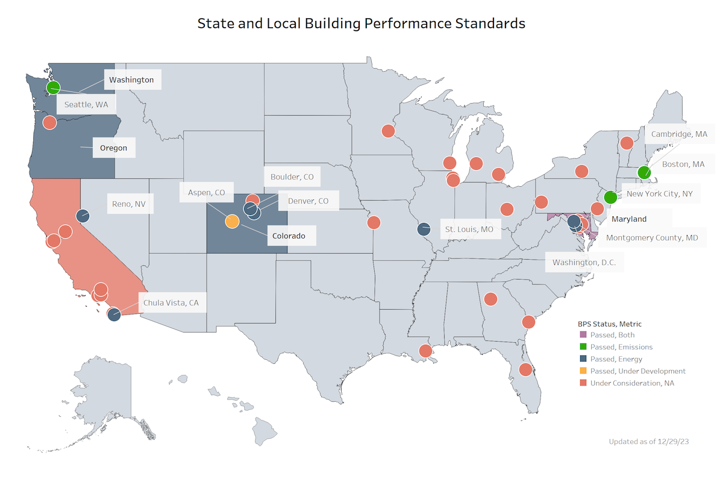
Existing Buildings Performance Standards – Energy & Emissions (as of Dec 2023)
https://www.energycodes.gov/infographics

Slide 16
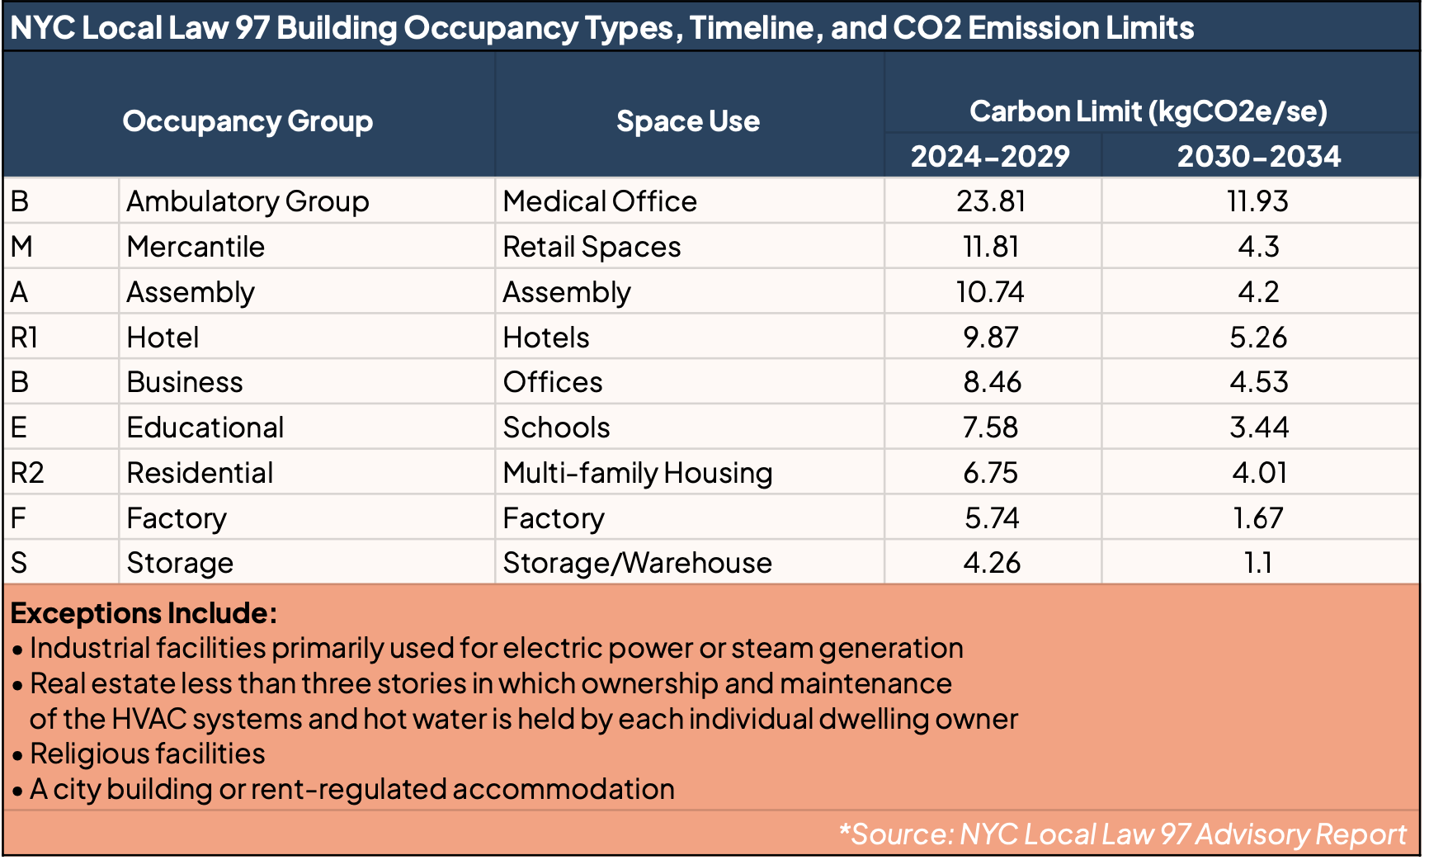
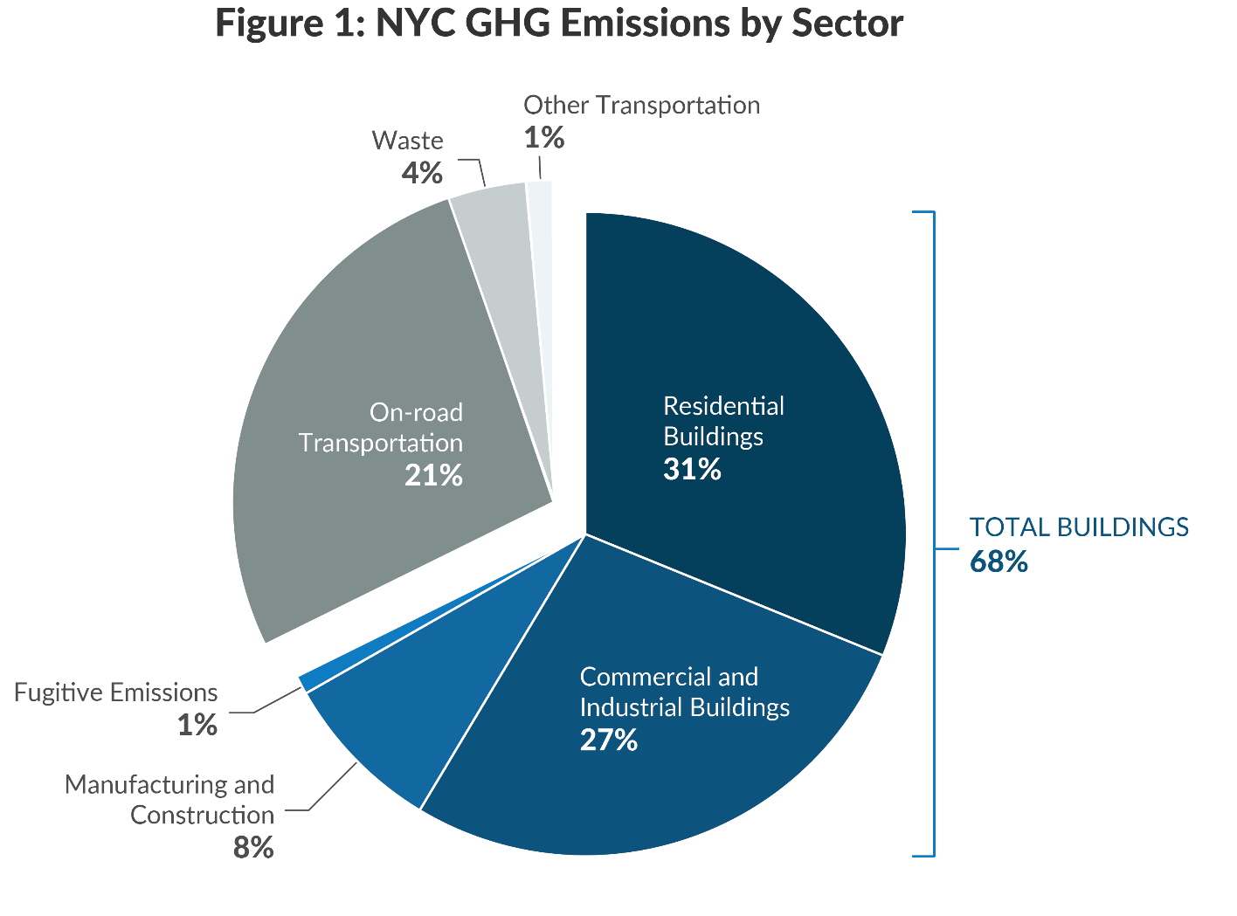
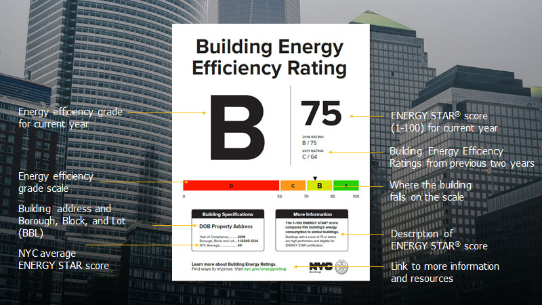
Building Performance Standards
Carbon targets & limits
Energy
ratings
NYC Mayor’s Office of Sustainability

Slide 17

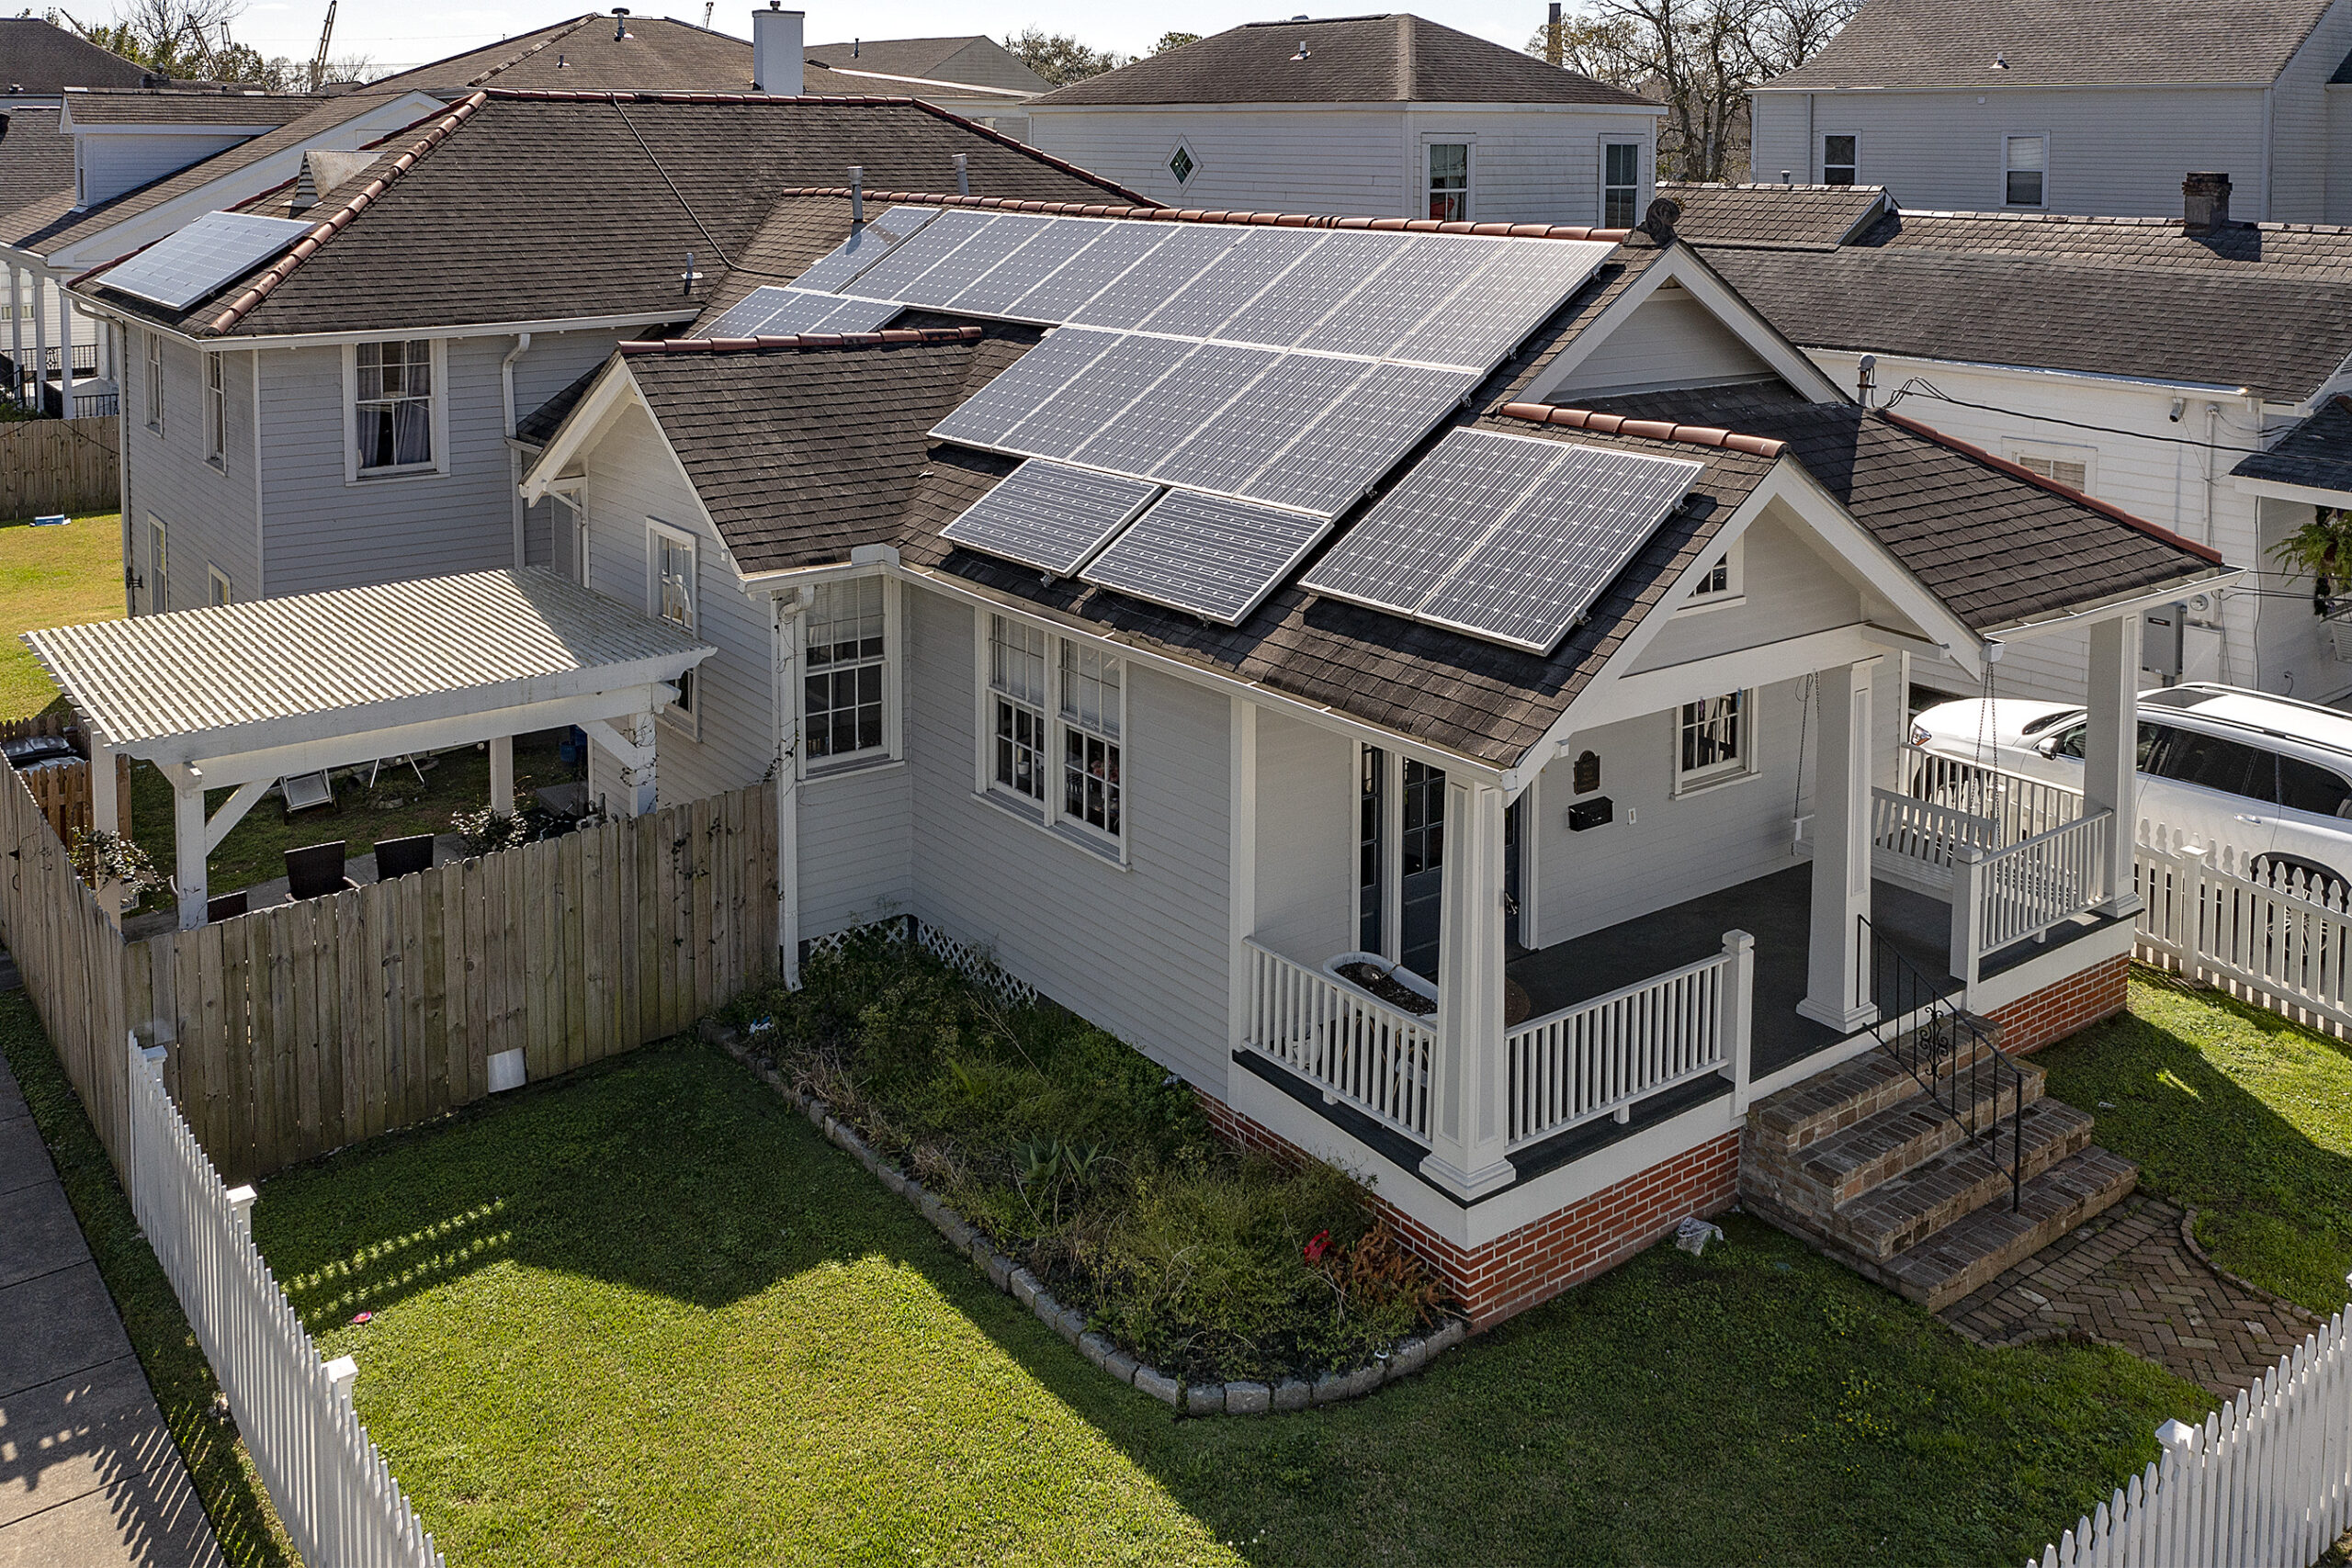
Sustainable Roofs
https://urbanstrong.com/projects/brooklyn-carriage-house-green-roof
©Charles E. Leche, Preservation Resource Center or New Orleans

Slide 18
Zoning & Densification
Energy Transitions
LAND USE
LAND USE

Slide 19
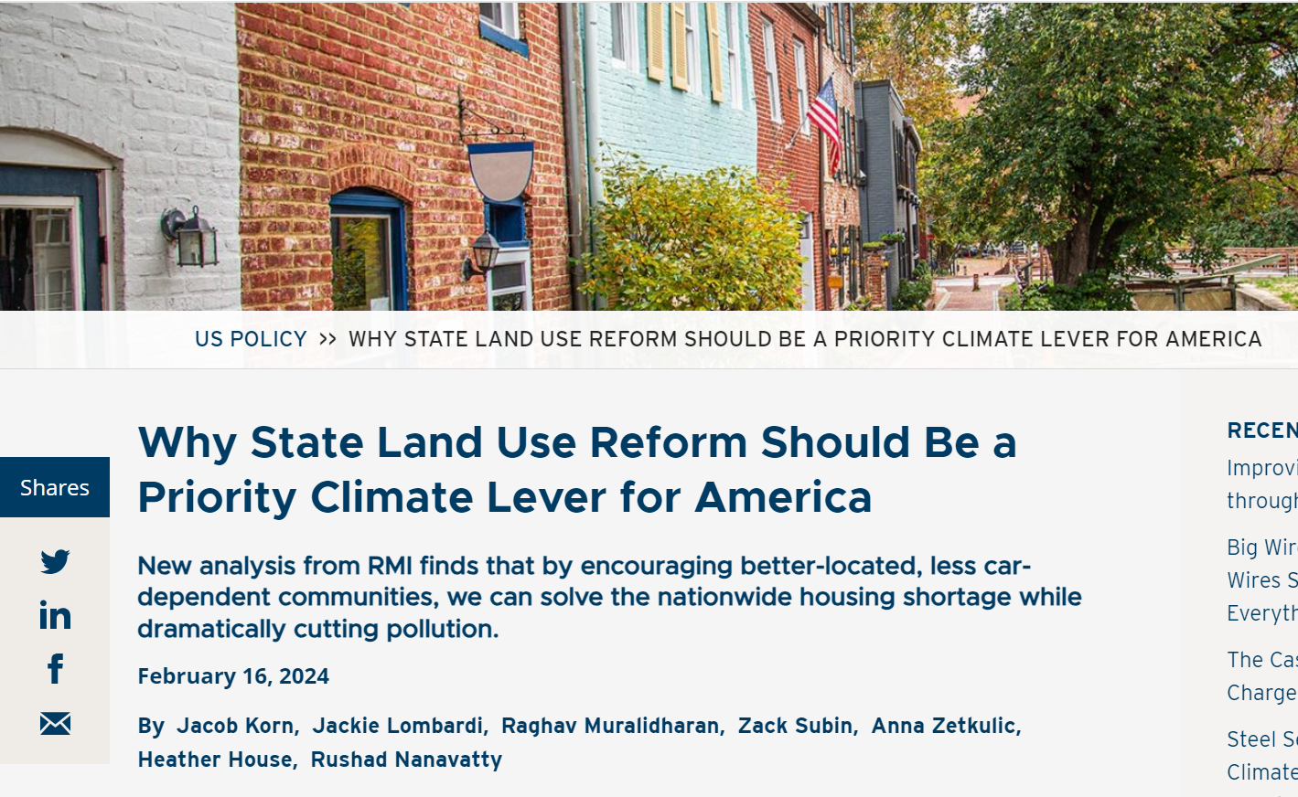
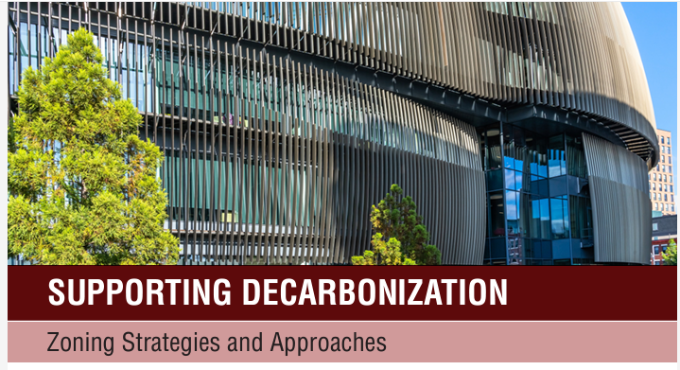
Zoning & Densification
RMI.org
ULI.org

Slide 20


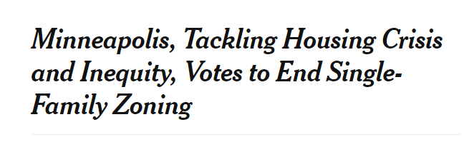
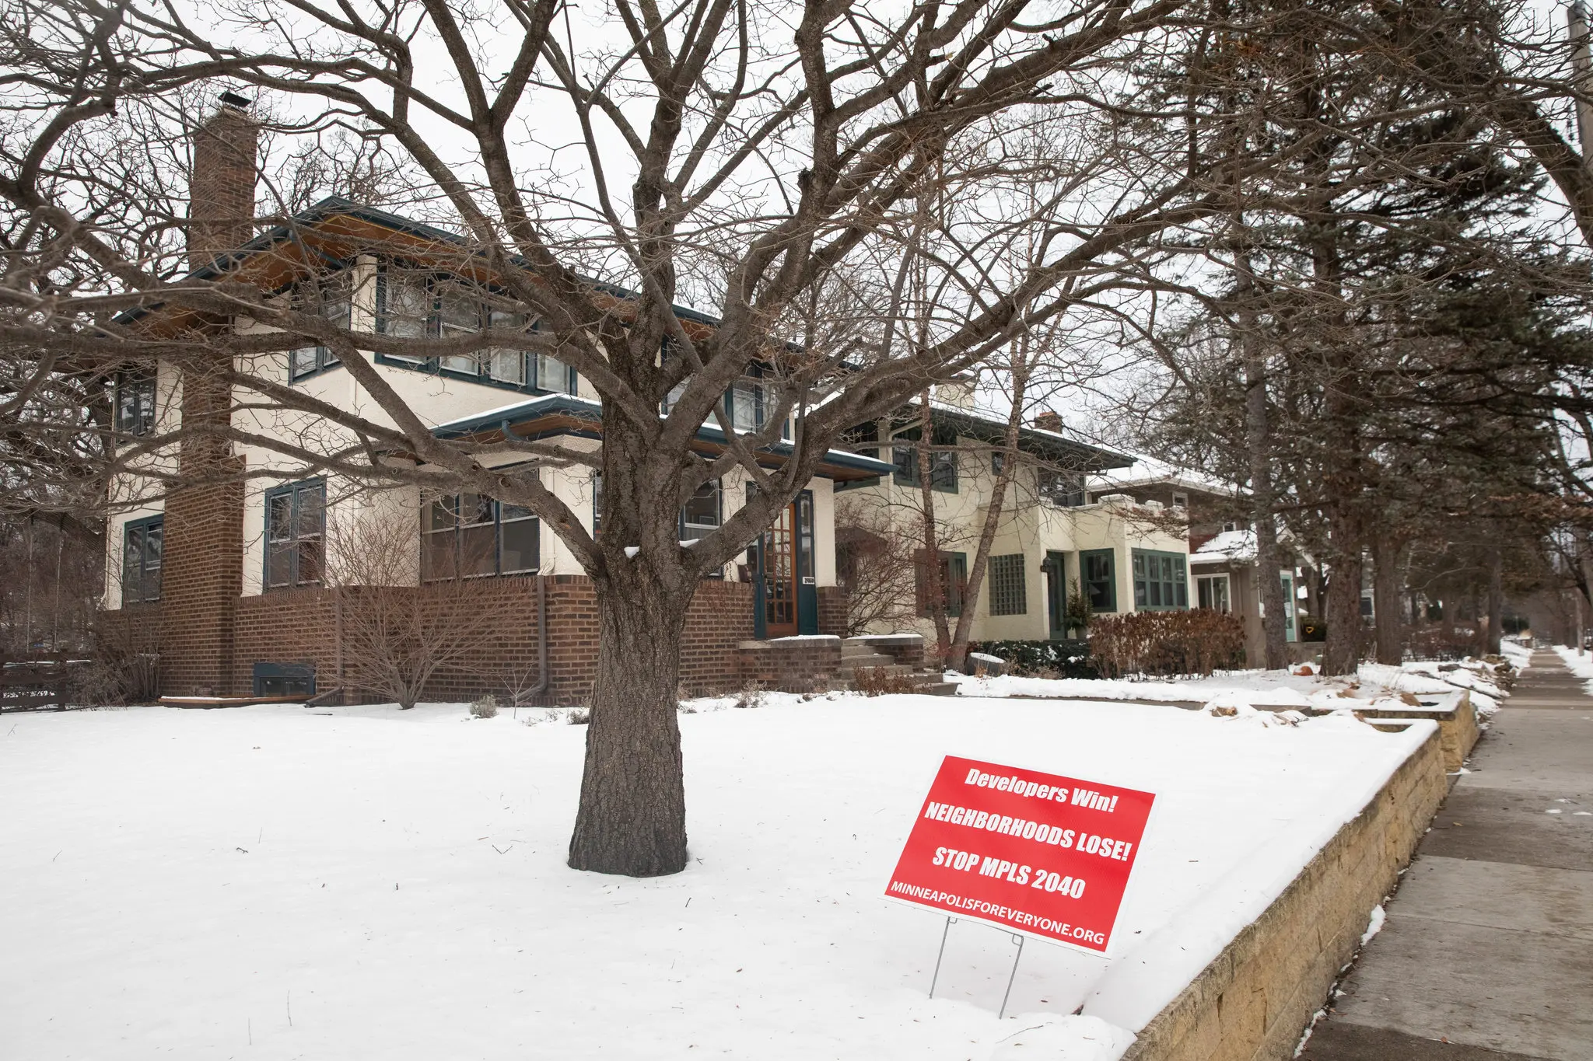
Zoning
Jenn Ackerman, The New York Times

Slide 21

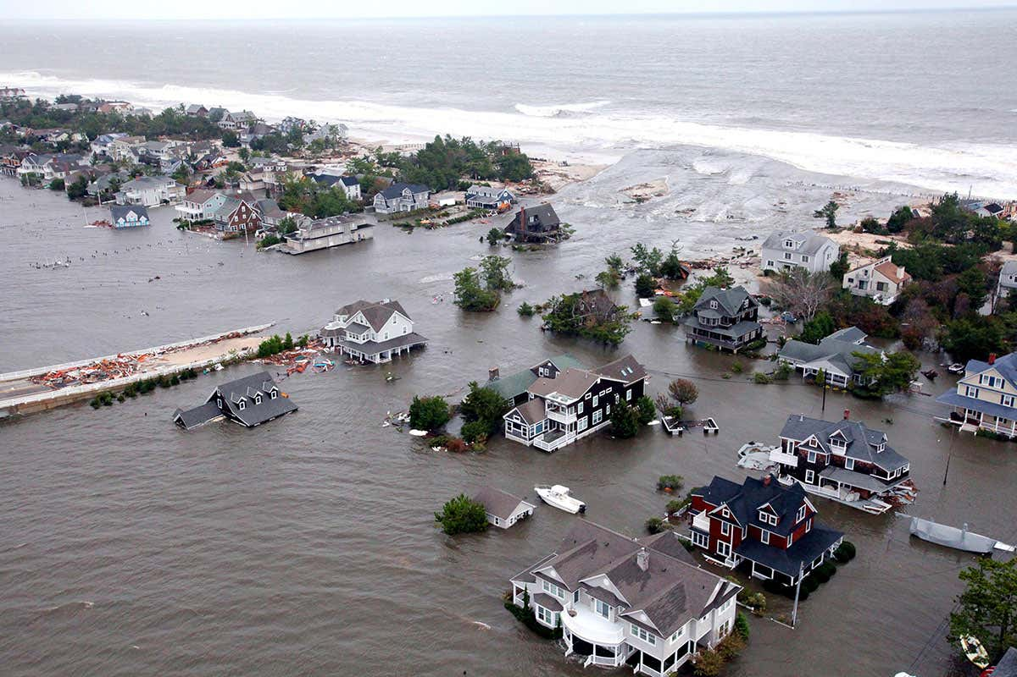
Energy Transitions
https://hub.jhu.edu/2021/06/04/model-to-predict-wind-energy/ GETTY IMAGES
Hurricane Sandy damage to the New Jersey coast
U S Air Force photo/Master Sgt Mark C Olsen/Alamy

Slide 22
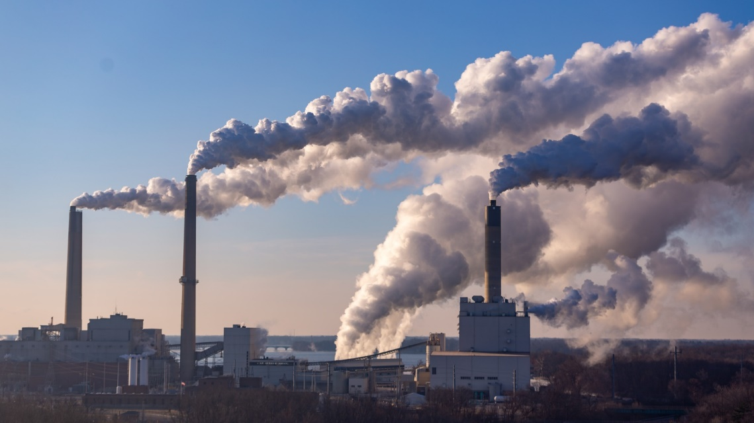
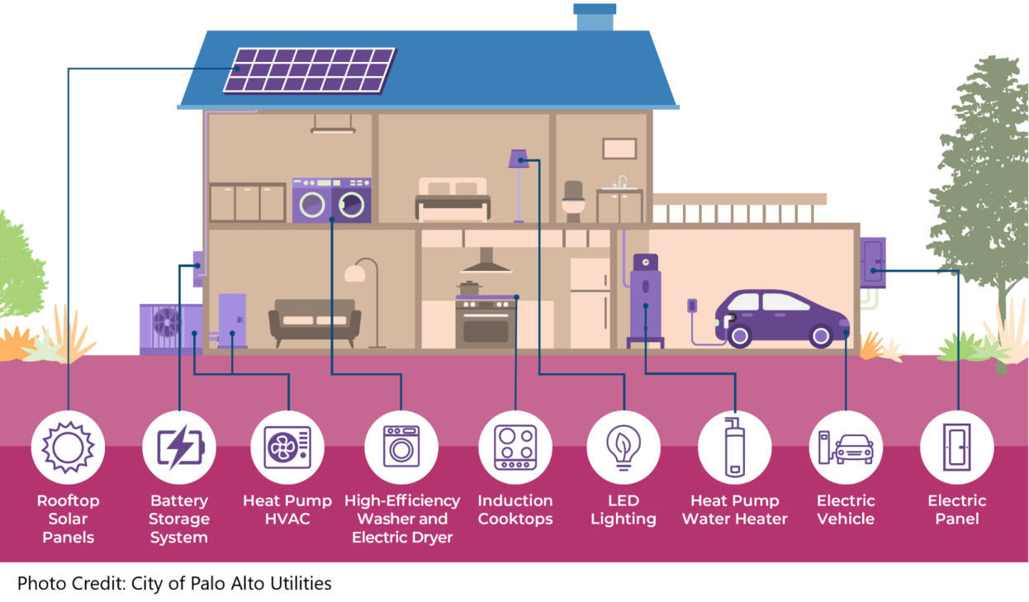

Energy Transitions
Getty Images
City of Palo Alto Utilities
US BLM
CO-DEPENDENCY

Slide 23
Building and Material Reuse
Life Cycle Analysis
Deconstruction
Energy Codes
Building Performance Standards
Sustainable Roofs
Zoning & Densification
Energy Transitions
CO2
EMBODIED
CO2
OPERATIONAL
LAND USE

