Slide 1
#ClimatEireitage
A Story
US Climate Heritage Policy, International Context
Dr Cathy Daly,
Carrig Conservation & University of Lincoln
Georgetown University Law Centre 4th October 2024

Slide 2
Introduction
Where to start?
Recent projects
Future directions

Slide 3
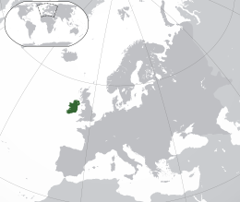
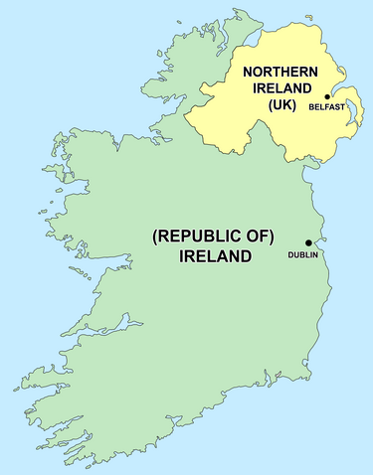
Where to start?
Ireland
Population 5.15 million
EU member
2 World Heritage Sites:
Brú na Bóinne
Sceilg Mhichíl
US Climate Heritage Policy International Context
This Photo by Unknown Author is licensed under CC BY-SA
This Photo by Unknown Author is licensed under CC BY-SA

Slide 4
Where to start?
US Climate Heritage Policy International Context

Slide 5
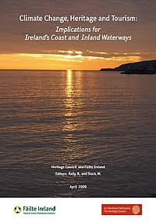
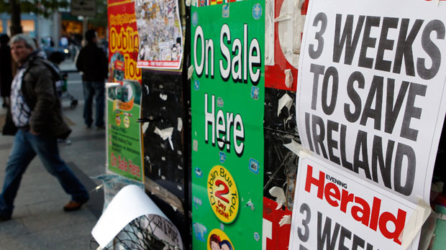
The start?
2009 report by Heritage Council and Failte Ireland
2010 Report ICOMOS Ireland
2011 IMF Bailout
2013 Vulnerability assessment World Heritage Sites
2016 Climate Action and Low Carbon Development Act
US Climate Heritage Policy International Context

Slide 6
Where to start?
Climate Change Adaptation Strategy for Built and Archaeological Heritage
2019
US Climate Heritage Policy International Context

Slide 7
Where to start?
Heritage & Climate Action
Mitigating the causes of Climate Change:
02
The Paris Agreement
Transition and Transformation
How can we respond?
Impacts on heritage – what are they, how do we understand vulnerability?
Understanding Climate Risk & Adapting:
01
US Climate Heritage Policy International Context

Slide 8
5 Goals, 16 Objectives, 48 actions (with indicators and outputs)
GOAL 1: Improve understanding of the heritage resource and its vulnerability to climate change impacts
GOAL 2. Develop and mainstream sustainable policies and plans for climate change adaptation of built and archaeological heritage
GOAL 3. Conserve Ireland’s heritage for future generations
GOAL 4. Communicate and transfer knowledge
GOAL 5. Exploit the opportunities for built and archaeological heritage to demonstrate value and secure resources

Slide 9
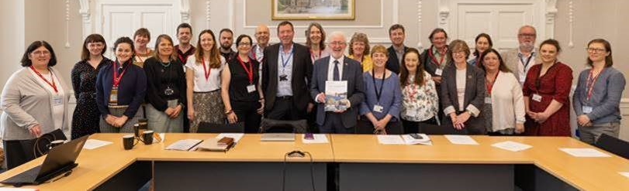
National strategy supported by scientific research leading to local actions
POLICY
Flexible
Anticipatory
Cross cutting
Leadership
ACTIONS
Stakeholder focussed
Win whatever
Informed & supported
Learning from experience
SCIENCE
Monitoring
Research
Communication

Slide 10
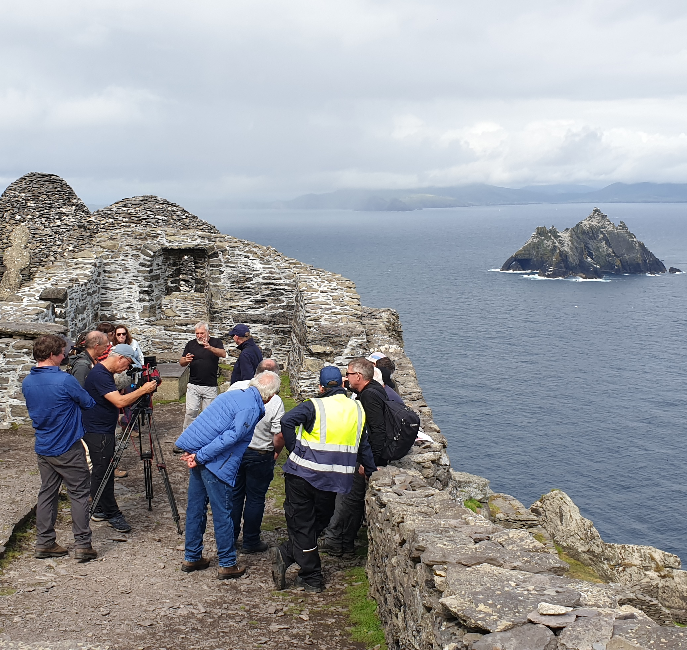
Recent Projects
US Climate Heritage Policy International Context

Slide 11
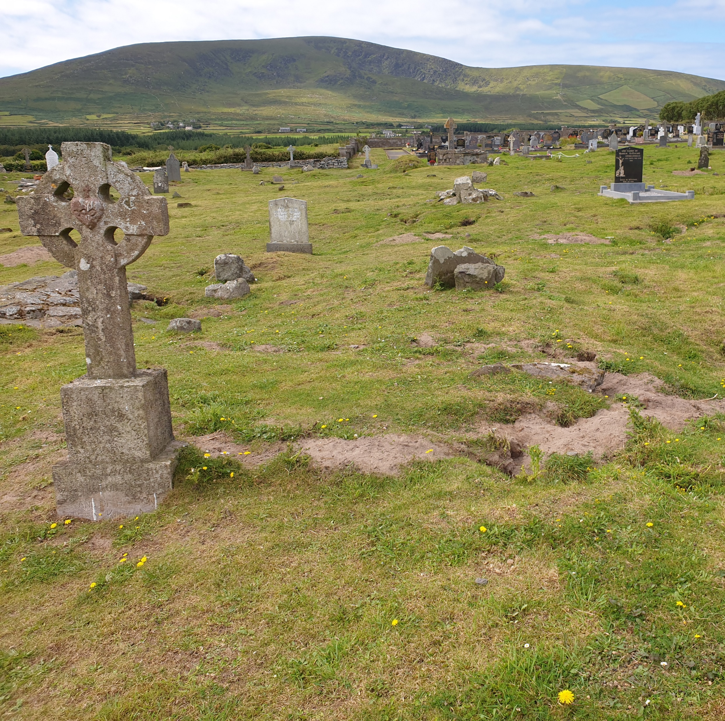
Climate Change Risk & Adaptation Assessment of Six Local Authority Graveyards in Co. Kerry
A project funded under the CMF

Slide 12
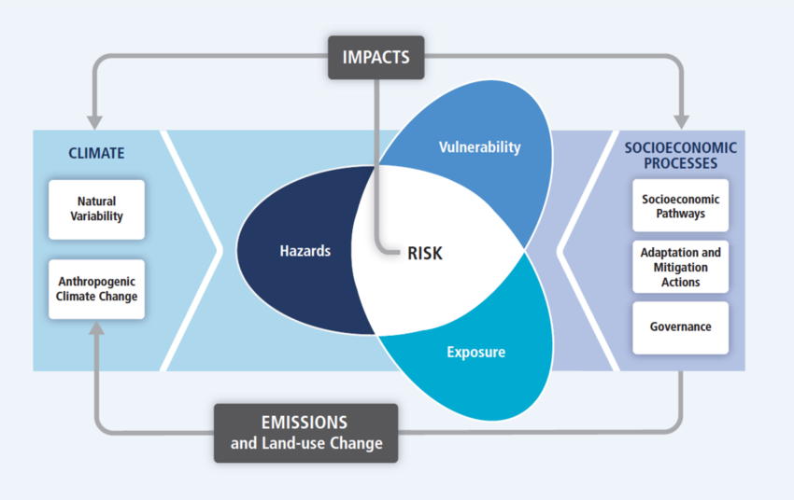
Illustration of the core concepts related to Risk in AR5 WGII (IPCC, 2014)

Slide 13
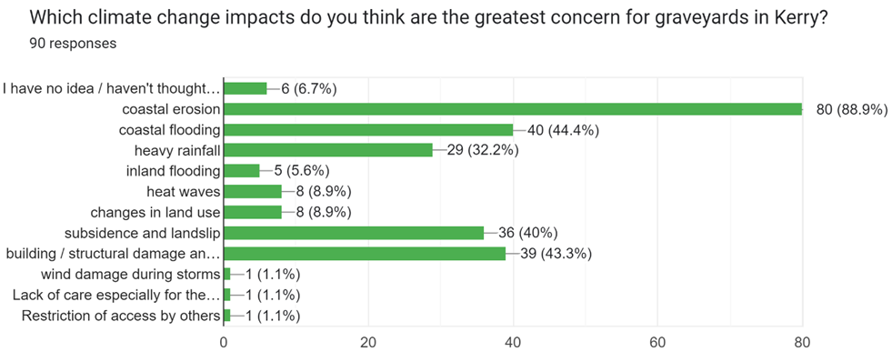
Community survey

Slide 14
Increasing resilience through maintenance and visitor management: Climate change is a stress multiplier, but resilience to its impacts can be created by improving the current condition of the sites
Interventions to improve the condition and authenticity of the built heritage: Collapse of poorly maintained historic churches and walls was identified as a key risk and inappropriate repairs further reduce authenticity and stability.
Sympathetic approaches to coastal processes (flooding and erosion): Monitoring should be undertaken to inform the choice of adaptation options in the future. The possibility of nature-based solutions should be considered in preference to hard engineering and a communication and engagement strategy to build community awareness of the challenges involved in protecting coastal graveyards should be undertaken.
Developing a strategy for managing loss: The current KCC management approach of defending the sites from the sea may require revision given climate change projections. Managed loss is likely to create conflict and requires structured consultation to negotiate options such as relocation, documentation and recording, memorialisation, etc.
Notes:
e.g. by reducing visitor impacts; improving systems for maintaining historic graveyards; providing training; supporting biodiversity friendly vegetation control, etc.
Stonemasons with traditional lime and dry-stone building skills are required to work across KCCs historic graveyards
The strategy behind managed loss should be clearly communicated both to help stakeholders understand the process as it is unfolding and to raise awareness of climate change impacts and the need to make difficult decisions.

Slide 15
Thank you for your interest in these graveyards, l have many treasured family members buried on Abbey Island. I understand that in time it may disappear to the sea, but even a memorial with their names on the mainland would be amazing
(respondent to community survey).

Slide 16
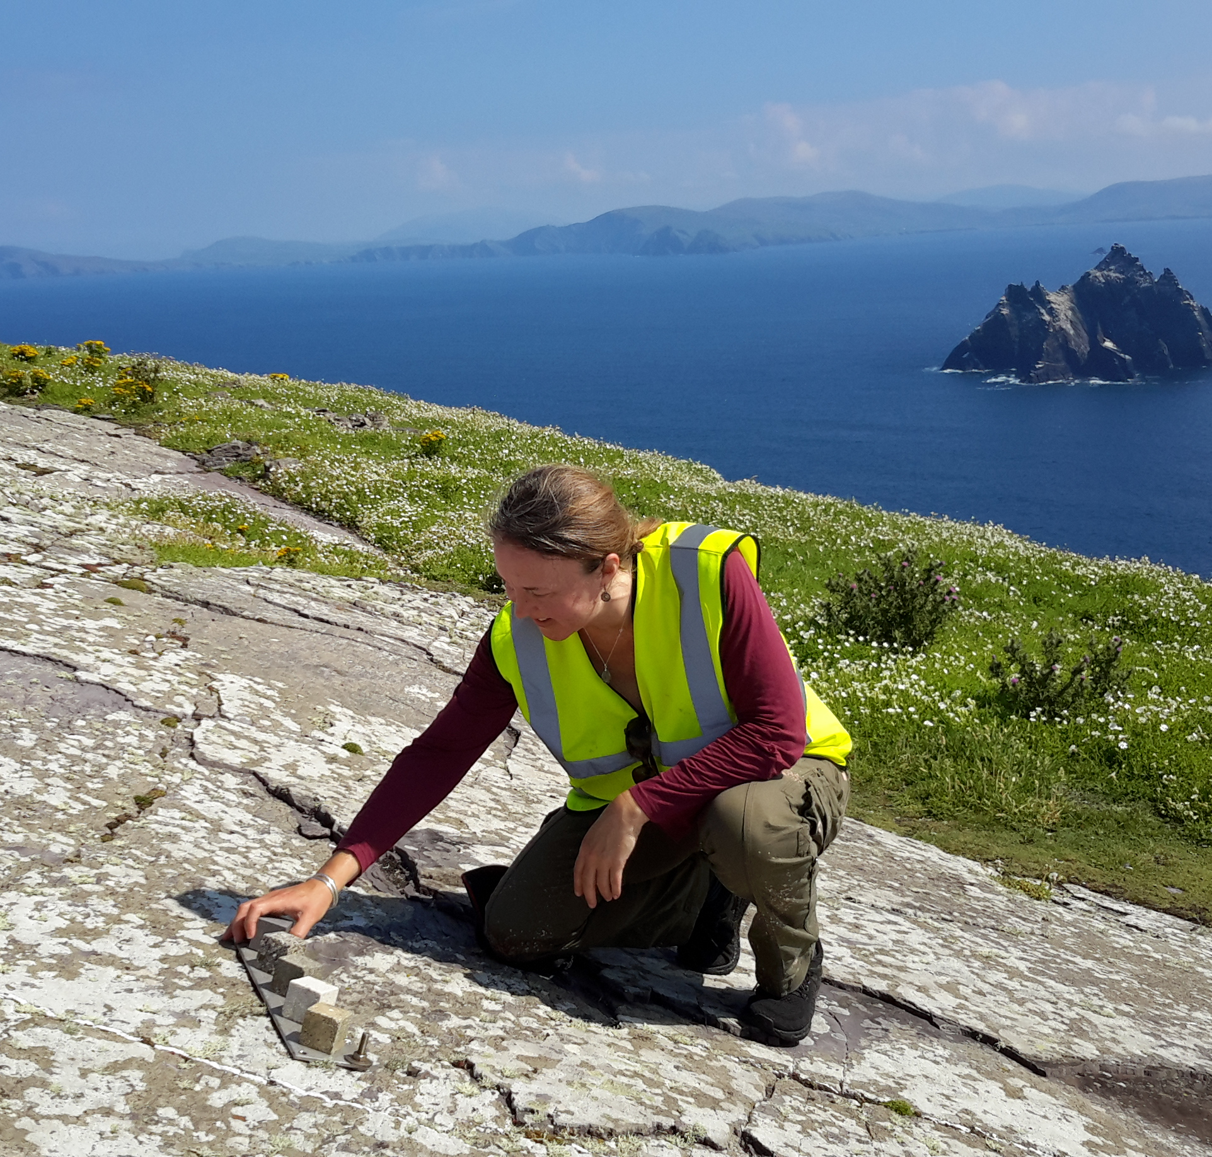
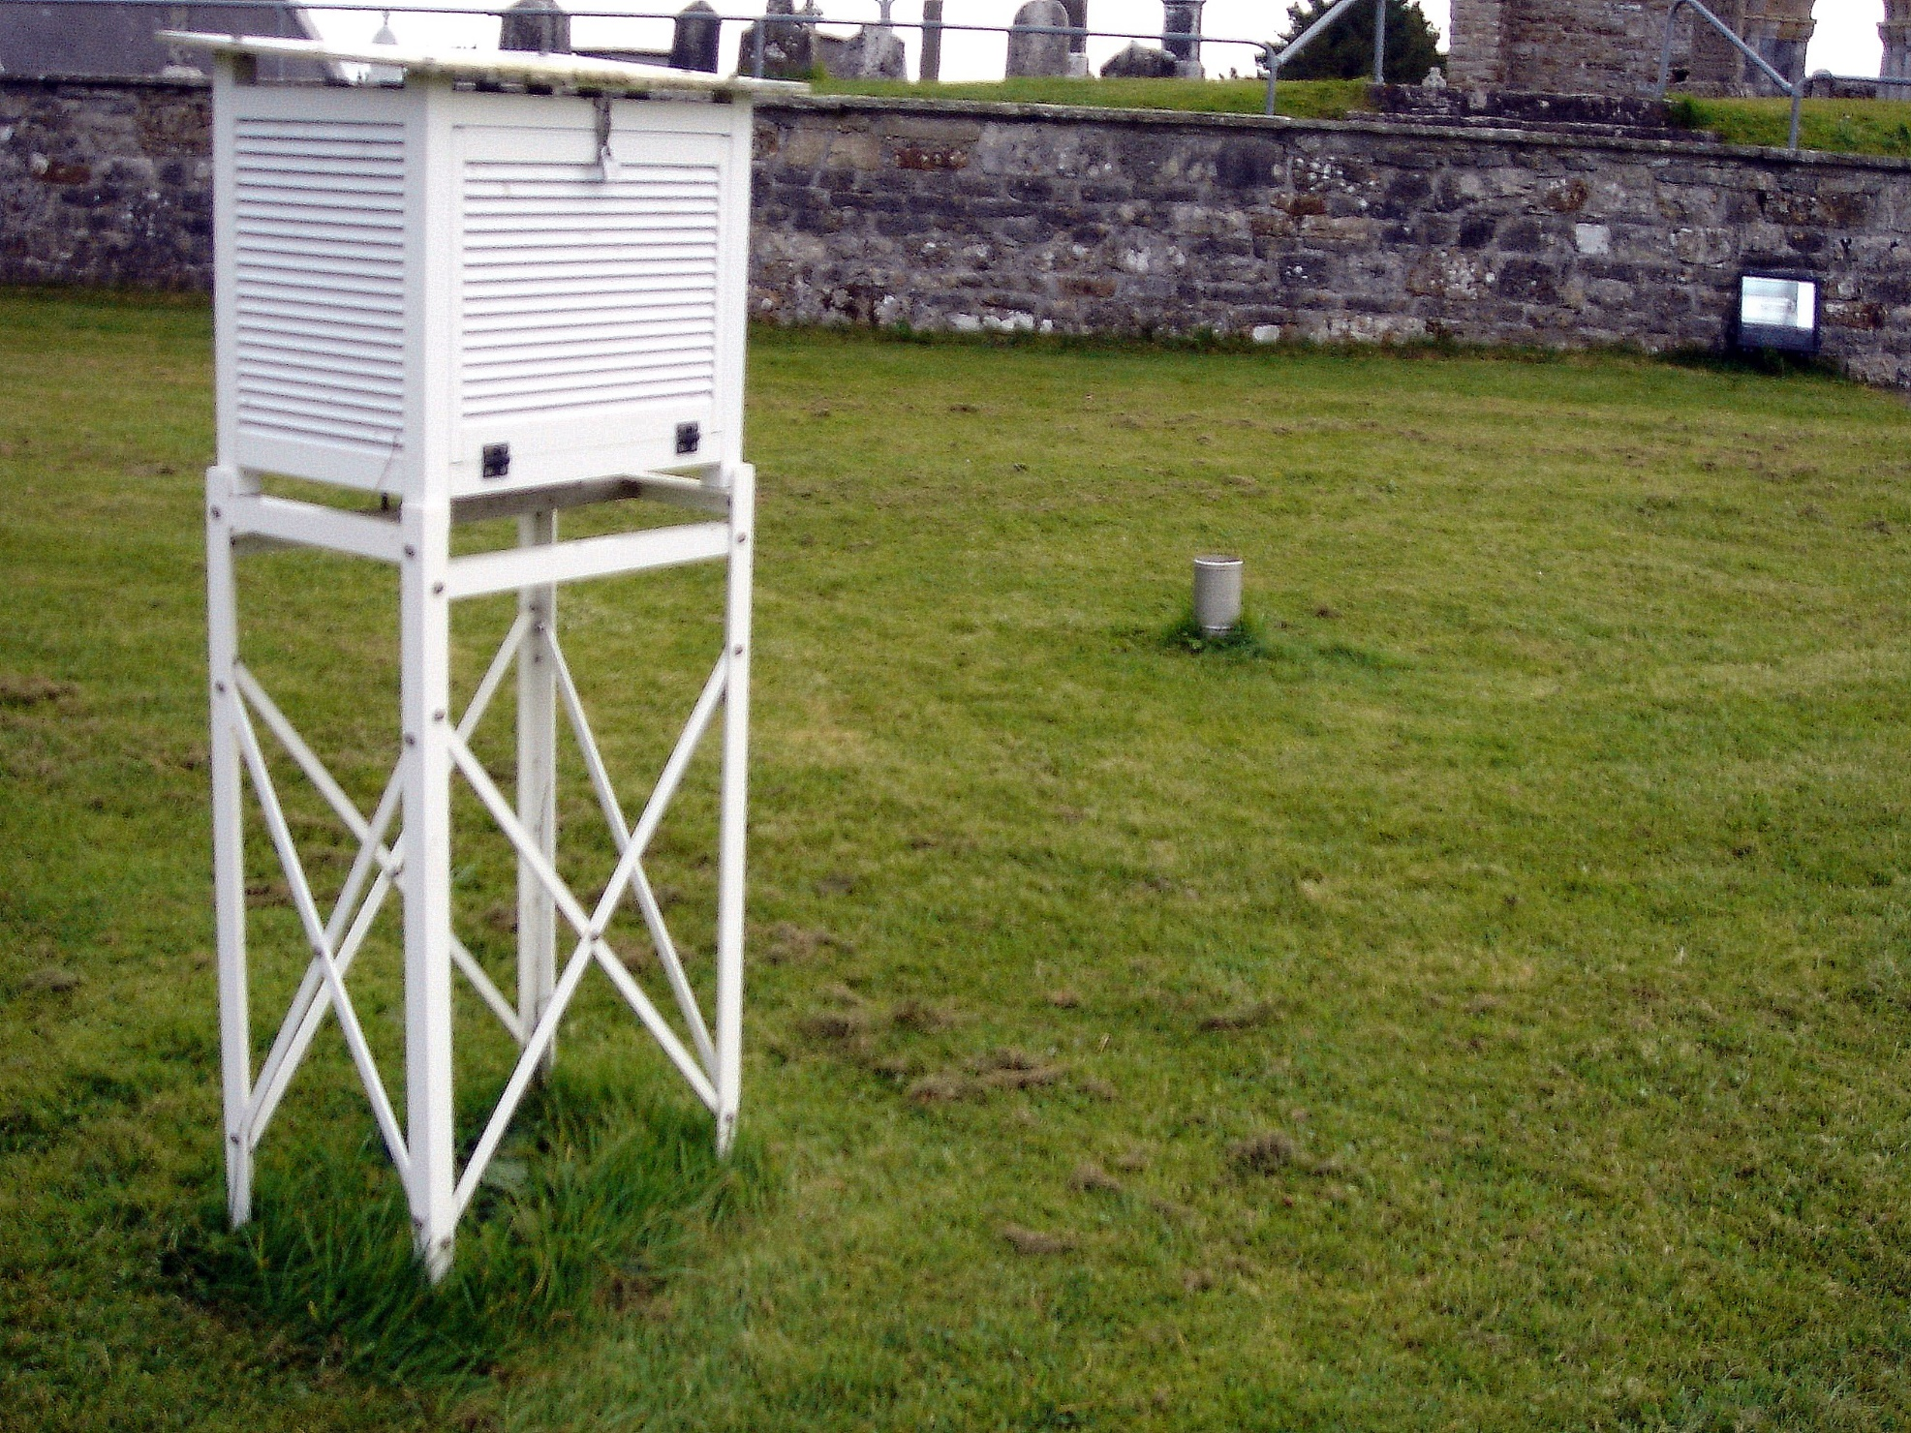
Monitoring climate & impacts

Slide 17
Climate Adaptation Guidance for Local Authorities: Increasing the resilience of heritage resources to current and future climate conditions Webinar: Actioning Policy, Climate Change Adaptation for Built and Archaeological Heritage

Slide 18
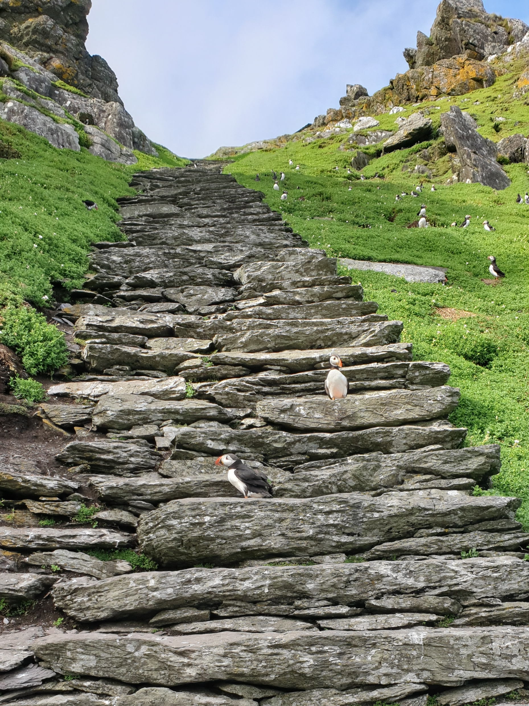
2024 Climate Change Risk Assessment (CCRA) Sceilg Mhichíl World Heritage Property
Built on research by Daly 2014 and combining elements of Adapt Northern Heritage (ANH) and Climate Vulnerability Index (CVI) approaches

Slide 19
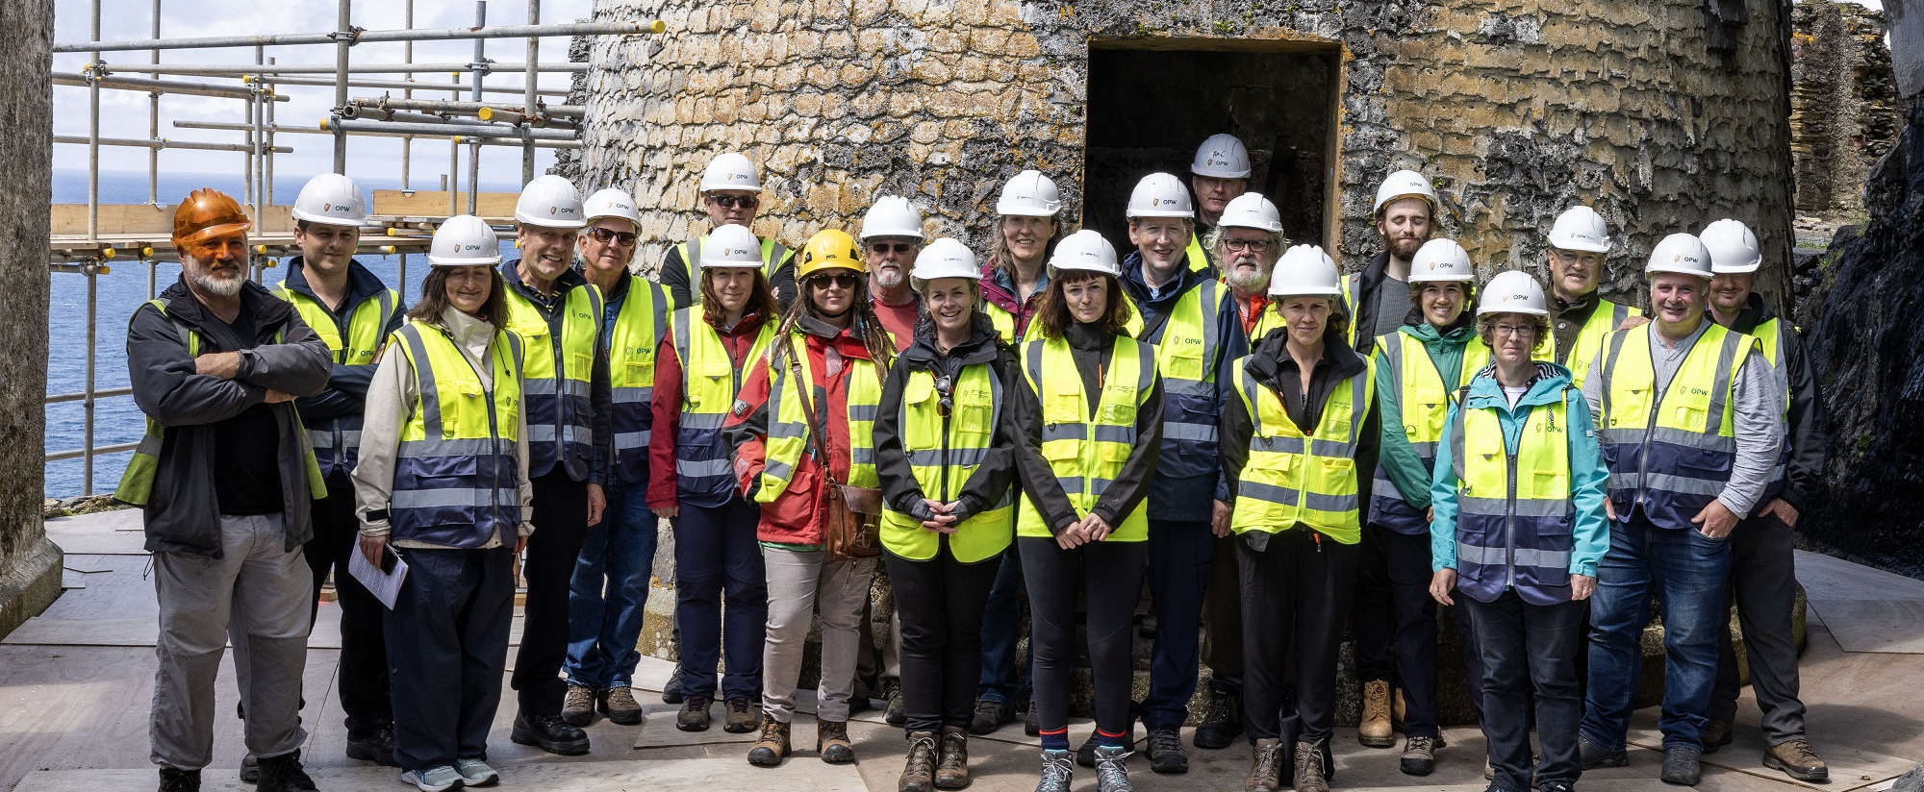
Technical Site Visit

Slide 20
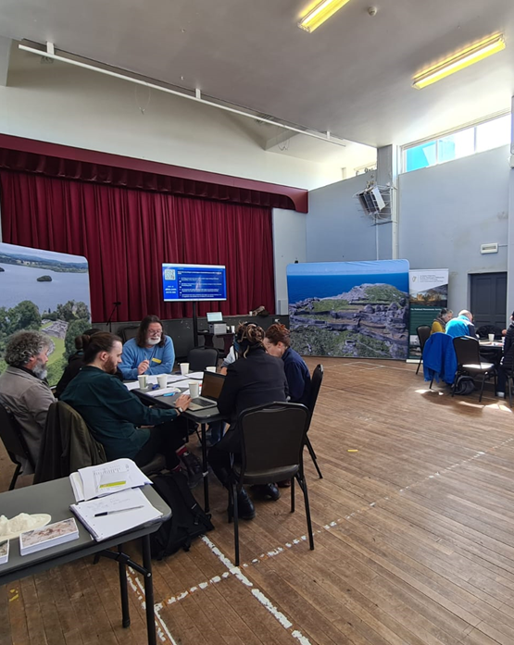
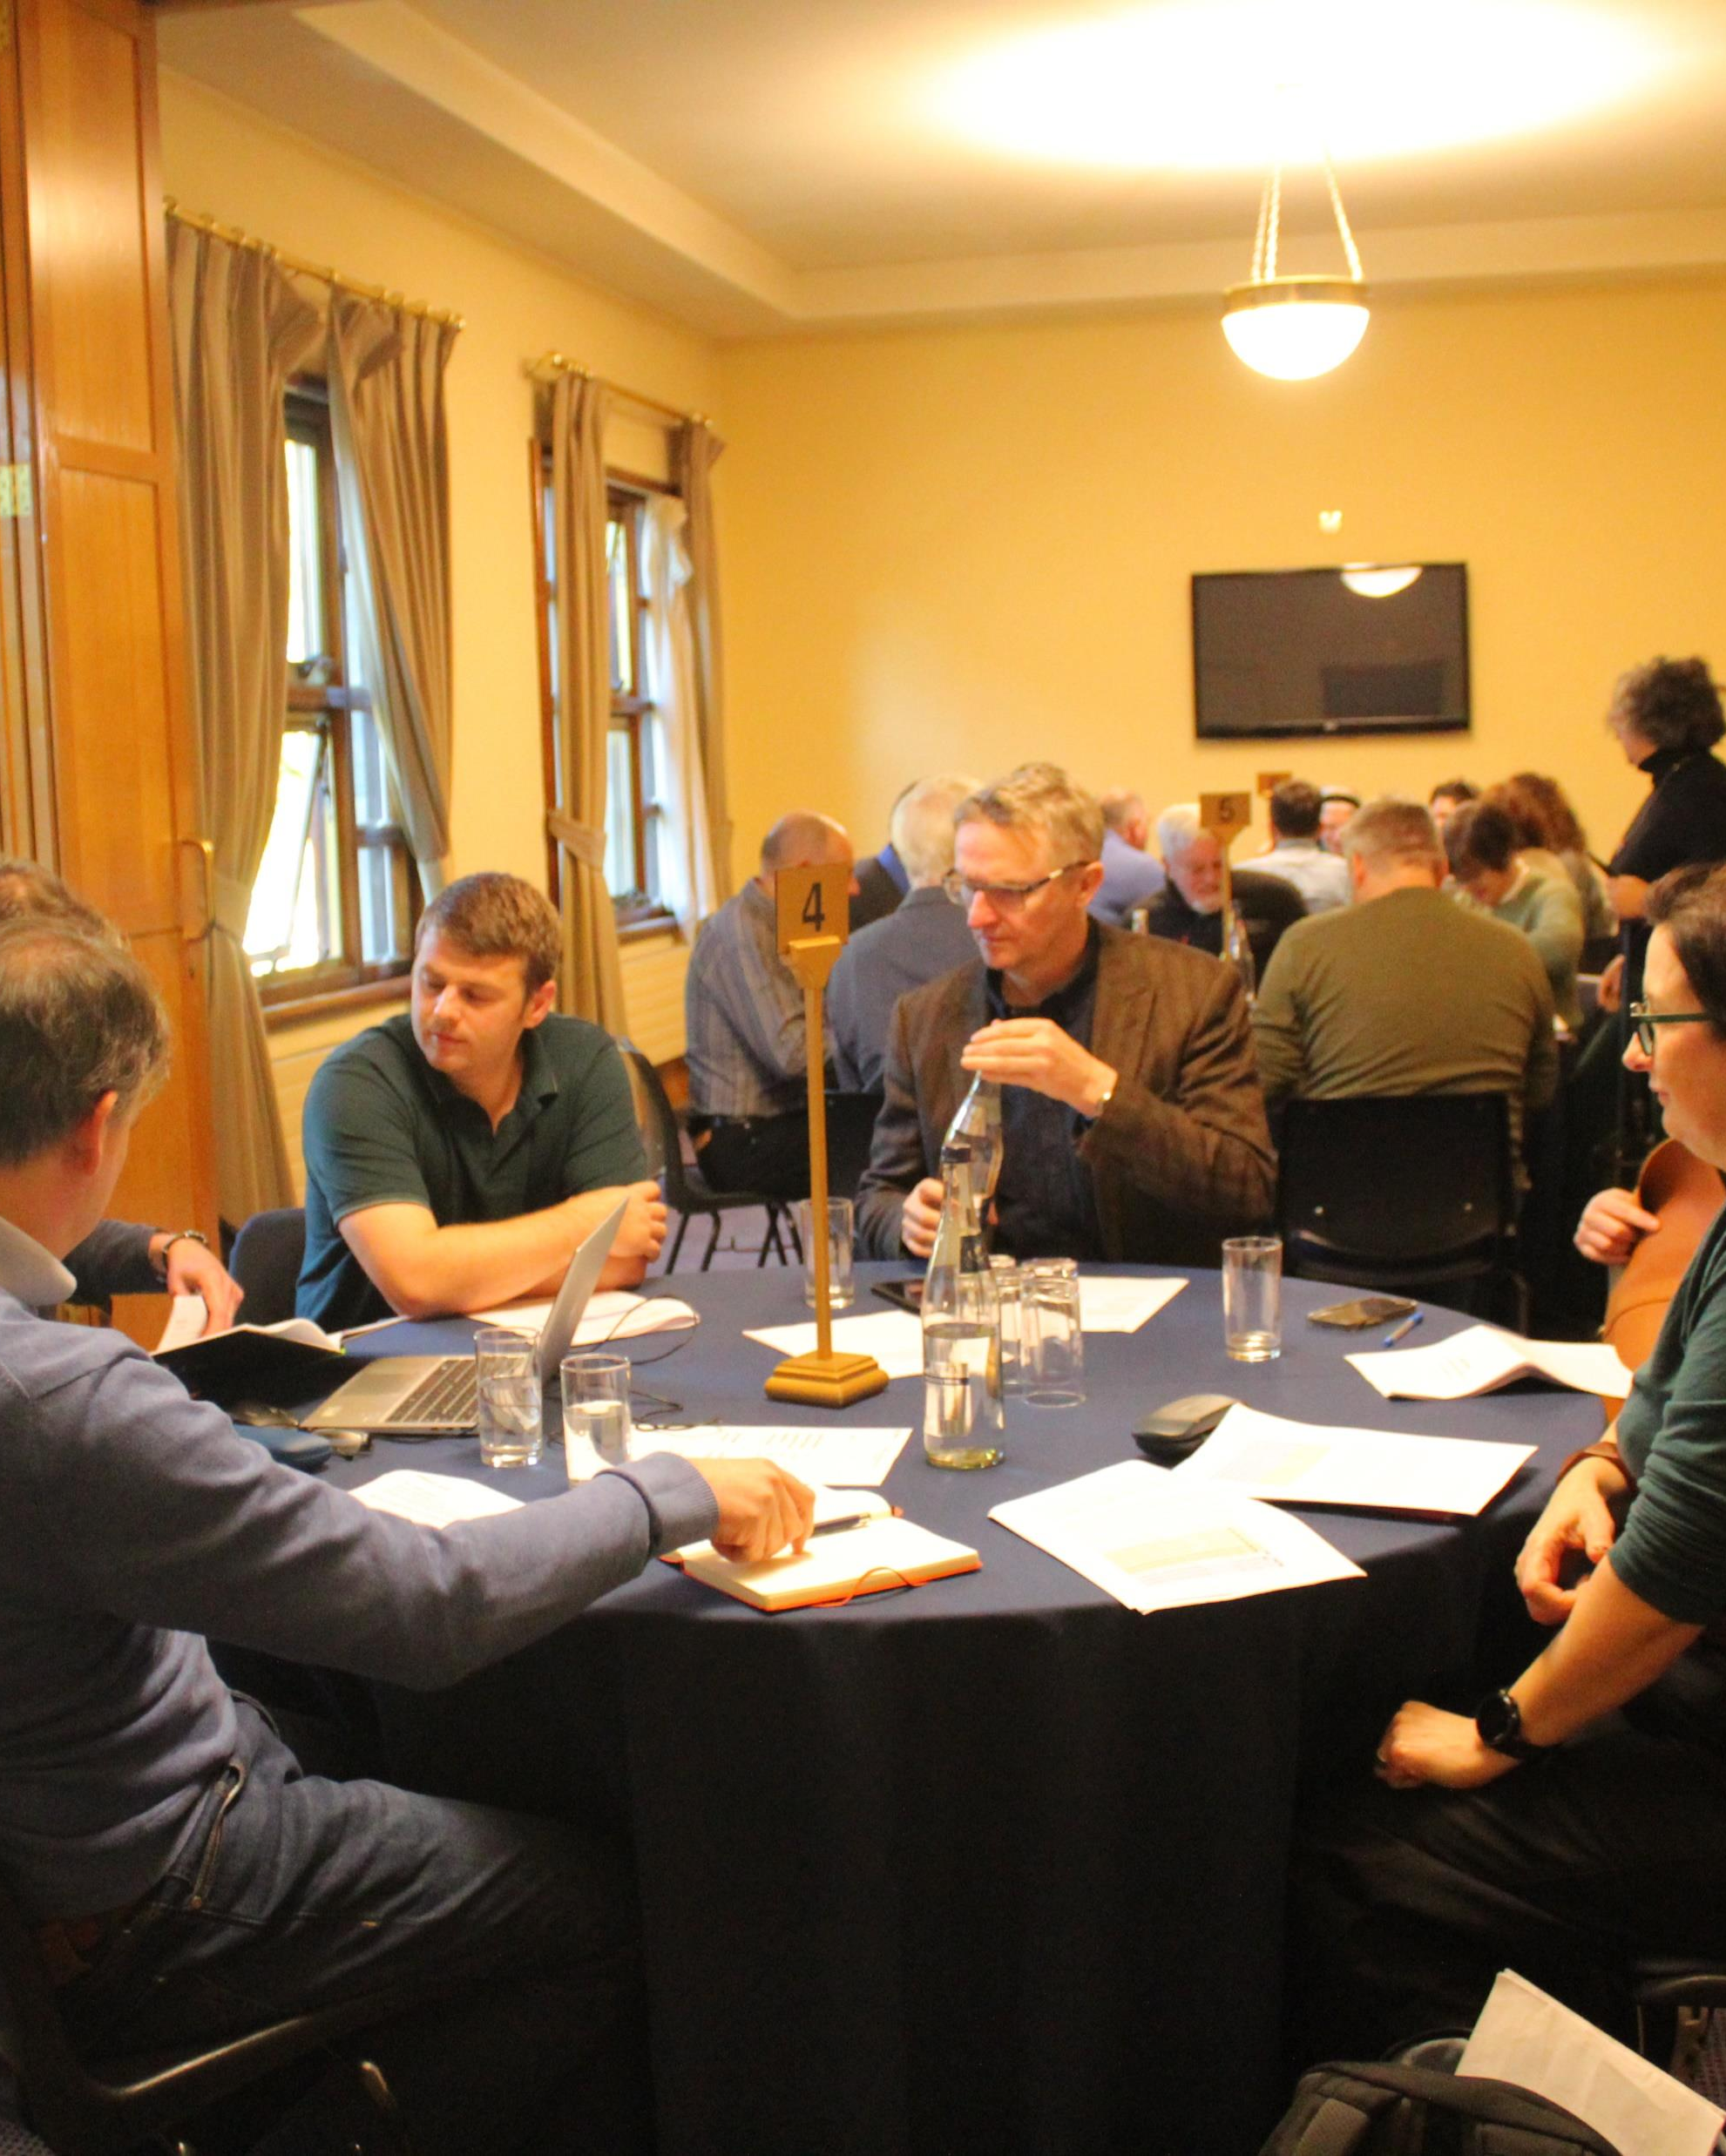
Technical & Community Workshops
FamilyID=Office_ArchiveTorn

Slide 21
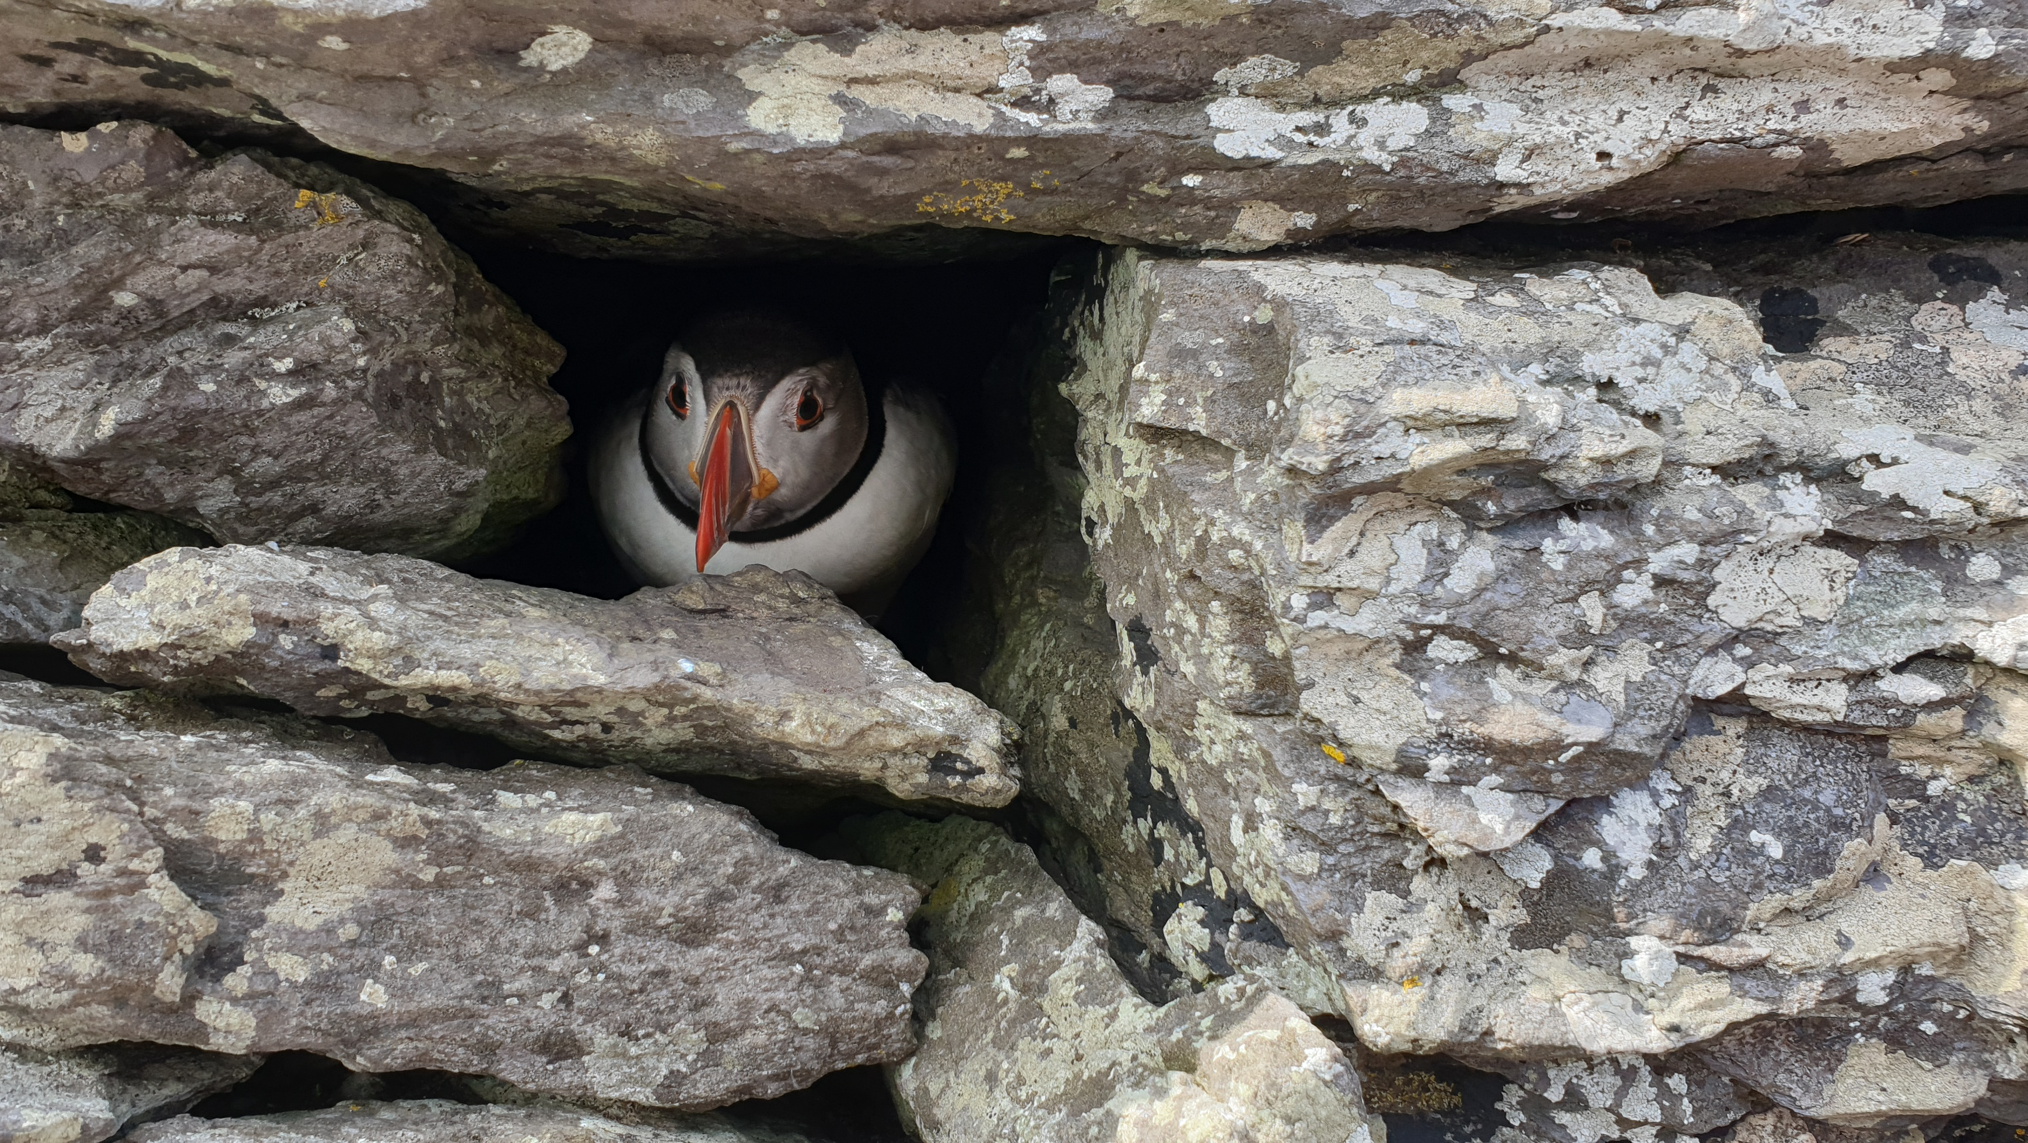
Future Directions
US Climate Heritage Policy International Context

Slide 22
Research Gaps
impacts within specific settings and systems
role of heritage in climate action
utilize diverse knowledge sources
limitations of current systems
pooling and sharing of data across sectors and disciplines
evaluations of Nature Based Solutions
inclusion of communities
mechanisms to help with uncertainty, future discounting, politics and financial instability
multi-disciplinary approaches
US Climate Heritage Policy International Context

Slide 23
Policy Gaps
Cultural Landscapes: One approach favoured is to take a landscape character approach to understanding climate change impacts and responses.
Moveable heritage: Collections and artefacts
Cross sectoral working: natural heritage, also agriculture, tourism and planning.
Dissemination: The stakeholder WGs have been very useful for creating awareness and capacity but a comment was made that this needs to disseminate further, faster.
Climate Action: Stakeholders were strongly in favour of continuing and strengthening the linkage between adaptation and mitigation
Strengthen linkages between sectoral and local plans (vertical integration)
Consider how B&AH CCSAP can contribute to the NAF – co-benefits.
US Climate Heritage Policy International Context

Slide 24
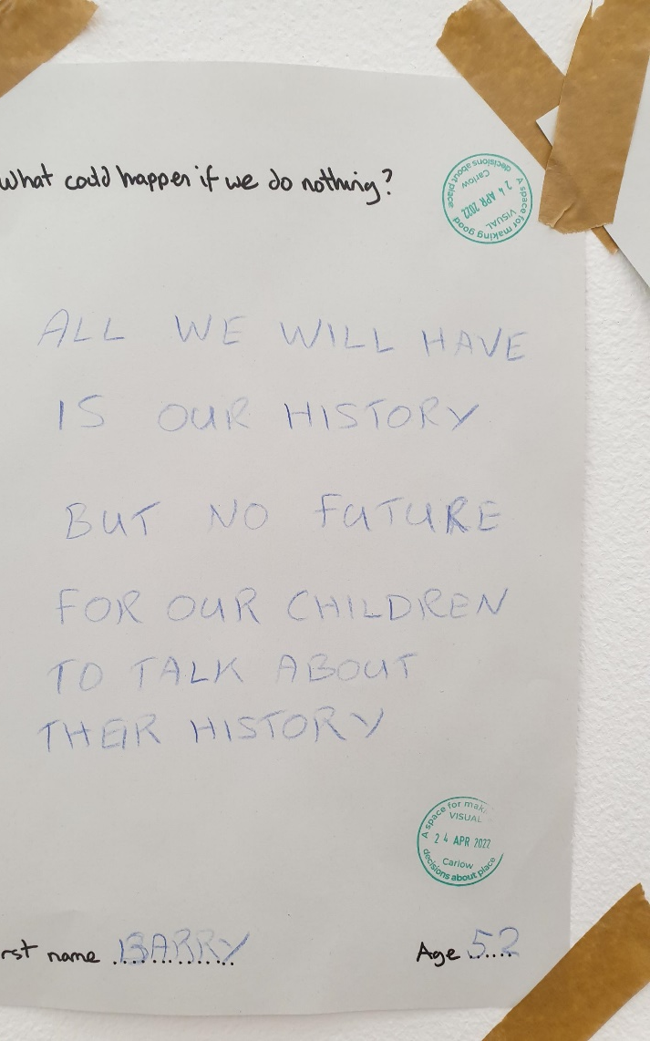
Visual Centre for Contemporary Art Short Circuit Short Circuit is a series of four conversation events taking place in Helena Fitzgerald’s exhibition A Space for Making Good Decisions About Place in April and May 2022.

Slide 25
Thank you for listening
www.drcathydaly.com
Cathy Daly | LinkedIn
cathy@carrig.ie
cdaly@lincoln.ac.uk

Slide 26
References
Climate Change Adaptation Sectoral Plan for Built and Archaeological Heritage. Dublin: Department of Culture Heritage and the Gaeltacht. Available at https://www.gov.ie/pdf/?file=https://assets.gov.ie/75639/a0ad0e1d-339c-4e11-bc48-07b4f082b58f.pdf#page=null
Daly, C., C. Engel-Purcell, C. Chan, J. Donnelly, M. MacDonagh & P. Cox. 2020. ‘Climate Change Adaptation Planning, a National Scale Methodology’ in Journal of Cultural Heritage Management and Sustainable Development Emerald Climate Change Adaptation Planning for Cultural Heritage, a National Scale Methodology - The Lincoln Repository
Daly, Cathy, Fatorić, Sandra, Carmichael, Bethune, Pittungnapoo, Witiya, Adetunji, Olufemi, Hollesen, Jørgen, Nakhaei, Masoud and Herrera Diaz, Alberto (2022) Climate Change Adaptation Policy & Planning for Cultural Heritage in Low- & Middle-Income Countries. Antiquity . ISSN 0003-598X
https://www.gov.ie/en/publication/22a37-heritage-and-climate-adaptation-guidance-for-local-authorities/

