Slide 1
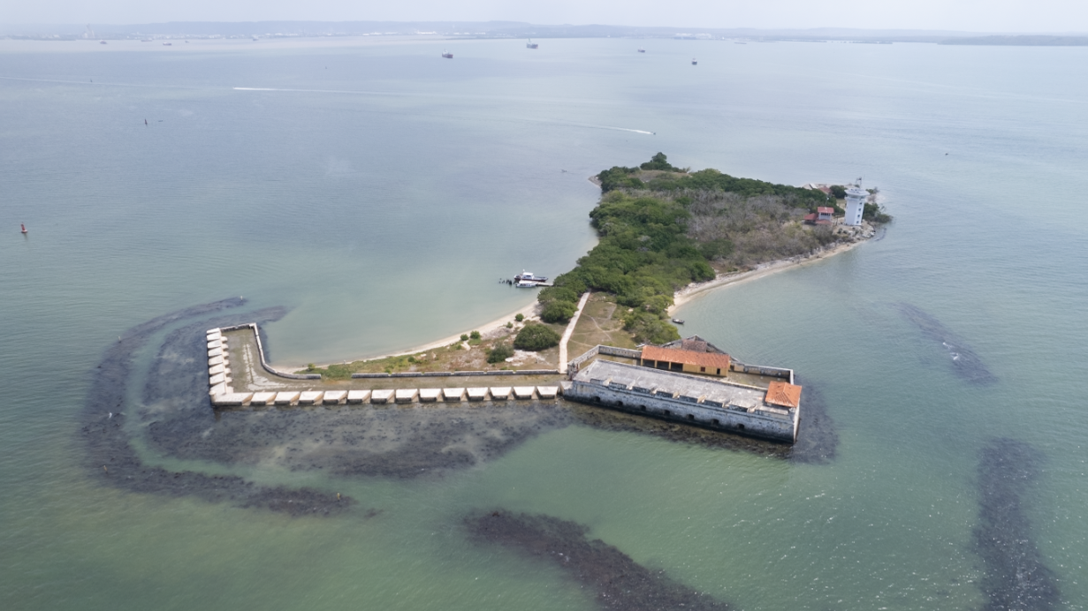
Local problems, global solutions:
Climate change impacts on the
Fortified Landscape of Cartagena de Indias, Colombia
Panel 3
Climate Change Adaptation: Domestic Efforts Towards Climate Heritage Policy
CARLOS DEL CAIRO HURTADO
Member of preserving Legacies Project
Professor – Researcher Escuela Naval Almirante Padilla ENAP
Colombia
U.S. Climate Heritage in the International Context
Washington D.C October 4th, 2024

Slide 2
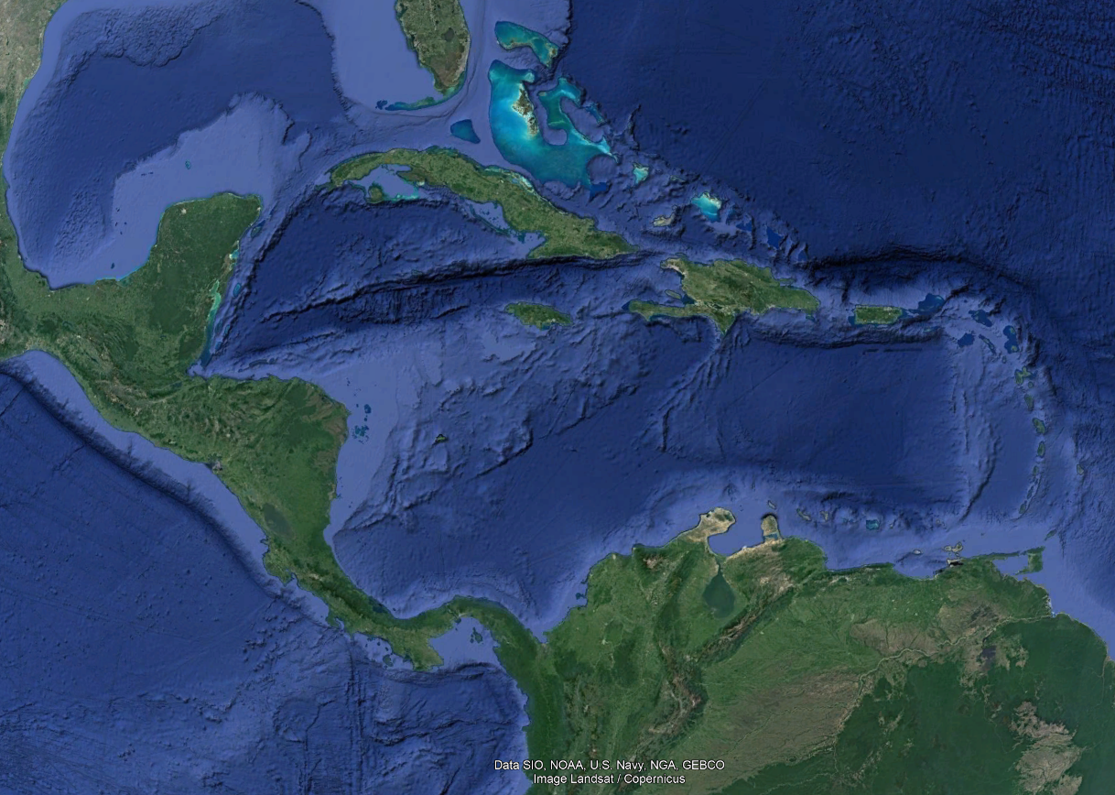
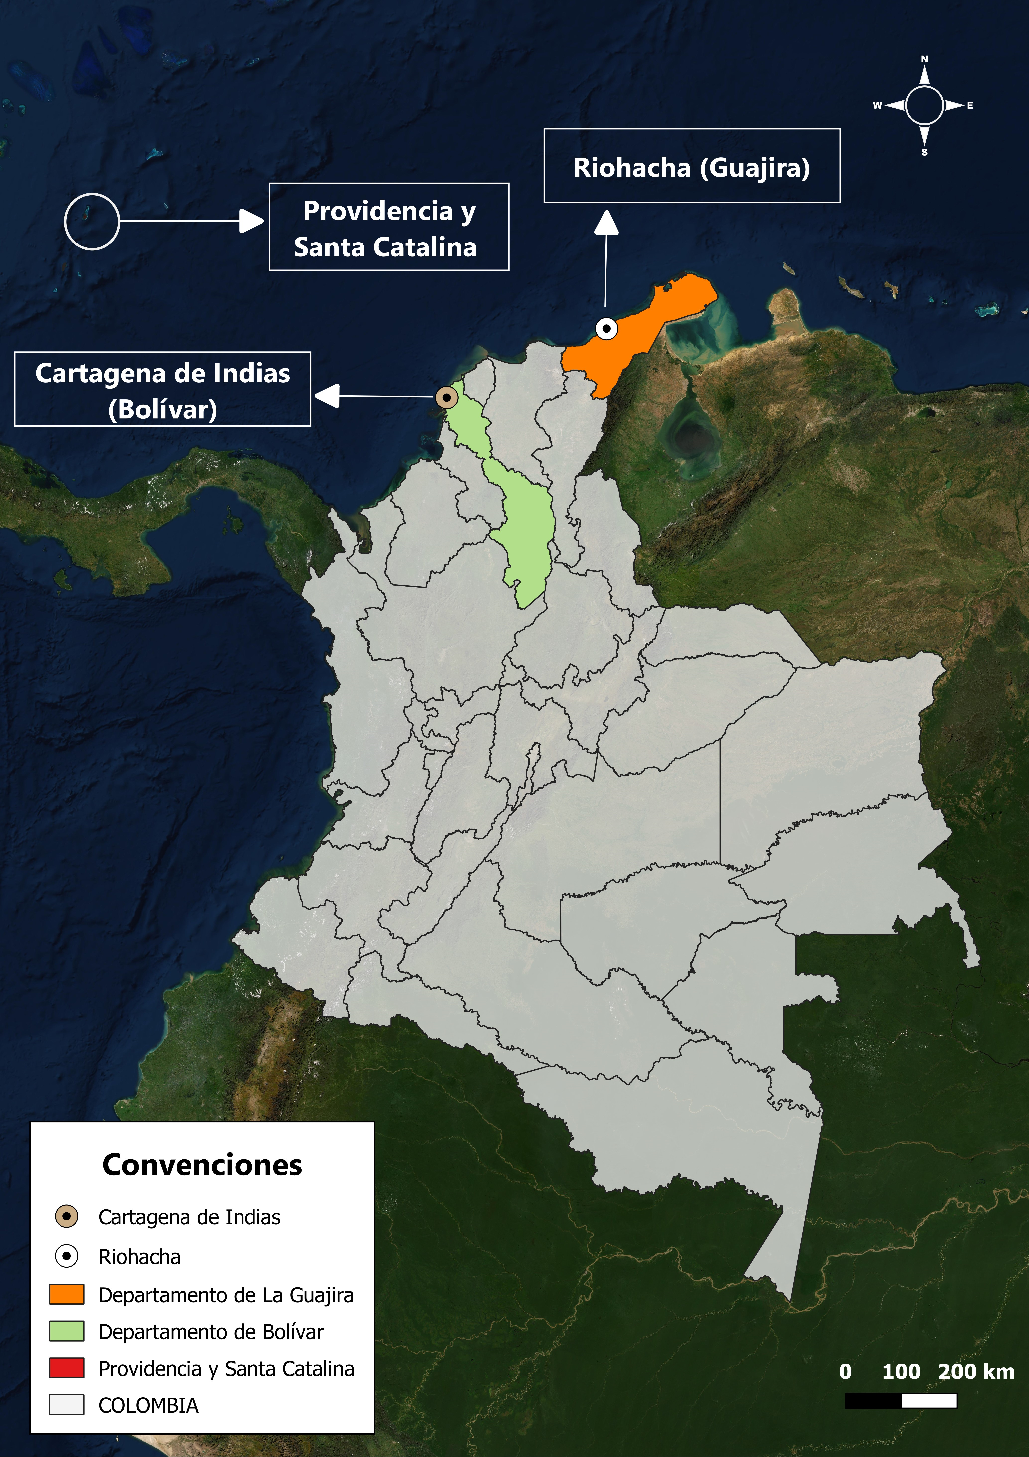
Cartagena de Indias, Colombia, South America

Slide 3
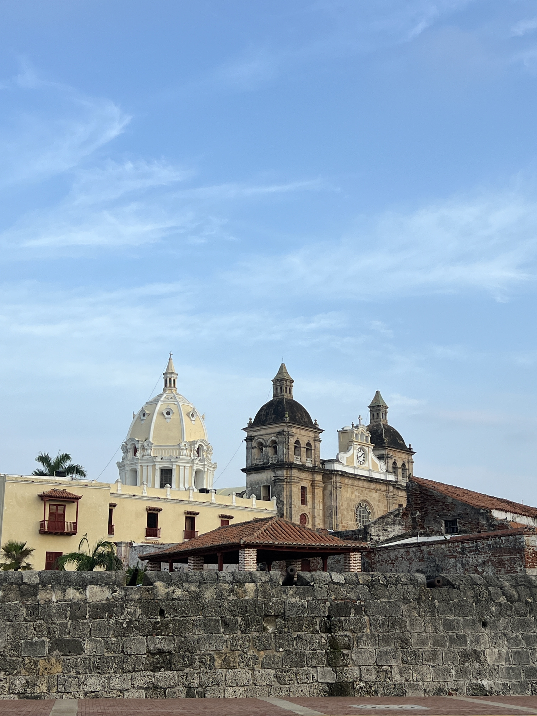
The city comprises the World Heritage site of Port, Fortresses and Group of Monuments, Cartagena was inscribed in the World Heritage list in 1984
The site includes the most extensive fortifications in South America, as well as several quarters of the historic city. A system of zones divides the city into three neighbourhoods: San Pedro, with the cathedral and many Andalusian-style palaces; San Diego, where merchants and the middle class lived; and Gethsemani, the 'popular quarter'.

Slide 4
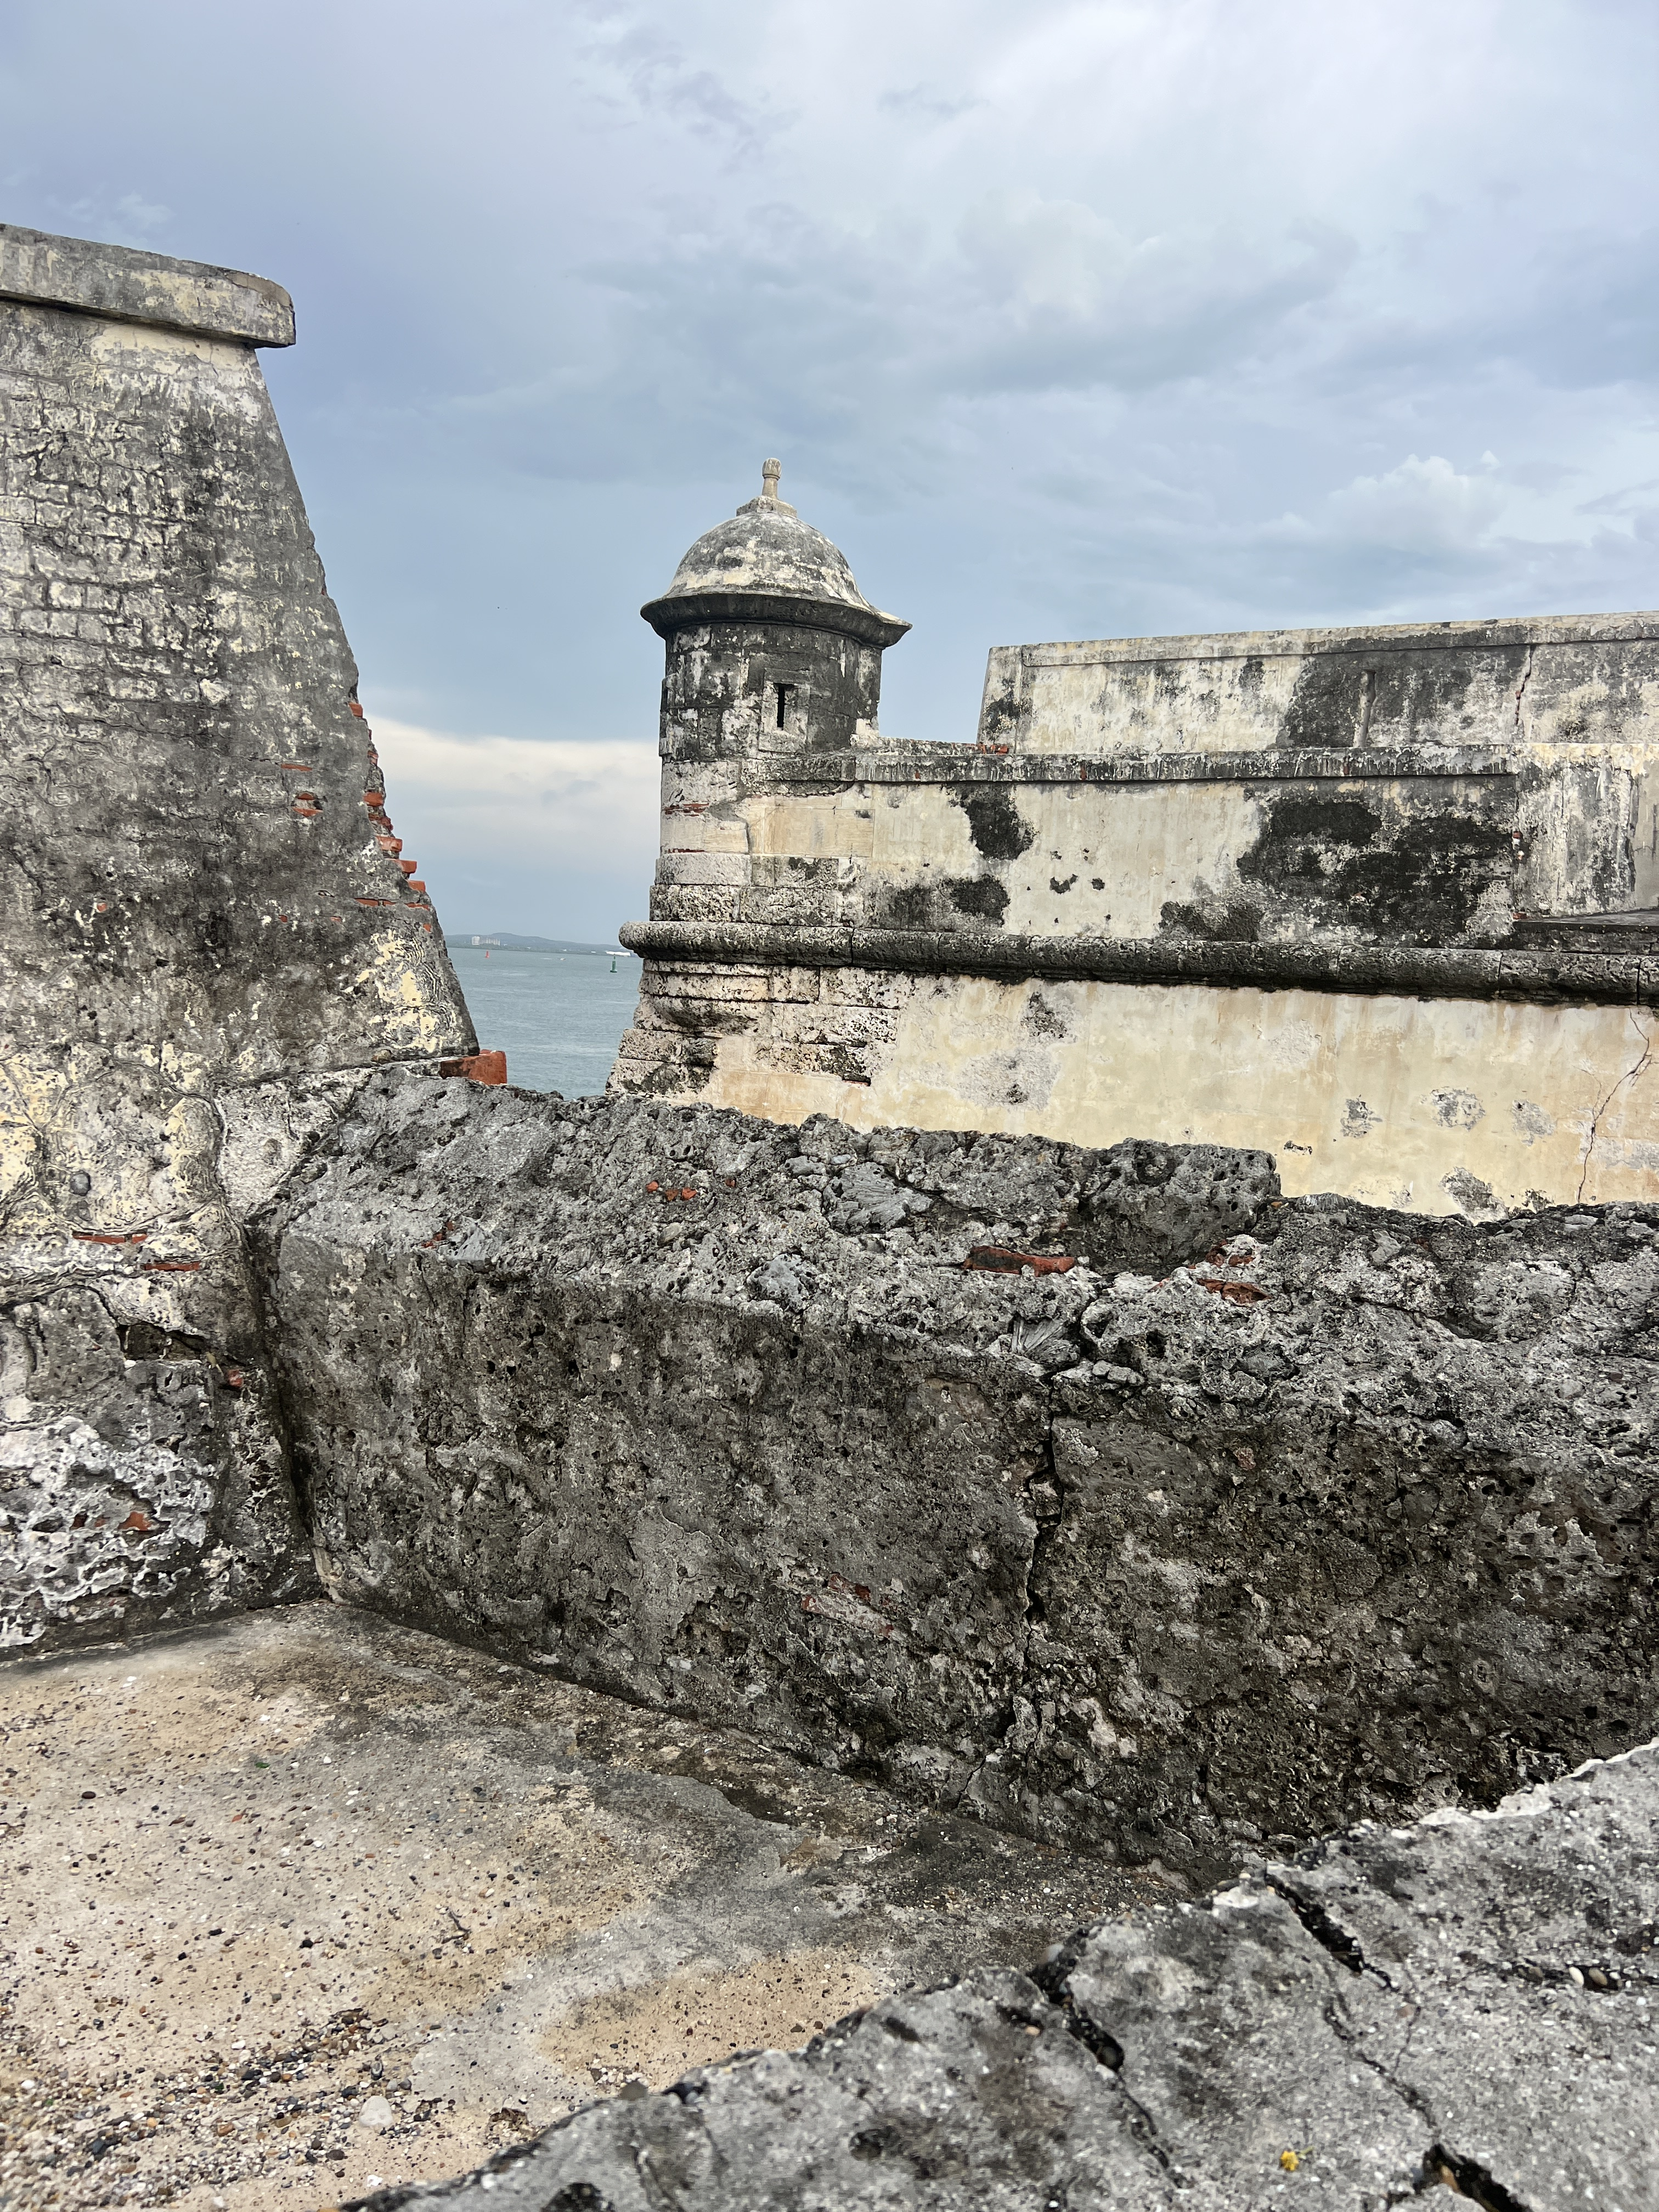
Cultural policies for heritage protection and conservation
from the verticality of state competences
have excluded the strategic participation of relevant actors in the processes of protection, research, dissemination and divulgation of cultural heritage.
contribute to avoid the destruction of cultural landscape contexts. .

Slide 5
Governance of cultural heritage
How to implement national and transnational public policies
Horizontal interaction of the various authorities with local civil society actors and academic structures based on pluralistic, inclusive and non-hierarchical action for the co-production of regulations and actions.
Construction of a Knowledge Society

Slide 6
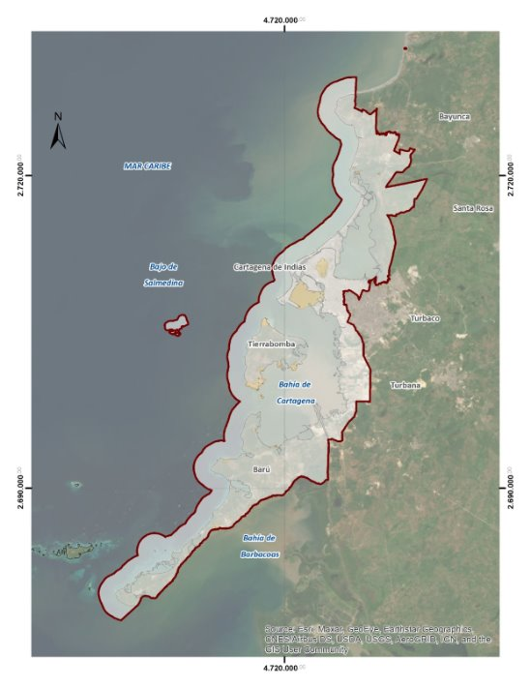
The Fortified Cultural Landscape of Cartagena de Indias is
An hybrid territory
Sea and land integrated as an assemblage of non human and human actor
Dissolution of borders horizontal and vertica
Sea-Land
Dissolution of dichotomy between nature and culture

Slide 7
if waves are understood in all their complexity – as forces, as vectors, as assemblages of molecules and meanings, as spaces of periodicity, randomness, instability and transformation, and as volumes (depths) and areas (surfaces) – then waves, and the wet ontology they exemplify, may be exceptionally well suited for understanding the politics of our watery planet. (Steinberg, 2015)

Slide 8
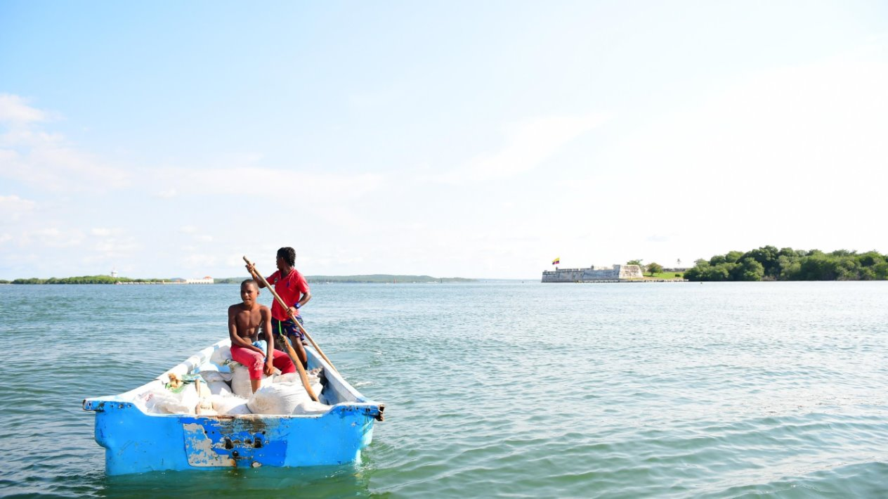
A Special Management and Protection Plan (PEMP
is a cultural heritage planning and management instrument that establishes the necessary actions to guarantee the protection, conservation and sustainability of heritage assets.

Slide 9
Interinstitutional Work in the Recent Years
Government Institutions
Academy
Local Communities
MANAGEMENT Of CULTURAL LANDSCAPE

Slide 10
the customs and traditions of the surrounding communities (daily life),
The natural elements of the bay (geomorphology, flora, fauna),
THE FORTIFIED LANDSCAPE OF CARTAGENA DE INDIAS
the water and land roads that connect and communicate the entire territory.
the physical contexts of the properties that are now national heritage (architecture adapted to the environment and in response to socioeconomic conditions),

Slide 11
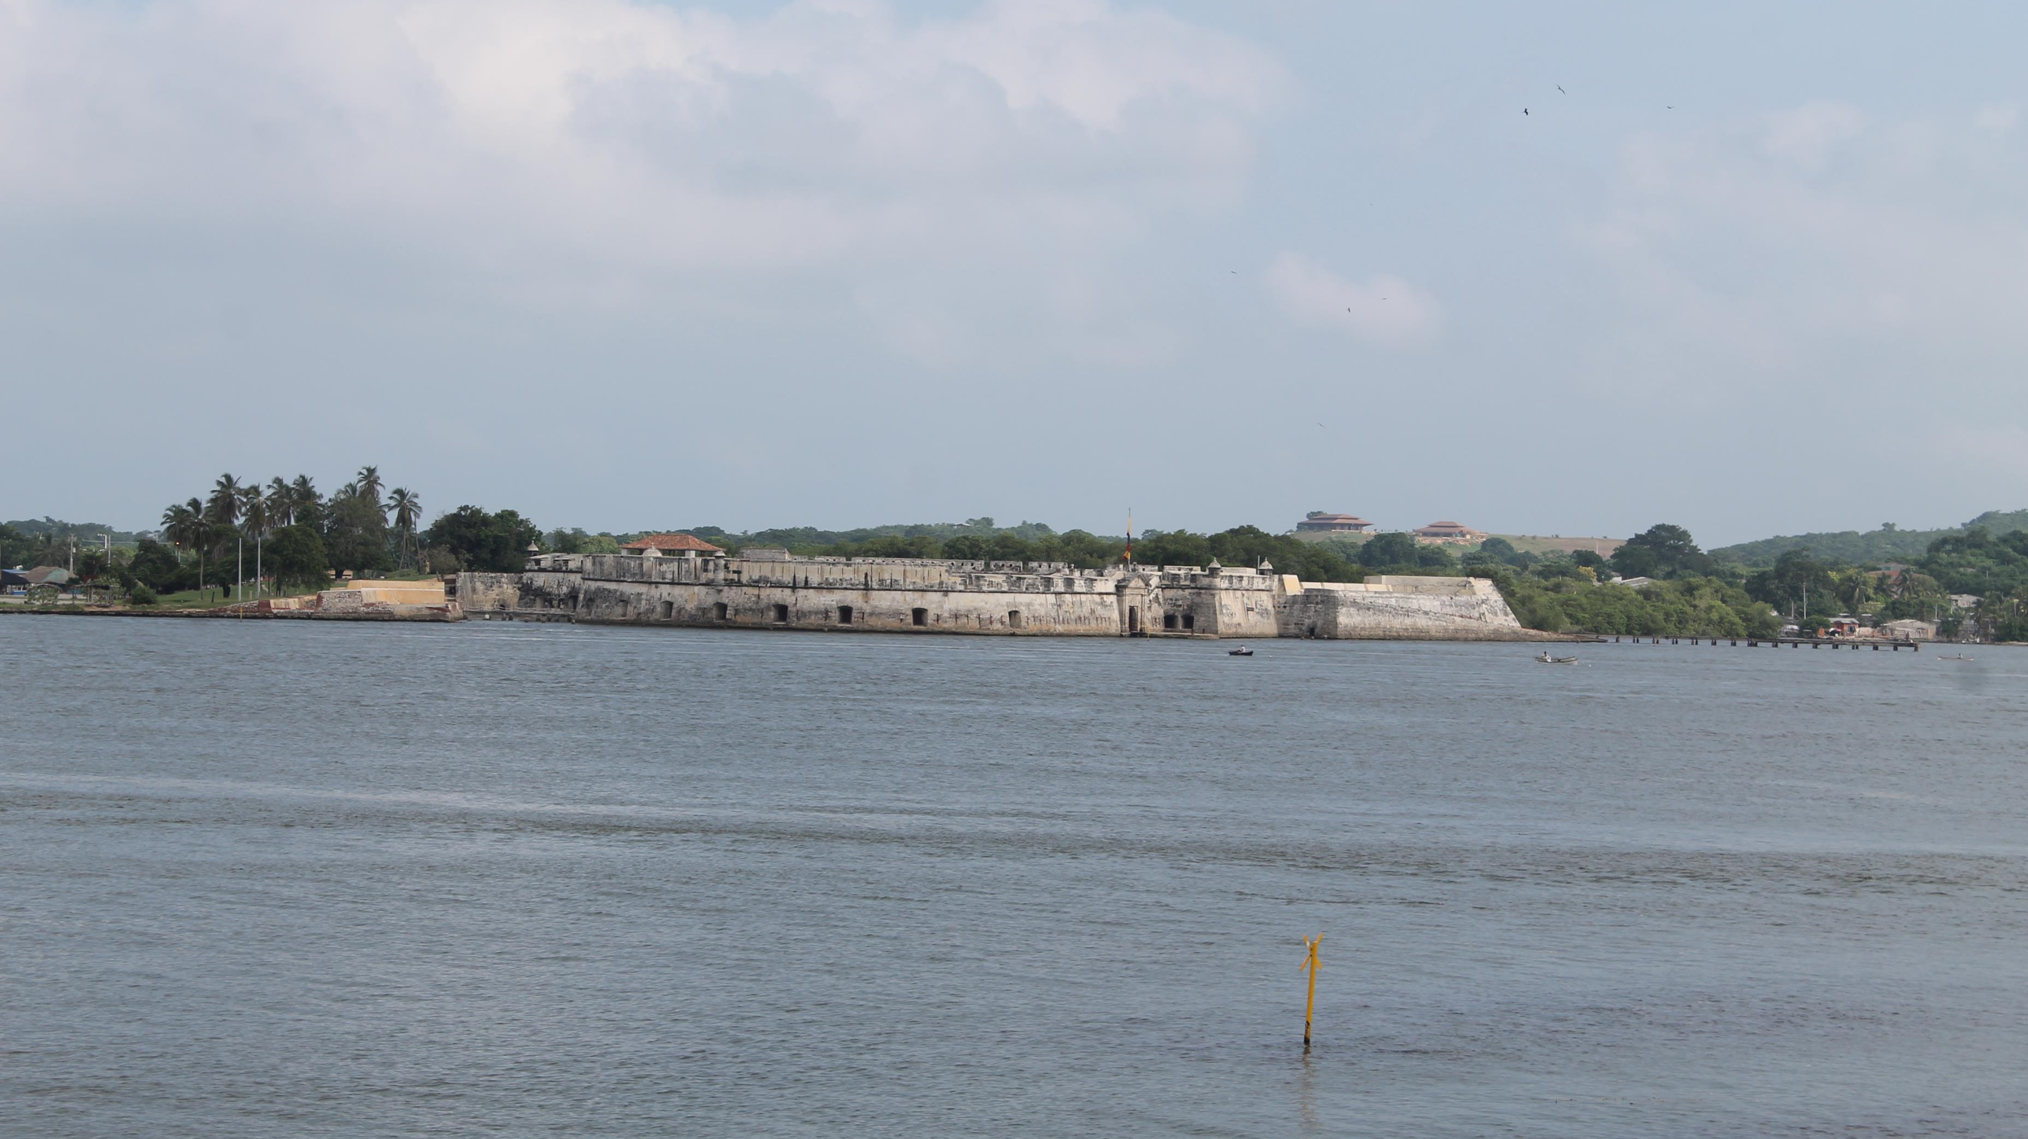
Military constructions

Slide 12
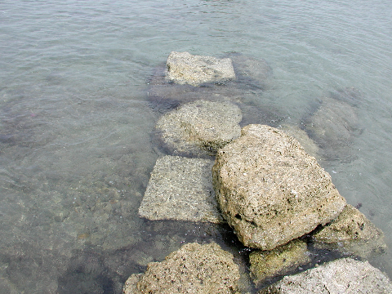
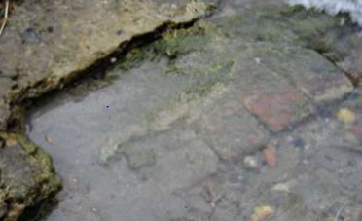
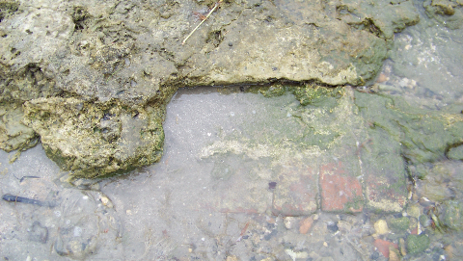
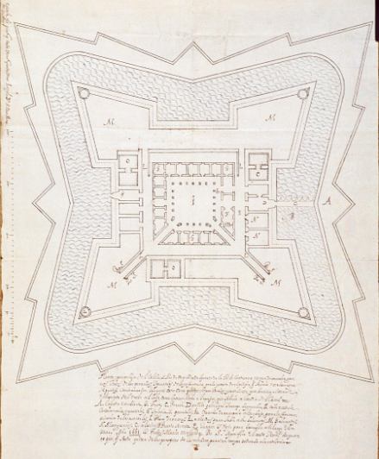
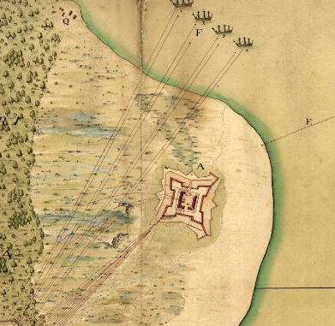
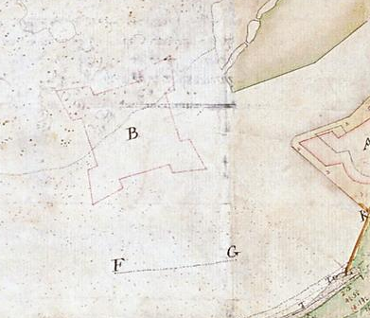
Fuentes Históricas
Del Cairo, C. (2011)
Del Cairo, C. (2011)
Del Cairo, C. (2011)
Planta y perspectiva del Castillo San Luis de voca Chica del Puerto de la Ciudad de Cartagena (1661) MP-PANAMA 73
A plan of Fort St. Louis, St. Joseph, St. Jago & of St. Philip scituated at ye entrance of Cartagena Harbour or Boca-Chica with ye parts adjacent and also of the attacks made against the said forts (1741) Library of the Congress
Plano del Canal de Boca Chica, Cartagena de Indias (1758) MP-PANAMA,342
Archaeological remains
Castillo de San Luis - S. XVII/XVIII

Slide 13
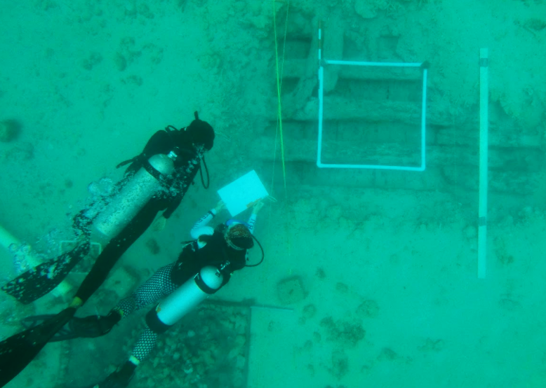
Underwater Cultural Heritage

Slide 14
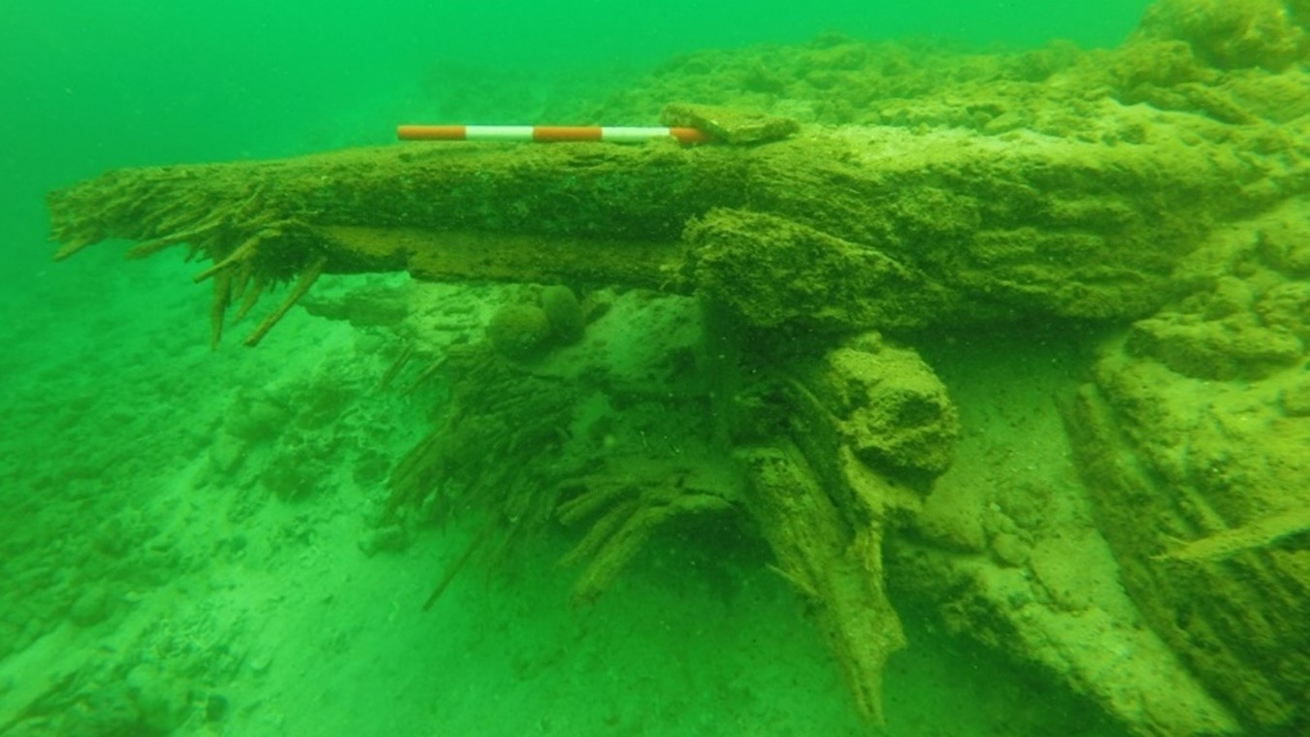
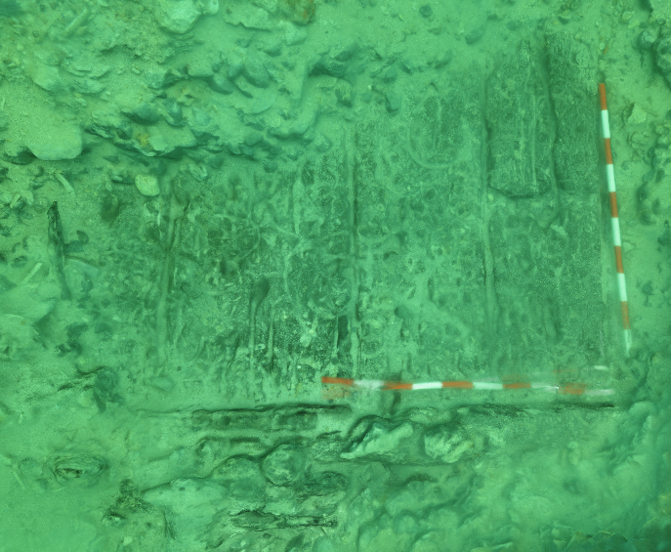
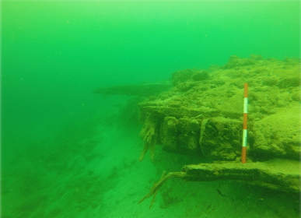
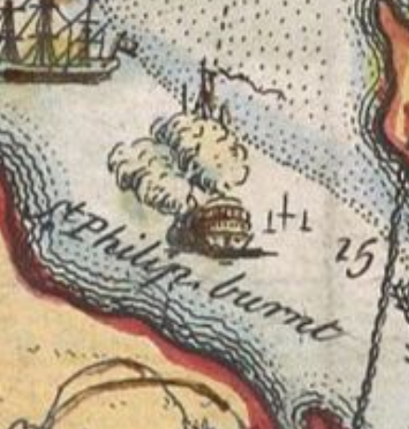
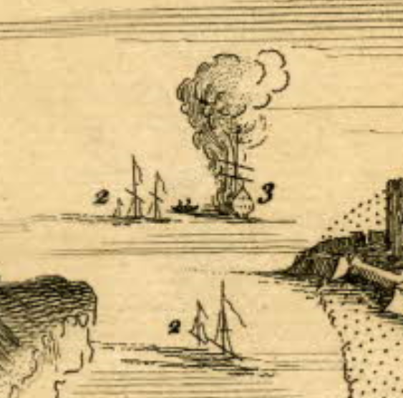
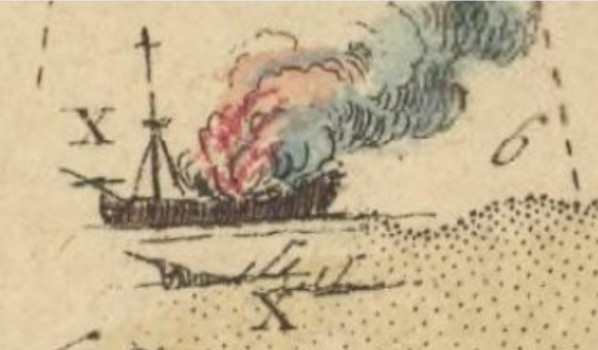
Fuentes Históricas
Fundación Terrafirme (2017)
Aldana, J. (2019)
Fundación Terrafirme (2017)
Plan of the Harbour of Carthagena in America Seated 16 Degrees 26 Minutes Lat. north and 75 degrees 21 Long. West of London, from a Draught brought to England by by Pet. Chassereau Archi: Also a View of the Fleet as they Anchor'd on ye C (1741) Osher Maps
A perspective view of the action at Cartagena (1741) British Library
Most humbly inscribed to the Rt. Honble. Sir Charles Wager. First lord comissioner of the admiralty, this plan of the harbour, town and several forts of Cartagena (1741) Bnf Gallica
Shipwreck San Felipe - 1741 (Canal de Bocachica)

Slide 15
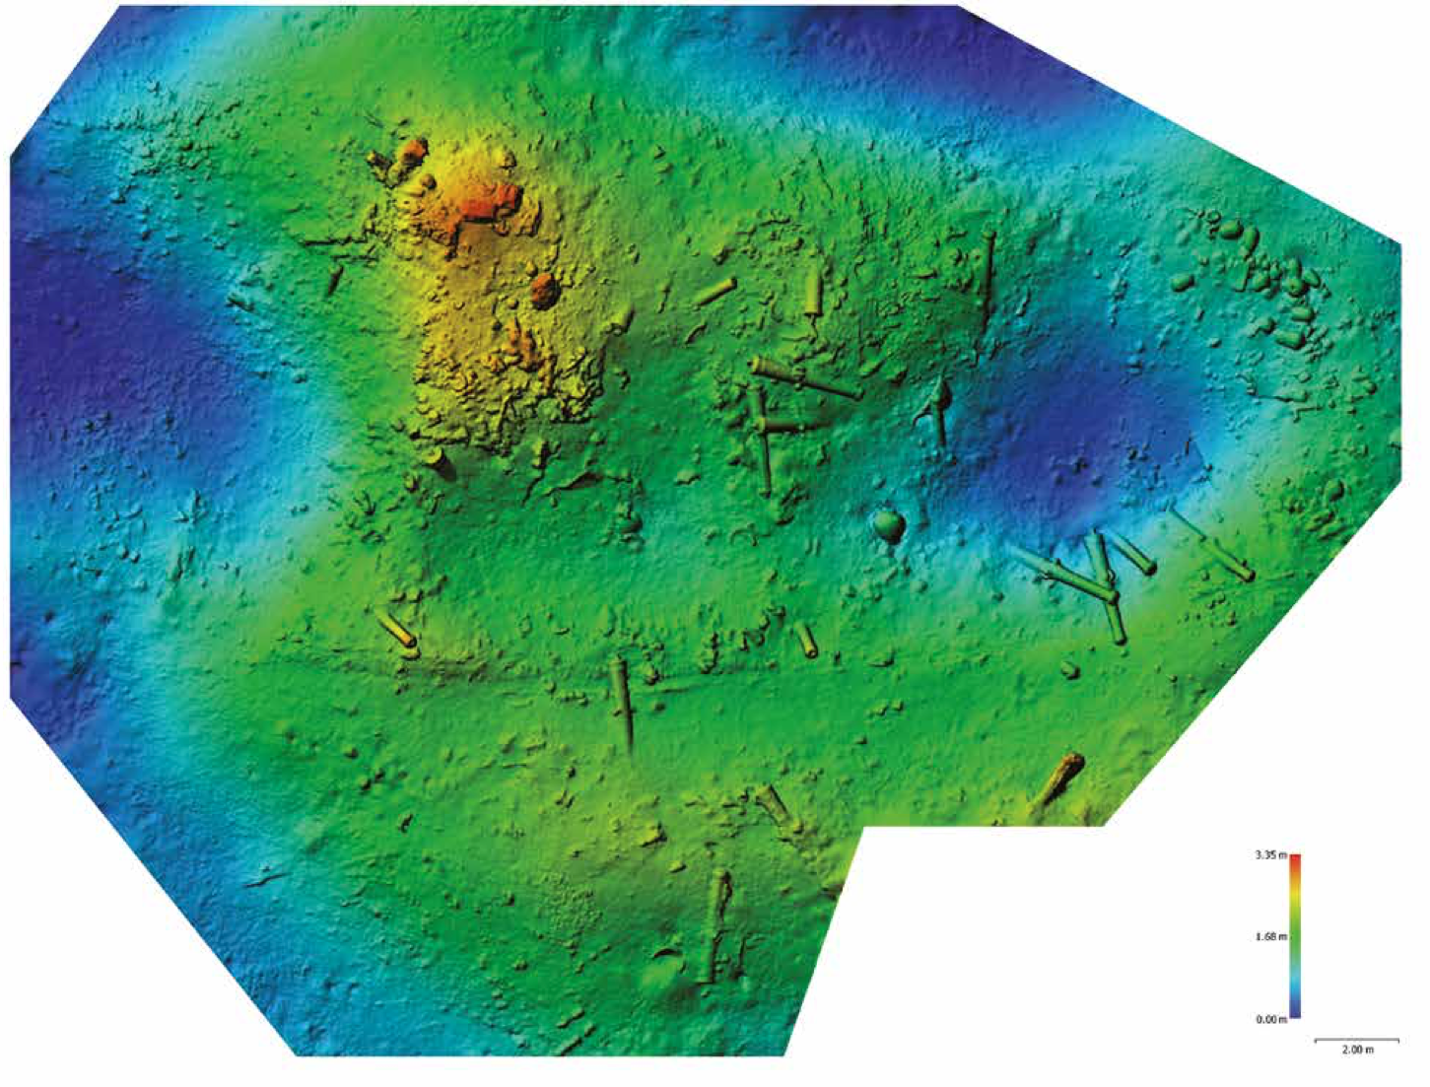
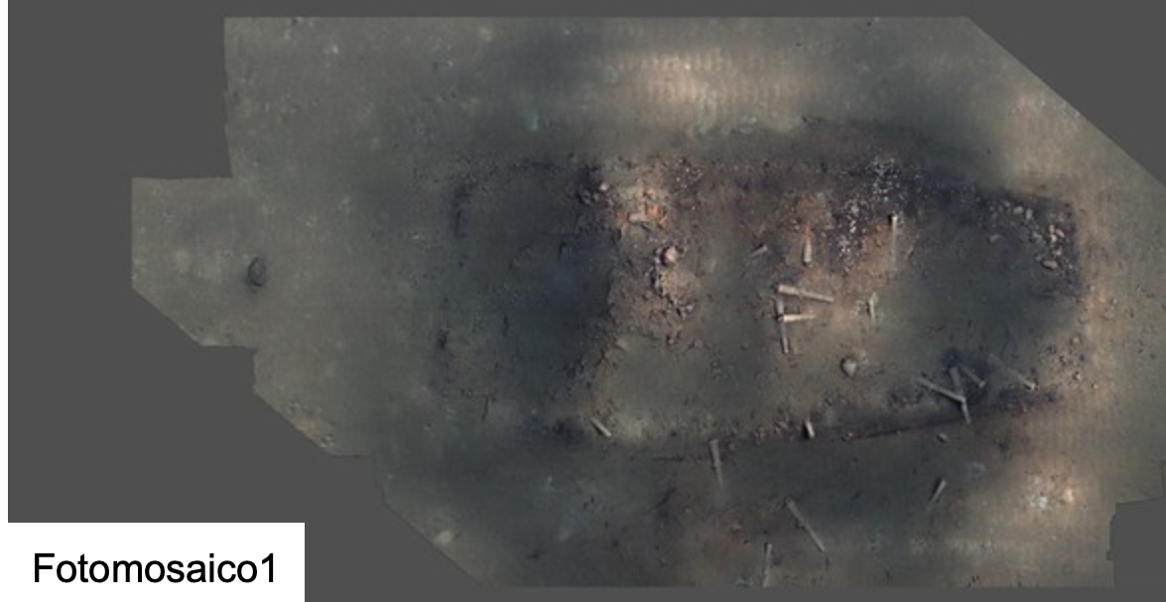
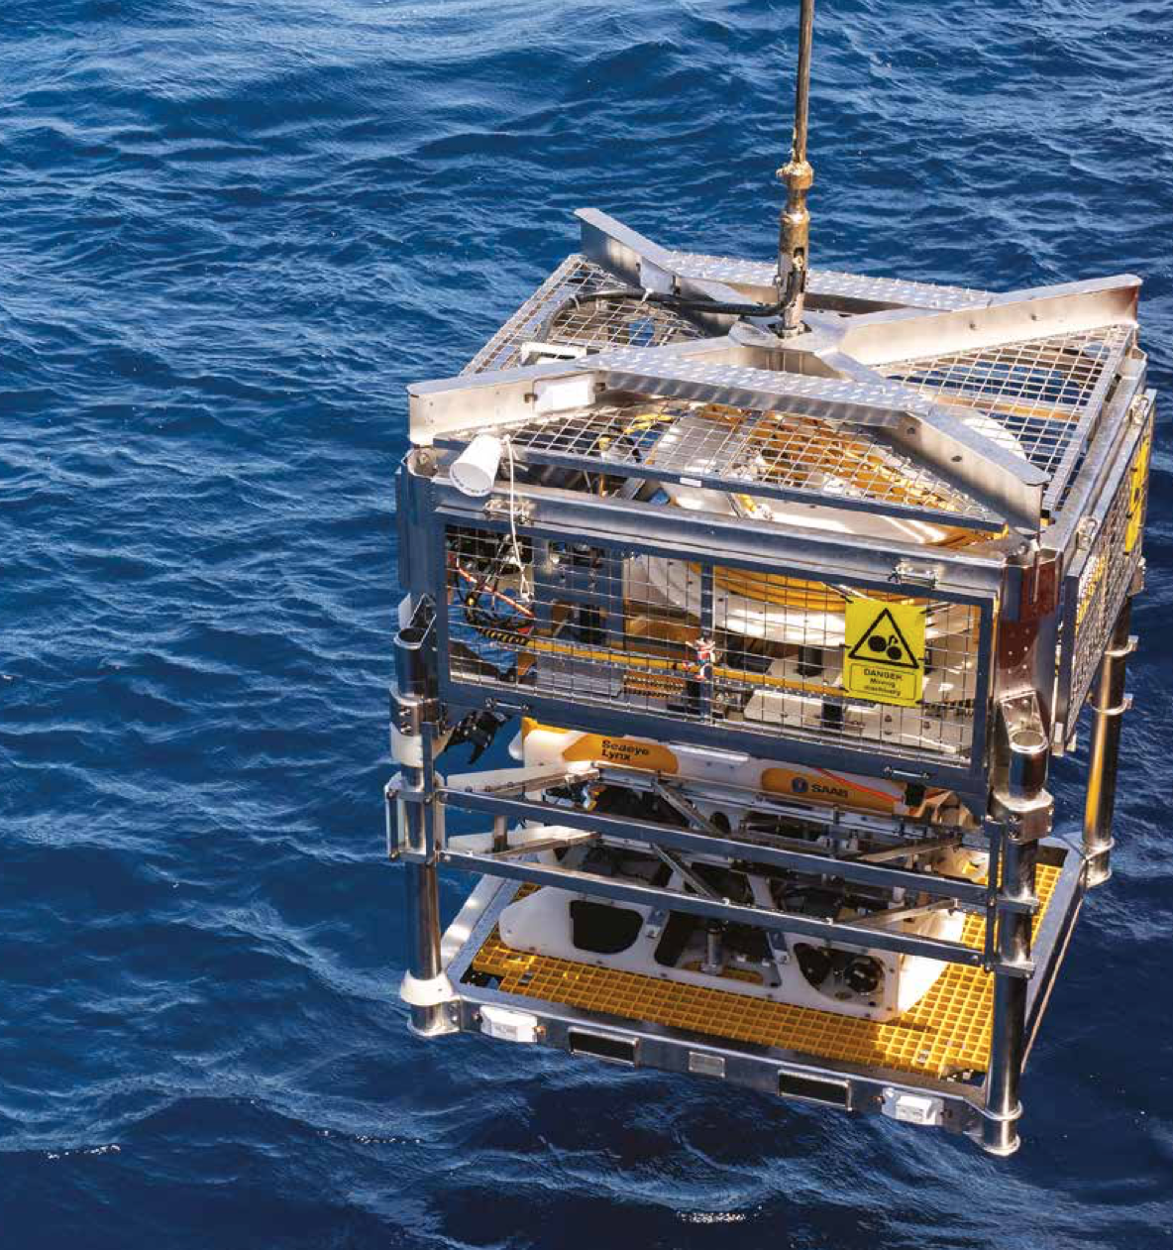
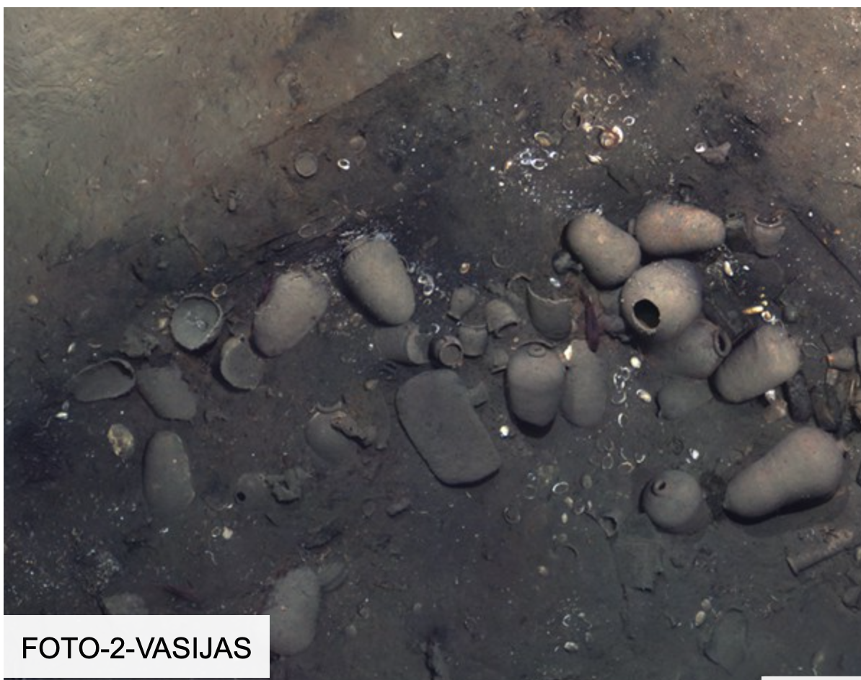
Declaration of the archaeological protected area archaeological context Galleon San José

Slide 16
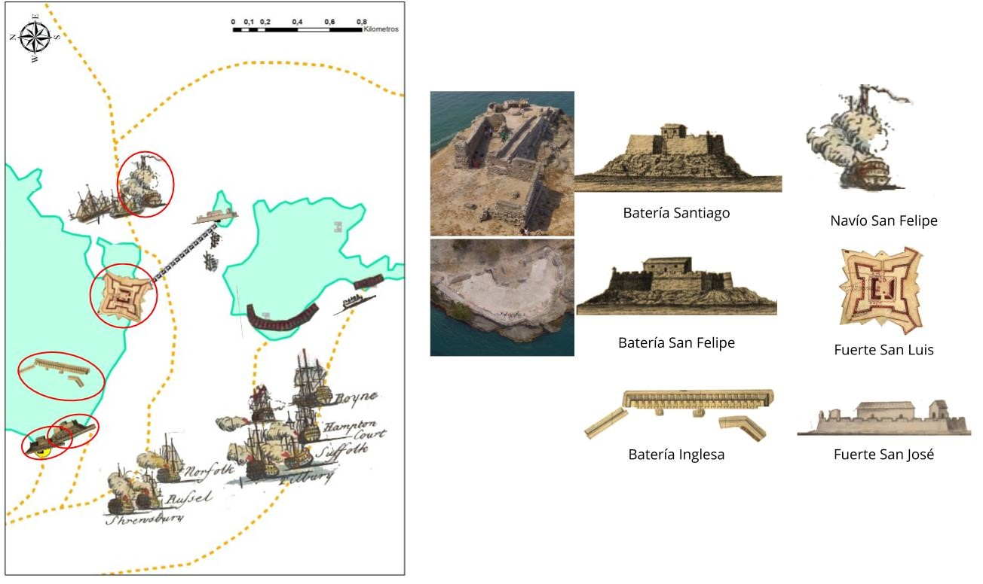
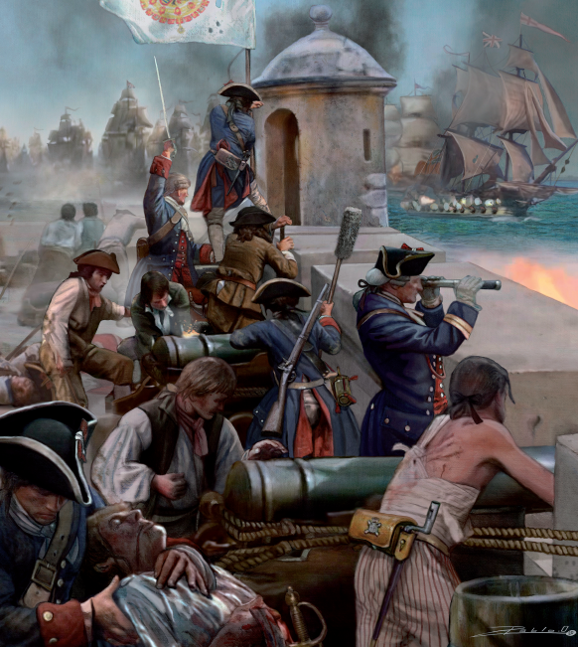
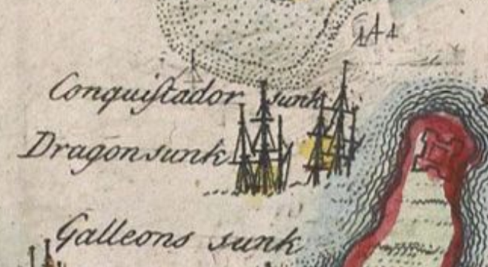
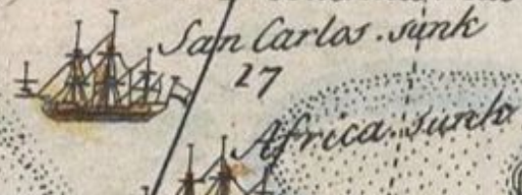
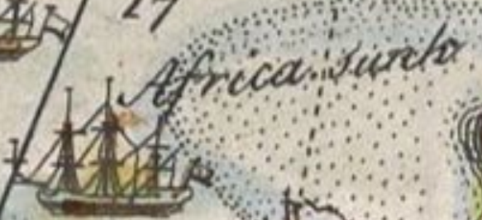
Desperta Ferro

Slide 17
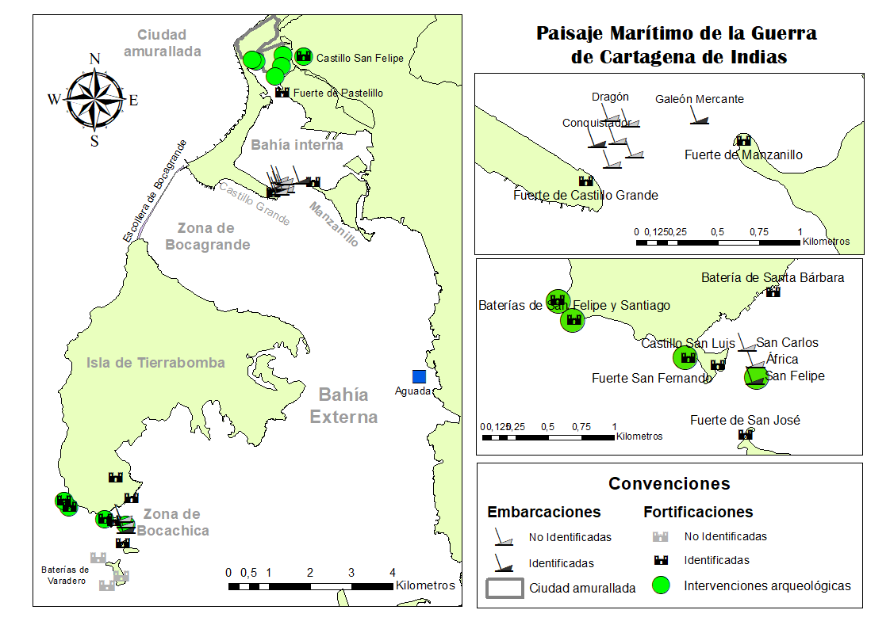
Archaeological Potential of Cartagena de Indias
WORLD HERITAGE SINCE 1984

Slide 18
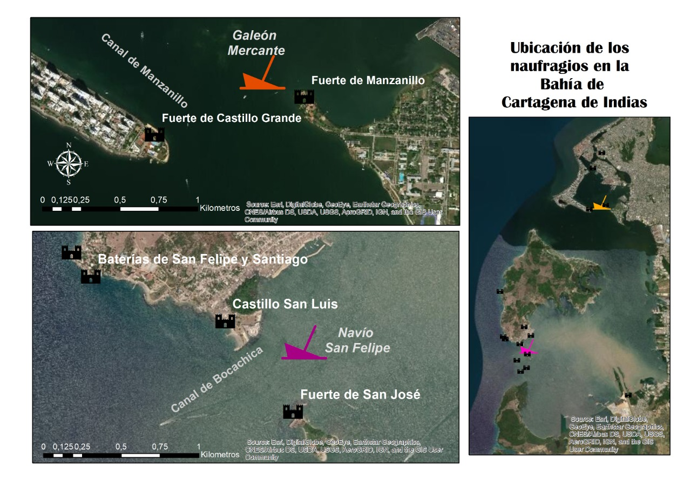
Underwater Archaeology in Historical Shipwrecks
Two Cases from 2015: Manzanillo and Bocachica Shipwrecks

Slide 19
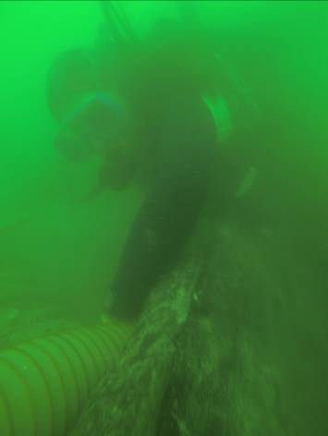
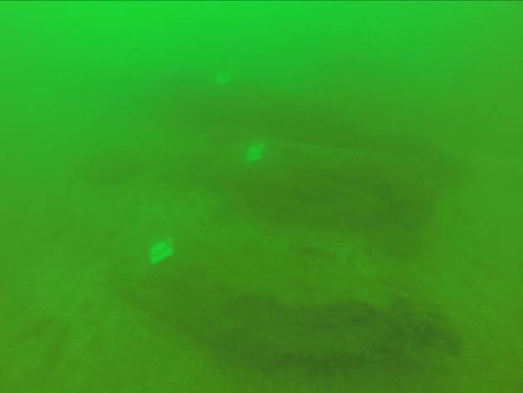
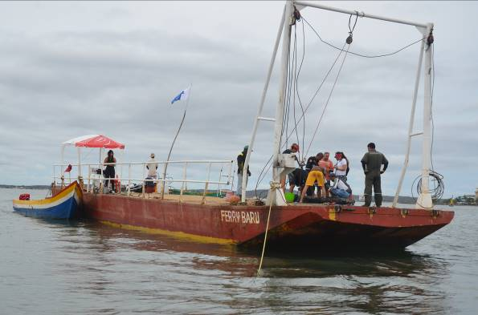
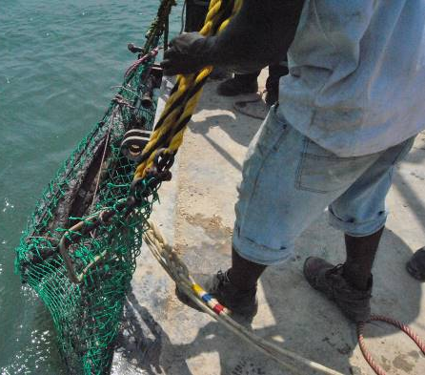
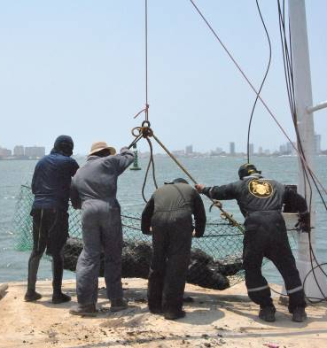
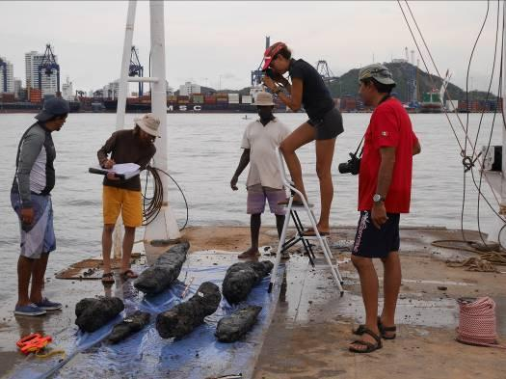
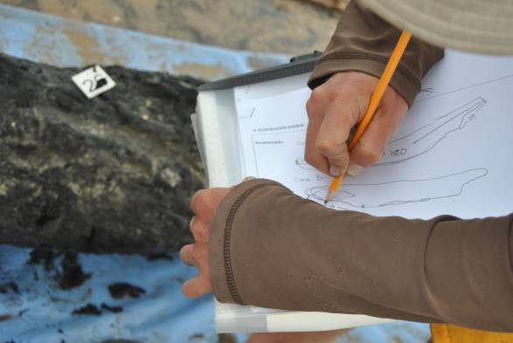
Underwater Archaeology in Historical Shipwrecks
Manzanillo Shipwreck: Merchant Ship, 1741
16 mts depth: Wooden structures (almost 50 elements) related with the keel, the keelson, and floor timbers; one isolated iron cannon

Slide 20
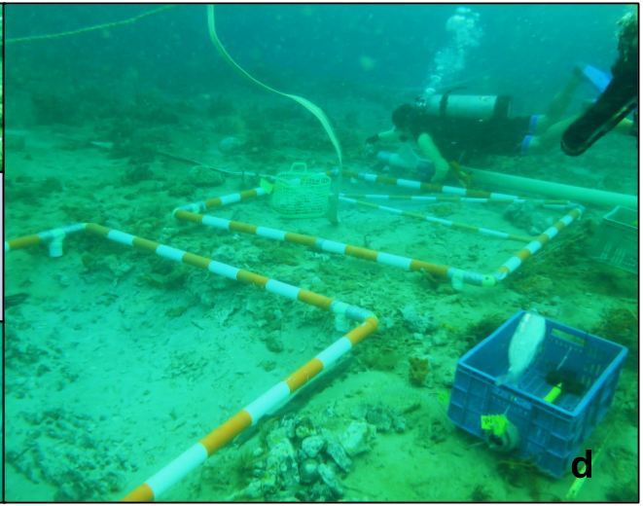
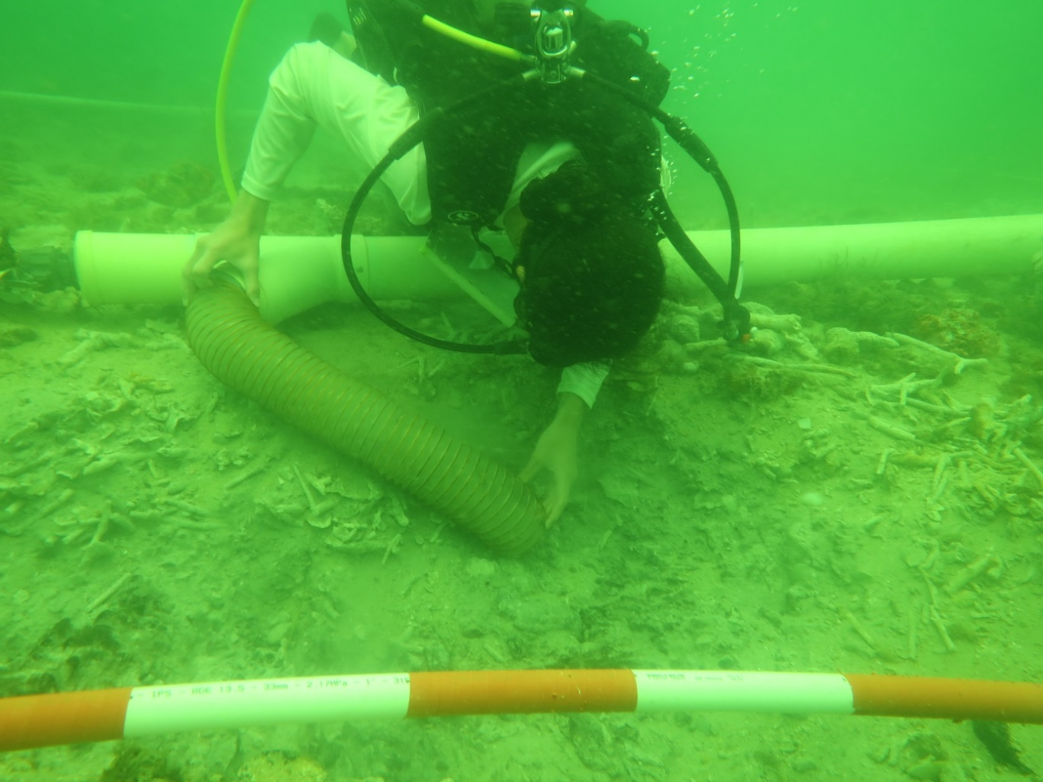
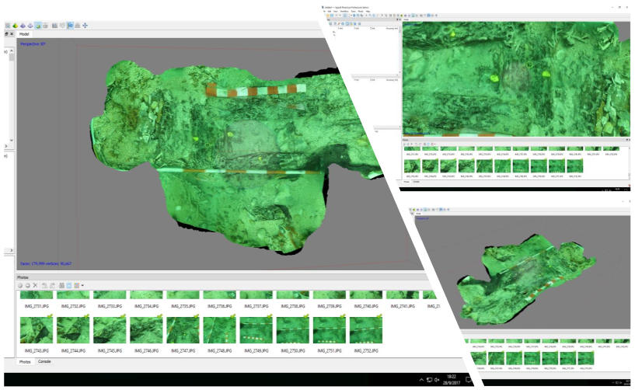
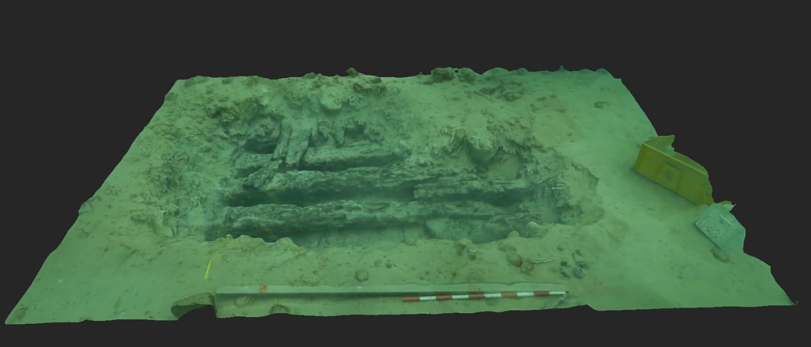
Underwater Archaeology in Historical Shipwrecks
Bocachica Shipwreck: San Felipe Ship of the Line, 1741
5 mts depth: Structural and other wooden elements (keel, keelson, frames, internal and external planking), ballast stones, ceramic fragments, lead sheets, fastening elements

Slide 21
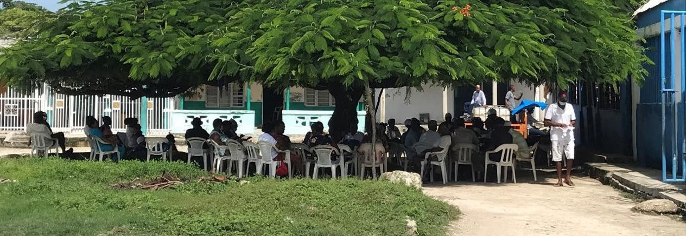
Natural resources and local communities

Slide 22
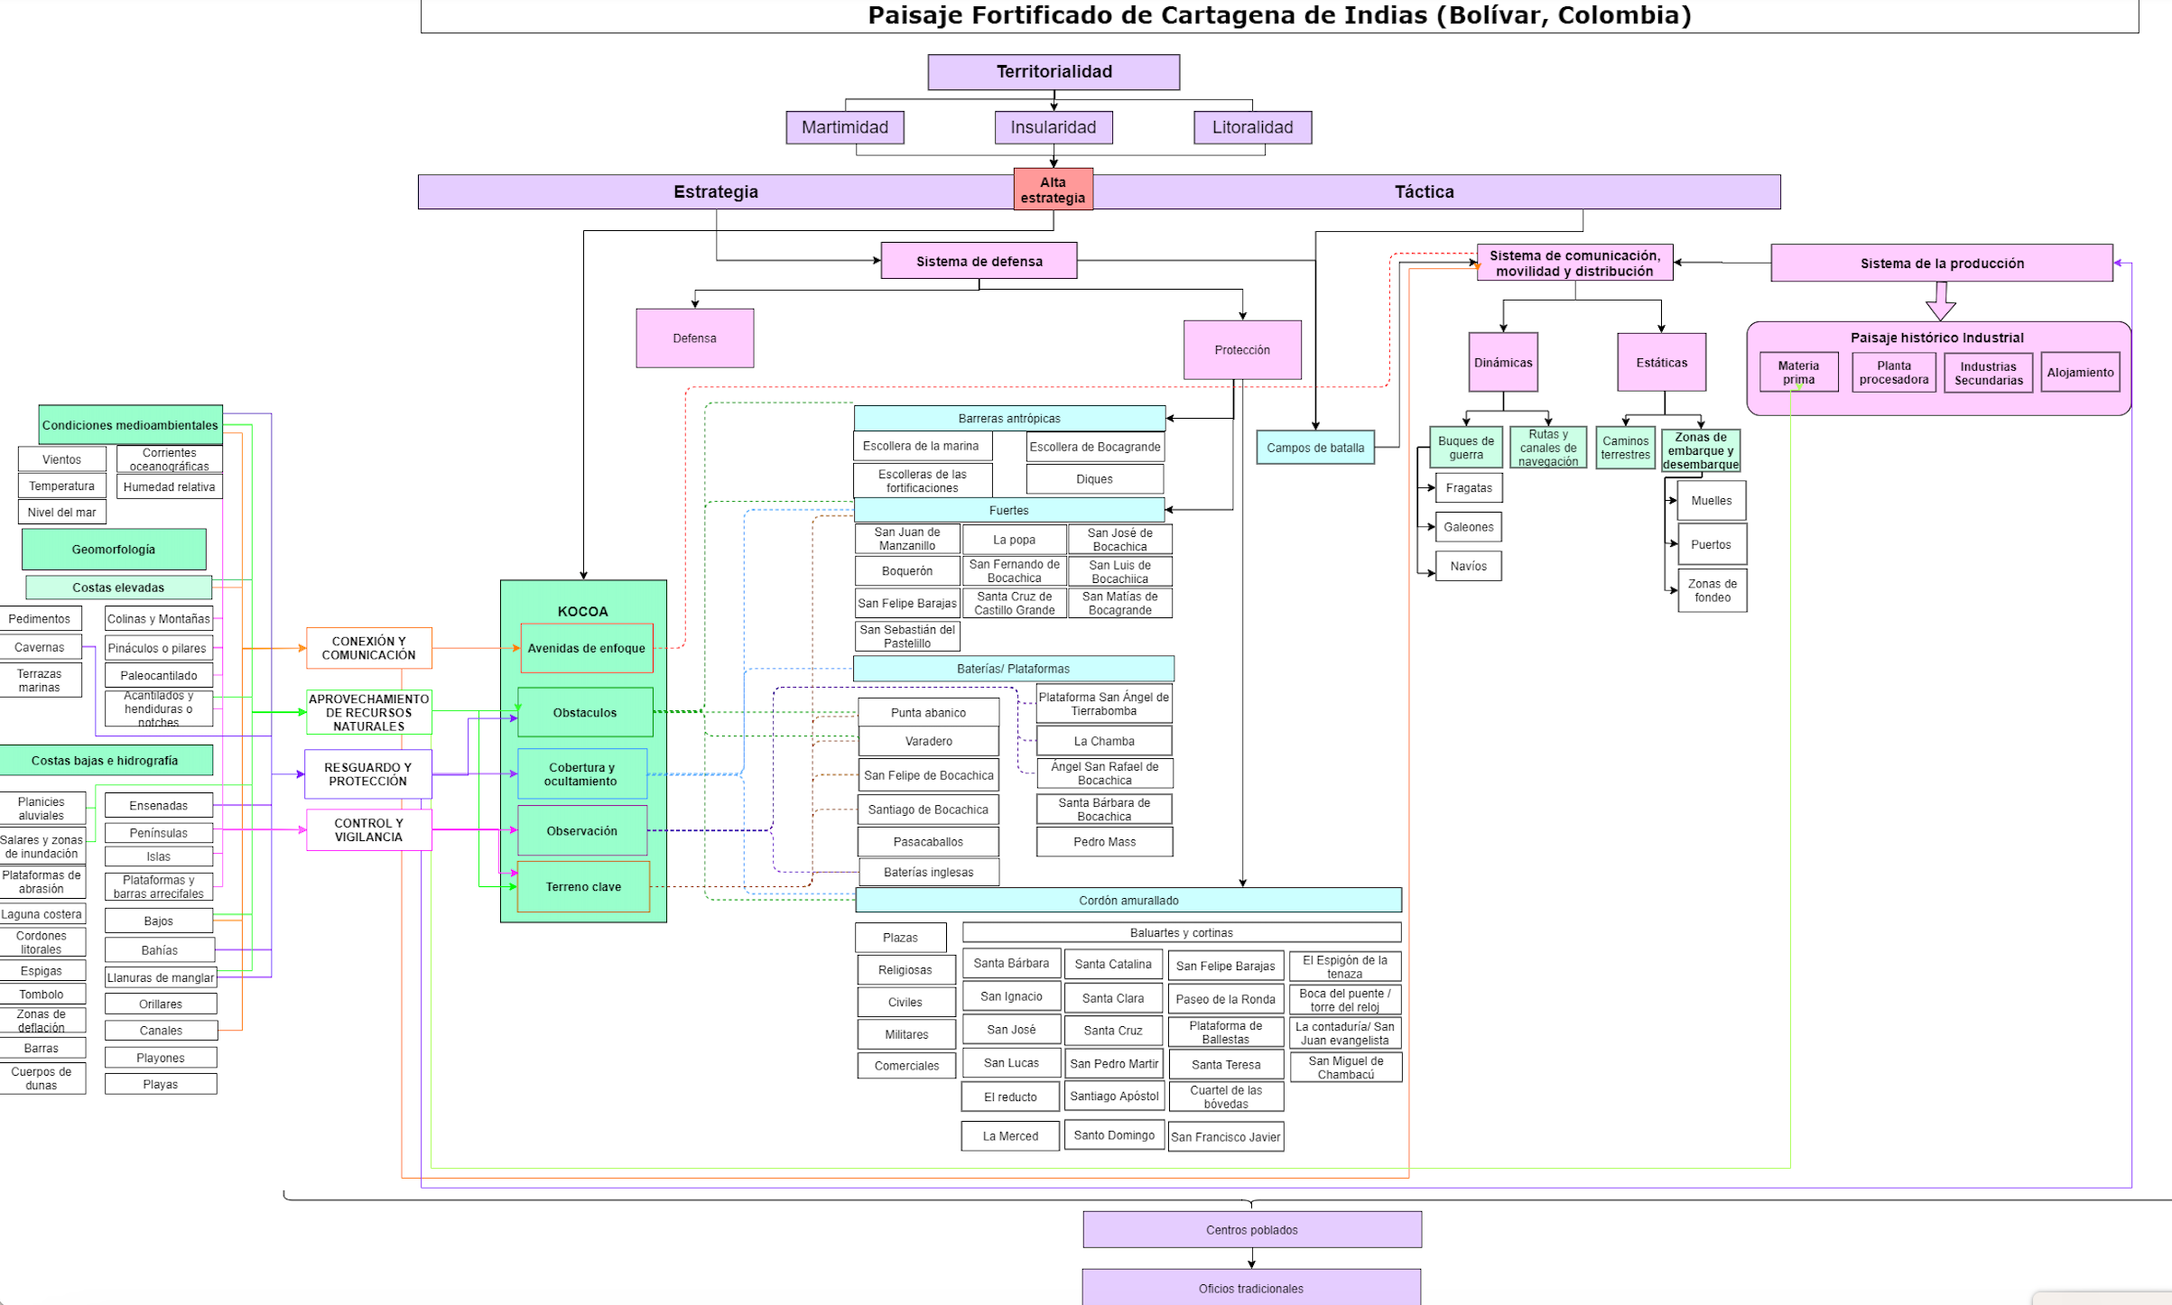

Slide 23
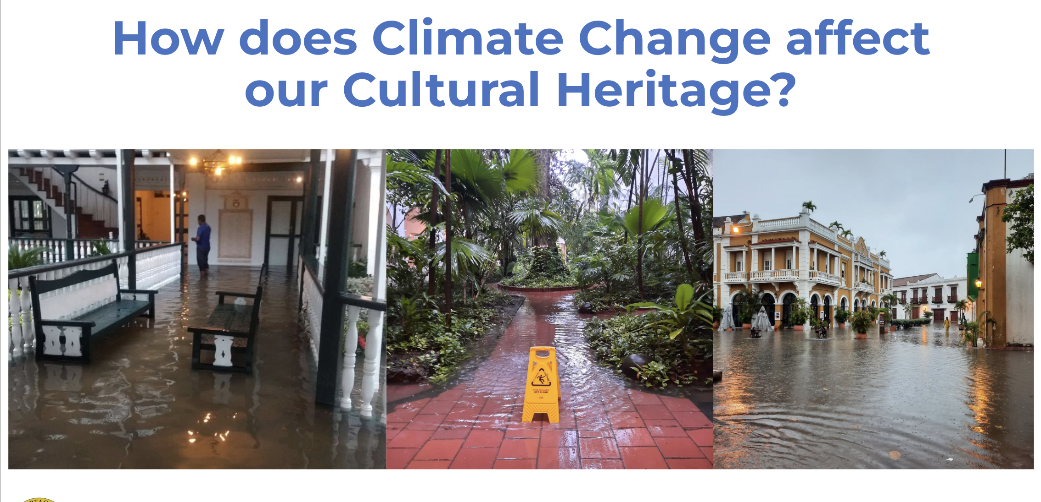
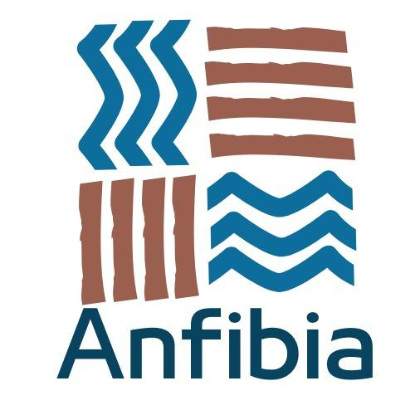
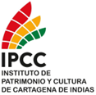
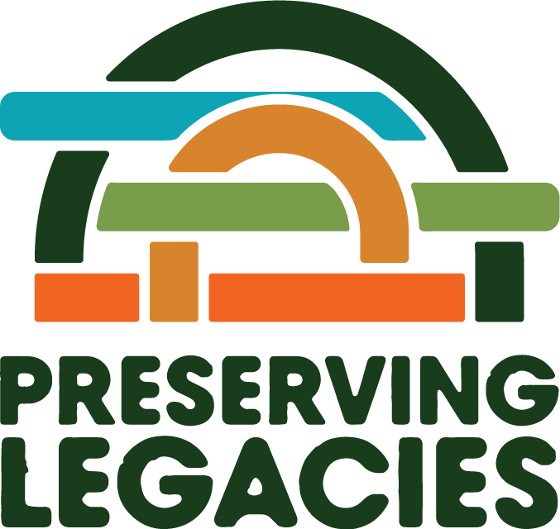
Community participation in the management of climate change impacts on the maritime cultural heritage of Cartagena de Indias, Colombia
Copyright / Privacy / Ownership

Slide 24
Funded by The National Geographic Society

Slide 25
Devolving decision making to the lowest appropriate level: The importance of the community
Funded by The National Geographic Society

Slide 26
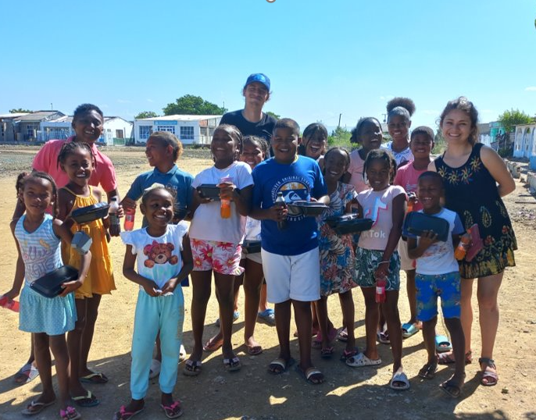
Addressing structural inequalities faced by women, youth, children, people with disabilities, people who are displaced, Indigenous Peoples and marginalized ethnic groups
Funded by The National Geographic Society

Slide 27
Investing in local capabilities to leave an institutional legacy:
Capacity building at the local level
Funded by The National Geographic Society

Slide 29
Locally Led Adaptation Principles for Locally Led Adaptation: Local Knowledge to understand the context

Slide 34
Antecedentes
Antecedentes
¿Blue Collaboratory?
¿Colaborartorio Azul?
Knowledge Co-production with Coastal Communities in Cartagena de Indias, Colombia for the understanding of Climate Change Impacts on Maritime Cultural Heritage.
PHase 1
Phase 2

Slide 35
General objective
To develop the pilot phase of a methodological proposal for the identification and analysis of the impacts of climate change on the Cultural Interest Assets that are part of the Bay of Cartagena, based on a co-participatory approach that allows the integration of the knowledge of local communities.
Phase 1

Slide 36
Generate scenarios for training and community strengthening supported by the use of virtual tools.
Develop a communication strategy based on the co-creation of content that integrates the knowledge and skills of local communities.
Designing participatory mechanisms for measuring the impacts of climate change on Cultural Heritage Sites.
Phase 1

Slide 37
Changes in the coastline of the Bocachica Sector between 1698 - 2022 from the superposition of historical cartography and contemporary satellite photographs (Del Cairo et al., 2022).

Slide 38
Affectations at Fort San José due to sea level changes.

Slide 39
Fase 1
Fase 1

Slide 43
THANK YOU
Copyright / Privacy / Ownership

