Slide 1
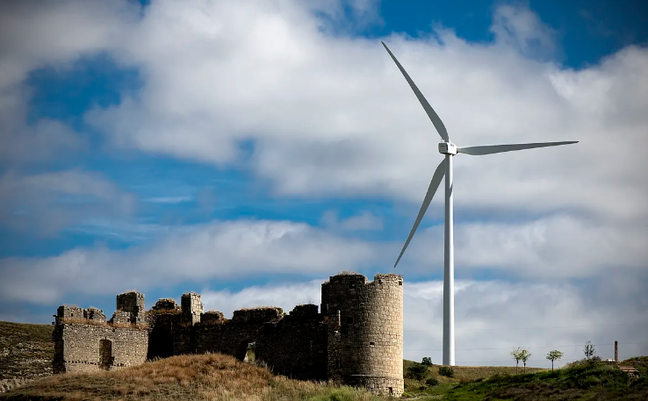
U.S. Climate Heritage Policy in the International Context: Climate Mitigation Strategies Incorporating Heritage. The case of Spain
Antonio Jesús Antequera Delgado (Ministry of Culture of Spain)

Slide 2
Climate Change impacts on the Spanish Cultural Heritage

Slide 3
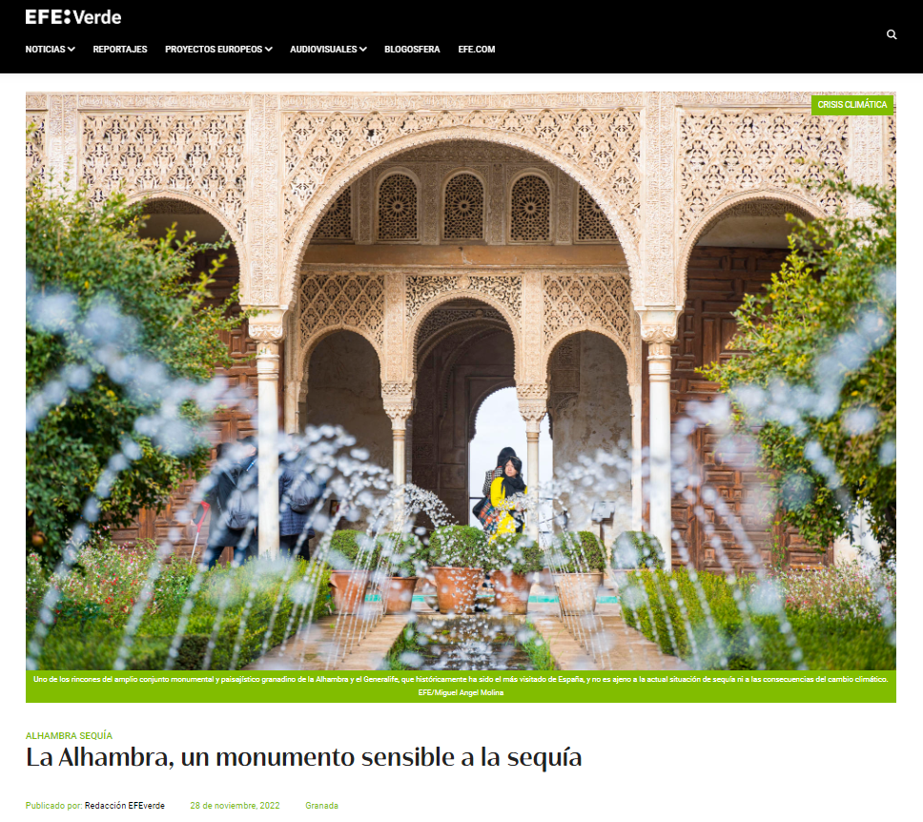
(“The Alhambra, a monument sensitive to drought”)

Slide 4
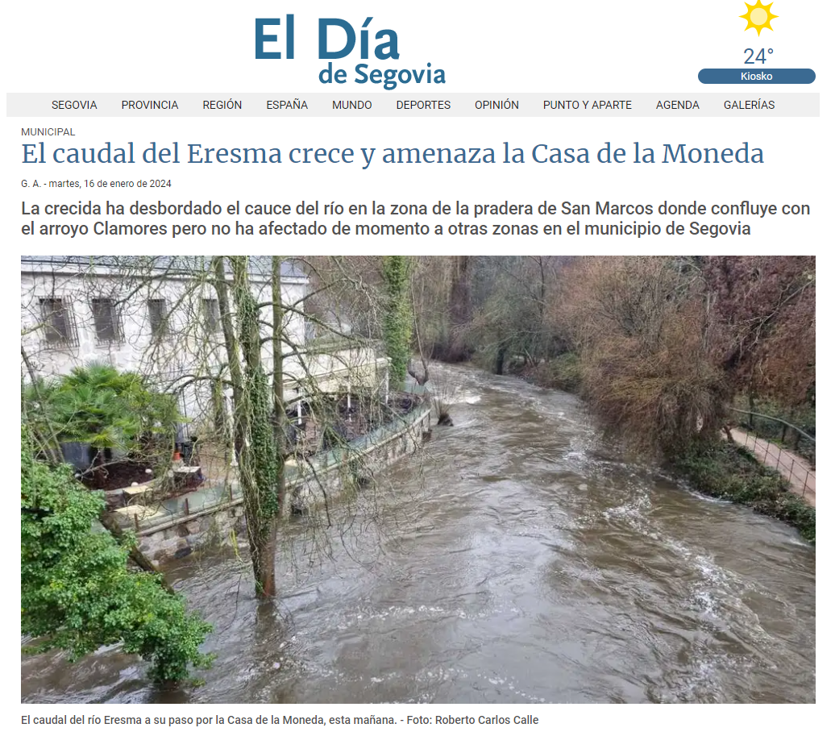
(“The flow of the Eresma rises and threatens the Mint”)

Slide 5
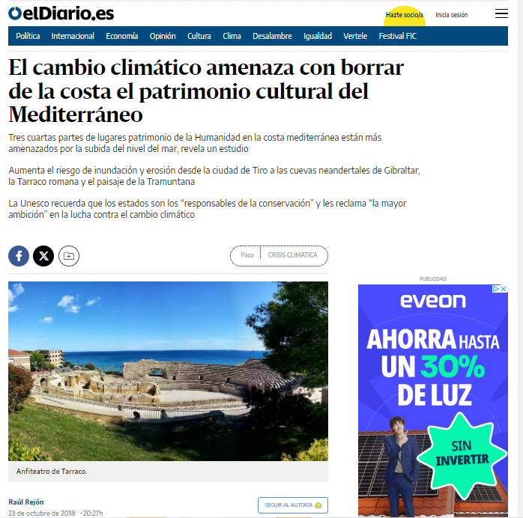
(“Climate Change threatens to erase the cultural heritage of the Mediterrean coast”)

Slide 6
(“Snow in danger of extinction in Majorca”)

Slide 7
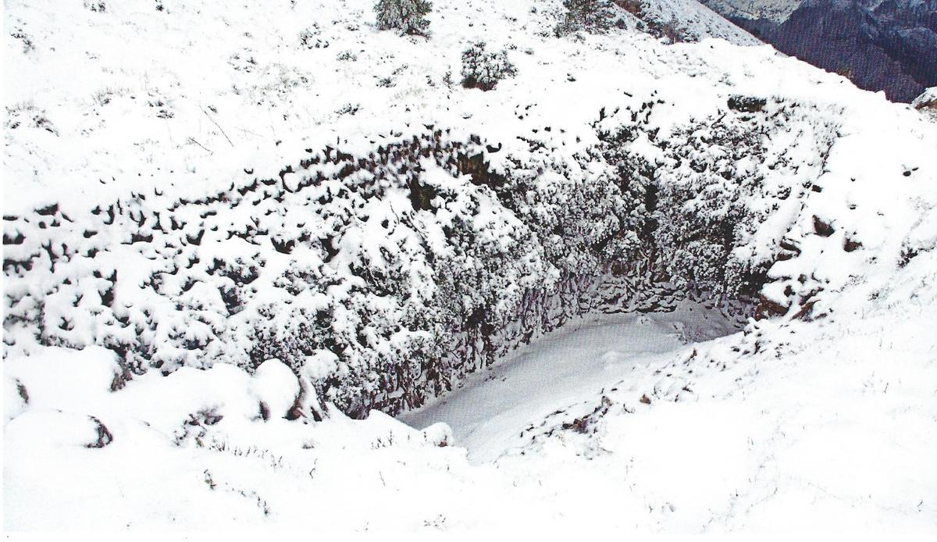
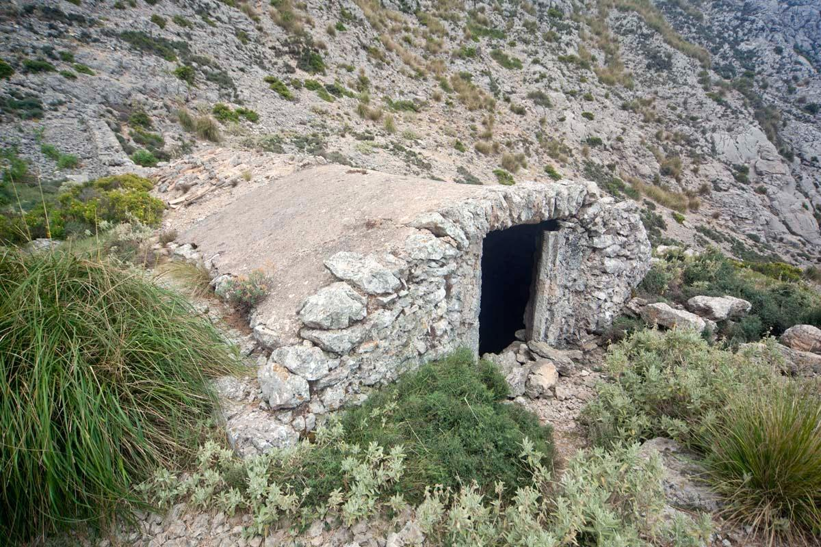
Snow pits and traditional trades endangered

Slide 8
(“Researchers create a mathematical model to protect the Altamira cave from Climate change”)

Slide 9
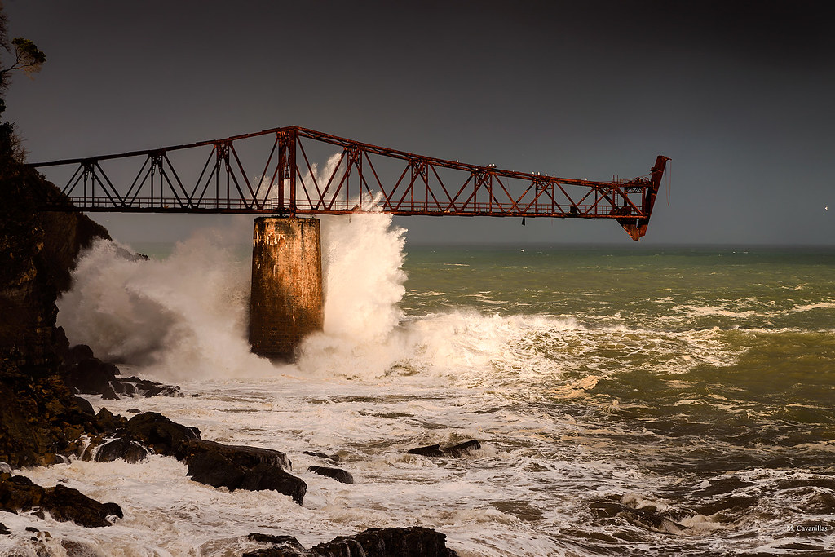
Dock for the mineral loading at the Cantabrian coast (Castro Urdiales, Cantabria)

Slide 10
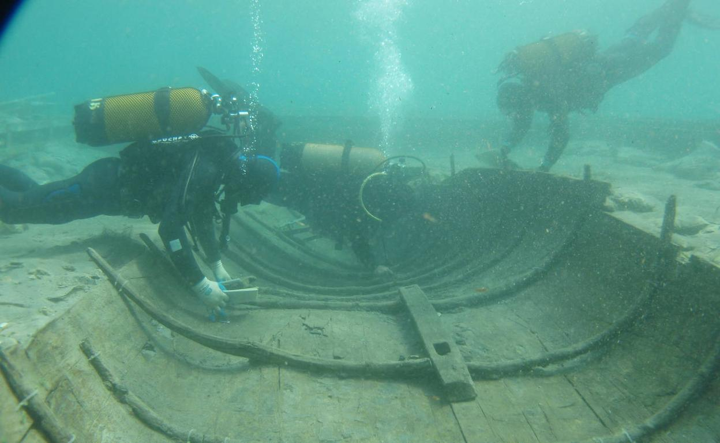
Extraction of the phoenician shipwreck Mazarrón II (Murcia)

Slide 11
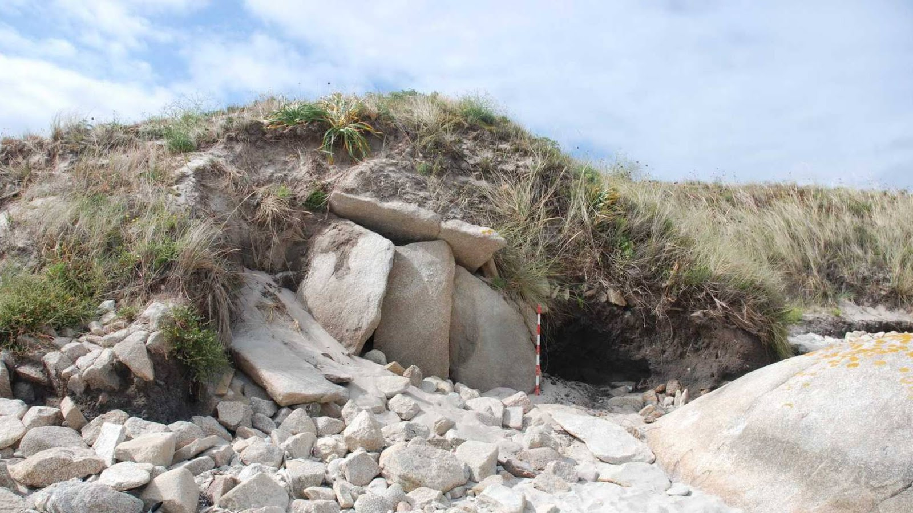
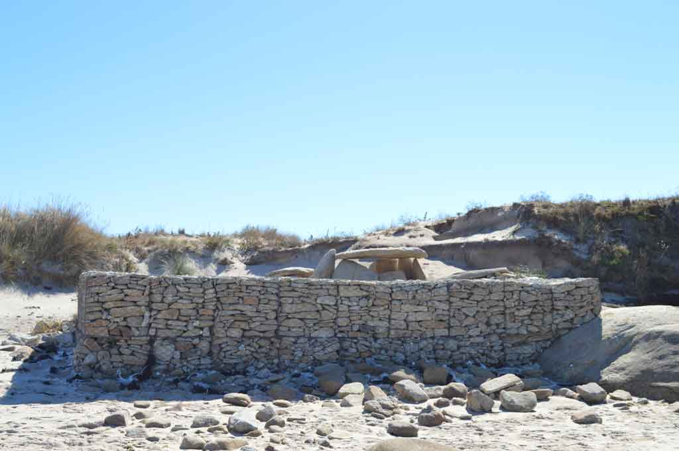
Areoso Dolmen (Arousa Island, Pontevedra)
Intervention of the Coast Service in 2011

Slide 12
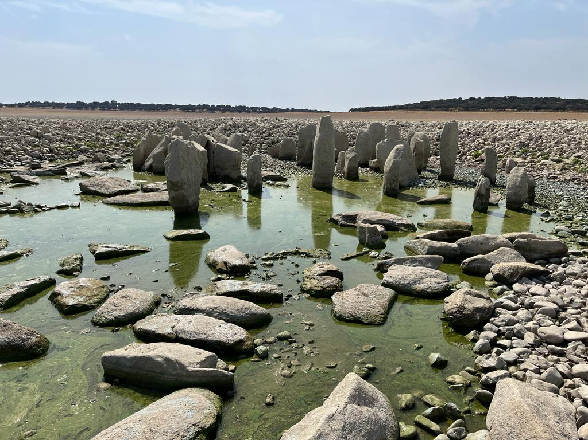
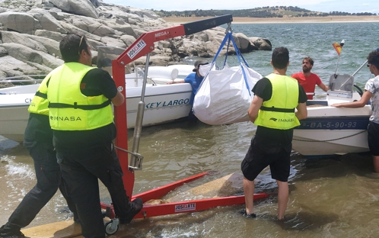
Guadalperal Dolmen (Valdecañas Reservoir, Cáceres)
Intervention of the Ministry of Culture in 2021

Slide 13
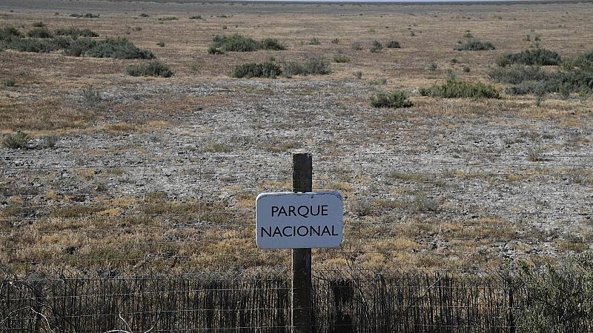
National Park of Doñana (marsh landscape now dry) (2023)

Slide 14
International initiatives and commitments and their impact on the Spanish regulations

Slide 15
PARIS AGREEMENT (UNITED NATIONS) - International legally binding treaty on climate change. - Adopted by 196 parties at COP21 in Paris (December 2015) and entered into force on November 4, 2016. - Objective: limit global warming to 1.5 degrees, compared to pre-industrial levels. - To do this, countries commit to reducing their greenhouse gases to achieve a neutral planet in 2050. - Each country commits to making “Nationally Determined Contributions” (NDC), to be developed in five-year cycles, and which include measures aimed at reducing greenhouse gas emissions as well as adaptive measures to combat climate change. - Spain's NDC is the one sent by the EU to the UNFCCC. - Currently zero emissions represent 25% of global emissions.

Slide 16
THE EUROPEAN GREEN DEAL (EUROPEAN UNION) - Presented in December 2019 at the European Commission. - It is a roadmap with actions to promote the move to a clean and circular economy, stop climate change, reverse the loss of biodiversity and reduce pollution. - It covers all sectors of the economy: transport, energy, agriculture, buildings and industries. - Goal: to make Europe the first climate-neutral continent by 2050. - To achieve this, it seeks to reduce greenhouse gas emissions by at least 55% between now and 2030 compared to 1990 levels. - Initiatives emanating from the European Green Deal: the New European Bauhaus (September 2020), European Climate Law (June 2021), REPowerEU (May 2022), among others.

Slide 17
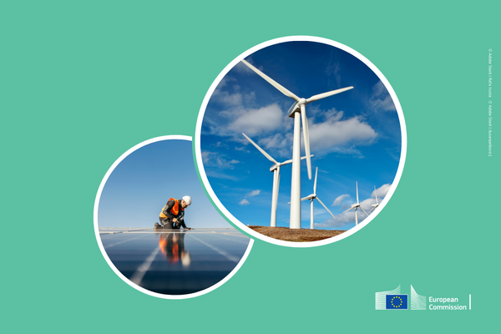
RENEWABLE ENERGY DIRECTIVE (RED) (EUROPEAN UNION) - They are mandatory through transposition into the regulatory framework of each Member State. - 2009: First Renewable Energy Directive (2009/28/EC) (RED I) - 2018: First review of the Renewable Energy Directive (2018/2001/EU) (RED II) - 2023: Modification of the Renewable Directive (EU/2023/2413) (RED III) - It came into force in November 2023 and member countries have 18 months to transpose it into their national regulations (May 2025). - The percentage of clean energy produced in the EU set as a strategic objective has been increasing (2023: objective of at least 42.5% for 2030, but aiming for 45%) (In 2009 it indicated 20% for 2020). - These increases imply regulatory changes and investments that encourage and make the installation of renewables more flexible.

Slide 18
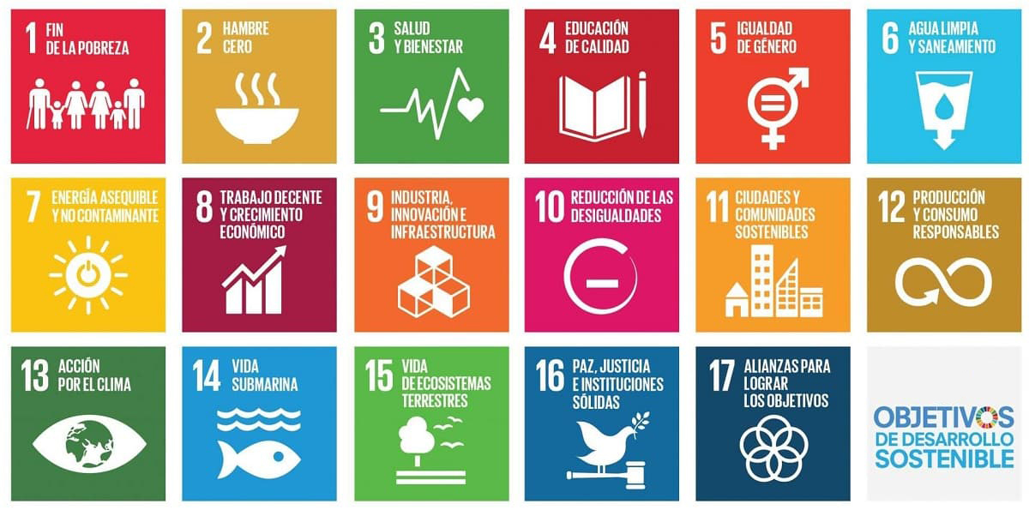
2030 AGENDA (UNITED NATIONS)

Slide 19
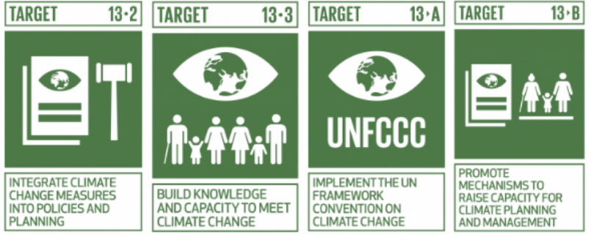
SOME SDG SPECIFIC TARGETS RELATED TO CULTURAL HERITAGE AND CC

Slide 20
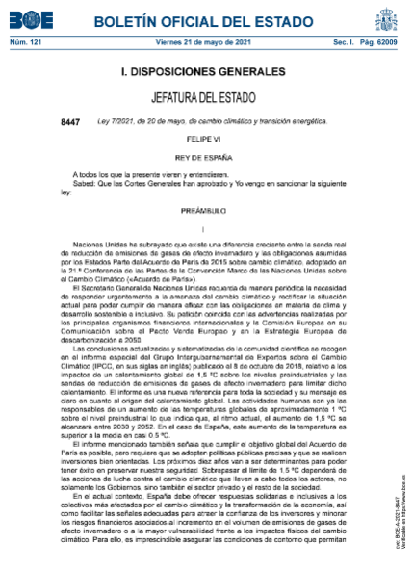
APPLICABLE SPANISH REGULATIONS
Law 7/2021, May 20th, on Climate Change and Energy Transition.
RD 244/2019, April 5th, which regulates the administrative, technical and economic conditions of energy self-consumption.
Law 21/2013, December 9th, on Environmental Assessment.

Slide 21
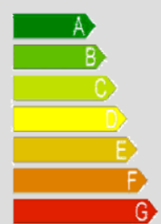
APPLICABLE SPANISH REGULATIONS (II)
Technical Code for Buildings.
It is compound by several Basic Documents on:
-Structural safety
-Fire safety
-Accesibility and safety use
-Energy saving
-Protection against noise
-Healthiness
Energy saving Basic Document implies a
Clasification of the Buildings based on their
energy saving performance

Slide 22
The response from the field of Cultural Heritage

Slide 23
Guidance and toolkit for Impact Assessments (in collaboration with ICOMOS, ICCROM y IUCN, july 2022) - Reference guide for technicians and cultural managers of the Asset Impact Assessment. - They are directed at World Heritage properties, although they may apply to other properties protected in other categories. - Importance of safeguarding Outstanding Universal Values (OUV). - Methodology for applying these evaluations on a case-by-case basis. - Incorporates evaluation tables and matrix models. - Includes a glossary of key concepts - It is currently not translated into Spanish.

Slide 24
GUIDELINES FOR THE INSTLATION OF RENEWABLE ENERGY-RELATED INFRASTRUCTURES AND EQUIPMENT AND THEIR POTENTIAL IMPACT ON CULTURAL HERITAGE (ICOMOS Spain, October 2022) - Promoted and coordinated by ICOMOS Spain. - It was drafted with the participation of technicians from the Spanish Regions, the Ministry of Culture and individual members of ICOMOS. - Approach from three scales: territorial, historical complex and buildings. - Addresses wind and solar energy. - The case studies are those of the publication of UNESCO and the Ministry of Ecological Transition of France translated into Spanish. - Develops the Heritage Impact Assessment methodology.

Slide 25
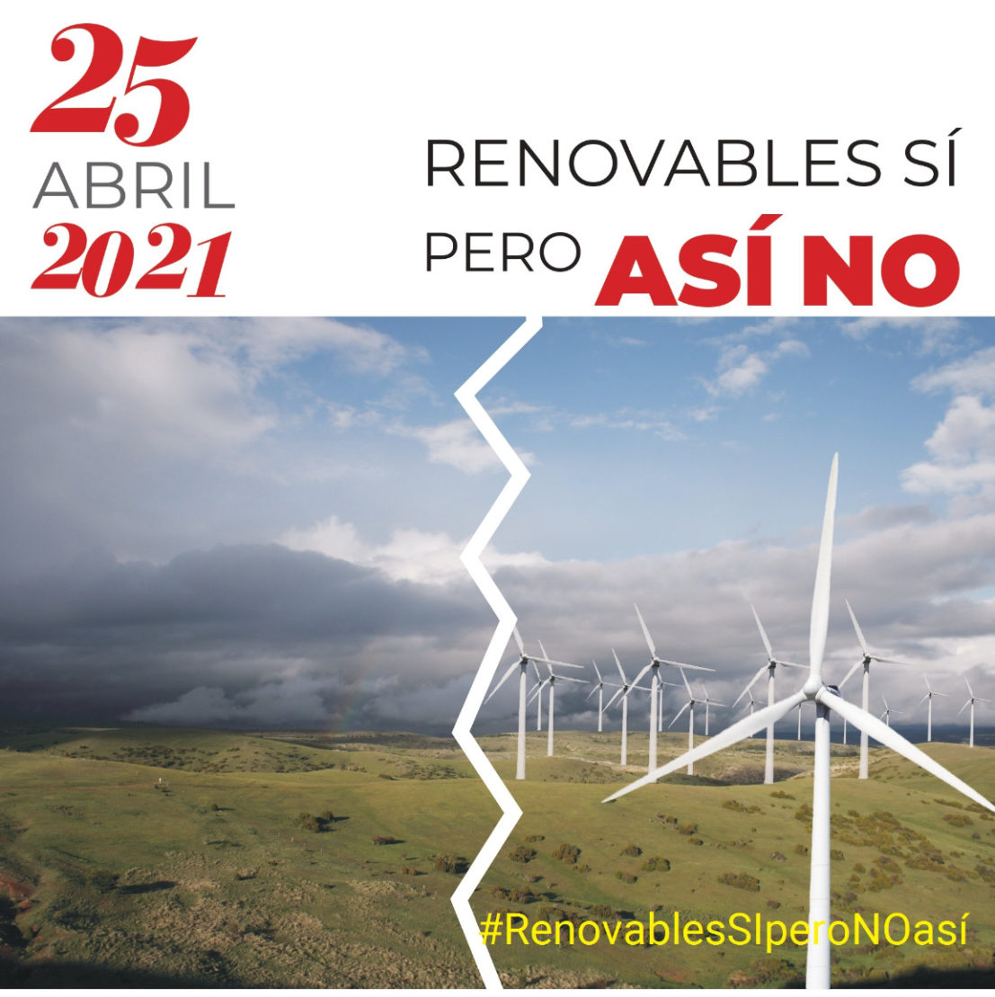
Civil society
“Renewable Yes, But Not Like This” Movement

Slide 26
The Spanish Protocol: convergences and singularities

Slide 27
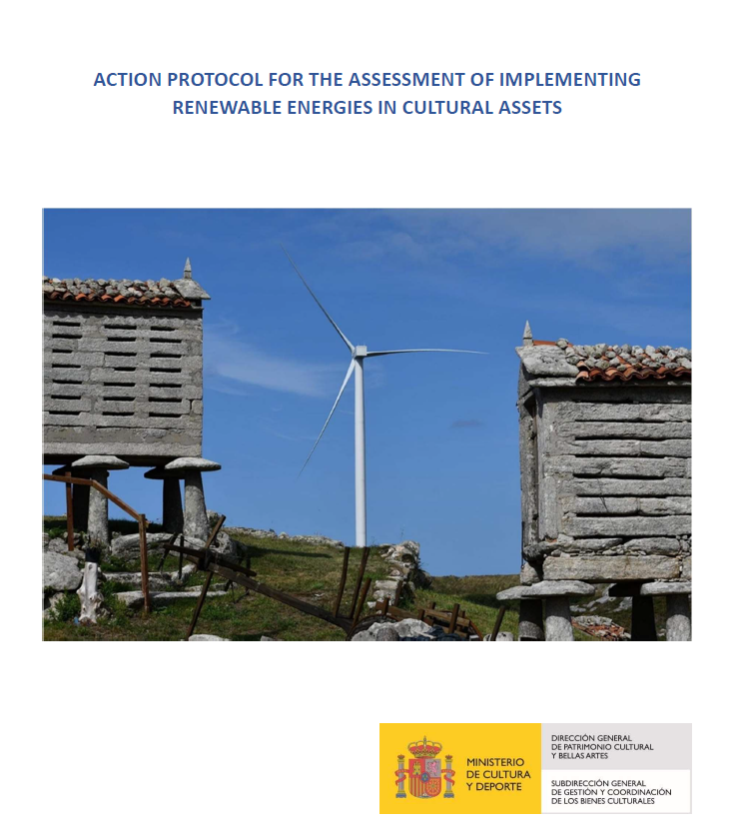

Slide 28
Methodological approach: scale criterion
Buildings
Historical Sets
Landscapes

Slide 29
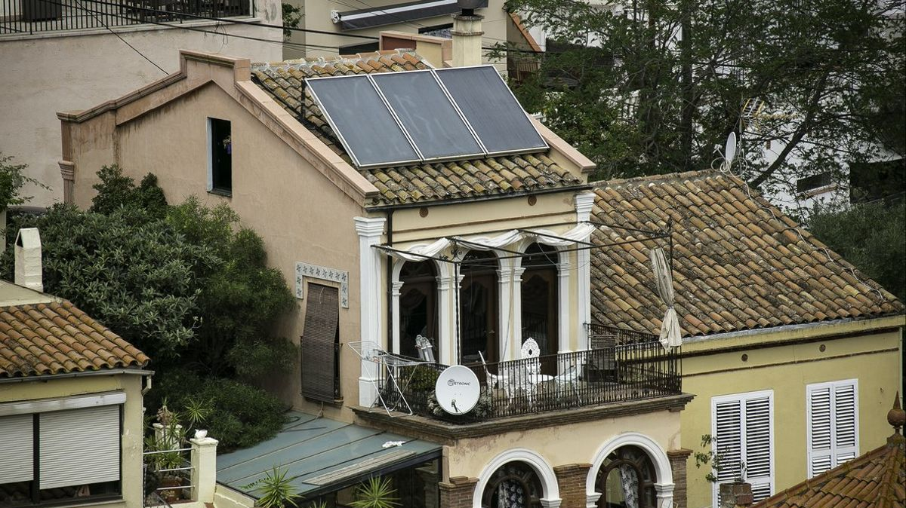
BUILDINGS

Slide 30
General criteria:
Previous energy efficiency. One of the criteria to be assessed will be the existence of energy efficiency measures previously adopted in the property, respecting the specific cultural values ​​of the Asset of Cultural Interest.
Visual criteria. One of the most important criteria is the visual condition that will be evaluated from three scales:
-Immediate vision: visual impact at street level by pedestrians.
-Near vision: visual impact from the protection environment of the Property.
-Distant vision: visual impact from viewpoints or singular points inside and outside the urban area, towards the property or the complex where it is located.

Slide 31
Technical-aesthetic criteria.
-In the case of Monuments on urban land, whenever possible, the criterion of locating the PVs on the roofs of secondary or annexed buildings and out of sight of pedestrians will be chosen.
-In the case of Monuments on rustic lands, whenever possible, the criterion of locating the PVs on the ground (with visual plant barriers) will be followed or, if this is not possible, in secondary or auxiliary buildings, out of sight of the pedestrian.
-If it is not possible to locate them on the ground or on the roof of auxiliary buildings, they may be located on the roof of the Property, under the following conditions:
*Its arrangement will be preferable in properties with flat roofs and a parapet.
*In the case of properties with sloping roofs, they will be located towards interior areas.

Slide 32
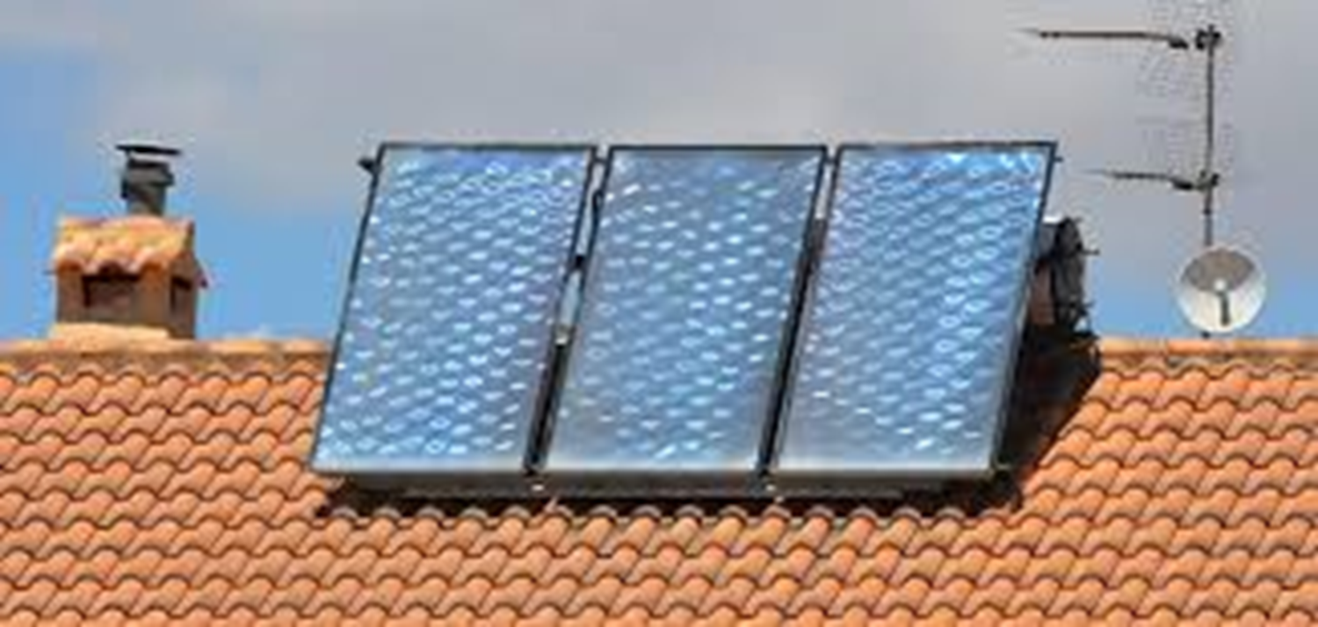
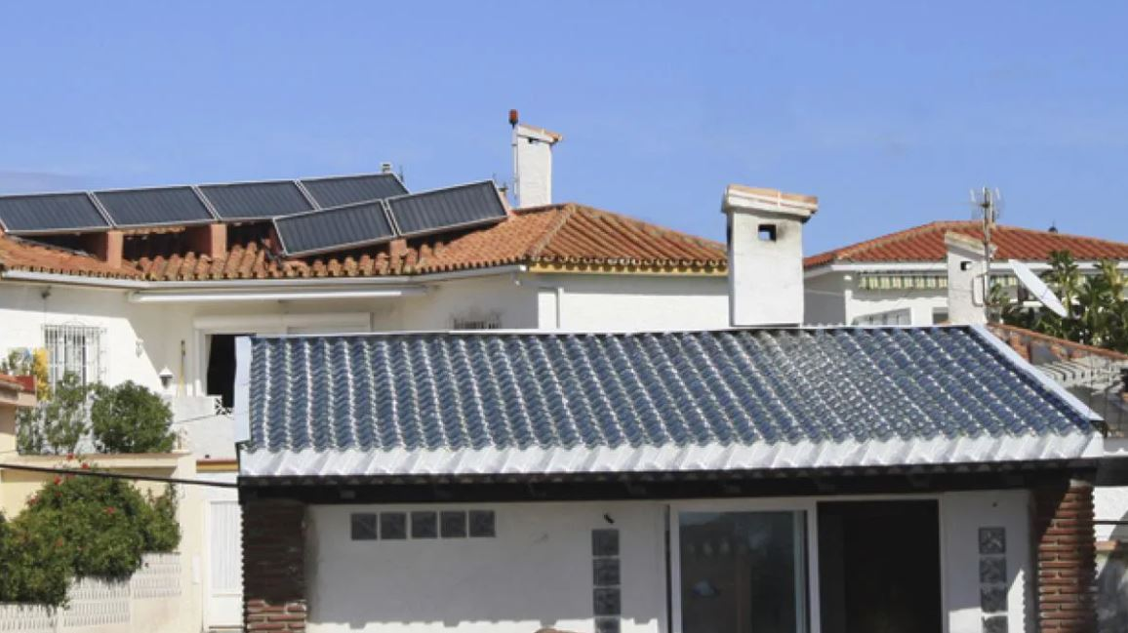
SITUATIONS TO AVOID

Slide 33
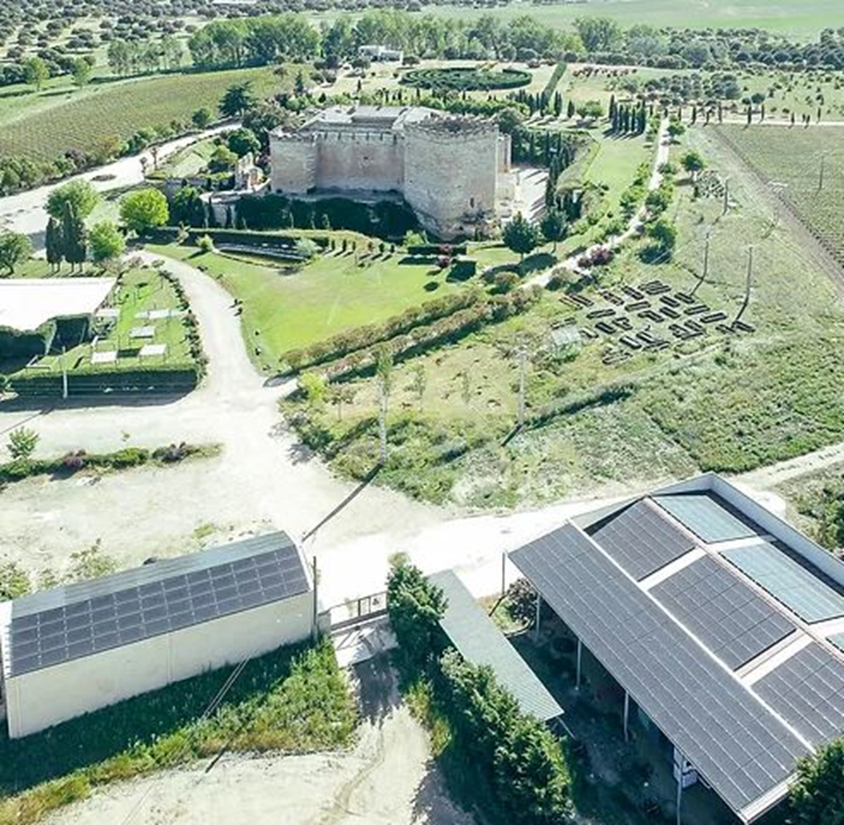
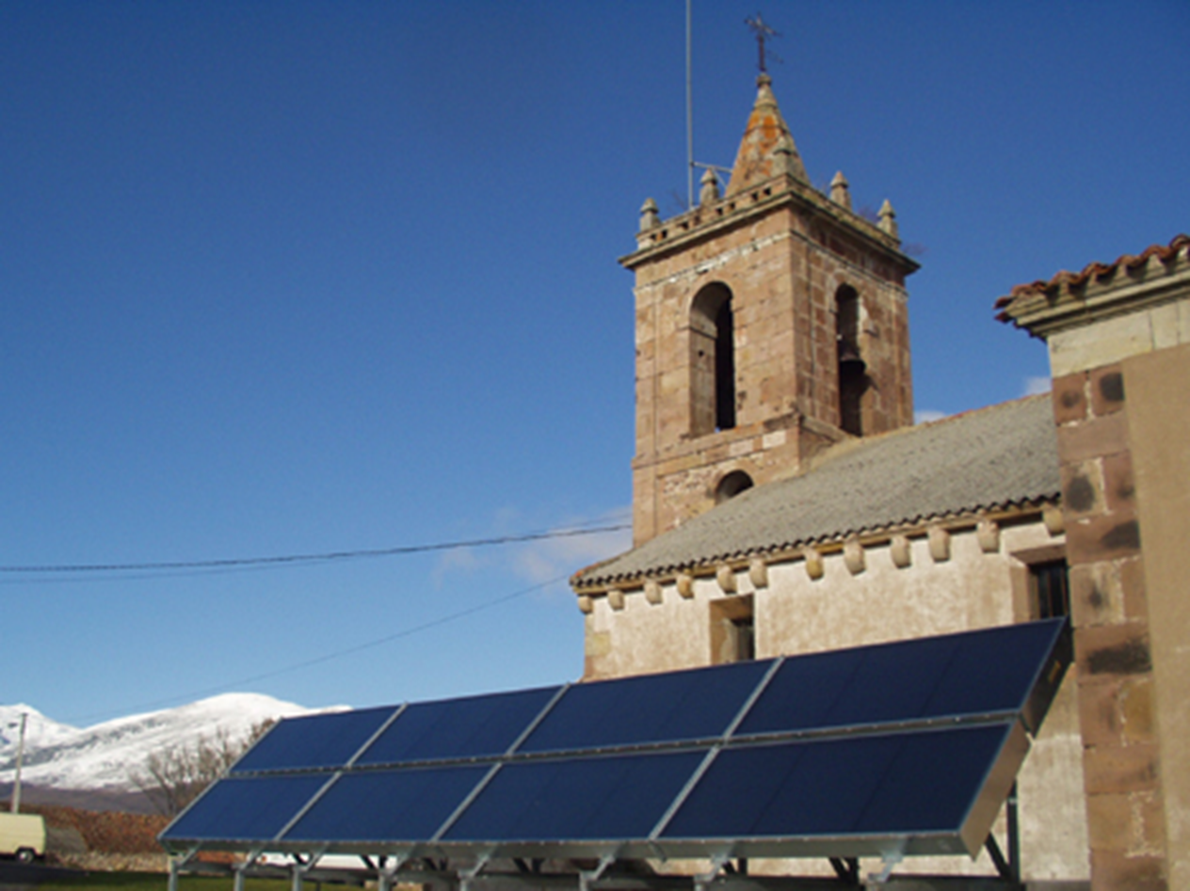
RECOMMENDED SITUATIONS

Slide 34
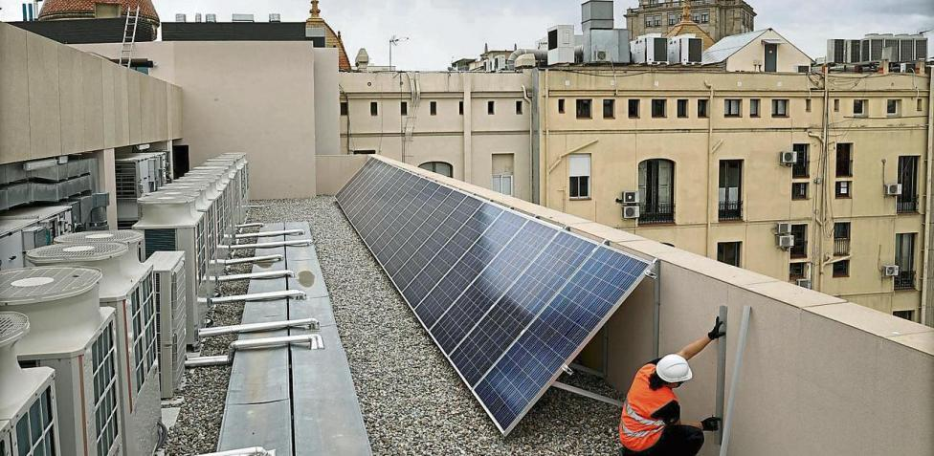
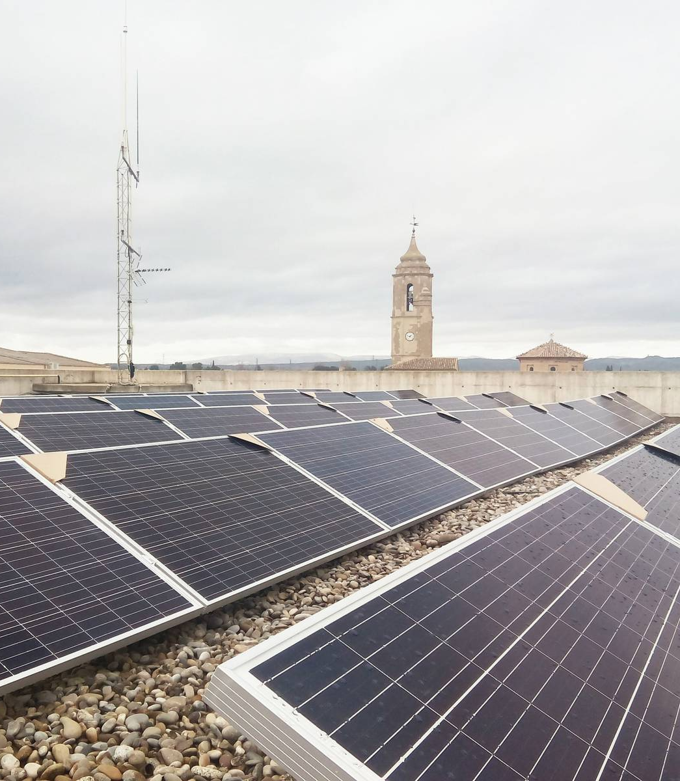
RECOMMENDED SITUATIONS

Slide 35
-The PVs will be anti-reflective. The fence and frame in matte.
-The supporting substructure shall be prevented from protruding beneath the panels.
-In no case will the PVs occupy the entire extension of the roof, being installed in a maximum percentage, established by the competent body in matters of cultural heritage, and following the criterion of grouping or concentration in a harmonious way (avoiding staggered, asymmetrical or dispersed arrangements by the cover).
-Renewable energy installations, whether on the ground or on the roof, will adopt the principle of reversibility.
-The auxiliary wiring will run whenever possible through the interior of the property, avoiding its passage through the façade.

Slide 36
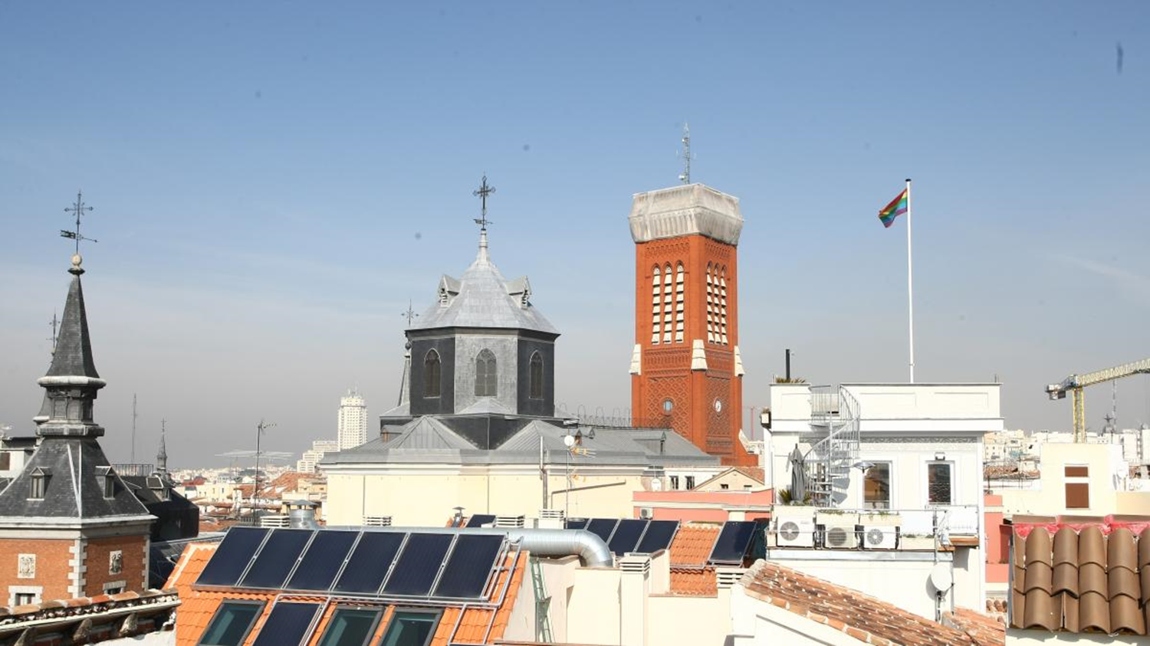
HISTORICAL SETS

Slide 37
In the case of historical sets or complexes listed of Cultural Interest, the possibility of prioritizing collective self-consumption or the so-called energy communities appears as a preferable option over self-consumption facilities.
For collective self-consumption and energy communities to be a viable alternative in historic complexes, it is important to continue developing aspects of RD 244/2019, related to the supply radius between the point of production and those of consumption.
Royal Decree Law 20/2022, in its article 18, modifies the maximum radius:
«A generation plant that exclusively uses photovoltaic technology […], on industrial land or in existing or future artificial structures whose main objective is not the generation of electricity, this is connected to the consumer or consumers through transportation or distribution lines and provided that these are at a distance of less than 2,000 meters from the associated consumers»

Slide 38
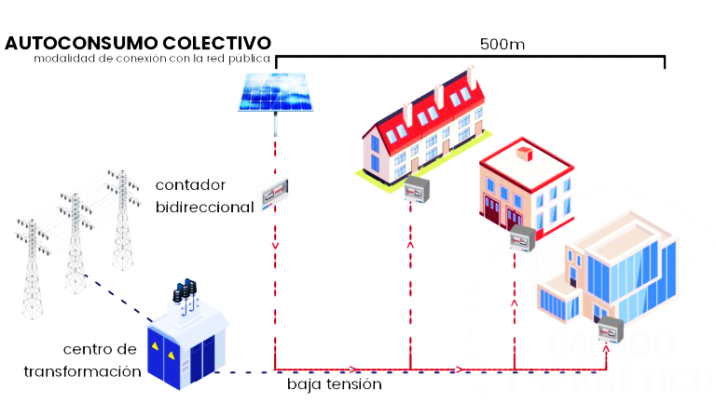
COLLECTIVE CONSUMPTION
Current Maximum Radius: 2.000 meters
------
TRANSFORMATION CENTER
LOW VOLTAGE

Slide 39
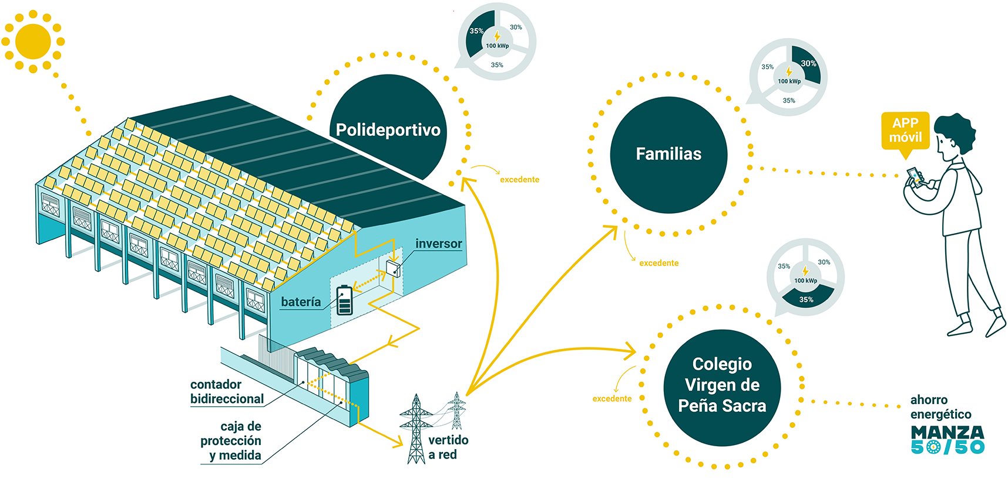
https://manzaenergia.manzanareselreal.es/

Slide 40
It is recommended that municipalities with historical sets listed as Cultural Interest Sites prepare, within their special plans, “Maps of potential solar resources”, identifying those public and private facilities that could be used as generating centers by energy communities (such as roofs, rooftops, canopies and other artificial structures, etc.).
On the other hand, within the Special Plans the possibility of including in the catalog of protected properties a mention of the possibility or not of being able to install renewable energies (and if possible, under what requirements) could be considered, according to the level of protection of each case and its morphological and constructive singularities.

Slide 41
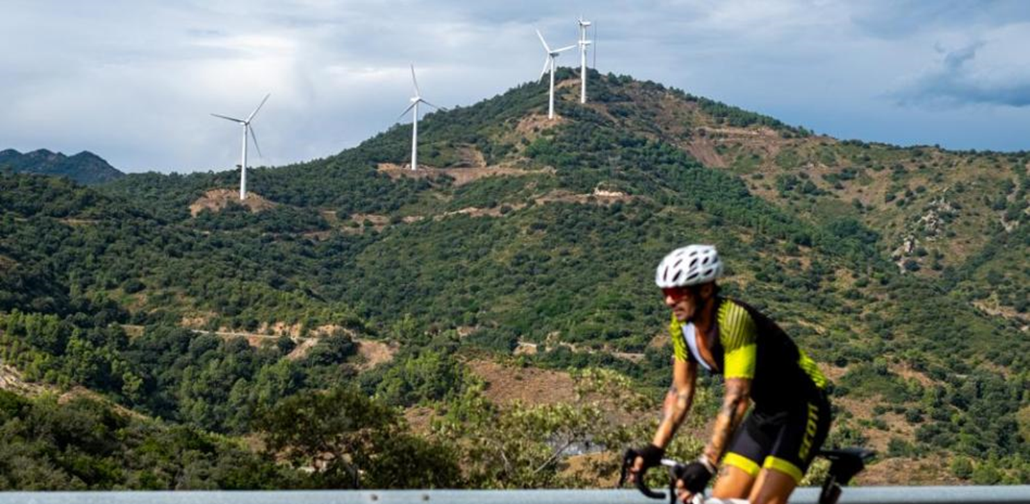
LANDSCAPES

Slide 42
Lack of legal definition of the concept “landscape” and “cultural landscape” at the National Law of Cultural Heritage (Law 16/1985). Law 16/85 does not recognize the figure of the cultural landscape. Meanwhile some Autonomous Communities have specifically legislated on the landscape. There is also no state landscape law by now.
The State regulations on environmental impact assessments, Law 21/2013, of December 9, exempt wind installations intended for self-consumption of power up to 100 kW from carrying out environmental impact assessments.
In relation to the “cumulative effect”, that is, the concentration of small solar and wind farms in a relatively small area, Royal Decree Law 20/2022, of December 27, establishes for certain projects, the evaluation by the promoter of the synergistic effects generated (10 km or less in wind farms, 5 km in photovoltaic plants and 2 km with respect to power lines).

Slide 43
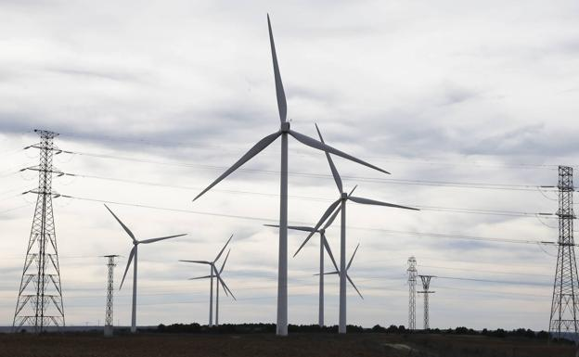

Slide 44
These facilities are not authorized, as long as an Asset of Cultural Interest is located in their affected area (archaeological zones, ethnographic sites, etc.).
The bodies competent in matters of heritage will establish the separation or buffer bands (“buffers”) with respect to each property declared an Asset of Cultural Interest, according to each specific case.
Likewise, our legislation prohibits this type of installations in special protected areas or zones such as natural parks, World Natural Heritage, Natura Network, protected marine spaces, etc.
In non-developable or rural lands with assets not protected as Assets of Cultural Interest or with other lower levels of protection, it is essential to carry out prior studies, so that the authorization of the installation will be conditional on these.

Slide 45
The Previous Studies required to authorize the installation of wind and solar farms:
Will be presented by the promoters and carried out by competent heritage technicians.
They will include all those archaeological, paleontological and ethnographic activities that are deemed appropriate by the body competent in cultural heritage.
Likewise, it is considered important to assess the incorporation of hearing and/or public information procedures, including not only the promoters, but also the local population.
Required documentation
It must be exhaustive and very defined. Likewise, it will be important to include technicians trained in cultural heritage in the writing teams of these projects.
The documentation provided will include, among others:
- Proper cartographic and graphic definition of the project.
At least, one render
A dismantling plan

Slide 46
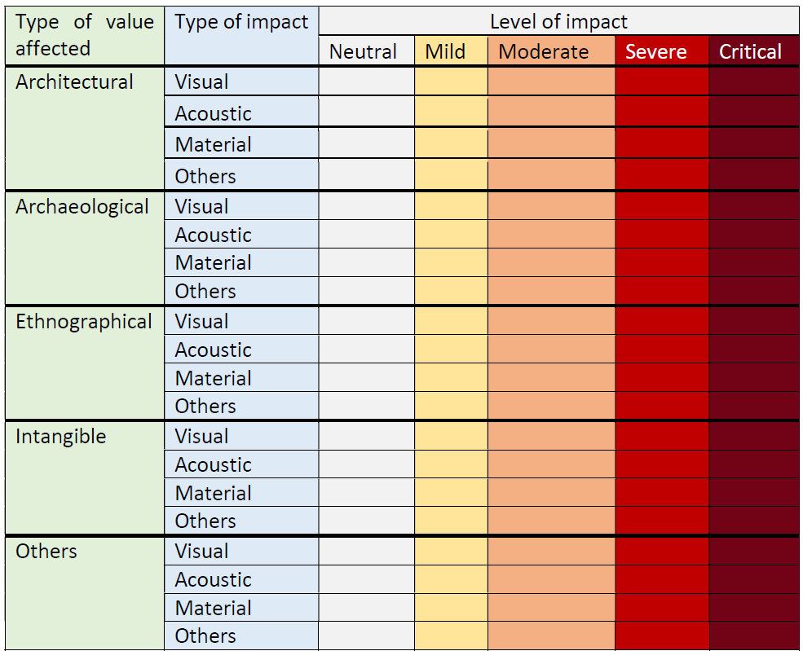
Impact evaluation matrix

Slide 47
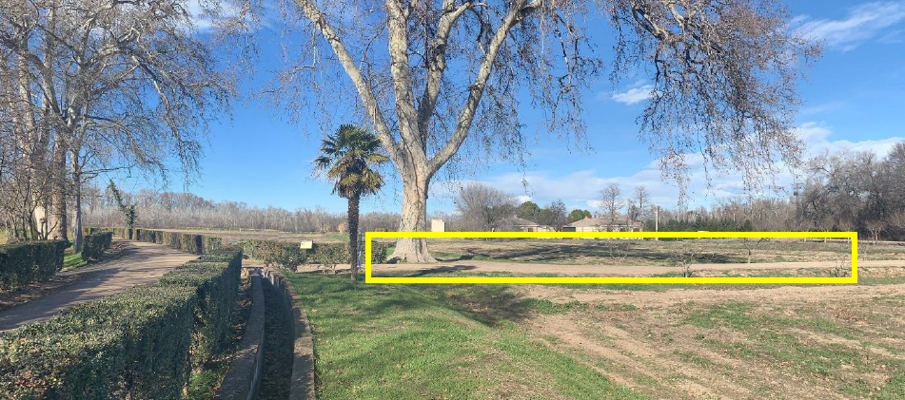
A recent evaluation: Aranjuez Gardens (WH Site): Authorized PVs with prescriptions

Slide 48
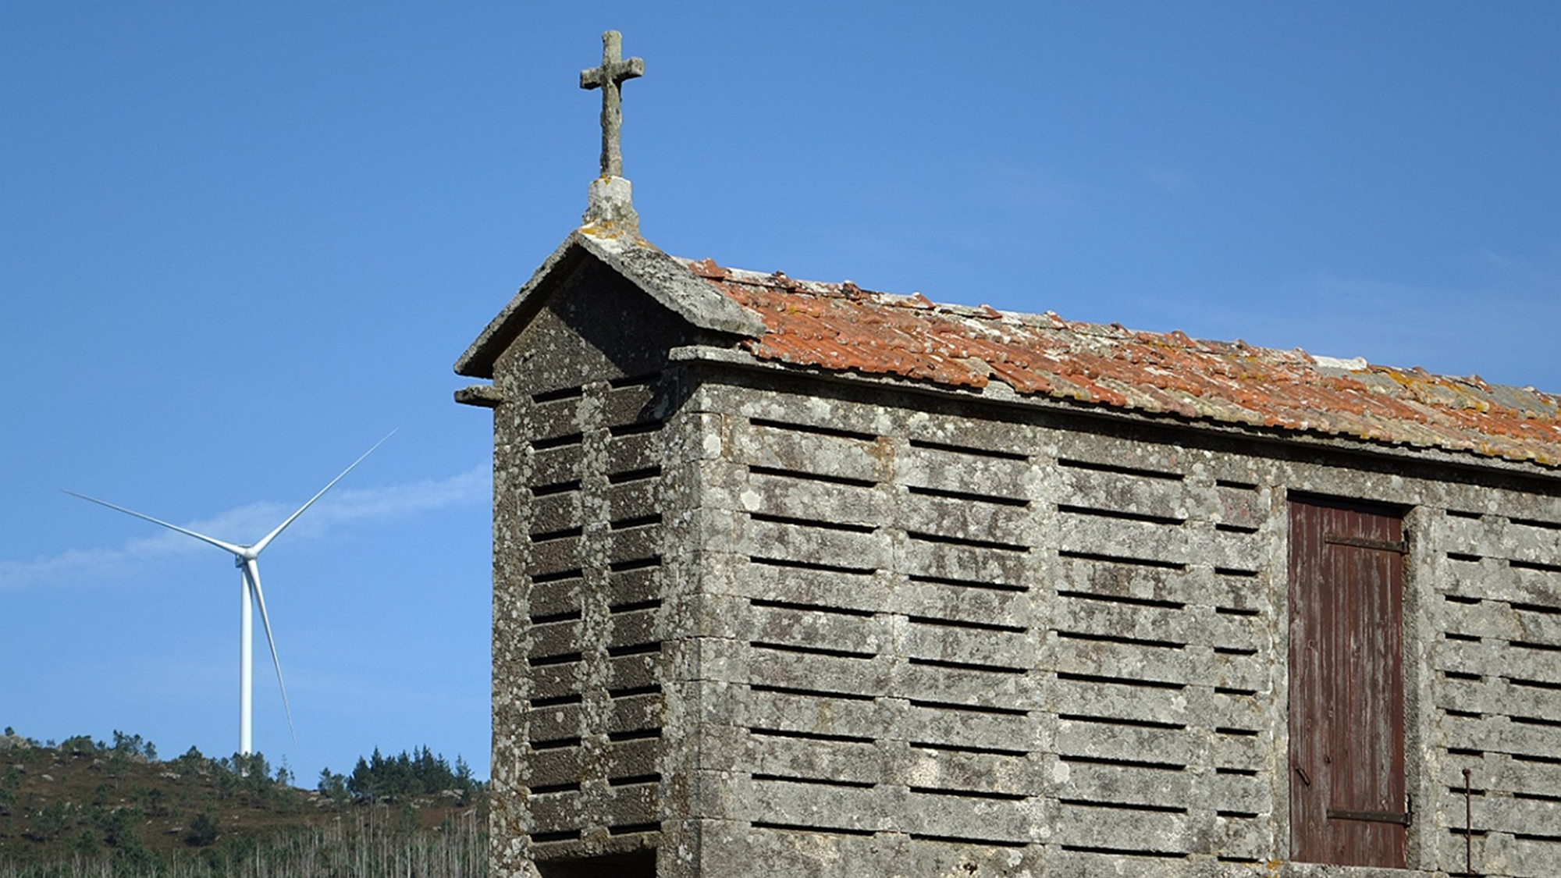
THANK YOU! ¡GRACIAS!
antonio.antequera@cultura.gob.es

